Slide 1
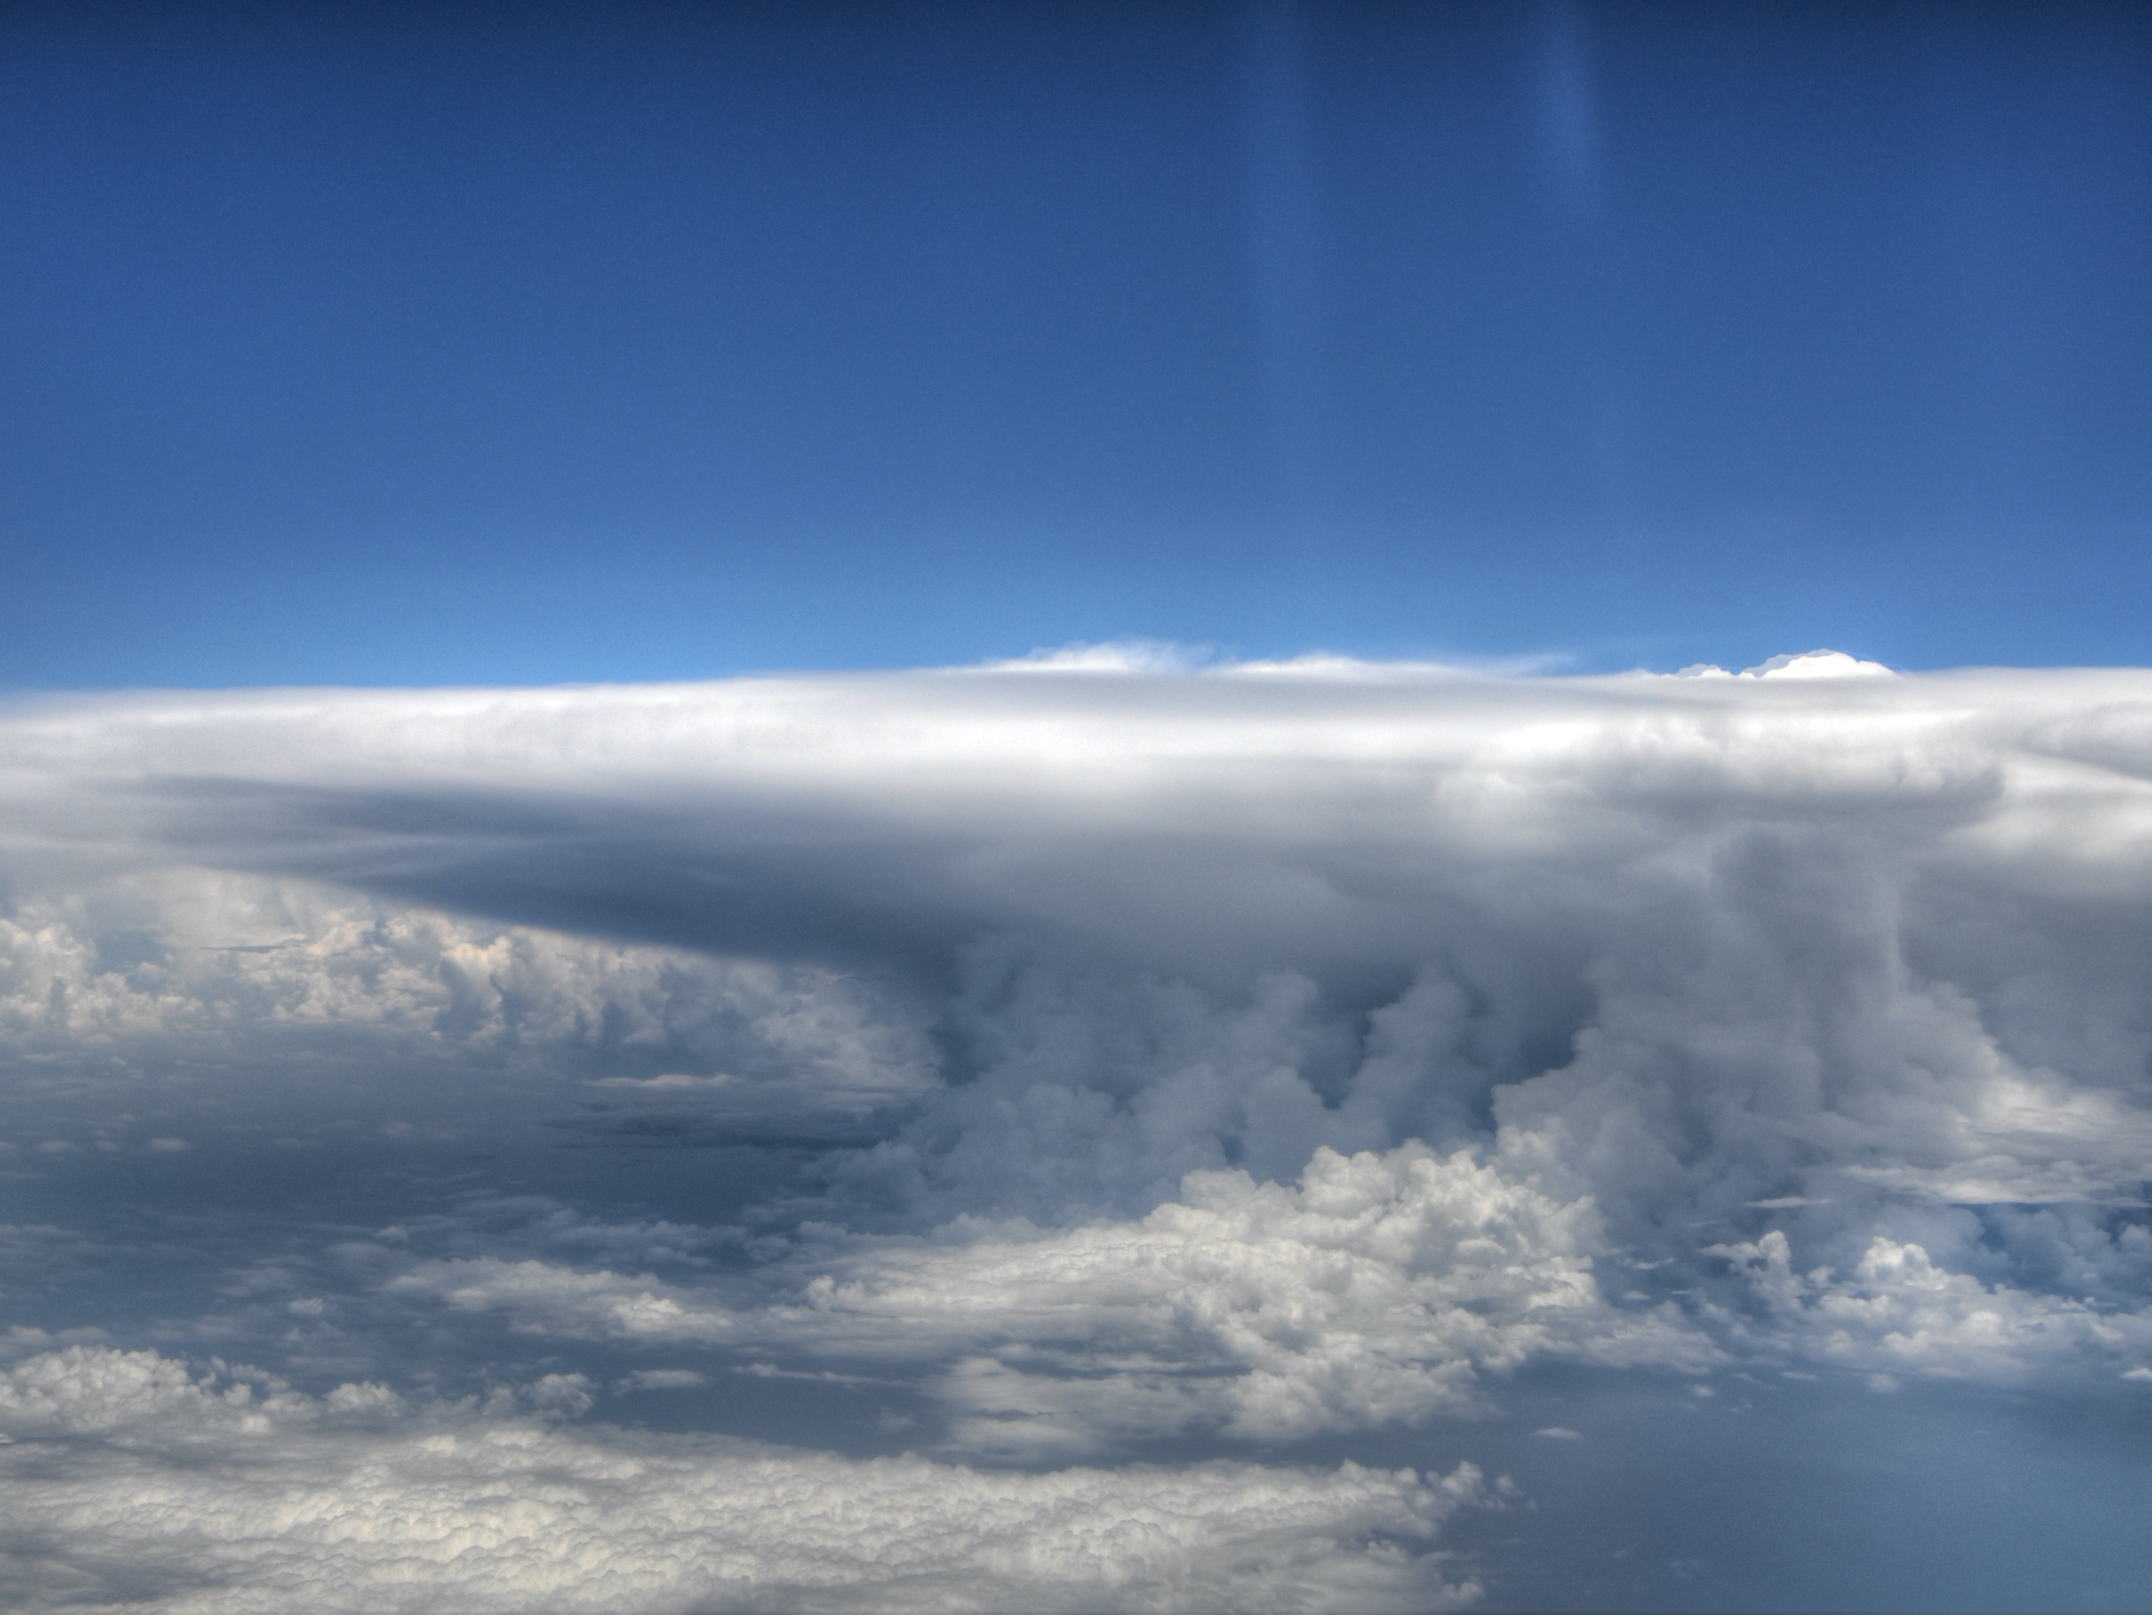
Convective Self-Aggregation:
Impact on Climate and Sensitivity to SST across the RCEMIP simulations
OTREC-August 2019
Notes:
Also thanks to DKRZ

Slide 2
Convective Self-Aggregation:
Impact on Climate and Sensitivity to SST across the RCEMIP simulations
Allison Wing*, Catherine Stauffer
Kevin Reed, Tobias Becker, Min-Seop Ahn, Nathan Arnold, Sandrine Bony, Mark Branson, George Bryan, Jean-Pierre Chaboureau, Stephan de Roode, Kulkarni Gayatri, Cathy Hohenegger, I-Kuan Hu, Fredrik Jansson, Todd Jones, Marat Khairoutdinov, Daehyun Kim, Shuhei Matsugishi, Zane Martin, Brian Medeiros, Hiroaki Miura, Yumin Moon, Sebastian Mueller, Tomoki Ohno, Thara Prabhakaran, David Randall, Rosimar-Rios Berrios, Nicolas Rochetin, Romain Roehrig, David Romps, James Ruppert Jr., Masaki Satoh, Levi Silvers, Martin Singh, Bjorn Stevens, Lorenzo Tomassini, Chiel van Heerwaarden, Shuguang Wang, Ming Zhao
Supported by NSF-AGS 1830724
Thanks to DKRZ for hosting data.
*Assistant Professor, Florida State University
Notes:
Also thanks to DKRZ

Slide 3

Sometimes tropical convection is isolated or scattered
OTREC-August 2019

Slide 4
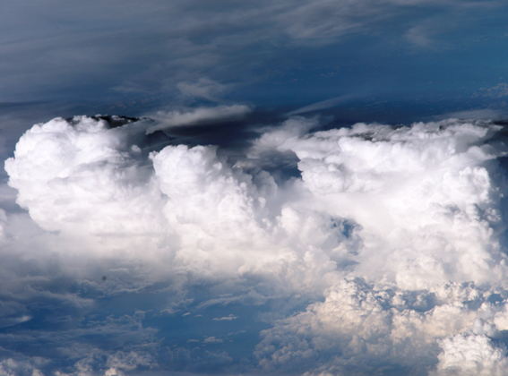
But often it is not

Slide 5
Convection may be organized, whether it is shallow…

Slide 6



EUREC4A HALO RF07 – 31Jan2020

Slide 7
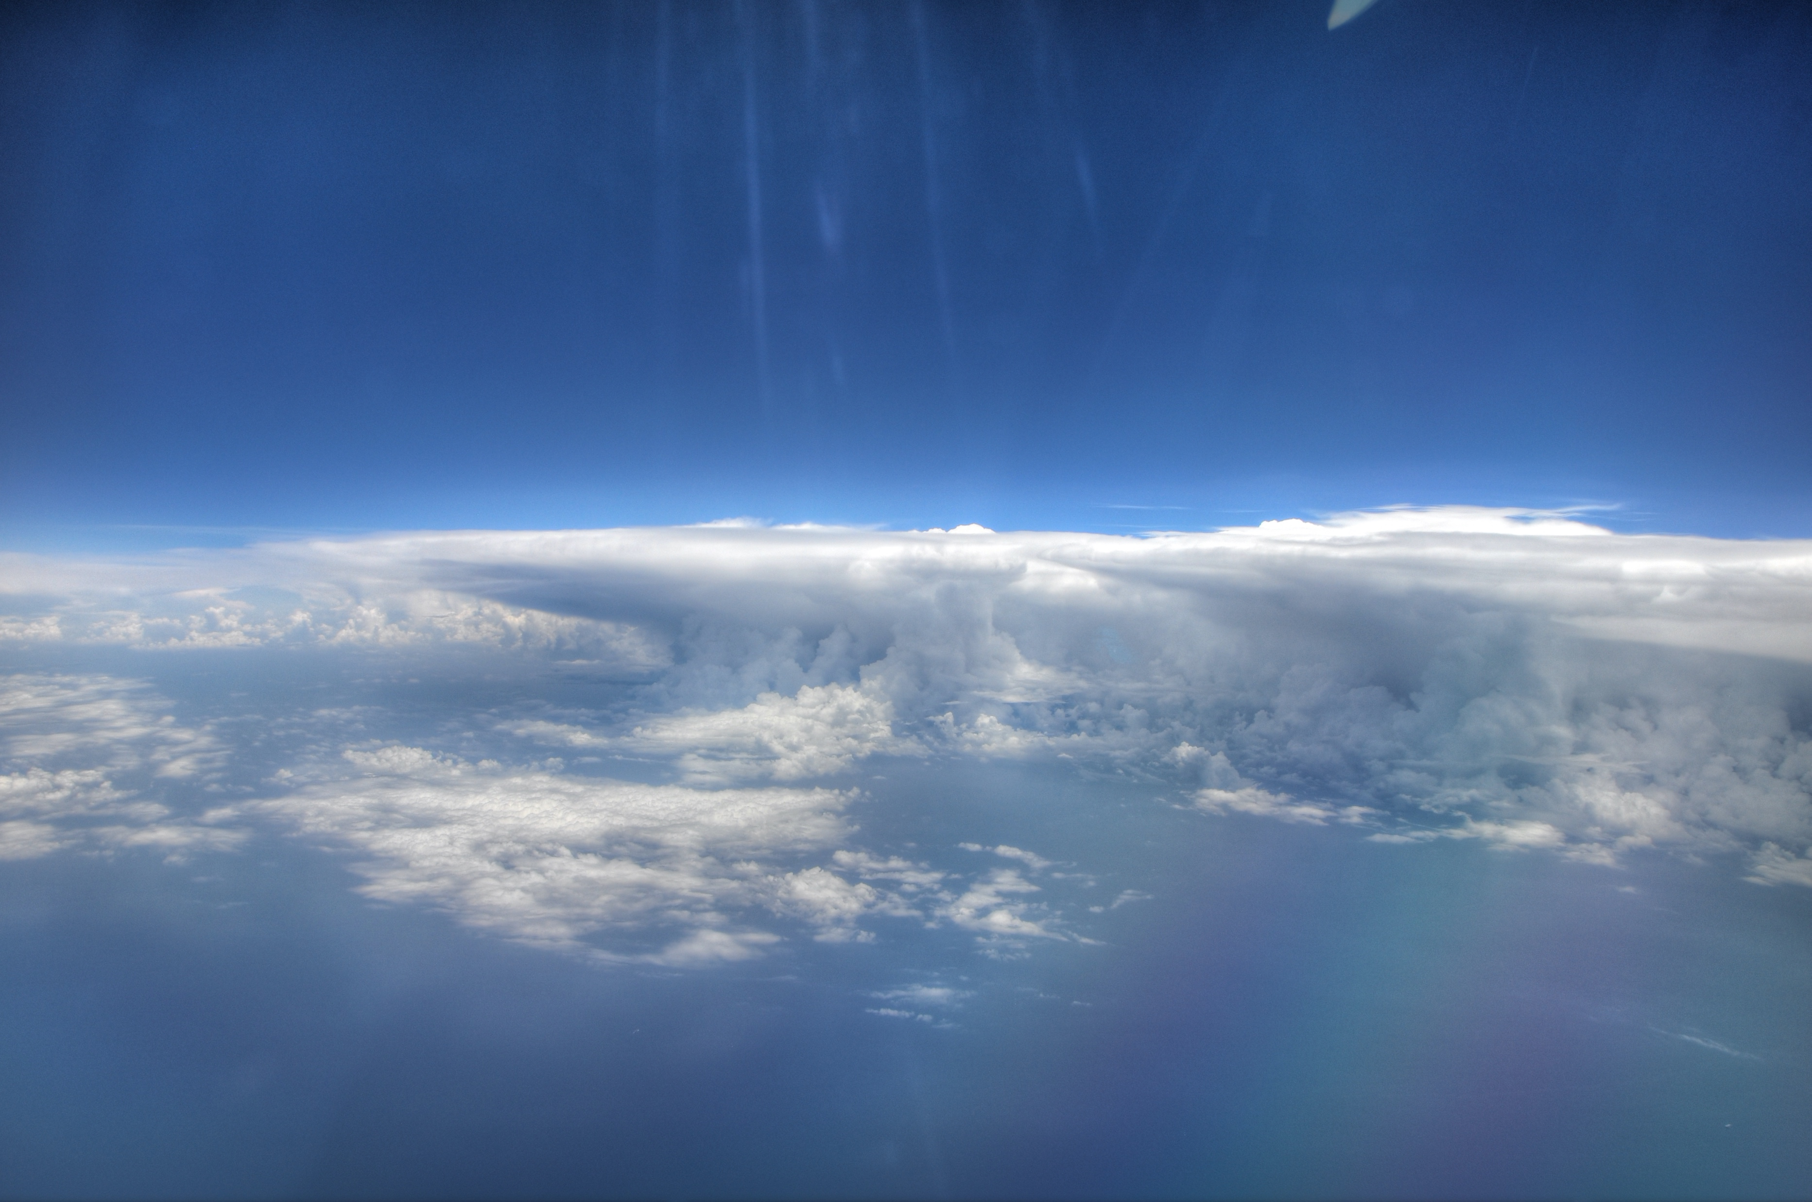
…or deep
OTREC-August 2019

Slide 8
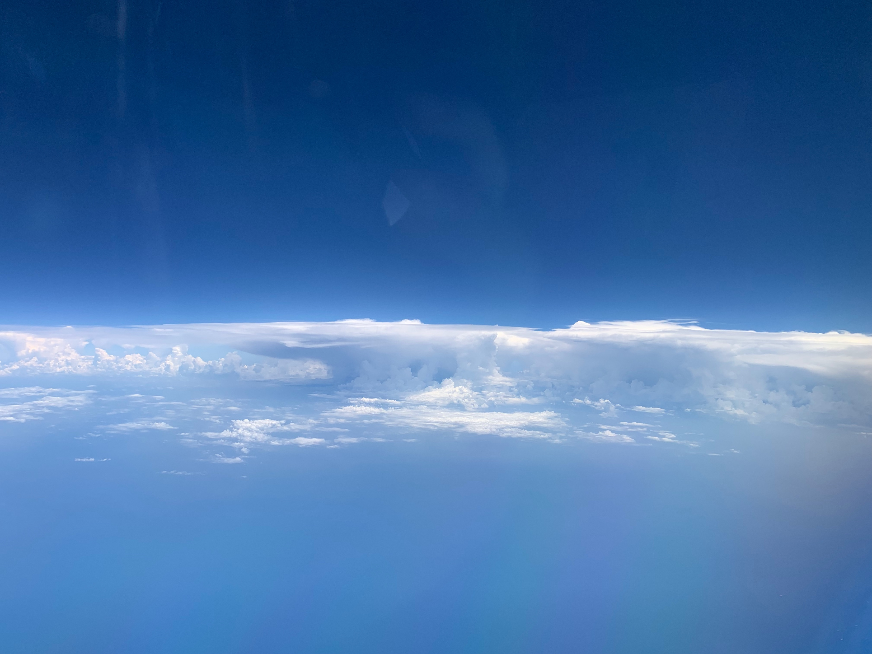
OTREC-August 2019

Slide 9

Can shallow clouds drive radiatively-driven circulations?
EUREC4A
How do these circulations help deep convection organize?
OTREC-August 2019

Slide 10
Investigate convective self-aggregation in a multi-model ensemble of radiative-convective equilibrium
OTREC-August 2019
Notes:
Also thanks to DKRZ

Slide 11
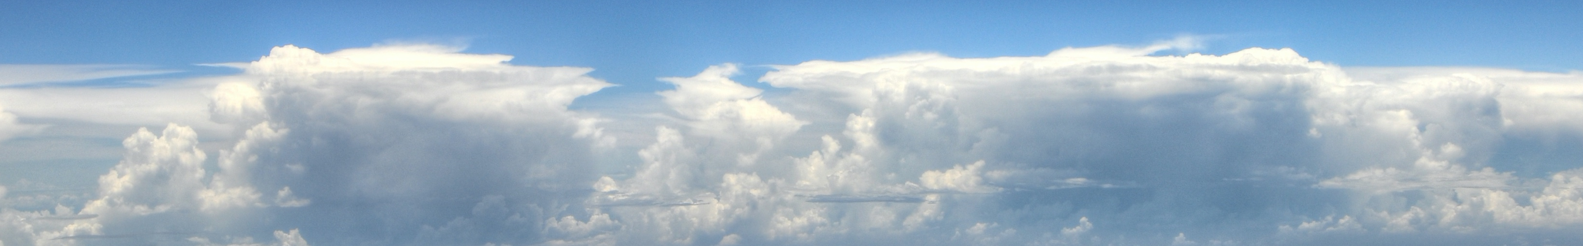
Radiative-Convective Equilibrium
A statistical equilibrium: balance between net radiative cooling and convective heating
“Time-honored idealization for understanding the tropical atmosphere and its sensitivity to relevant forcings” Bretherton et al. (2005)
Simplest possible way to phrase questions about climate
Accessible by many model types
Common baseline needed
Shortwave radiation
Latent heat
Sensible heat
Longwave radiation
RCEMIP:
Response of clouds to warming & climate sensitivity
Convective self-aggregation
Robustness of RCE state
Notes:
Despite simplicity, many questions remain about basic physics of RCE
Simplest possible way to phrase questions about:
Basic characteristics of climate, climate sensitivity
How the representation of subgrid-scale processes influences the coupling of clouds and convection to the climate system
Response of clouds and hydrological cycle to warming

Slide 12
RCEMIP Protocol
Two Sets of Simulations:
1. RCE_small (295 K, 300 K, 305 K)
100 km square for CRMs, 1 km horiz spacing
Single column or small Earth for GCMs
200 m horiz spacing for LES
2. RCE_large (295 K, 300 K, 305 K)
6000 km x 400 km rectangle for CRMs, 3 km horiz spacing
Global for GCMs, GCRMs
Length ~ 100 km
Width = 100 km
Length ~6000 km
Width ~400 km
Aquaplanet, uniform insolation, uniform SST, initialized from random noise
Participation from 47 Models
GCMs (16), CRMs (17), LES (6), GCRMs (3), SCMs (5)
Notes:
Aquaplanet, uniform insolation, no diurnal cycle, initialized by random noise

Slide 13
Outgoing Longwave Radiation, Day 80: CRMs
RCE_small300

Slide 14
Outgoing Longwave Radiation, Day 80: CRMs
RCE_large300

Slide 15
Outgoing Longwave Radiation, Day 80: WRF
CRM
GCMs
RCE_large300

Slide 16
Outgoing Longwave Radiation, Day 80: GCMS
GCRMs
RCE_large300
Notes:
Day 70 GCRMs

Slide 17
Outgoing Longwave Radiation, Day 80: GCRMS
RCE_large300
Notes:
Day 70 GCRMs

Slide 18
Large Domain Simulations are Aggregated!
CRMs
GCMs
RCE_large300

Slide 19
Half the simulations have an increase in aggregation with warming, half have a decrease
CRMs
GCMs

Slide 20
How does self-aggregation impact the mean state?
Compare small & large simulations

Slide 21
Aggregated - Unaggregated
Reduction in high cloud fraction with aggregation
RCE_large300 – RCE_small300

Slide 22
Aggregated - Unaggregated
Reduction in relative humidity with aggregation
RCE_large300 – RCE_small300

Slide 23
Aggregated - Unaggregated
Increase in temperature with aggregation
RCE_large300 – RCE_small300

Slide 24
With aggregation…
more rain
less radiation into column at TOA (more cooling to space)
more condensed water?
drier
more stable
RCE_large300, RCE_small300

Slide 25
Self-aggregation impacts the climate
Does self-aggregation impact climate sensitivity?
What is the climate sensitivity in the RCEMIP simulations?

Slide 26
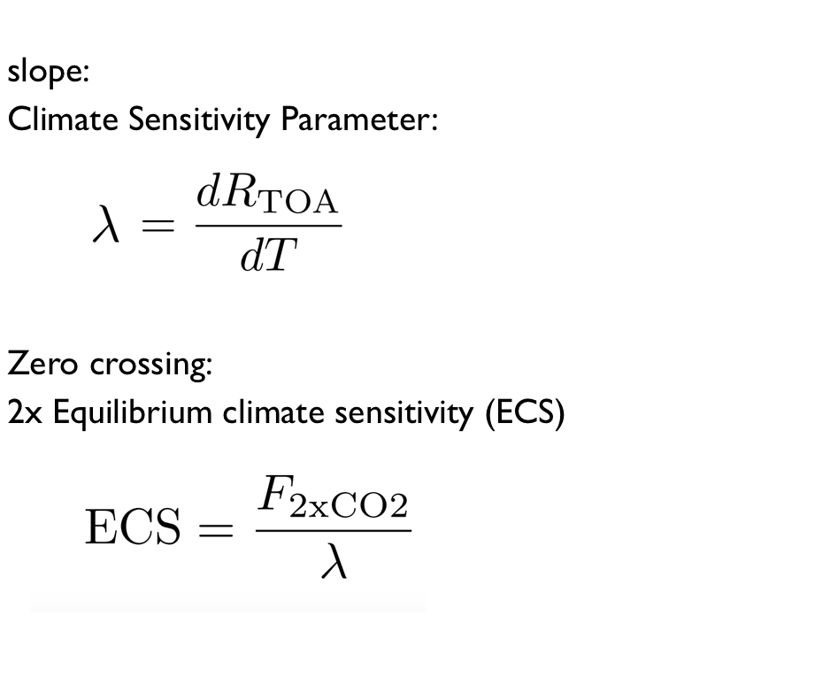
Net climate feedback parameter
Equilibrium climate sensitivity
small domain CRMs / LES:
high climate sensitivity
spread(models) > spread(setups)
LES models with similar spread as at coarser resolution
No Aggregation

Slide 27
large domain CRMs:
spread significantly larger
Aggregation
No Aggregation

Slide 28
GCMs:
spread even larger
low mean climate sensitivity
Aggregation
No Aggregation
Notes:
WRF-GCMs show spread within with different convection schemes is just as large

Slide 29
Wide spread in climate sensitivity
Wide spread in self-aggregation
Wide spread in changes in self-aggregation with warming
Do changes in self-aggregation with warming explain the intermodel spread in climate sensitivity?

Slide 30
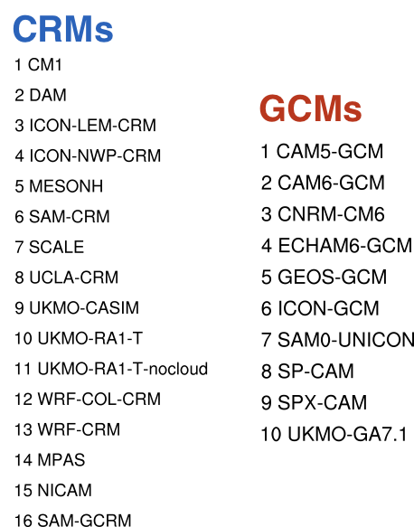
Extreme changes in aggregation are related to extreme climate sensitivities
dark color:
300 K - 295 K
bright color:
305 K - 300 K

Slide 31
Conclusions
All models self-aggregate to some extent in the large domain
Wide variability in spatial structure & degree of aggregation
Half models have an increase in aggregation with warming, half have a decrease
All models indicate decrease in high clouds, drying, warming, increased cooling to space with aggregation
Climate sensitivity is overall smaller and has more spread in large, aggregated simulations compared to small
Extreme changes in self-aggregation with warming lead to extreme climate sensitivities*
Climate sensitivity is overall smaller in GCMs than in CRMs because GCMs have more self-aggregation with warming*
*changes in shallow clouds are also important
http://myweb.fsu.edu/awing/rcemip.html
Notes:
increased convective self-aggregation leads to larger and drier subsidence regions, and thus to increased outgoing longwave radiation
Climate sensitivity is overall smaller in GCMs than in CRMs because GCMs have more shallow clouds and more self-aggregation with increasing temperature, while CRMs show no overall tendency On the large domain and in GCMs, differences in shallow cloud fraction and convective self-aggregation lead to an extreme spread in climate sensitivities across RCEMIP

Slide 32
Participation from 47 Models
GCMs (16), CRMs (17), LES (6), GCRMs (3), SCMs (5)
GCMs | CRMs | LES | GCRMs | SCMs
CAM5 | DALES | CM1 | MPAS | CNRM-CM6
CAM6 | DAM | DALES | NICAM | GEOS5
CNRM-CM6 | CM1 | ICON-LEM | SAM | SCAM5
ECHAM6 | GFDL FV3 | MESONH |  | SCAM6
GEOS5 | ICON-LEM | MicroHH |  | UKMO GA7
ICON-A | ICON-NWP | SAM
SAM0-UNICON | MESO-NH
SP-CAM | MicroHH
SPX-CAM | SAM
UKMO GA7 | SCALE
WRF 3.5.1* (x 6) | UCLA-CRM
 | UKMOi v11.1 RA1-T
 | UKMOi v11.1 RA1-T-nocloud
 | UKMOi v11.1 RA1-T-hrad
 | UKMOi v11.1 CASIM
 | WRF 3.9.1
 | WRF 3.5.1

Slide 33
Large variability in cloud fraction profiles across simulations
*
*
Definition of “cloud”:
Cloud condensate >
min(1 x 10⁻⁵ g g⁻¹, 0.01*q_{sat})
or
output of cloud scheme
*
* = SCM
RCE_small300
Notes:
ICON-LEM: microphysics scheme produces a lot of thin cirrus cloud. If use 5*10^-5 threshold, cloud fraction more comparable. See spread in total cloud water as well.

Slide 34
Widely varying degrees of aggregation
Notes:
All CRMs

Slide 35
Widely varying response of aggregation to warming
Notes:
All CRMs

