Slide 1
Sand and Dust Storm (SDS) Monitoring and Forecasting for the Caribbean and Pan-America
Andrea M. Sealy, Ph.D.
Meteorologist, Caribbean Institute for Meteorology and Hydrology
Chair, WMO SDS-WAS Pan-American Regional Steering Group
Member, WMO SDS-WAS Global Steering Committee

Slide 2
"Sand and dust storms have become more frequent in this region and other parts of the world, but armed with the knowledge, tools and resources we can adapt to and mitigate their impacts."

Slide 3
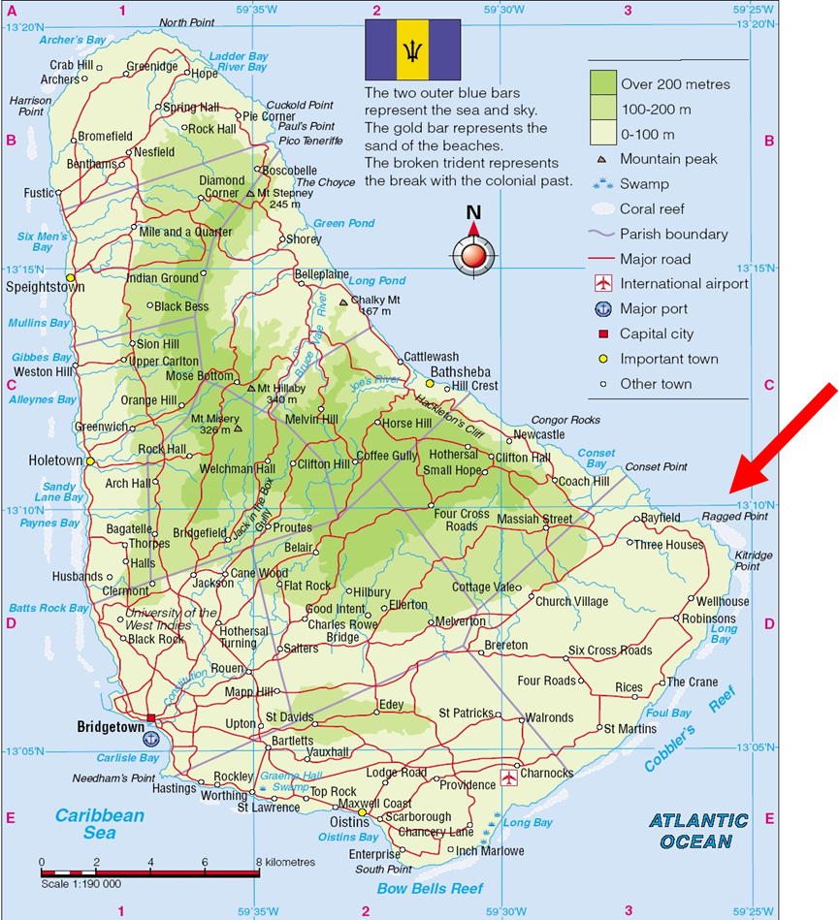
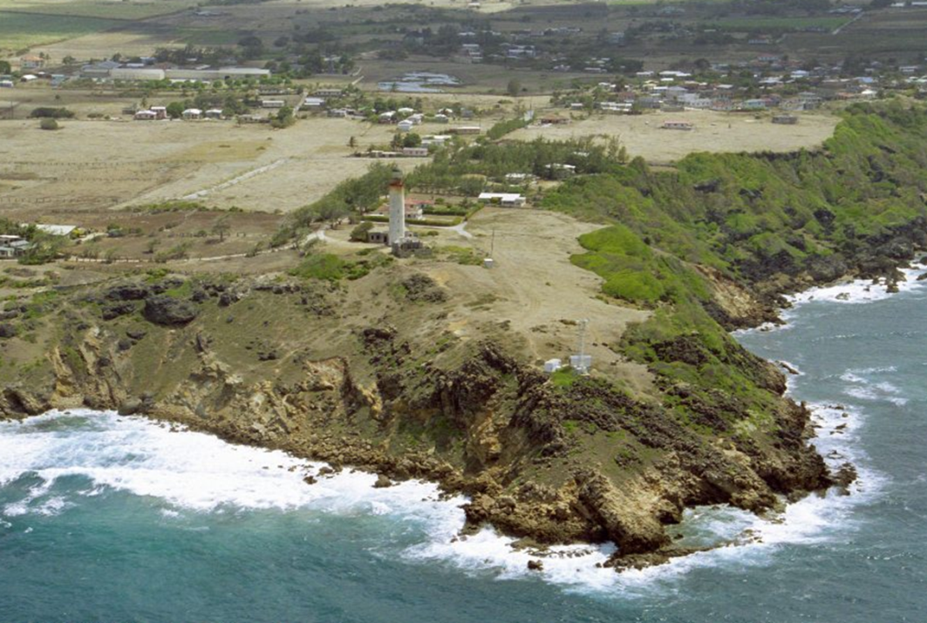
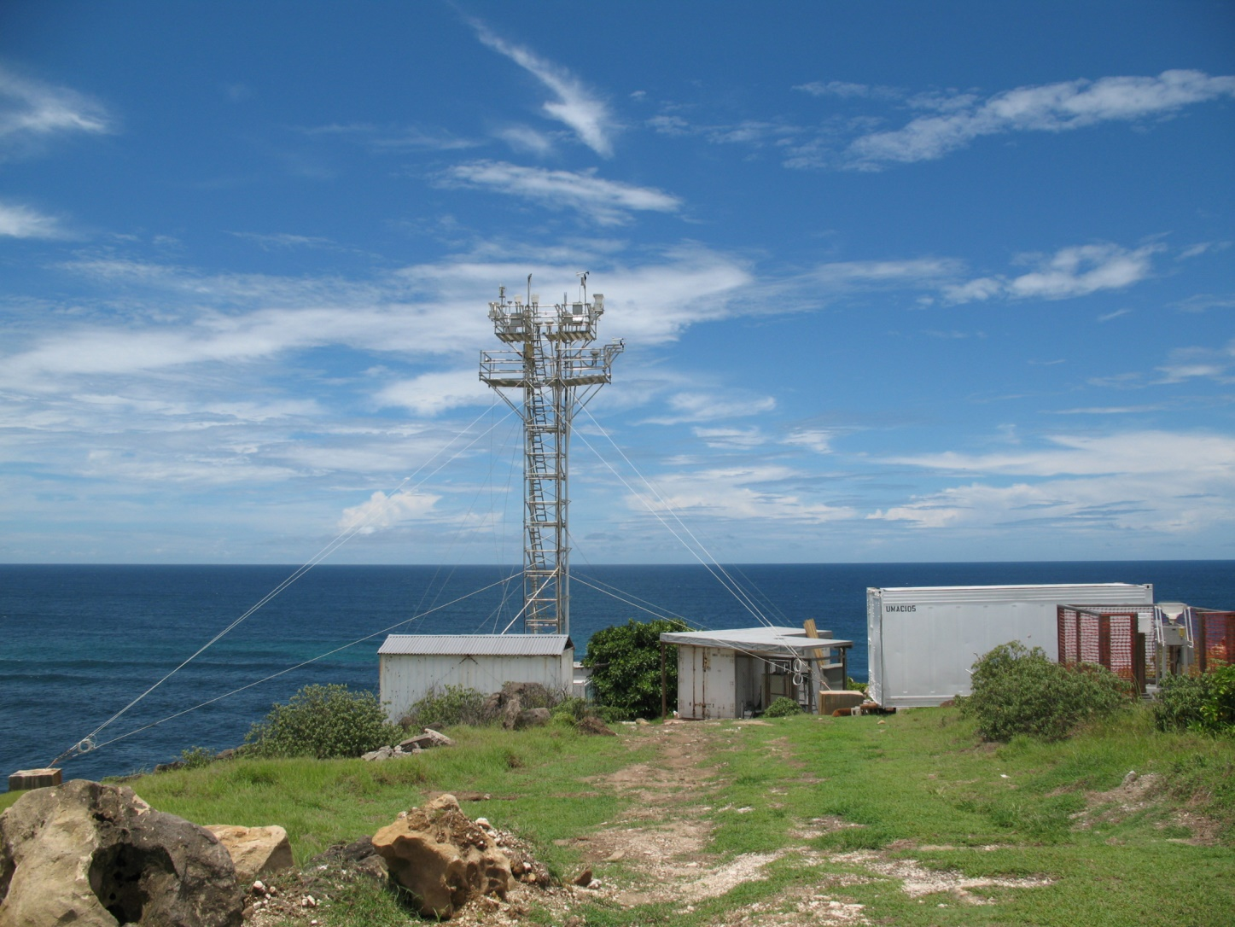
University of Miami Atmospheric Chemistry Station, Ragged Point, Barbados (1965-present)

Slide 4
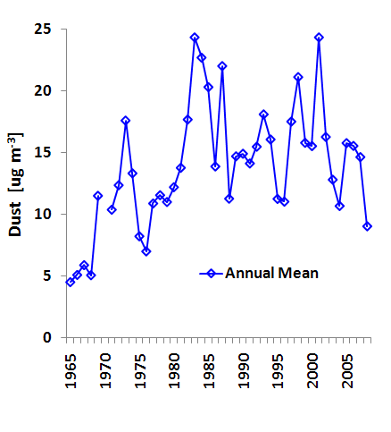
Barbados Dust Annual Means
Dust transport has stabilized at moderately high levels since the late 1980s
(Prof. Joseph Prospero, University of Miami)
Notes:
G:\Data\Atlantic\Bar\Monthly\[Bar6596-98-01m_pptn_MAIN_16Nov02_04m_6Dec06_9Jan08_12Feb10.xlsx]Notes

Slide 5
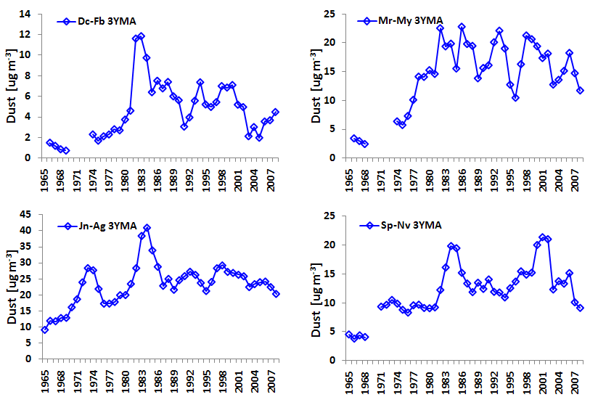
Barbados: Seasonal Dust Trends - Three Year Moving Averages
Dec-Jan-Feb
Mar-Apr-May
The greatest changes in dust transport occurred in the Winter and Spring periods
Jun-Jul-Aug
Sep-Oct-Nov
(Prof. Joseph Prospero, University of Miami)
Notes:
G:\Data\Atlantic\Bar\Monthly\[Bar6596-98-01m_pptn_MAIN_16Nov02_04m_6Dec06_9Jan08_12Feb10.xlsx]Notes

Slide 6
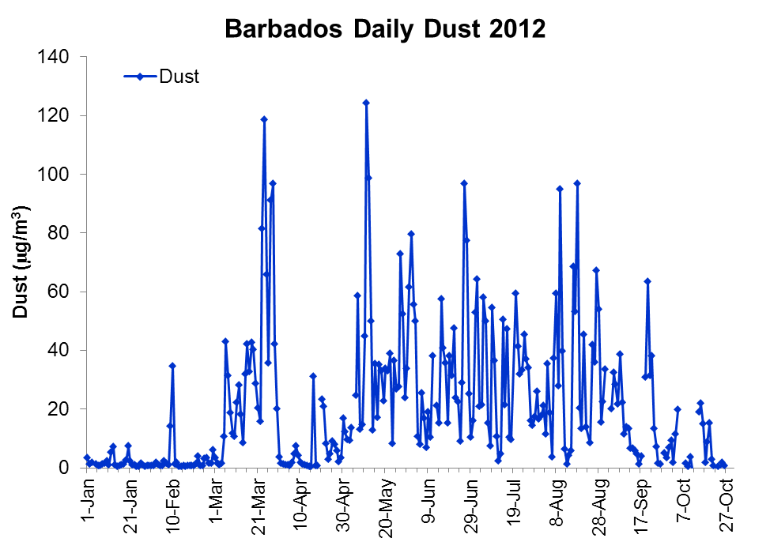
Barbados Dust and PM10
WHO PM10 Guideline
(Prof. Joseph Prospero, University of Miami)

Slide 7
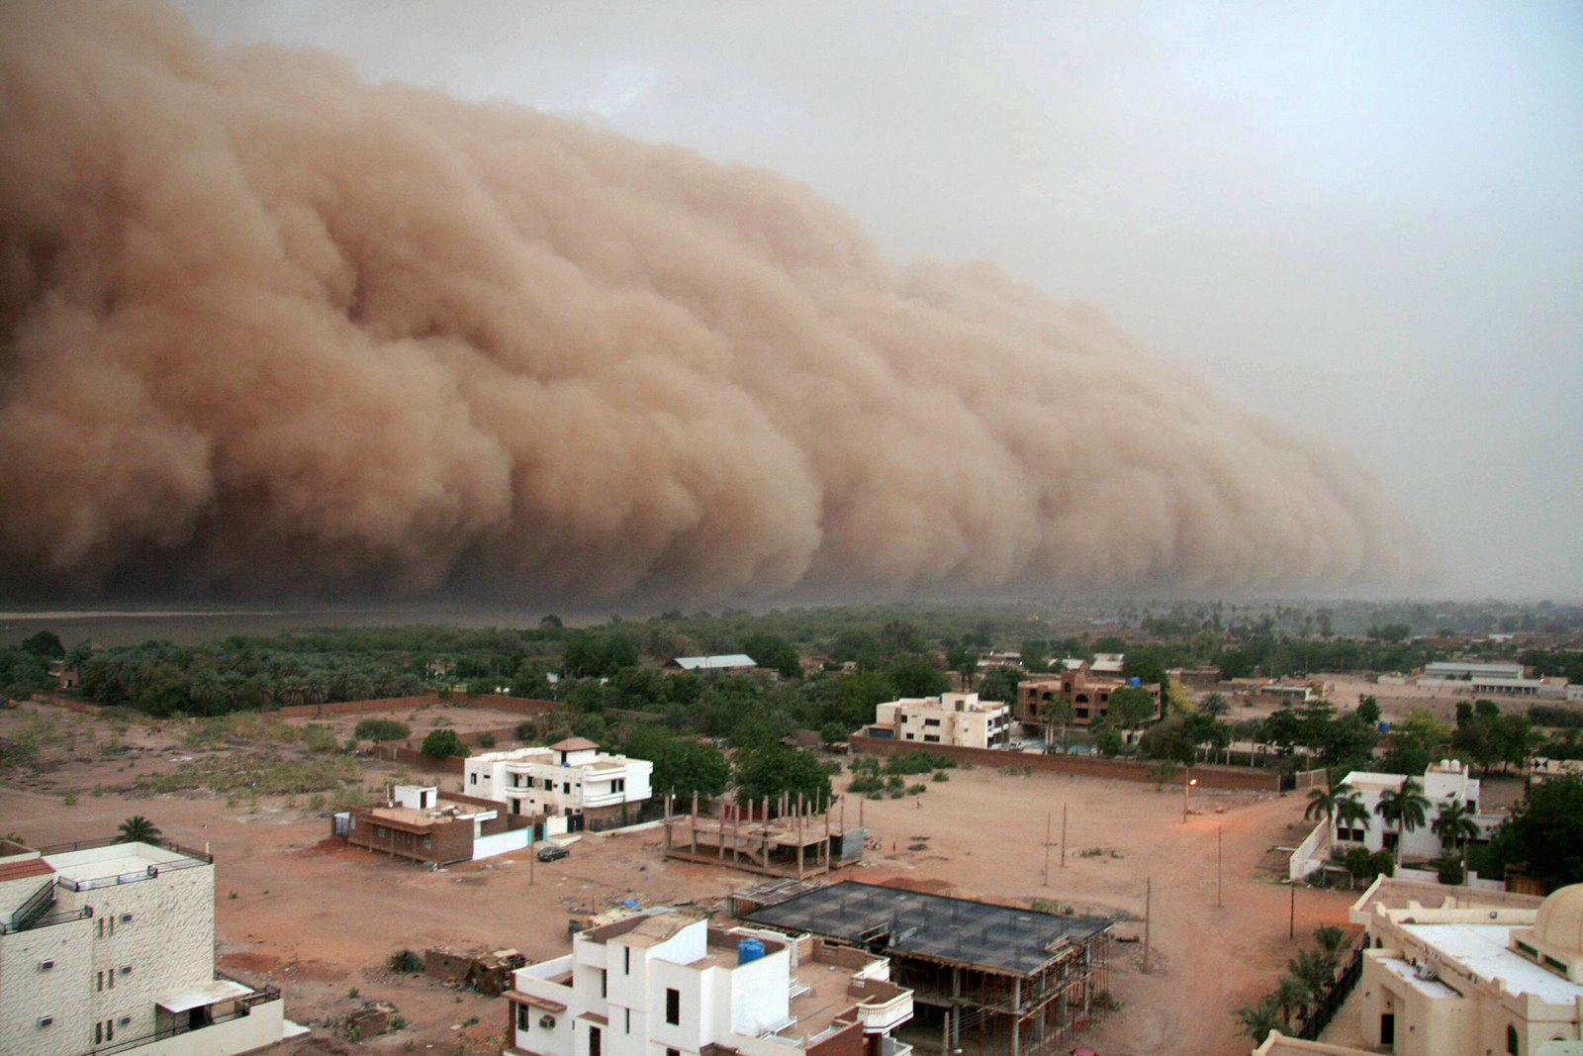
World Meteorological Organization Working together in weather, climate and water
WMO Sand and Dust Storm Warning Advisory and Assessment System
(SDS-WAS)
WMO

Slide 8
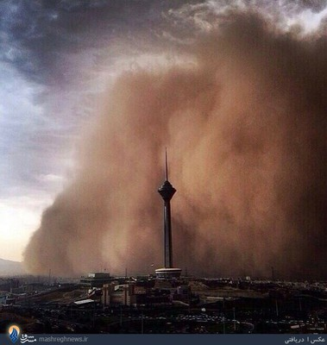
SDS-WAS initial mission (launched 2007)
To establish a coordinated global network of SDS research and forecasting centres
To enhance the ability of countries to deliver timely and quality SDS forecasts, observations, information and knowledge to users through an international partnership of research and operational communities
(WMO, Atmospheric Research & Environment Branch, Research Dept.)

Slide 9
SDS - Global Scale & Multidisciplinary Problem
Atmospheric Aerosol Eddies NASA Animated Map: 10km Geodetic Earth Orbiting Satellite (GEOS-5) AOD: Red colour – Dust Aerosols
http://geo-pickmeup.com/atmospheric-aerosol-eddies-nasa-animated-map/
Transport
Climate
Climate Change
Human Health
Agriculture
Marine productivity
Aviation
Ground Transportation
Infrastructure and industry
Energy production
Health
Marine productivity
Aviation
Ecosystem
Agriculture
Clear industries

Slide 10
SDS-WAS Regional Nodes and Centers
Regional Node for Asia, coordinated by a Regional Center hosted by the CMA (Beijing, China)
Regional Node for Northern Africa, Middle East and Europe (NA-ME-E), coordinated by the Regional Centre as a consortium of the Spanish State Meteorological Agency (AEMET), and the Barcelona Supercomputing Center – National Supercomputing Center (BSC-CNS)
Pan-American Regional Node hosted by the Caribbean Institute for Meteorology and Hydrology (CIMH), Barbados
Two Operational (RSMC-ASDF) Centers were approved: Barcelona (2014) and Beijing (2017)

Slide 11
SDS-WAS focus at CIMH: Predicting Saharan Dust Incursions using WRF-Chem
Ashford Reyes, Nicola Alexander, Andrea Sealy and Rebecca Chewitt-Lucas

Slide 12
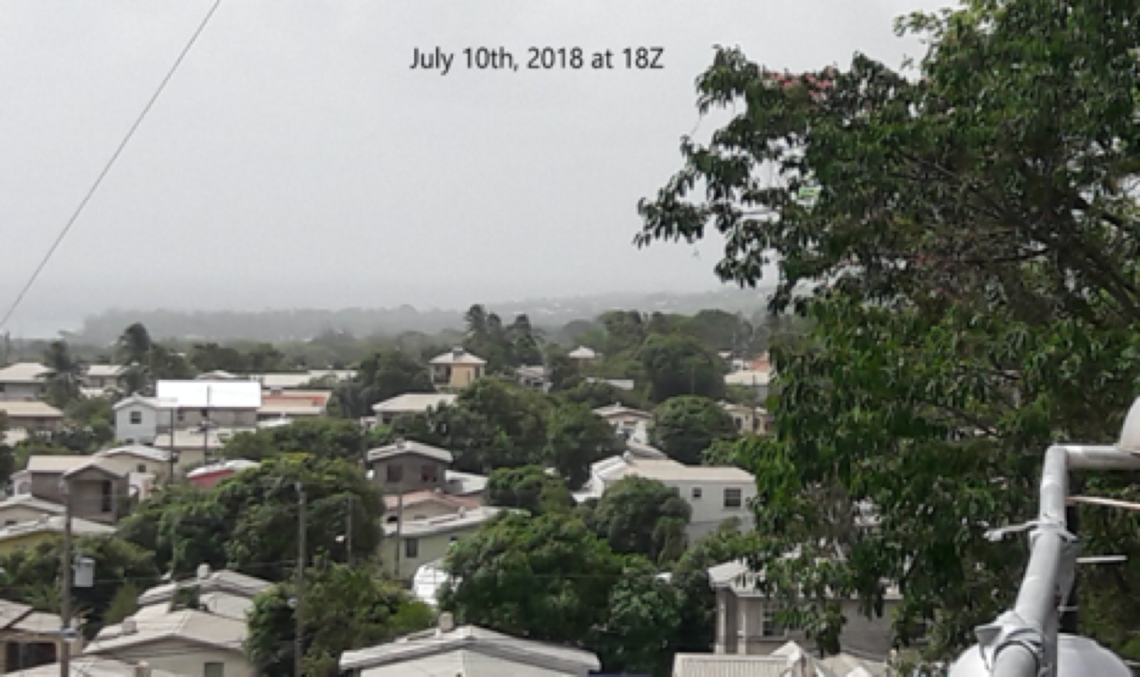
Dust Event #1 - July 10th 2018
Caribbean Institute for Meteorology and Hydrology Ashford Reyes areyes@cimh.edu.bb
Large dust event affecting the Eastern Caribbean on July 10th 2018.
Simulations initialised on July 1st 00Z and cycled through July 5th 00Z with deterministic forecasts until July 12th 00Z.

Slide 13
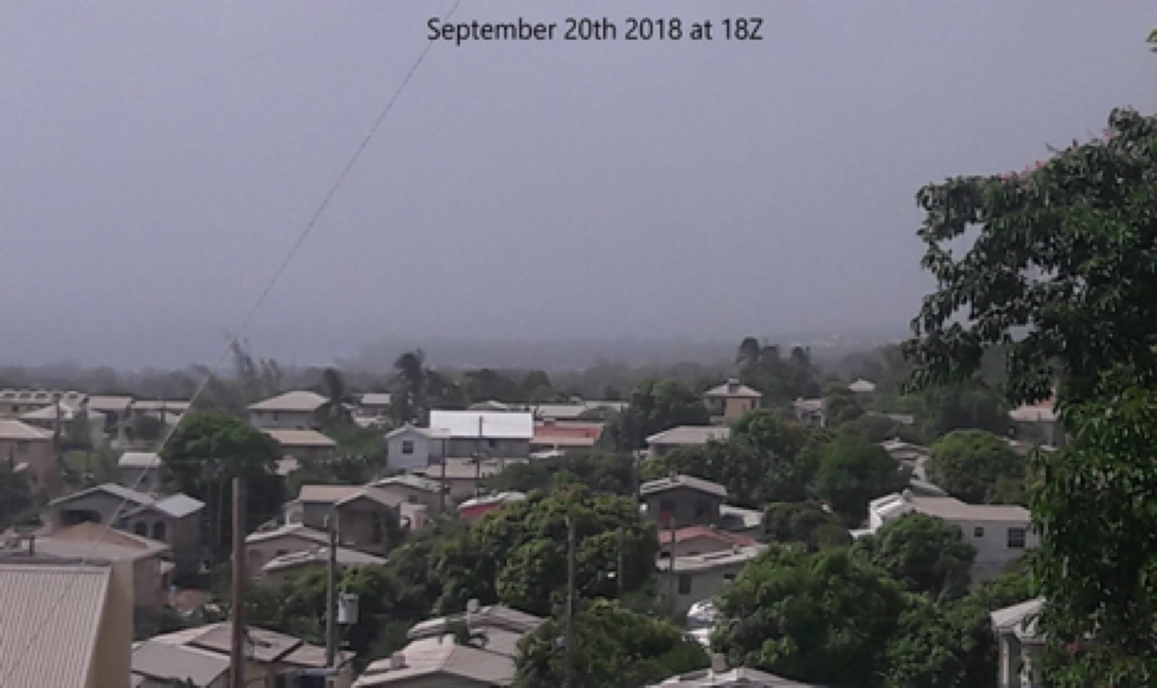
Dust Event #2 - Sept 20th 2018
Caribbean Institute for Meteorology and Hydrology Ashford Reyes areyes@cimh.edu.bb
Large dust event affecting the Eastern Caribbean on September 20th 2018.
Simulations initialised on Sept 10th 00Z and cycled through Sept 15th 00Z with deterministic forecast until Sept 22nd 00Z.

Slide 14
Model Setup
Caribbean Institute for Meteorology and Hydrology Ashford Reyes areyes@cimh.edu.bb
Version 4.1.1 of the WRF-Chem model is used.
Chemistry initialised from prep chem sources and is cycled daily.
Model is initialised with the Global Forecast System(GFS) with 0.25 degree resolution at 00Z.
Domain resolution of 27-km extending from 2 S to 36 N and 45 E to 90 W.

Slide 15
Experimental Design
Caribbean Institute for Meteorology and Hydrology Ashford Reyes areyes@cimh.edu.bb
Experiments were initialized from GFS forecasts and cycled every 24 hours.
Dust Event #1 initialized on July 5th 00Z and cycled through July 10th 00Z with deterministic forecasts until July 12th 00Z.
Dust Event #2 initialized on Sept 10th 00Z and cycled through Sept 15th 00Z with deterministic forecasts until Sept 22nd 00Z.
00Z
00Z
00Z
Dust Event

Slide 16
Data and Methods
Caribbean Institute for Meteorology and Hydrology Ashford Reyes areyes@cimh.edu.bb
CIMH WRF-Chem Model outputs
Surface dust concentration
Particulate matter (PM2.5 and PM10) surface concentration
Aerosol Optical Depth (AOD)
Surface ozone concentration
Satellite and ground-based observations
MODIS
AERONET
NOAA-ESRL Global Monitoring Division
Barbados Cloud Observatory
Martinique Air Quality Observatory

Slide 17
Dust Event #1 - CIMH WRF-Chem Simulations
Caribbean Institute for Meteorology and Hydrology Ashford Reyes areyes@cimh.edu.bb

Slide 18
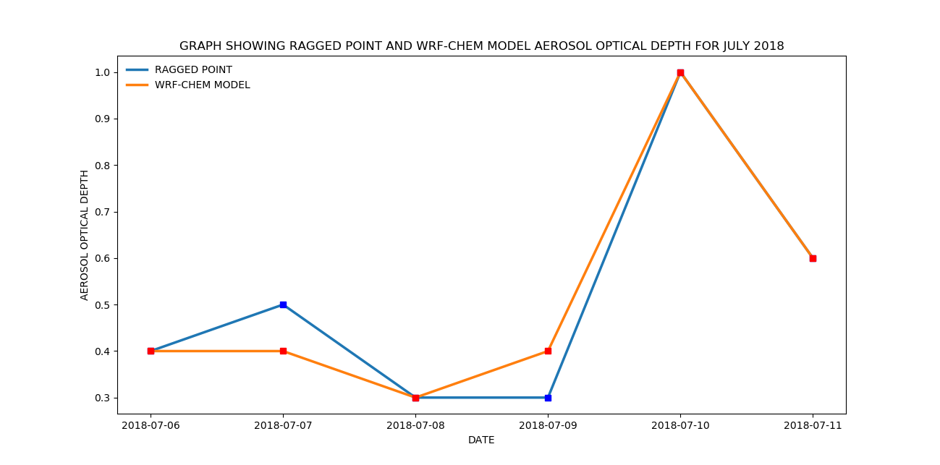
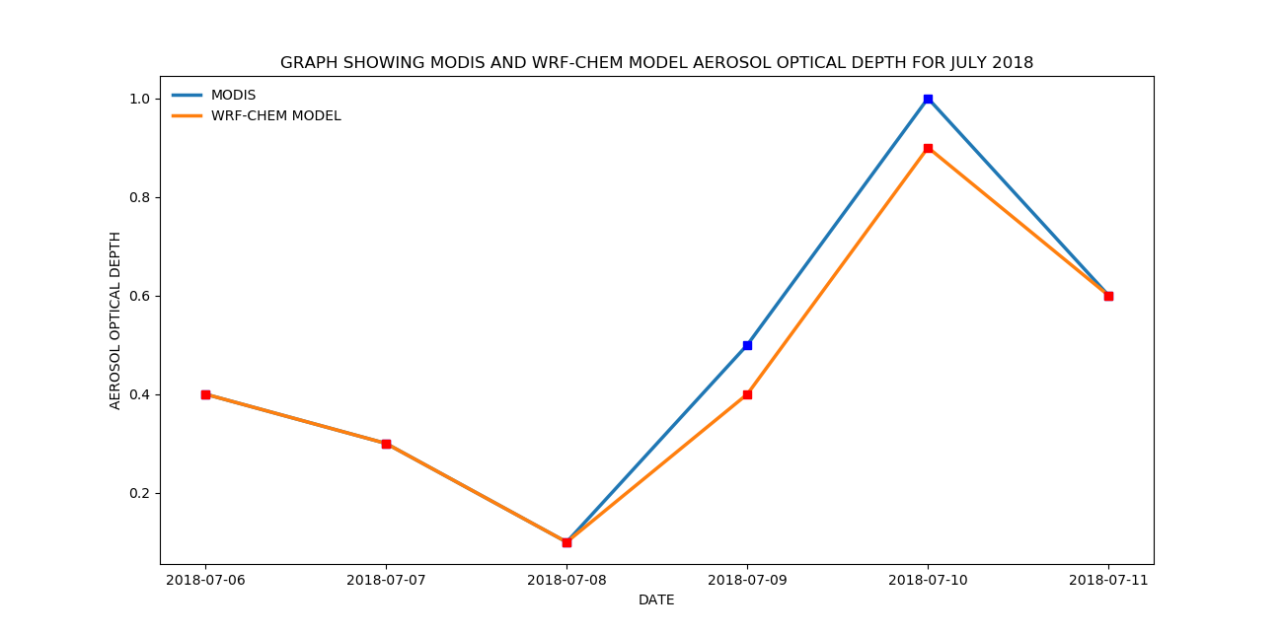
Dust Event #1 - AOD Verification
Caribbean Institute for Meteorology and Hydrology Ashford Reyes areyes@cimh.edu.bb
CIMH WRF-Chem simulated AOD shows a strong positive correlation with both MODIS and AERONET (Ragged Point) data.
MODIS-CIMH correlation = 0.987
AERONET-CIMH correlation = 0.973

Slide 19
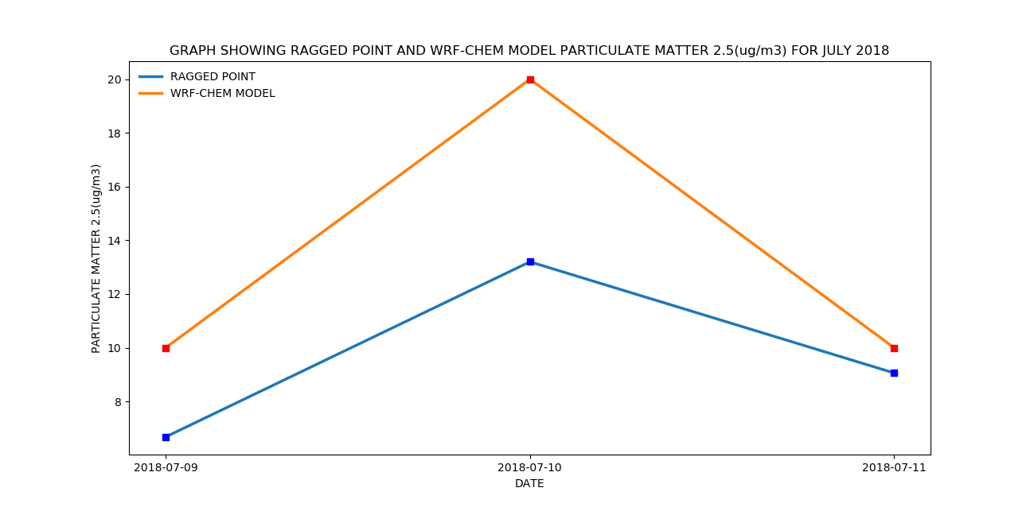
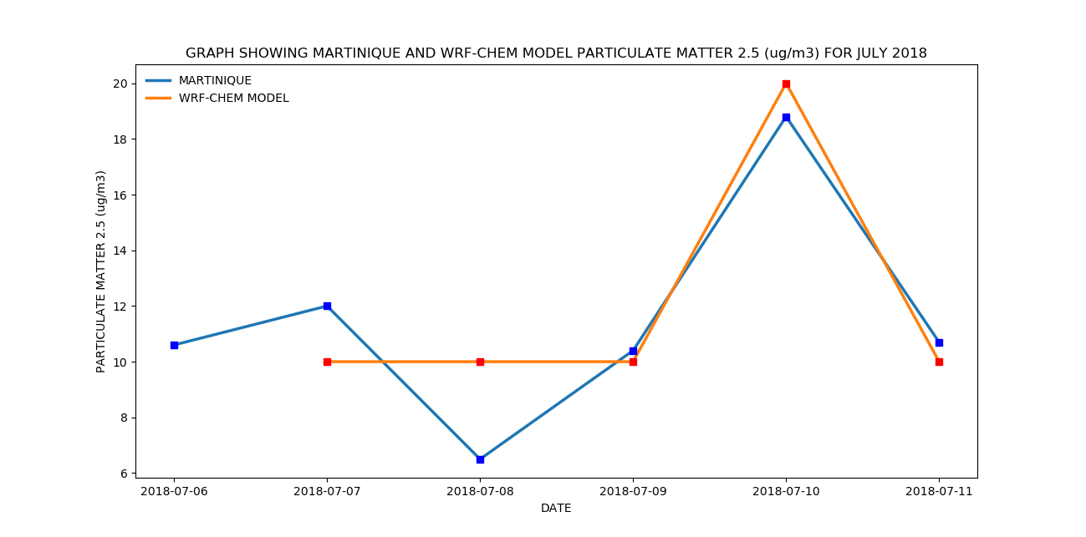
Dust Event #1 - PM2.5 Verification
Caribbean Institute for Meteorology and Hydrology Ashford Reyes areyes@cimh.edu.bb
CIMH WRF-Chem simulated PM2.5 shows a strong positive correlation with both Martinique and Ragged Point data.
Martinique-CIMH WRF-Chem correlation = 0.764
Ragged Point-CIMH WRF-Chem correlation = 0.937

Slide 20
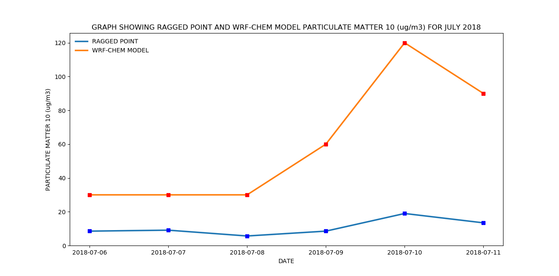
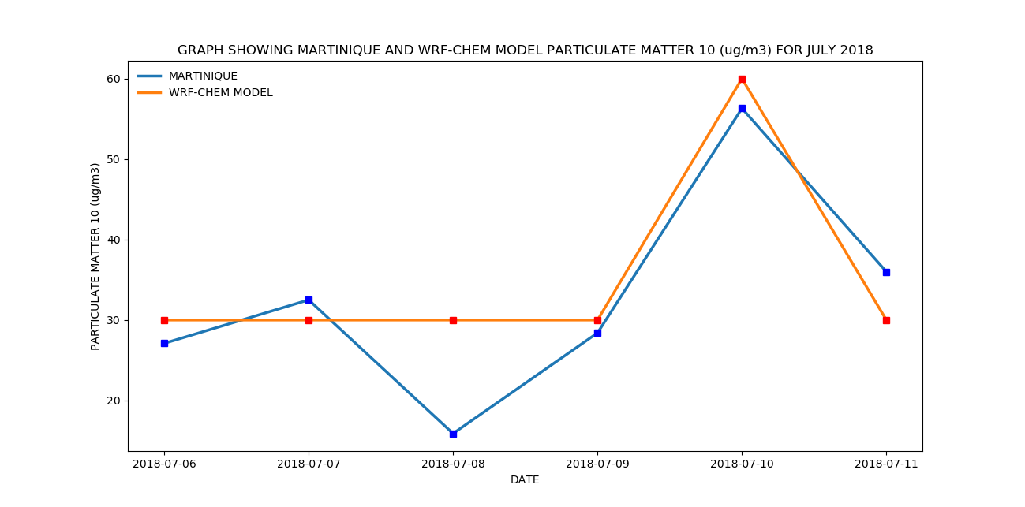
Dust Event #1 - PM10 Verification
Caribbean Institute for Meteorology and Hydrology Ashford Reyes areyes@cimh.edu.bb
CIMH WRF-Chem simulated PM10 shows a positive correlation with both Martinique and Ragged Point data.
Martinique-CIMH correlation = 0.67
Ragged Point-CIMH correlation = 0.908

Slide 21
Dust Event #2 - CIMH WRF-Chem Simulations
Caribbean Institute for Meteorology and Hydrology Ashford Reyes areyes@cimh.edu.bb

Slide 22
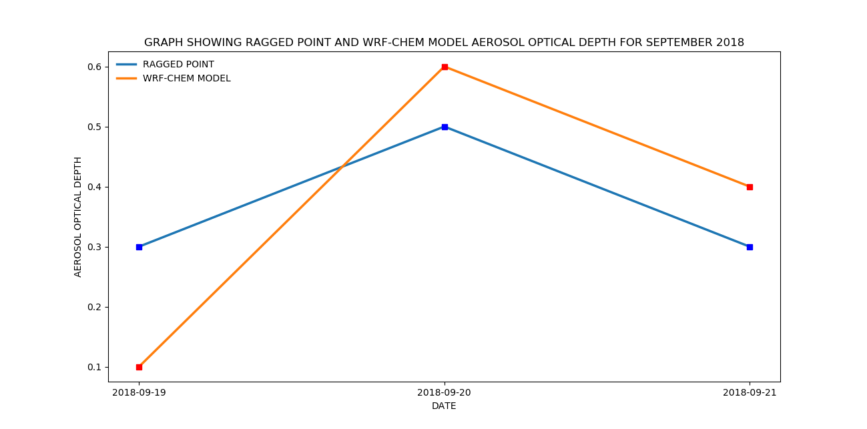
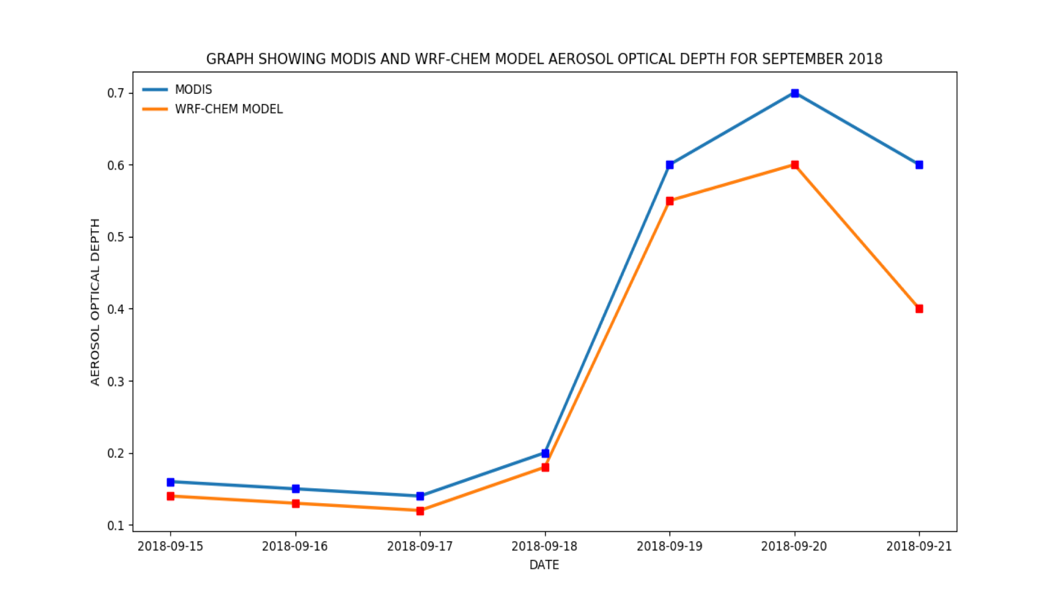
Dust Event #2 - AOD Verification
Caribbean Institute for Meteorology and Hydrology Ashford Reyes areyes@cimh.edu.bb
CIMH WRF-Chem simulated AOD shows a strong positive correlation with both MODIS and AERONET (Ragged Point) data.
MODIS-CIMH correlation = 0.976
AERONET-CIMH correlation = 0.802

Slide 23
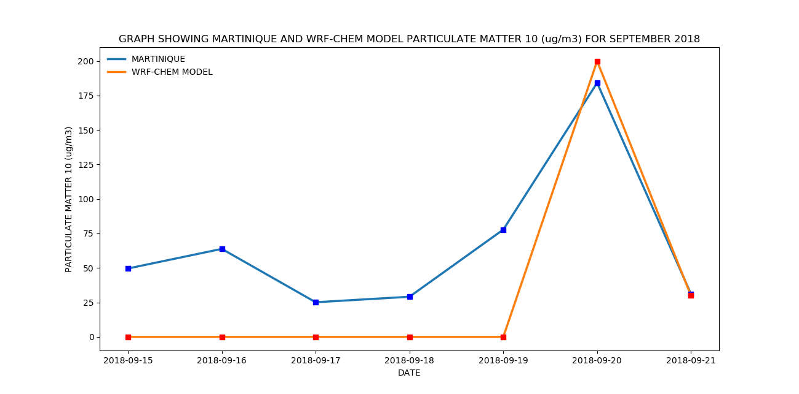
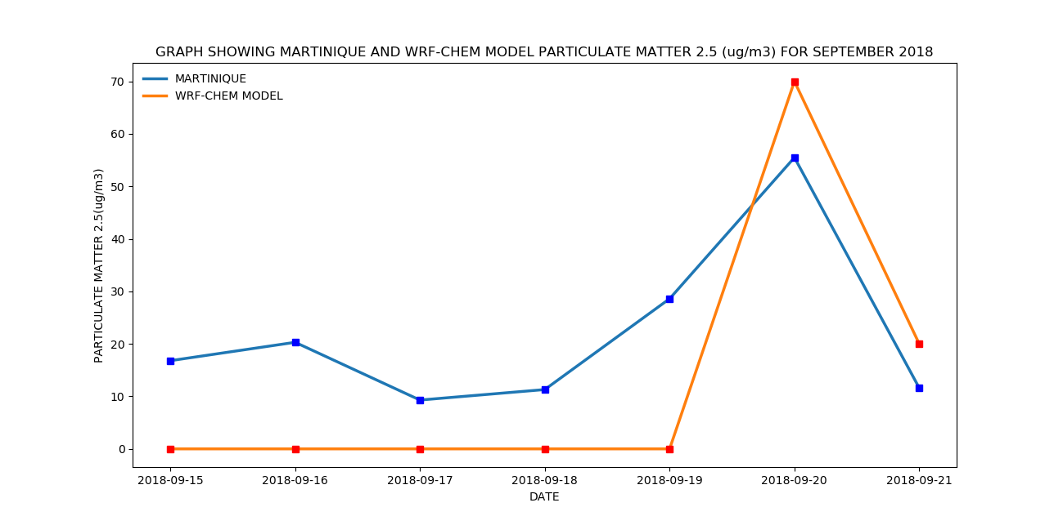
Dust Event #2 - PM2.5 & PM10 Verification
Caribbean Institute for Meteorology and Hydrology Ashford Reyes areyes@cimh.edu.bb
CIMH WRF-Chem simulated PM2.5 and PM10 shows a strong positive correlation with Martinique data.
PM10 correlation = 0.718
PM2.5 correlation = 0.743

Slide 24
Summary
Caribbean Institute for Meteorology and Hydrology Ashford Reyes areyes@cimh.edu.bb
CIMH WRF-Chem is able to predict dust incursions over the Eastern Caribbean five days in advance
CIMH WRF-Chem is able to predict AOD trend
CIMH WRF-Chem also predicts PM2.5 and PM10 trends
More testing and validation
CIMH WRF-Chem to be made more useful for research and for providing air quality information

Slide 25
Moving forward: Pan-American node of SDS-WAS
PM_{2.5} and PM₁₀ samplers on Barbados, ideally Ragged Point
Training
Model validation
Complement the dust concentration and AOD measurements, LIDAR and other aerosol measurements at Ragged Point/Deebles Point
Pan-American SDS-WAS web site to be updated
Necessary to map out structure, working groups including 3-5 years’ plan
Formation of sub-committees/working groups- similar to other nodes and based on Pan-American focus
Develop terms of reference for education and training, instrumentation, modelling and other aspects of SDS-WAS
Ensure relevance and create/enhance synergy among all sectors and stakeholders involved

Slide 26
Thanks for listening!
Contact information:
Andrea Sealy: asealy@cimh.edu.bb
Ashford Reyes: areyes@cimh.edu.bb
Rebecca Chewitt-Lucas: rchewitt@cimh.edu.bb
http://sds-was.cimh.edu.bb/
http://dafc.cimh.edu.bb/
http://www.cimh.edu.bb/

