Slide 1
From scientific discovery to science-based action: Speeding up that journey for EUREC4A and beyond
Arlene Laing (PhD)
Coordinating Director
Caribbean Meteorological Organization (CMO)
Headquarters Unit
Port of Spain, Trinidad and Tobago

Slide 2
Focus of presentation
Caribbean Weather Forecasting Challenges
How can EUREC4A help to meet challenges
Research to Operation (R2O), Operation to Research (O2R), Operation to Practice
WMO Research Board - Seeking information from RA IV on “Innovation in the Regions”

Slide 3
Caribbean Weather Forecast Challenges/Targets
Tropical cyclones
Other Severe Weather –Heavy Rainfall, Strong winds
Rough seas and Swells
Air Quality
Extreme Heat
Multi-scale Interactions and High Impact Weather

Slide 4
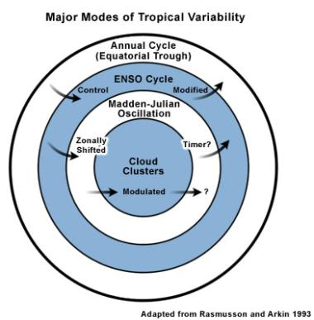
Caribbean Weather and Climate
Semi-permanent features: ITCZ, Subtropical Ridge, Trade Wind Inversion, Caribbean Low-level Jet
Hazardous Weather: Hurricanes, Saharan dust outbreak, Tropical waves, Cold fronts/Shear lines, Upper level troughs, Trade Wind Surge, Severe thunderstorms/lightning; Tornadoes/Waterspouts, Sea/land breezes, Volcanic ash, Wildfires
Climate variability: Wet/Dry spells, Seasonal and inter-annual droughts, Heat waves, ENSO, MJO, Atlantic Multi-decadal Oscillation

Slide 5
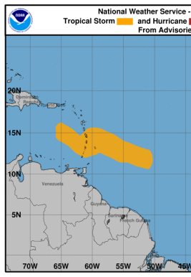
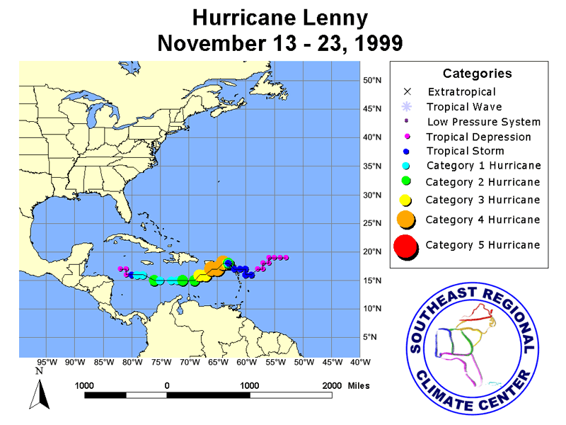
Challenges: Tropical Cyclone O2R and R2O
Tropical Cyclone Sub-seasonal Variability
Prediction of TC temporal and geographic clustering
Tropical Cyclogenesis
Varying methods of cyclogenesis
Tropical Cyclone Rapid Intensification
Close to landfall - Hurricane Maria (2017),
Tomas (2010)
Weak Tropical Cyclones
Forecasts of weak tropical cyclone track & associated precipitation
Tropical Cyclone Tracks
Unusual cases, Lenny (1999), west to east
Kirk (2018)

Slide 6
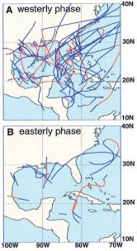
Challenges: Sub-seasonal Variability of TCs, etc.
Predicting clustering of tropical cyclones and other high-impact weather would help with disaster risk reduction and regional and international resource mobilization
Tropical cyclone genesis influenced by MJO and equatorial waves – High potential for progress in predictive skill at sub-seasonal time scale
However, global models have difficulty predicting these convectively-coupled tropical circulations
Evaluate EUREC4A models based on prediction of sub-seasonal circulations and coupled-convection
MJO Phase and Tropical Cyclones
Mahoney and Hartmann 2000

Slide 7
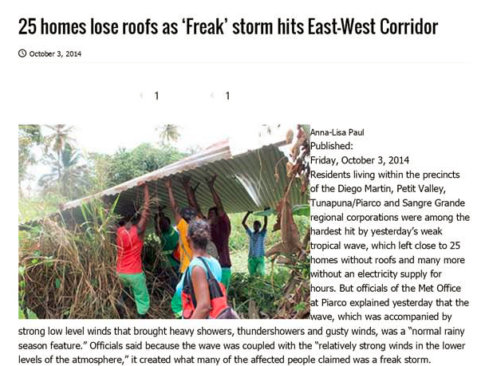
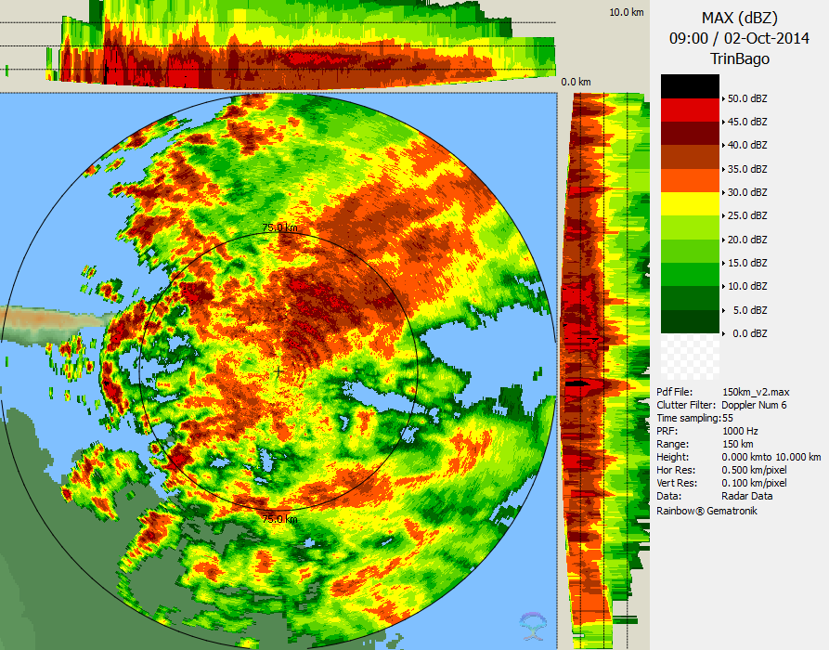
Challenges: High impact mesoscale and local weather
Downward Sloping Wind Max
Need effective scan strategies to identify mesoscale wind features
Trinidad and Tobago Met
Service

Slide 8
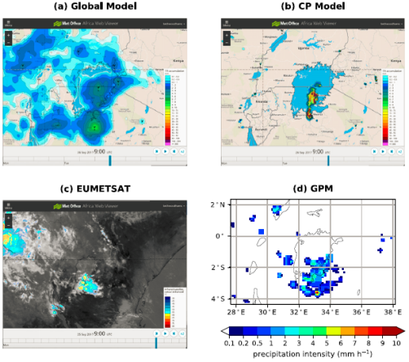
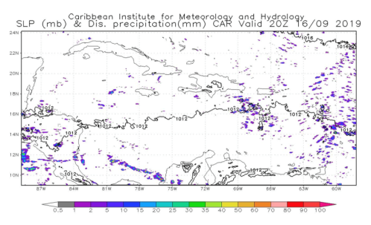
Challenge: Convection-Allowing Models & Obs
Need ensembles of convection-allowing models (CAMs) to better serve small island forecasting. Little long-term evaluation of CAMs in tropics.
UK Met: 2-year experiment with CAM over East Africa showed greater skill than global model, particularly for storms over land. CAM Ensembles over Singapore and for hurricanes in Caribbean show promise.
Real-time Deterministic CAMs over Caribbean:
CIMH real-time WRF runs, twice daily over entire Caribbean (4-km)
Experimental HRRR-Caribbean over northern Caribbean (3-km)
AROME: MeteoFrance (2.5km grid)
Woodhams et al. (2018)
CIMH WRF-ARW 4-km Caribbean Domain

Slide 9
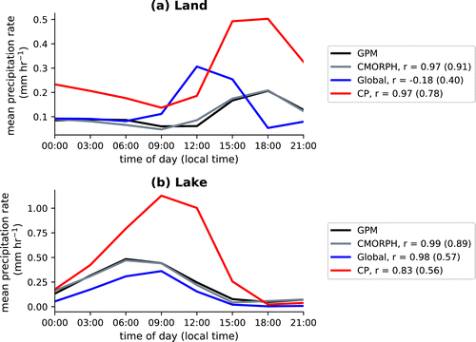
Challenge: Convection-Allowing Models & Obs
Exploit EUREC4A, satellite and radar data for data assimilation and verification of CAMs
Evaluate statistics of convection produced by CAMS (e.g., diurnal cycle, distribution of cloud types and patterns), since nature of observed and model convection can lead to mismatch in location and time.
Recommend: Model Evaluation Group – Use cases to explore model biases, document performance of operational models (local and regional) for different types of events
Woodhams et al. (2018)

Slide 10
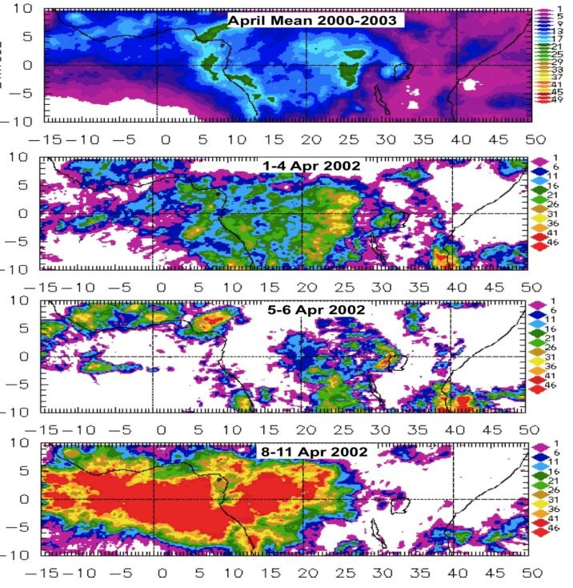
Challenge: Convectively-coupled Kelvin waves and Wet/Dry spells
Normal Convective Activity
Weak Dry phase of Kelvin Wave
Suppressed convection over the West
Little propagation
Wet phase of Equatorial Kelvin Wave
Copious convection over the West
Suppressed convection over the East
Laing et al 2011
Laing et al. (2011)

Slide 11
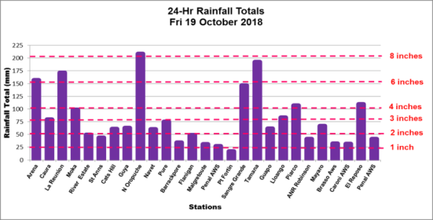
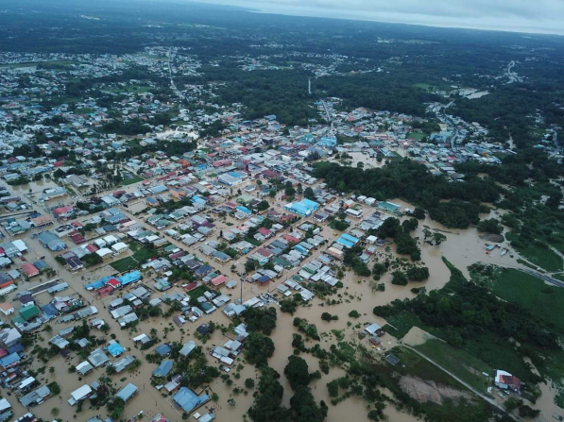
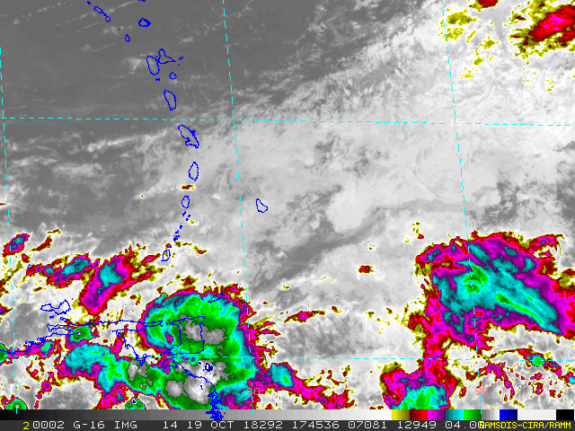
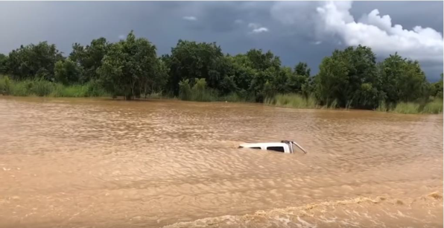
Challenge: Multi-scale interactions, High impact Wx
Trinidad & Tobago – 17-23rd October 2018 Floods
Wettest on 19 Oct 2019
Shakeer Baig, TTMS, CMC58

Slide 12
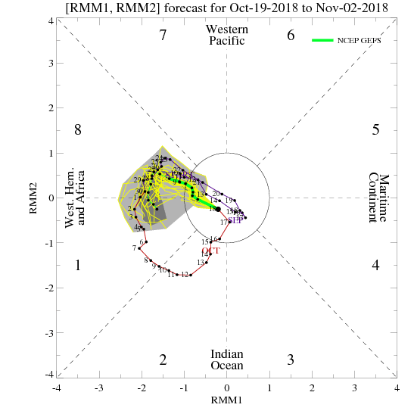
Challenge: MJO, Kelvin Wave & other Influences
Precursor Tropical Wave, 17 Oct
Anomalously High Precipitable Water
Sub-Tropical Jet Streak
Upper-level Divergence
Weak MJO forecasted to continue over Western Hemisphere, late Oct 2018
Kelvin Wave across Caribbean and South America

Slide 13
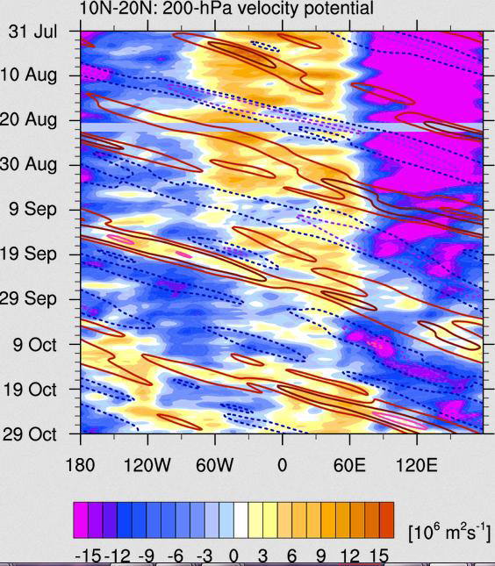
200 hPa Velocity Potential – Filtered for Kelvin Waves
Trinidad & Tobago (10-11 N, 60-61W)
Negative Velocity Potential:
Divergent Upper troposphere, from 16-20 October 2018
Source: http://mikeventrice.weebly.com/tropical-waves.html
Shakeer Baig, TTMS, CMC58

Slide 14
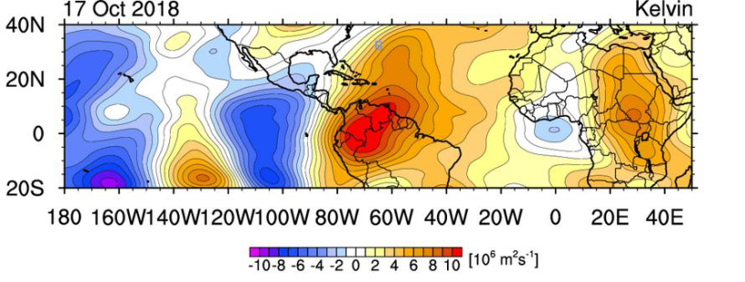
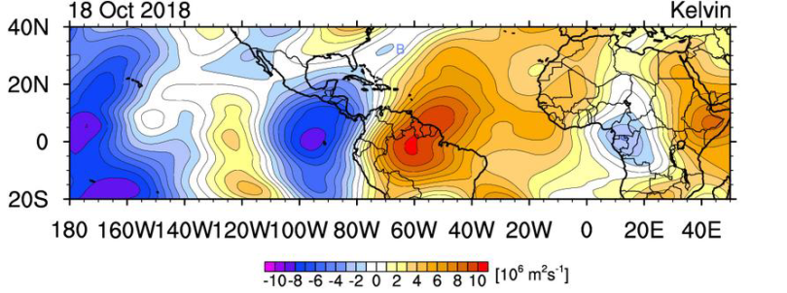
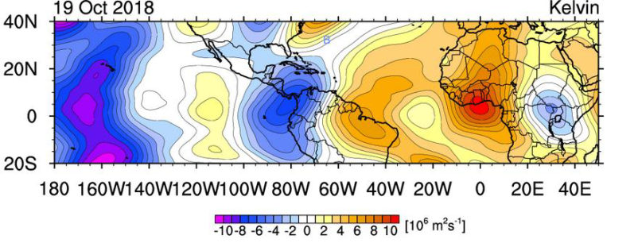
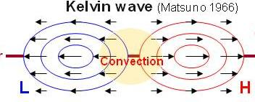
Kelvin wave and Oct 2018 Trinidad & Tobago Floods
19 Oct – Wettest Day
Source: http://mikeventrice.weebly.com/tropical-waves.html

Slide 15
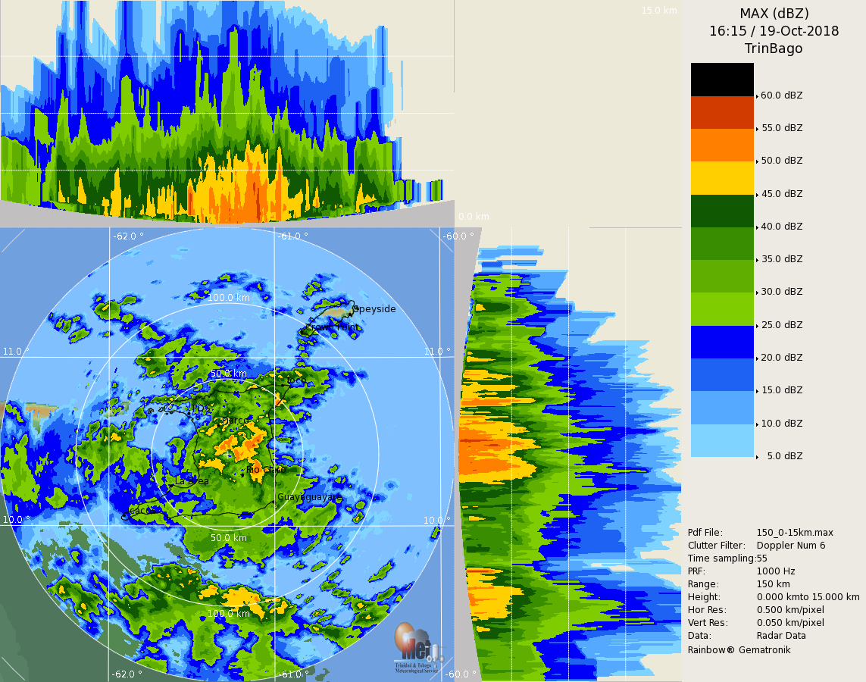
Low-level echo max, deep layer of moisture
Indicators for Heavy Rainfall
Deep layer moisture
Low–level echo maximum
Warm rain dominance
Low-level warm advection
Wettest day

Slide 16
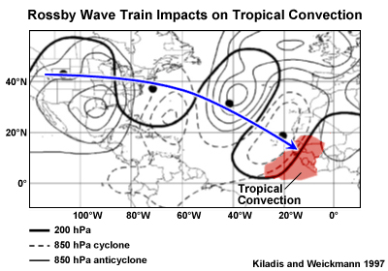
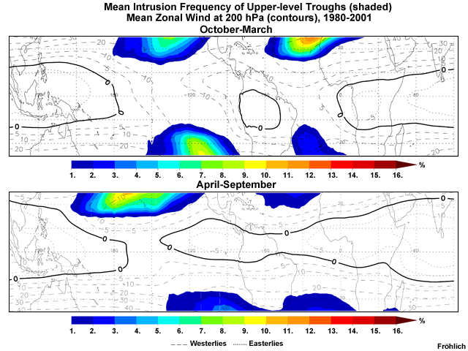
Challenge: Rossby Wave trains into Tropics

Slide 17
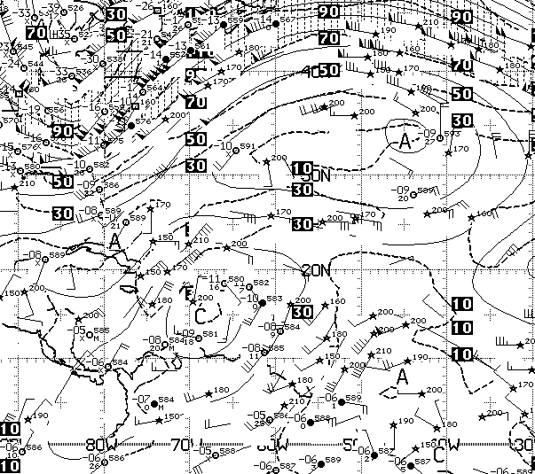
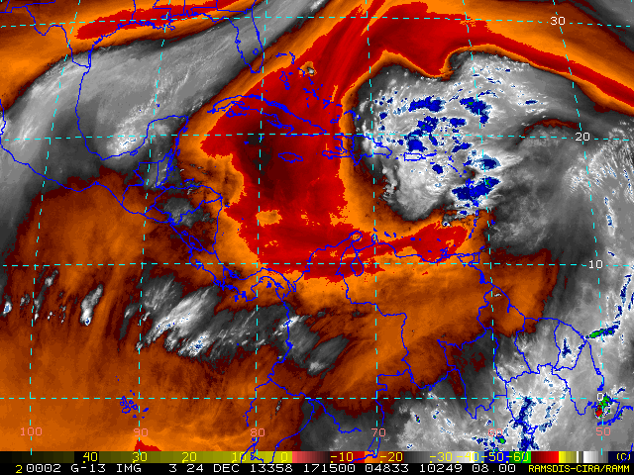
Challenge: Multi-scale interaction, High impact Wx
GFS 250 hPa1200 UTC
24 Dec 2013
A
C
A

Slide 18
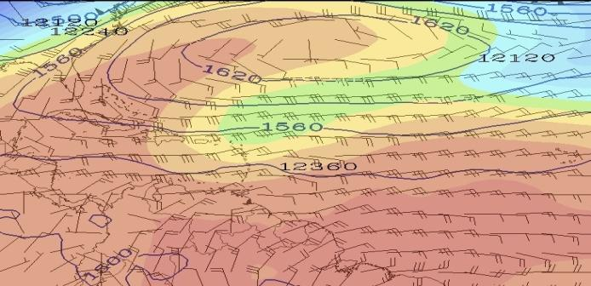
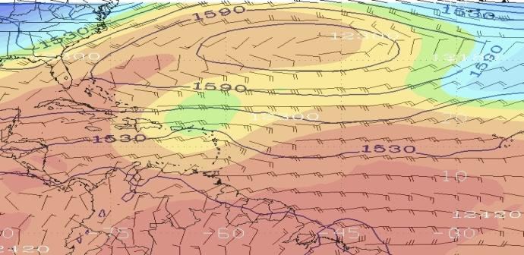
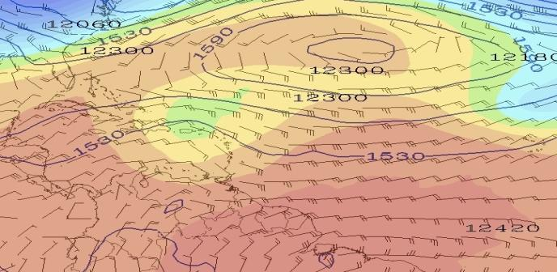
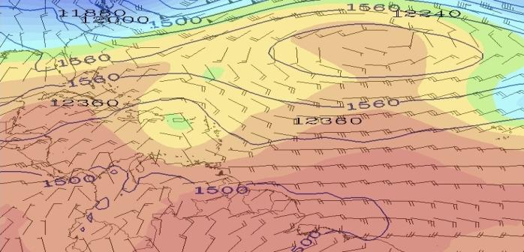
Rossby Wave Breaking 200hPa (height, color-shaded), 850 hPa (height contours, winds)
Backward moving upper cyclone
A
More intense
30
C
C
Jet Streak
20
850 flow
Low-level
Convergence
850 flow
10
12 UTC 23 Dec 2013
00 UTC 24 Dec 2013
-75
-60
-45
-75
-60
-45
A
A
30
C
C
20
850 flow
850 flow
10
12 UTC 24 Dec 2013
00 UTC 25 Dec 2013
-75
-60
-45
-75
-60
-45

Slide 19
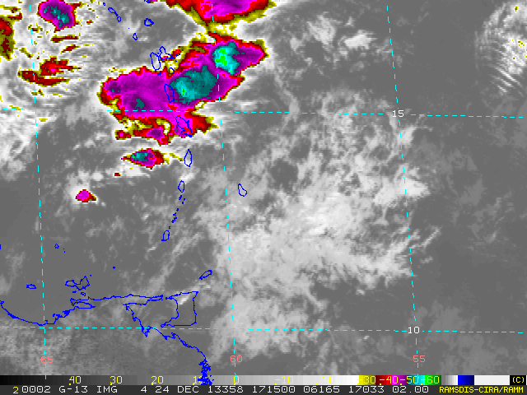
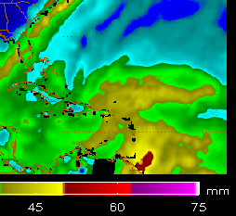
Mesoscale Convective Systems
Back-building convection, Training of cells
Interaction of Upper-level cyclone (SW’ly flow) and Low-level trough (E’ly-to-S’ly flow)
Low-level Warm Advection, Weak mid-level shear, Low-level Convergence, Upper Divergence
St. Lucia
St Vincent
1200 UTC 24 Dec 2013
Moisture
Convergence
TPW > 50 mm, Deep layer of moisture
K-Index ~ 36-38
TPW > 50 mm
Deep layer of moisture
K-Index ~ 38 - Guadeloupe
Moisture from Atlantic and South America

Slide 20
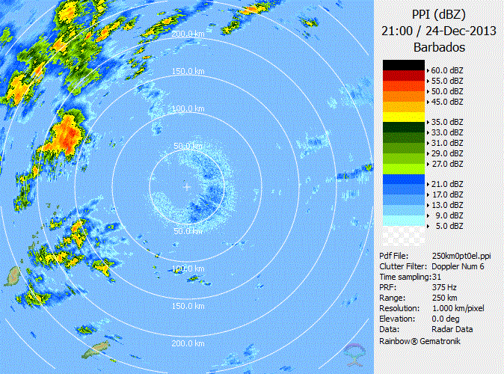
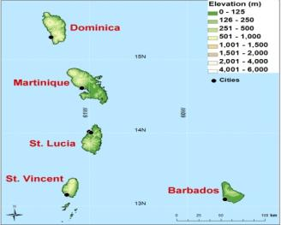
Mesoscale and Storm-scale: PPI 250km range
2100 UTC 24 Dec – 0100 25 Dec 2013
MCSs over St. Lucia
Cells persist in same area for ~ 3 hours
Orographic lift
Back-building, Training of storm cells
St. Lucia
St. Vincent
Barbados Meteorological Service

Slide 21
High-Impact Weather and Sub-seasonal Variability
To improve forecasting of high impact weather
Expand long-term statistics on atmospheric variability at sub-seasonal scales through observations and modeling (EUREC4A, etc…)
Quantify influence of equatorial waves and MJO on high impact weather events
Develop observational and analysis system that integrates data at sub-seasonal, synoptic, and local, and scales using the forecast funnel approach (from large- to small-scale)
Build capacity for utilizing NWP and incorporating multi-scale interactions into weather and climate analysis.

Slide 22
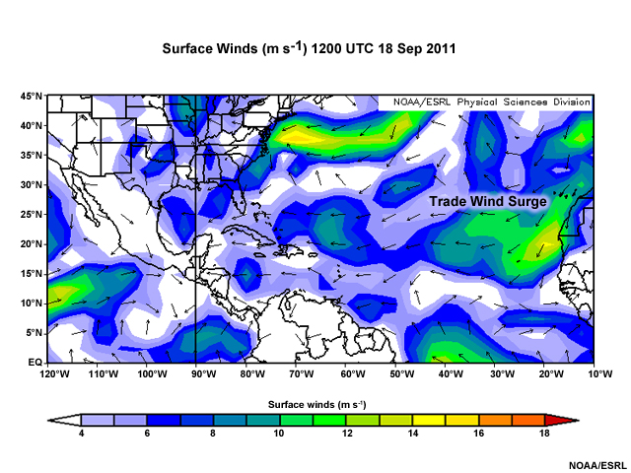
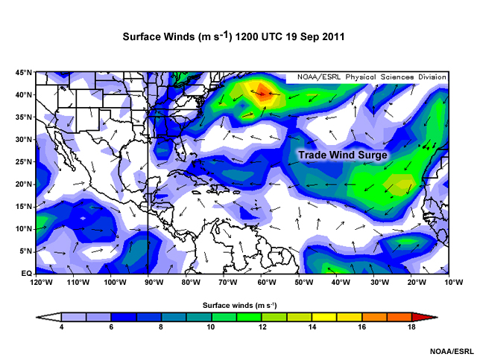
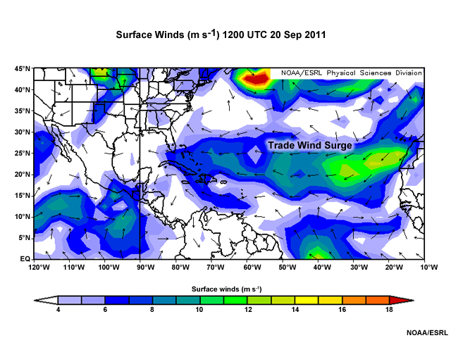
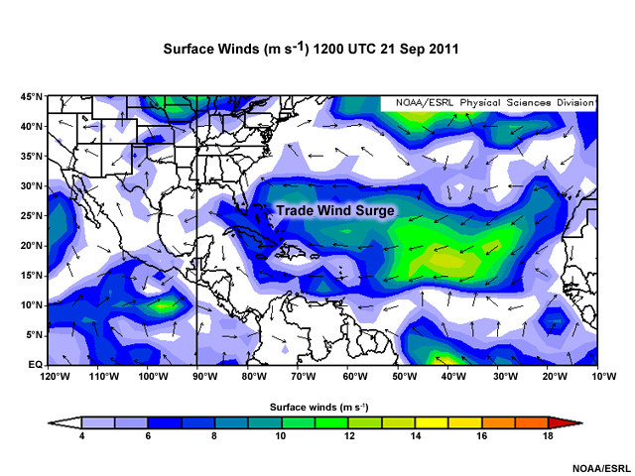
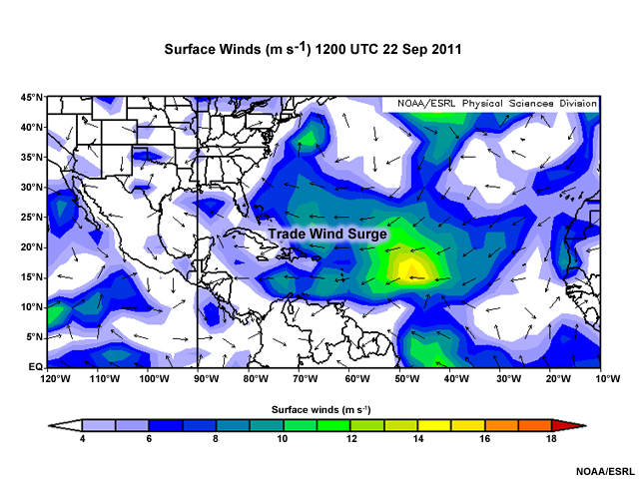
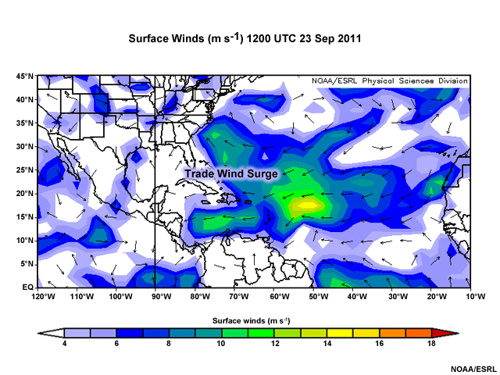
Challenge: Trade Wind Surge
1 Feb 2020
Laing EUREC4A Symposium

Slide 23
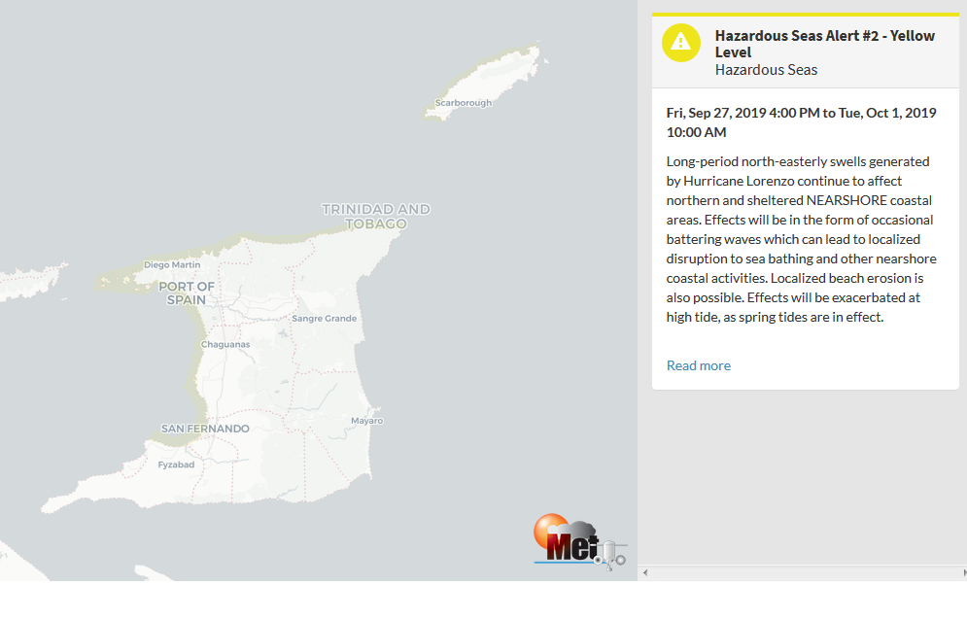
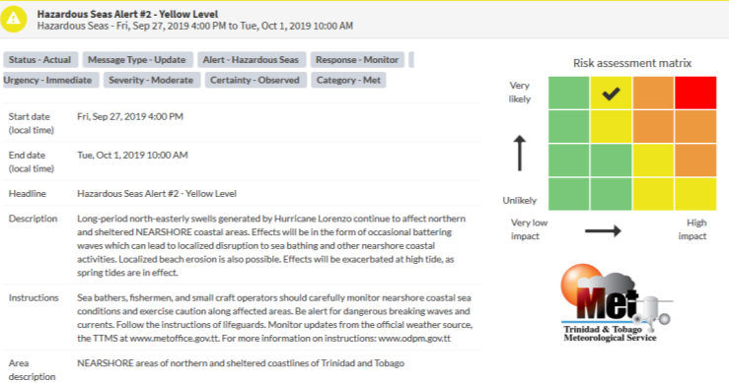
Challenge: Communicating Warnings and Impacts
Impacts-Based Forecasting: Being the Authoritative Voice

Slide 24
Research to Operations and Operations to Research, Operations to Practice
Rationale for EUREC4A: Improve models – hence improve operational prediction – better decisions
Is that really the case?

Slide 25
R2O and O2R: Conditioning Environment
Create opportunity for dialogue
Identify common interest => mutually beneficial and rewarding projects
Engagement with practitioners
Ensures that priorities are suitable
Establishes appropriate baselines (realistic expectations)
User-focused metrics and objectives
Respect each other’s perspective
Extend beyond usual comparative reference group

Slide 26
R2O and O2R: Support at the Upper Levels
Find incentives to reward those who work to ensure successful R2O transition and engage with practitioners to develop operationally-focused research (needs more creativity than counting number of publications)
Develop non-traditional work plans
For National Met Services – Limited staff
How to foster engagement with researchers?
Encourage partnerships (with CIMH, UWI, CCCCC, …)

Slide 27
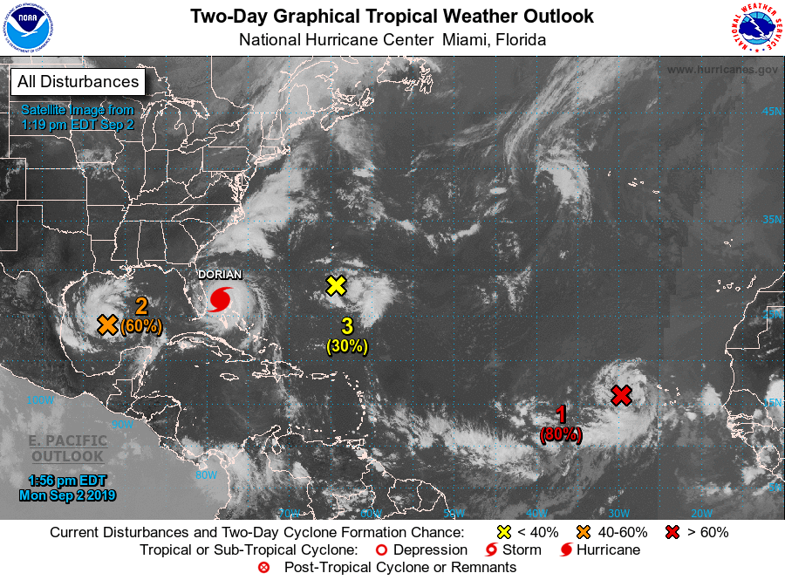
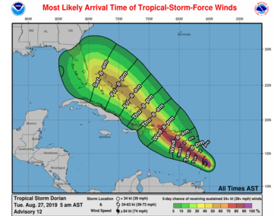
R2O, O2R Success: Hurricane Forecasts
Products developed with user decision timeline in mind

Slide 28
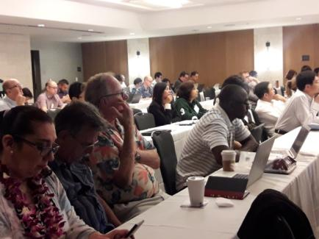
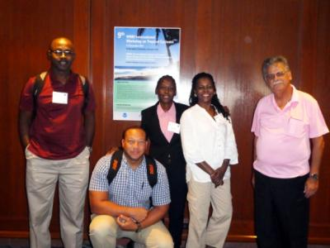
R2O, O2R Success : Hurricane Forecasts
Long history of close collaboration between workers in research and operations
NOAA Joint Hurricane Testbed (continuous dialogue, testing of ideas, product development)
International Tropical Cyclone Workshops (every 4 years) – brings together researchers and forecasters from all over the world
Hurricane Committee (annual) – opportunity to identify priorities for operationally-focused research

Slide 29
EUREC4A-UK-CMO-SWFP Forecasting Initiative
International researchers in the Caribbean for EUREC4A – opportunity for interaction with local practitioners
Local forecasters have considerable knowledge around drivers of weather patterns
Weather Forecasting Initiative facilitates knowledge-exchange, building relationships to support R2O, O2R
Pre-EUREC4A training workshop, 2-6 Dec 2019
Forecast “Testbed” during field campaign, contributing to research operations planning
Workshop in July to consolidate knowledge gained from testbed and 1st workshop

Slide 30
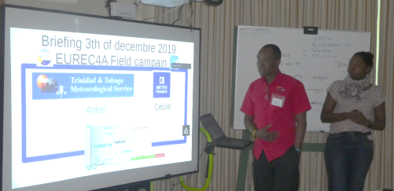
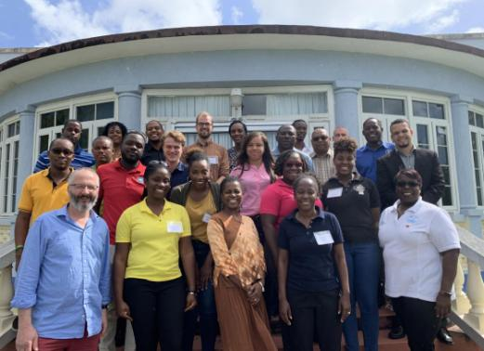
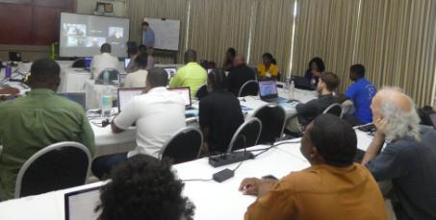
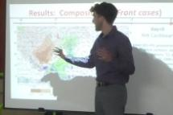
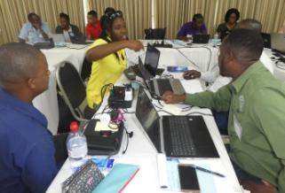
EUREC4A-UK-CMO-SWFP Forecasting Initiative
Supports Severe Weather Forecast Programme (SWFP) in Eastern Caribbean
Expanding capability in interpretation and use of NWP products
Developing collaborative practice among forecasters

Slide 31
EUREC4A-UK-CMO-SWFP Forecasting Initiative
Forecasters want to keep having access to new high-resolution models – esp. mesoscale features
Happy for opportunity provided by CIMH to join EUREC4A research
Researchers found the knowledge-exchange useful

Slide 32
Research to Operations to Practice
Early engagement with practitioners/stakeholders/users
Understand priorities for operationally-directed research
User-focused metrics and objectives (including decision timeline)
Evaluate forecast skill by generating products that are operationally-meaningful
E.g., Probability of cloud base below threshold specified by civil aviation flight safety rules
Co-produce and co-design products with users
Use social and behavioural science to understand both forecast decision and end-user decision making

Slide 33
WMO Research Board: Innovation in the Regions
Research needs in WMO RA IV
https://docs.google.com/forms/d/e/1FAIpQLSezokh__cf43KZQmrVarY-zUz7qdXsM6TwzWoI-3Wh5_t_fEw/viewform?vc=0&c=0&w=1
Identify one pressing regional problem that needs attention from WMO research
How can developing countries and SIDS articulate their needs and be better engaged in research?
How can research in the academic community be made available to NMHSs and for climate services?
Thanks for your time and attention
http://www.cmo.org.tt

Slide 34
Acknowledgements
Workshop Organizing Committee
Prof. Doug Parker (University of Leeds)
Dr Arlene Laing (CMO Coordinating Director and Permanent Representative for the British Caribbean Territories with WMO)
Mrs Margarette Als-Mayer (CIMH)
Prof Alan Blyth, Principal Investigator of EUREC4A-UK, (National Centre for Atmospheric Science, University of Leeds)
Lecturers in the workshop
Forecast Testbed
Dr Arlene Laing – Coordinator
Dr Leif Denby (U of Leeds) - Archiving of Forecast Briefings and Recordings
Nicola Alexander (CIMH) - Forecast Testbed Schedule
Workshops supported by a grant to University of Leeds by Natural Environment Research Council (NERC), United Kingdom, and a grant from WMO to CMO, respectively

