Slide 1
Air-sea Fluxes: BOMEX to EUREC4A/ATOMIC
C.W. Fairall NOAA
Jim Edson, Frank Bradley, Jeff Hare, Sergio Pezoa, Ludovic Bariteau, Byron Blomquist
What are fluxes?
Why do we want fluxes?
Measurement
Issues
BOMEX
Modern

Slide 2
Fluxes In General
Budget equation for variable x=X+x’
Rate change = [ turbulent + molecular + mean fall + slip covariance+ Source]
Volume source becomes an area flux
<w’x’> turbulent transport
Source Examples:
Temperature – radiative flux, condensation
Water vapor – evaporation
Liquid water – condensation, sea spray
Ozone – chemical reactions in air or water, e.g. Q_{x}=-C_{xy}XY
Particles – gas-particle, coalescence, sea spray, blowing dust, meteors

Slide 3
Applications for Surface Fluxes
A few examples
Model lower boundary conditions (LES, PBL, Mesoscale, NWP, GCM)
Ocean budgets (stress, heat, waves, sea-ice)
Carbon budgets (uptake CO2 by oceans)
Pollution deposition (particle, ozone)
Cloud microphysics (aerosol source, DMS source of sulfur)
Hurricane intensity
Global warming

Slide 4
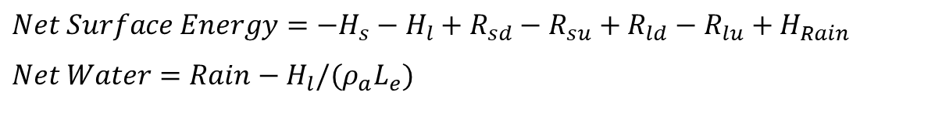
Turbulent Flux Definitions
Surface Energy and Mass Budgets
$Net Surface Energy=−H_{s}−H_{l}+R_{sd}−R_{su}+R_{ld}−R_{lu}+H_{Rain}$
$$Net Water=Rain−H_{l}/(ρ_{a}L_{e})$$

Slide 5
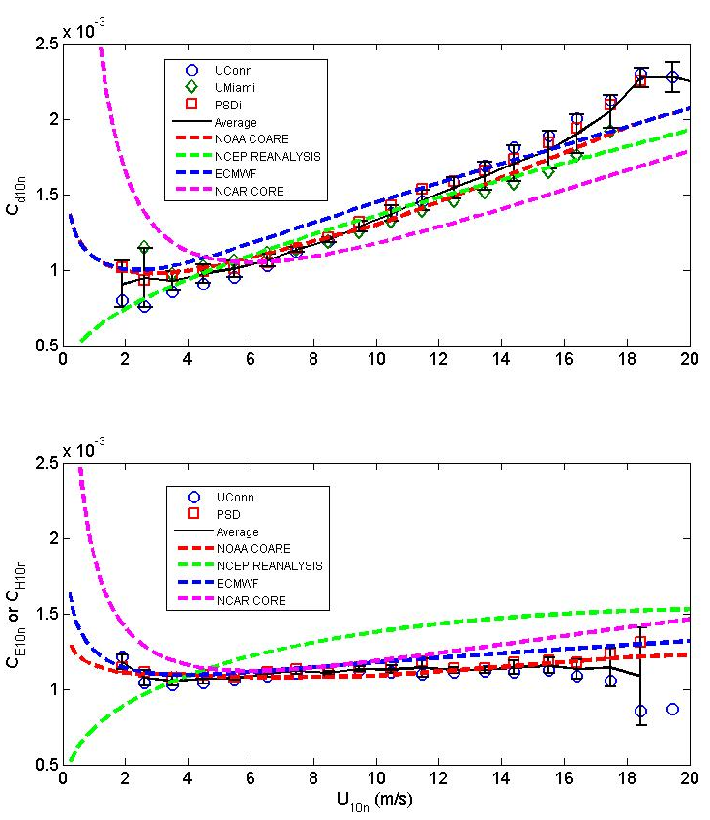
Surface Turbulent Flux Parameterizations
Turbulent Fluxes: Parameterization using U, Ts, T, etc.
Flux= Mean correlation of turbulent variables, <w’x’>
MetFlux – Dominated by atmospheric turbulent transfer physics
GasFlux – Dominated by oceanic molecular transfer physics;
Enhanced by whitecap bubbles
Transfer coefficients computed from direct flux measurements

Slide 6
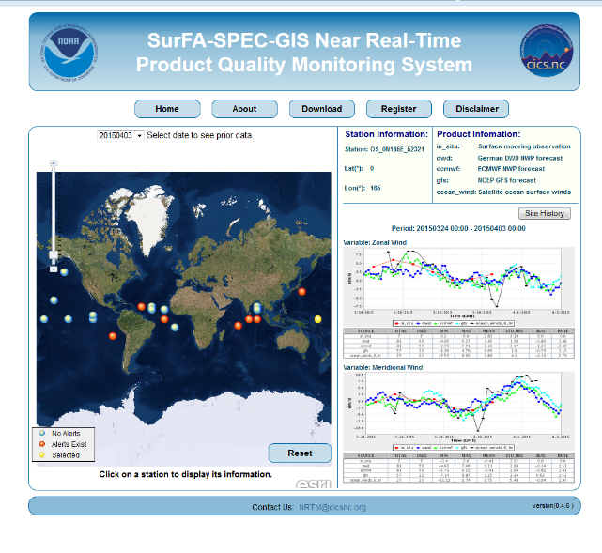
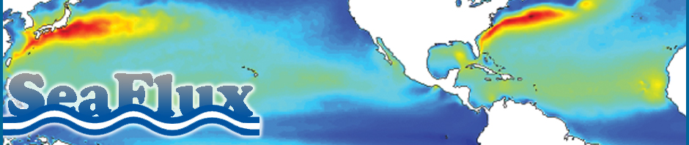
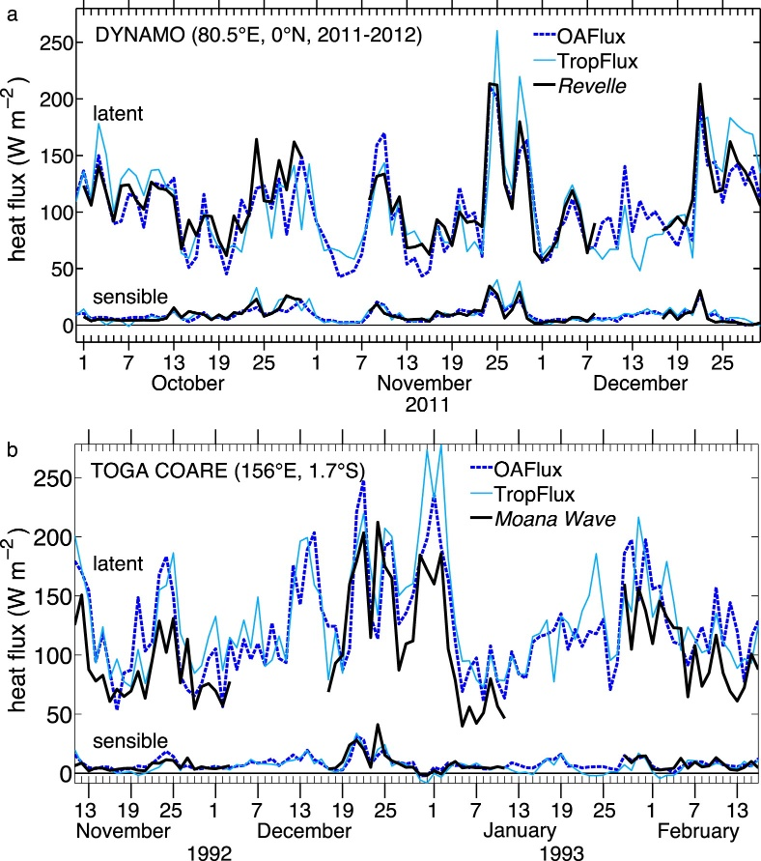
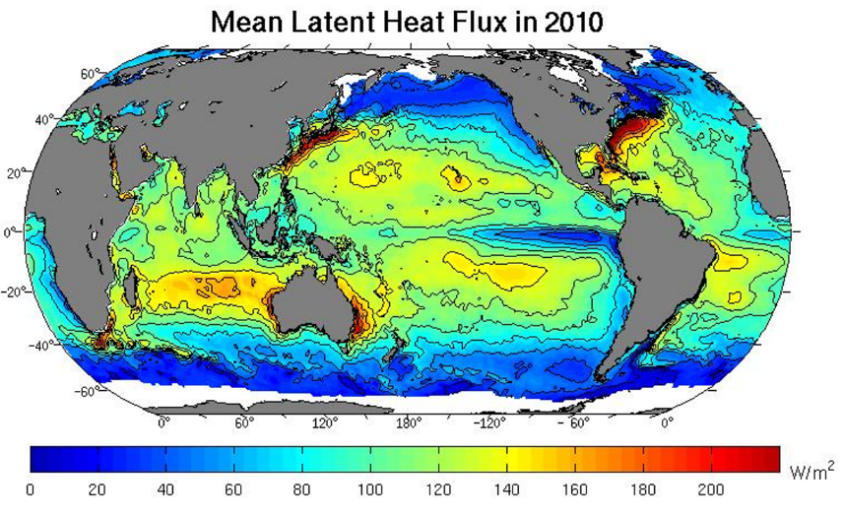
Community Flux Products Using Bulk Estimates
NWP: SURFA Archived flux fields from ECMWF, DWD, JMA
Blended: WHOI OAFlux, CORE,..
Satellite: SEAFLUX, GSSTF, HOAPS, JOFURO, IFREMER

Slide 7
Measurement Near-Surface Turbulent Fluxes <w’x’>
Sensors (w’, x’)
  10 Hz, 3 digit resolution, 2.5% accuracy, withstand marine environment
Platform
  Ship, buoy, aircraft, pier, ocean- or land-based tower
Processing
  Fast DAS, time synchronization, high pass filtering (x=X+x’), averaging, motion corrections, coordinate transform
Dirt effects
  Sensor crosstalk, Sea salt and biochemical, ship effluent, radio/radar interference, flow distortion, flow distortion, birds
Ancillary
  All variables relevant to parameterization, platform navigation, food

Slide 8
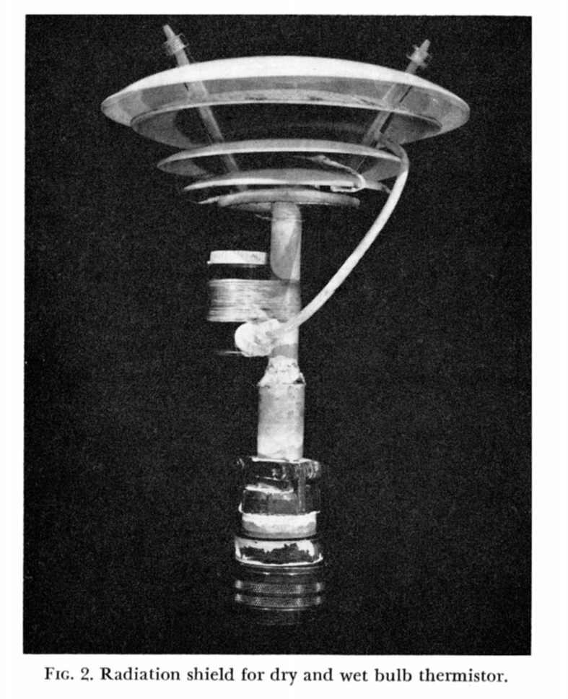
BOMEX Research Vessel with Flux Sensors

Slide 9
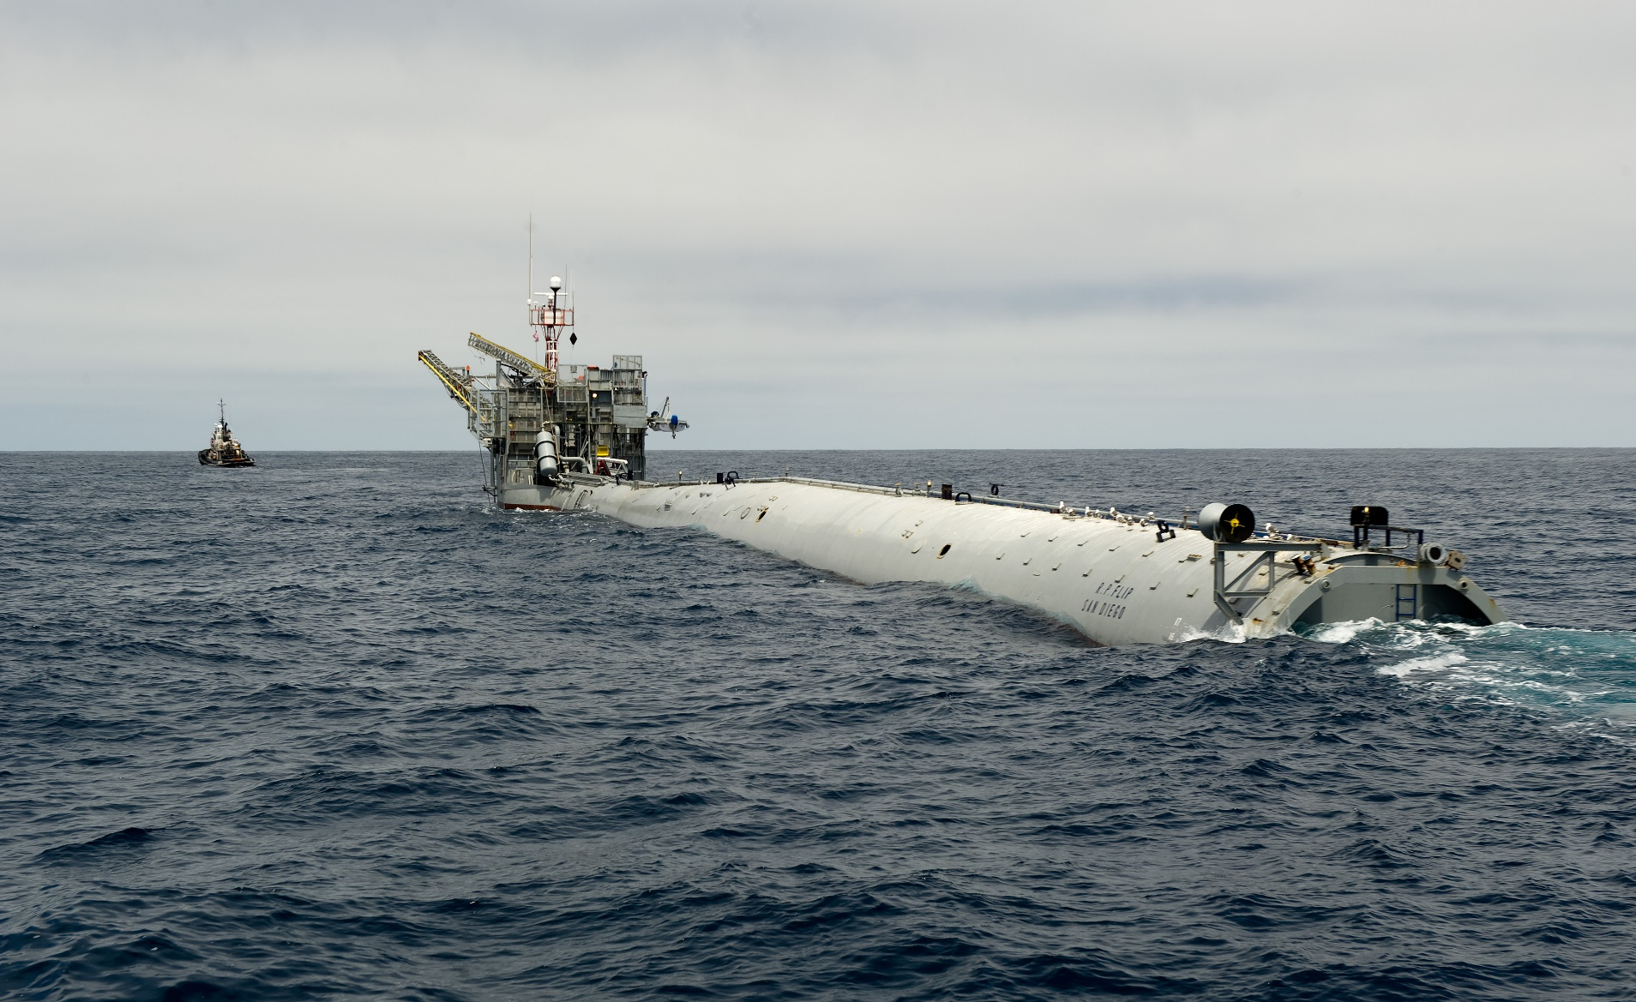
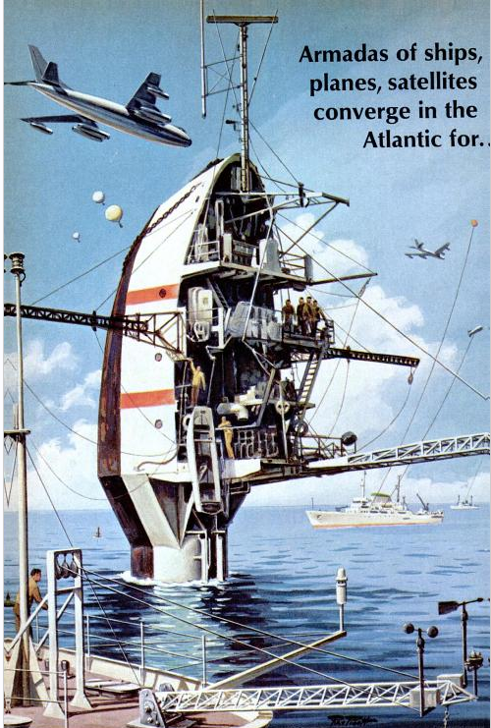
Floating Instrument Platform FLIP
World’s Largest Spar Buoy

Slide 10
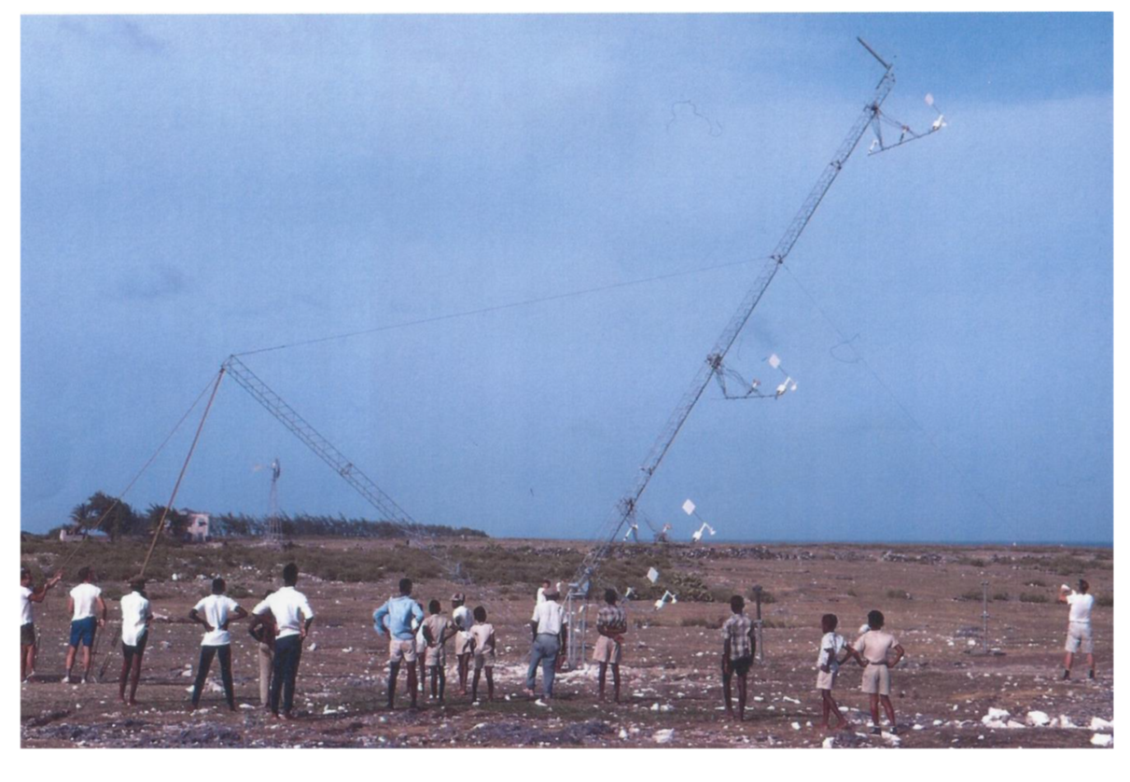
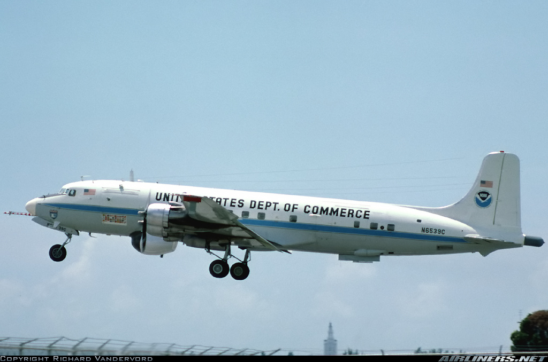
BOMEX Platforms: Land and Air
Tower on Barbados
NOAA DC-6

Slide 11
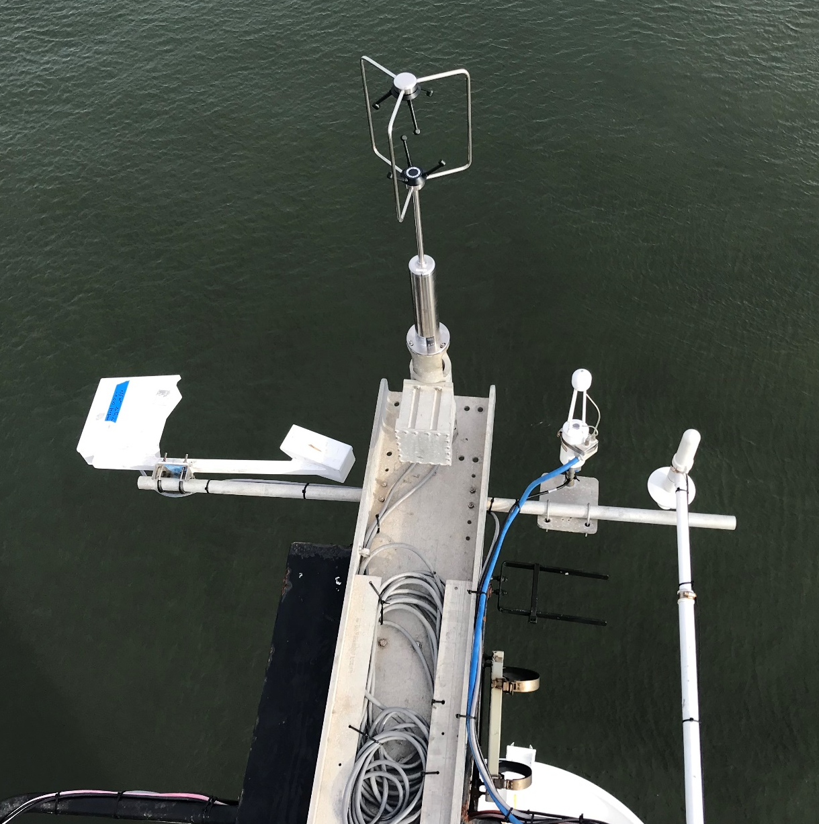
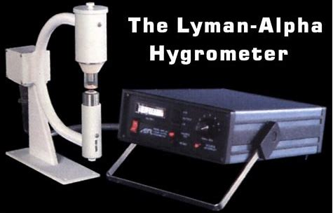
BOMEX vs Modern
 | BOMEX | EUREC4A/ATOMIC
Flux Platforms | Ships, FLIP, 2 A/C, Tower | 4 ship, 4 A/C, UAS, UAV
u’, v’, w’ | Sonic anemometer, gust vanes, propellers, hot wire anemometer | Sonic anemometer, 5-hole pressure ports
T’ | Microthermal wires | Sonic anemometer, Microthermal (UAS)
q’ | 1 channel UV absorption, wet/dry bulbs | 3-channel IR absorption
Motion | FLIP (cheating), INS | IMU (combined accelerations/GPS)
sonic
IR hygrometer
Rain gauge
T/RH
motion
Lidar wave gauge

Slide 12
BOMEX Latent Heat Flux Estimates
6 mm/day = 173 W/m^2

Slide 13
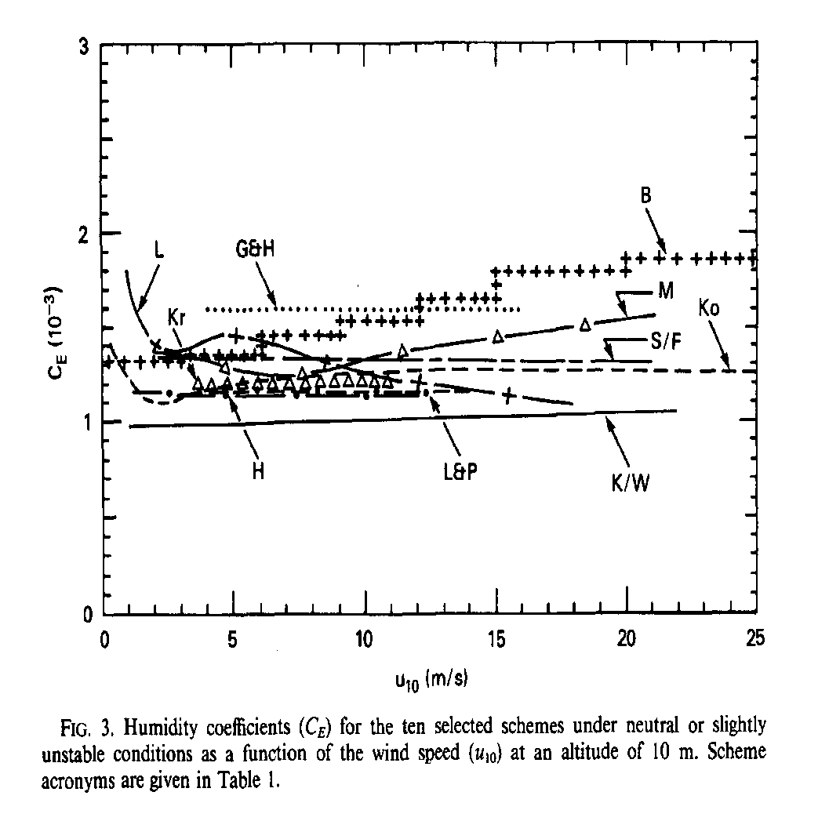
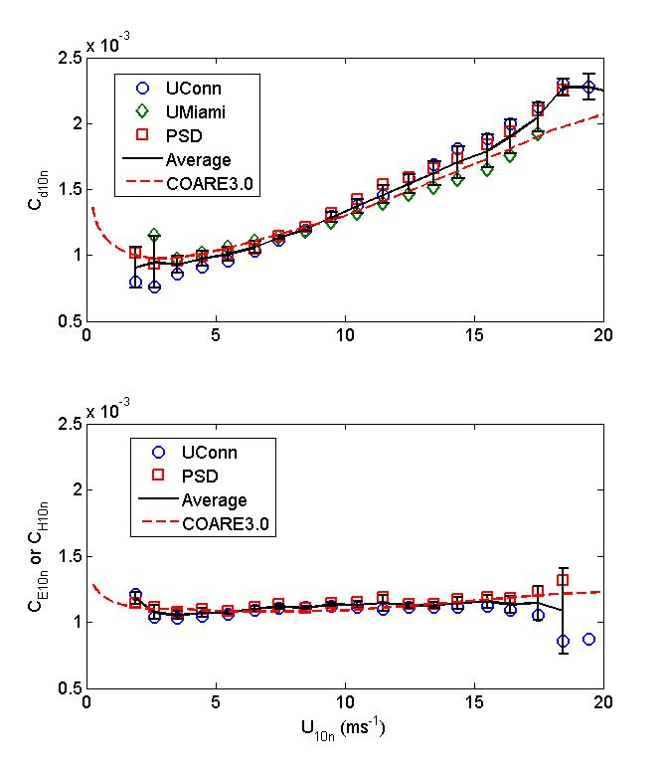
10-m Evaporation Coefficient
Post BOMEX
Fairall et al. 2011
Humidity and heat 10-m transfer coefficients. Average 20,300 observations. Uconn – Hs; PSD – Hl.

Slide 14
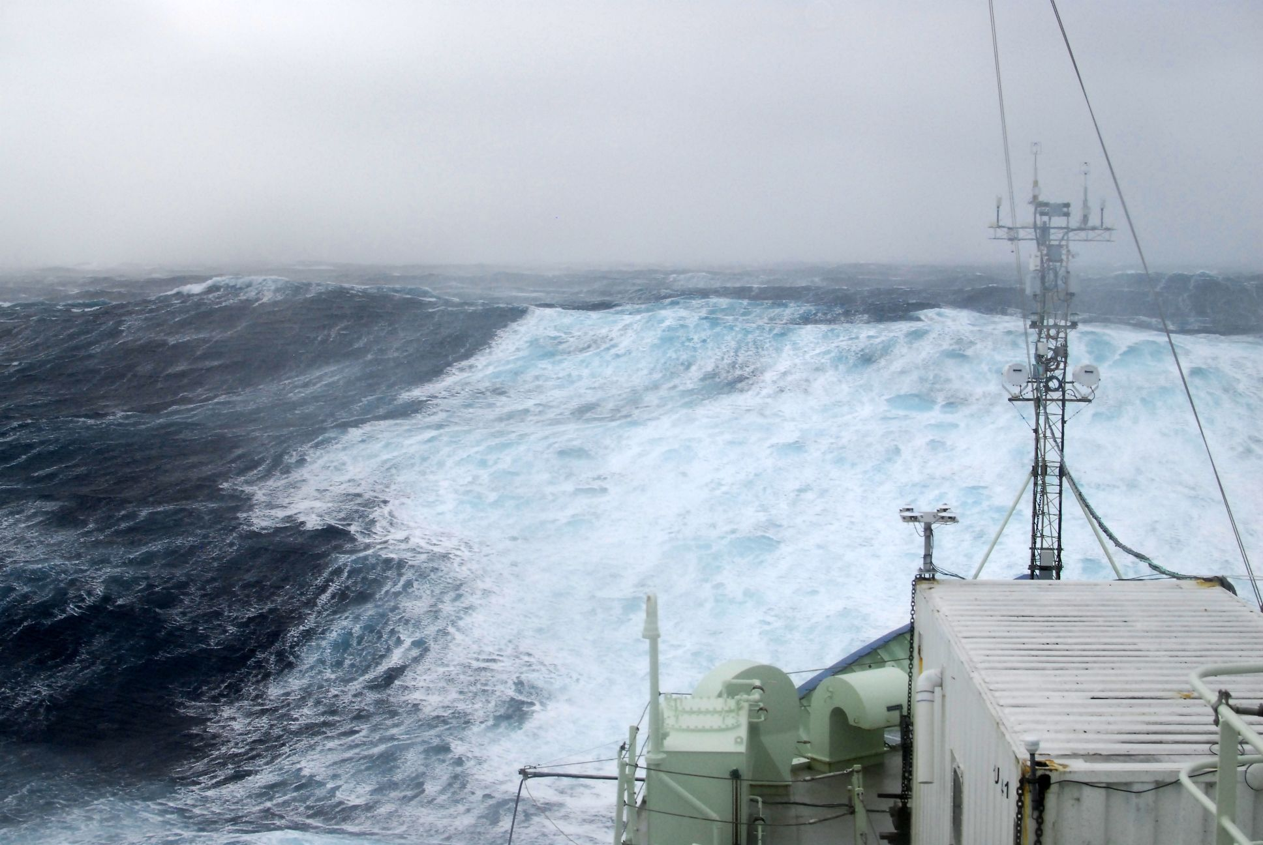
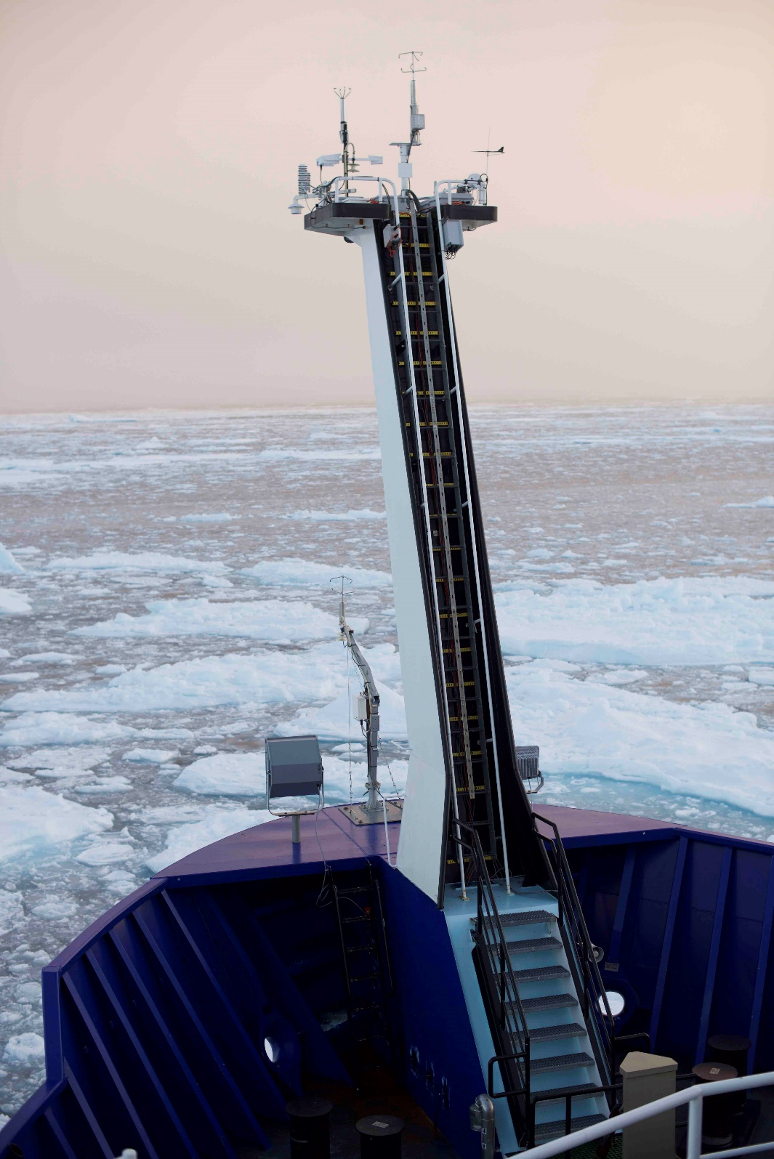
HIWINGS 2013
SeaState 2015
‘You cannot measure fluxes from a ship’ quote from a famous tropical meteorologist

Slide 15
Improved in situ air-sea flux observations
1974
2005

Slide 16
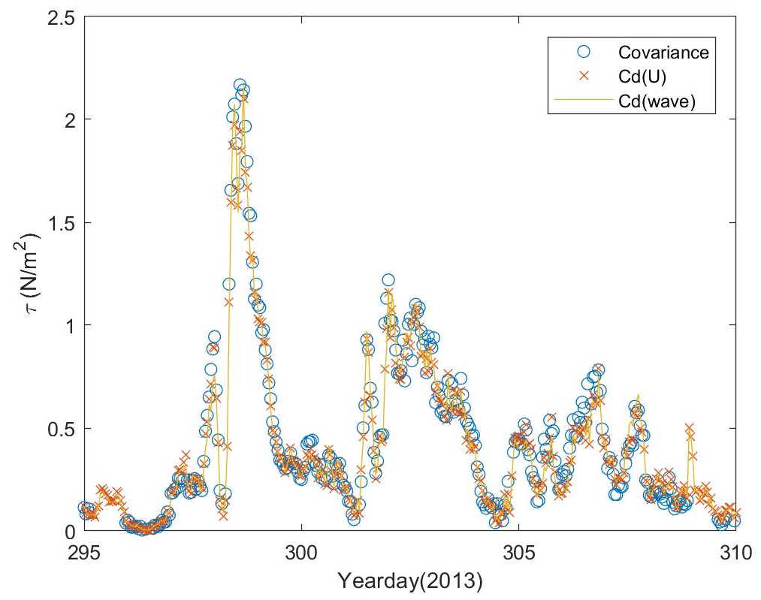
‘You cannot measure fluxes from a ship’ - a famous tropical meteorologist
Stress observations
HIWINGS field program South of Greenland November 2015.
Covariance measurements vs two versions of COARE model

