Slide 1
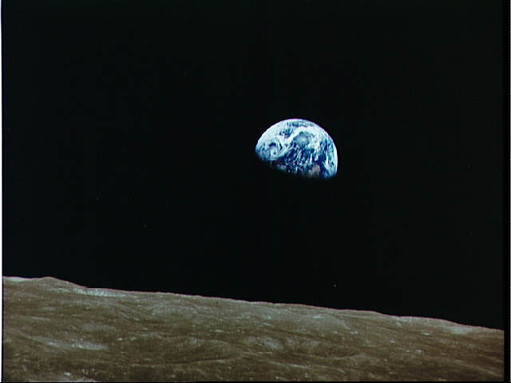
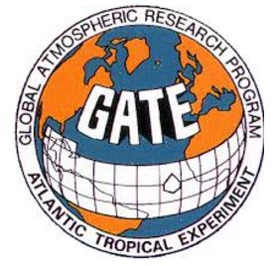
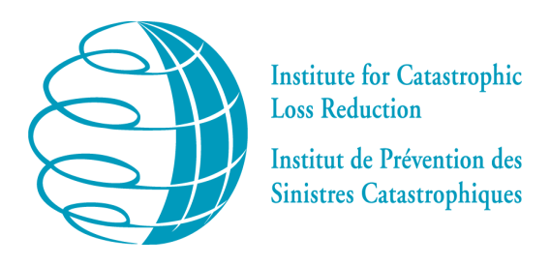
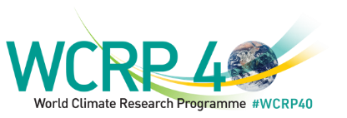
From BOMEX to GATE - the pioneering field campaigns over the Atlantic
Gordon McBean CM, OOnt, PhD, FRSC, FAGU, FAMS, FIUGG Director, Policy, Institute for Catastrophic Loss Reduction Professor Emeritus, Department of Geography, Western University
JSC-WCRP – Member 1984-94; Chair 1988-94; Vice-Chair 1986-88
President – ICSU (2014-18)
Presentation to:
From BOMEX to EUREC4A
Carribean Institute for Meteorology and Hydrology (CIMH)

Slide 2
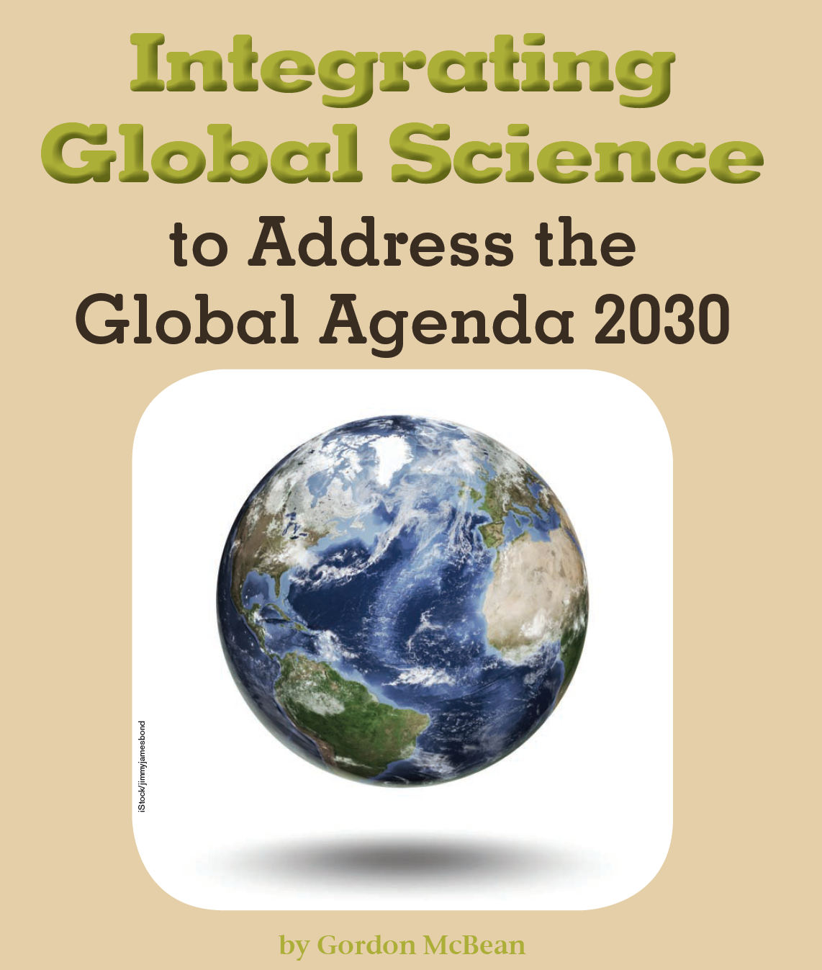
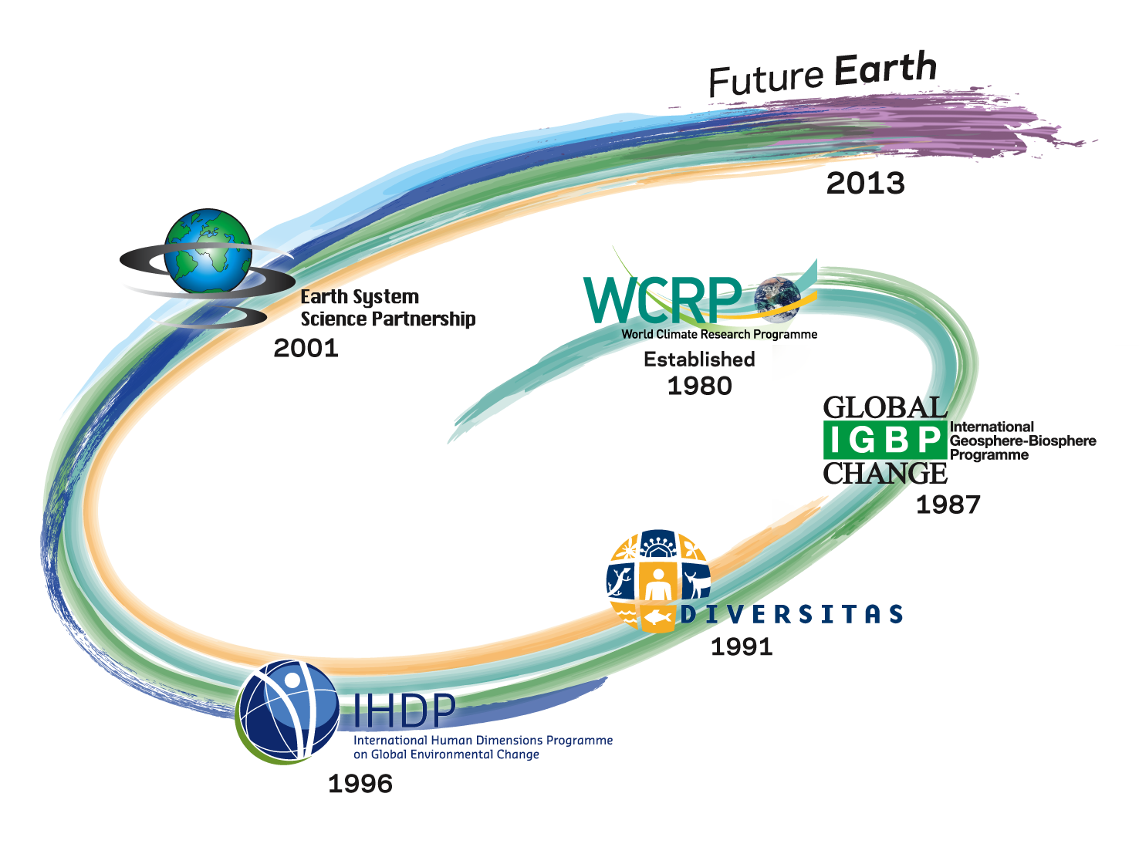
International Research Collaboration
WCRP: to determine: the predictability of climate; and the effect of human activities on climate
1979 – First World Climate Conference – Geneva
Global Atmospheric Research Program
1967-80
IGBP: earth system science to help guide society onto a sustainable pathway during rapid global change
IGY – Int’l Geophysical Year
1957-58
CO₂, O₃, ….
On Oct. 4, 1957, Sputnik 1
Jan. 31, 1958, Explorer I
NASA (July 1958)
space-based observing systems
IPCC
1988
2nd WCC - UN Climate Convention

Slide 3
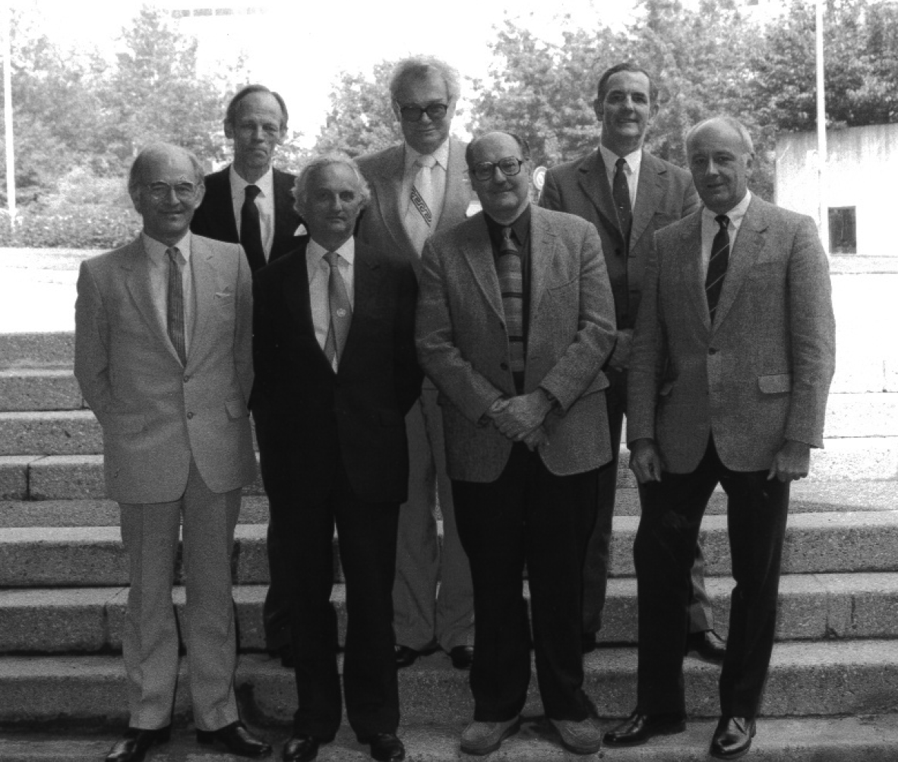
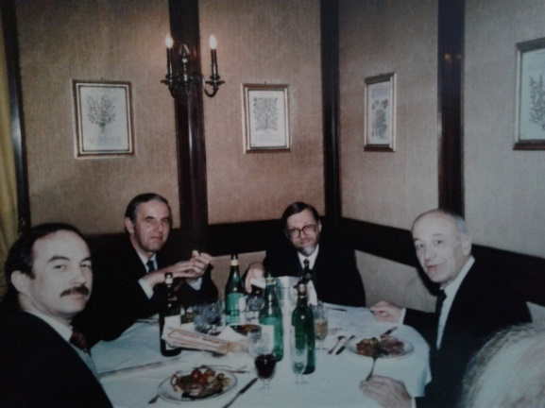
GARP
IGY – Int’l Geophysical Year
1957-58
CO₂, O₃, ….
On Oct. 4, 1957, Sputnik 1
Jan. 31, 1958, Explorer I
NASA (July 1958)
Space-based observing systems
Weather Observations by Satellite -
Advance science
Roles of tropical Oceans
Global Atmospheric Research Program
GARP -1967-80
Bert Bolin (1st GARP Chair), John Houghton (W 1982-84), Joseph Smagorinski
(W 1980-81) and Pierre Morel : Bo Döos (3rd GARP), Robert Stewart (2nd GARP); John Mason (W 1985-88)
Objectives: advancing the range of deterministic weather prediction, and understanding the physical basis of climate.
Weather Prediction – extending the time period and skills
Major focus on tropical oceans – atmosphere-oceans interactions –
BOMEX - 1969

Slide 4
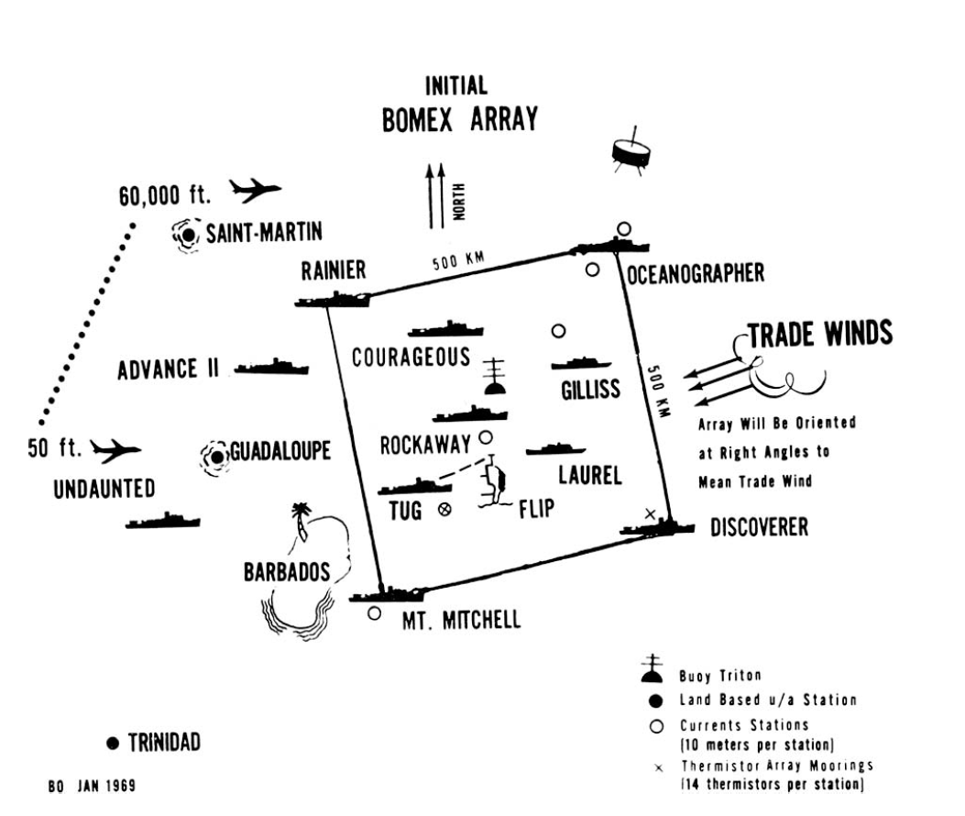
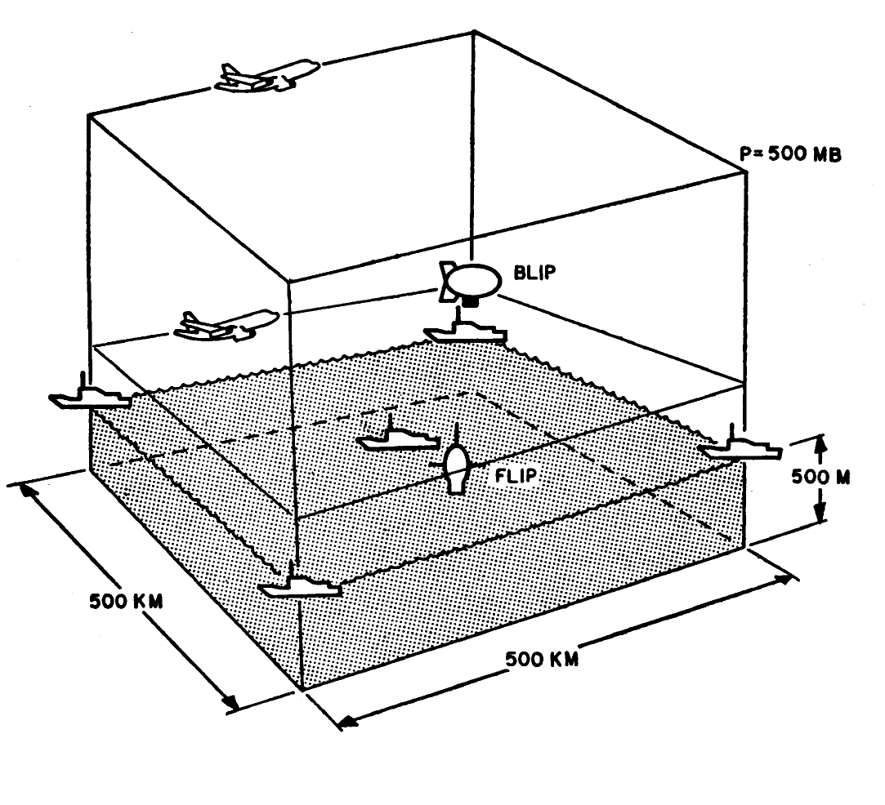
Barbados Oceanographic and Meteorological Experiment (BOMEX) 1969 - Observational phase: May, June, and July 1969.
Central objective – ocean-atmosphere interactions – storms (hurricanes) over tropical oceans – interdependencies - methods – water vapor flux. Challenges – an array of ships, platforms, pales and satellites - field management, data processing, and analysis.

Slide 5
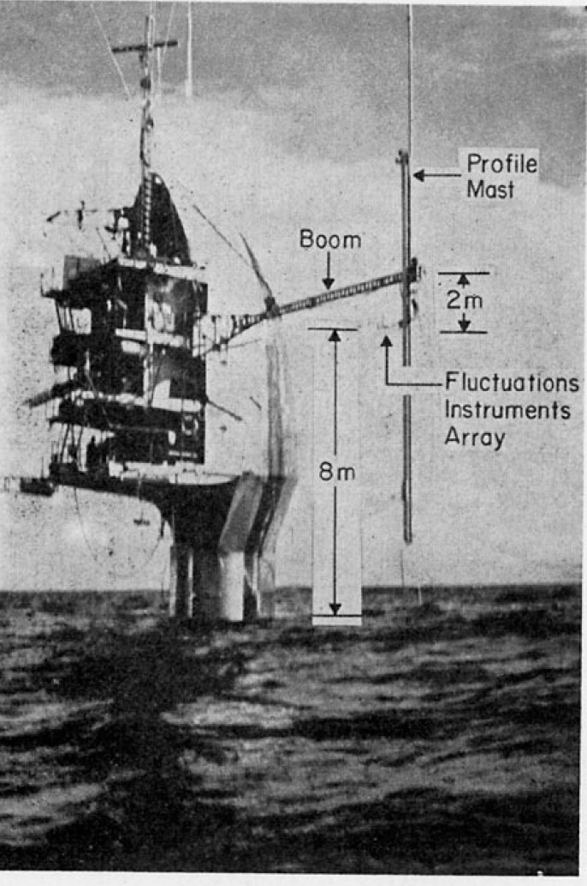
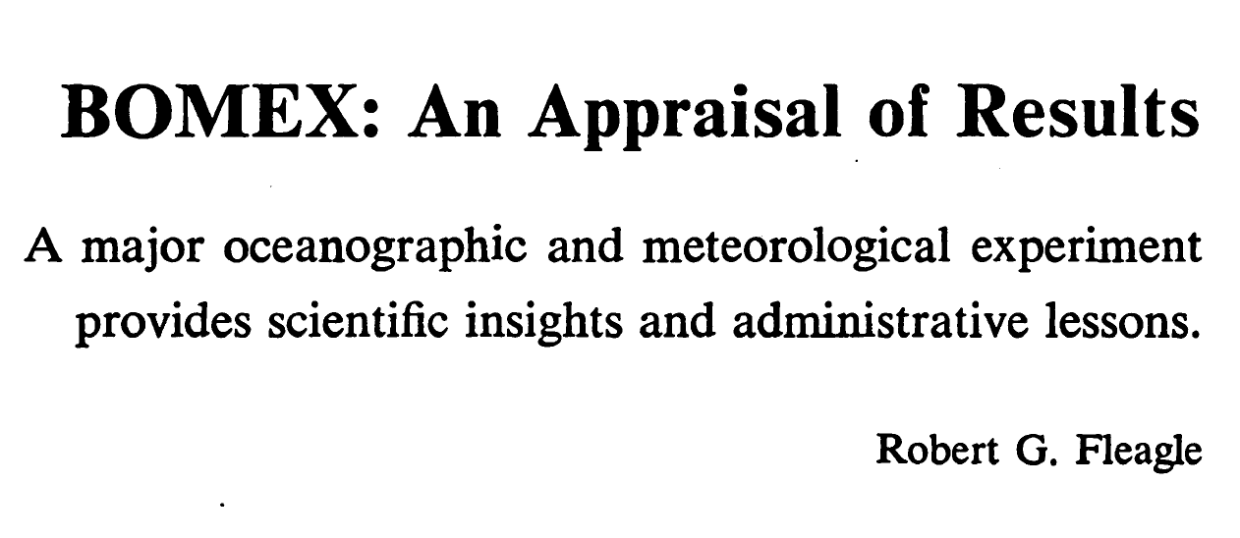
80+ independent research projects, divided - subprograms:
1) Sea-air interaction program
2) Oceanographic program
3) Radiation program
4) Satellite program
5) Tropical exploration program
Direct measurements turbulent transfers of momentum, heat, moisture – and indirect via profiles and other means.. Wave measurements.
Integrated ship, airplane, balloon, satellite observations - enhanced information for calculating and projection energy transfers for weather and climate predictions.
Barbados provided logistical facilities - Project Field Office - at Seawell Airport, Barbados.

Slide 6
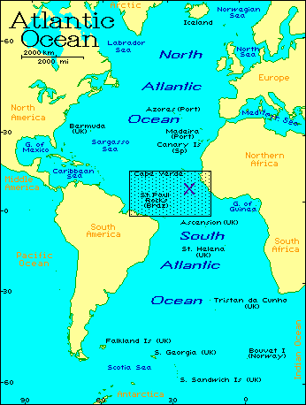
GARP Atlantic Tropical Experiment - 1974
Building on BOMEX, go to larger scale and across equatorial ocean to address larger scale ocean-atmosphere interactions.
GARP Atlantic Tropical Experiment - GATE
- To understand (more fully) the tropical atmosphere and its role in the global circulation of the atmosphere - to understand the predictability of the atmosphere and extend the time range of daily weather forecasts to over two weeks.
Summer of 1974 in an experimental area that covered the tropical Atlantic Ocean from Africa to South America.

Slide 7
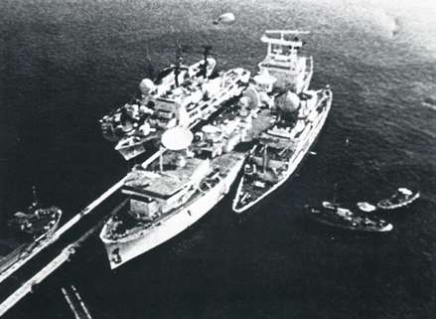
GARP Atlantic Tropical Experiment - 1974
GATE - “probably the largest and most complex international scientific experiment ever undertaken, ten nations—Brazil, Canada, France, Federal Republic of Germany, German Democratic Republic, Mexico, Netherlands, USA, UK and USSR—working in close collaboration, contributed 40 specially equipped ships, 13 large research aircraft, several meteorological satellites and some 5,000 personnel to an intensive three-month study of weather systems in the tropical eastern Atlantic Ocean; in addition, some 50 countries in Africa and South America participated by making additional surface and upper-air observations”

Slide 8
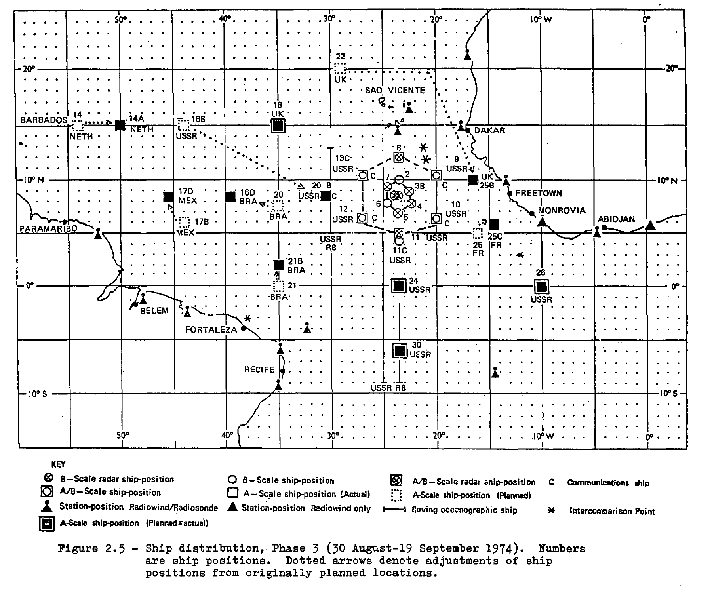
GARP Atlantic Tropical Experiment - 1974
Ships with Digital Rain Radars

Slide 9
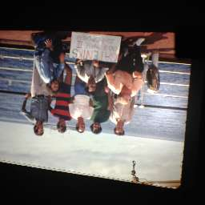
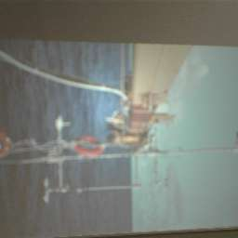
GARP – GATE – Canadian Ship CCS Quadra
GATENIKS
At end of Phase III
Varied Weather to Observe
Instruments for Boundary-Layer Measurements near Surface
Marine Instruments – surface and submarine or Ocean Measurements
Tethered Balloon with Instruments for Upper Boundary-Layer Measurements
Drones from other ships pass by

Slide 10
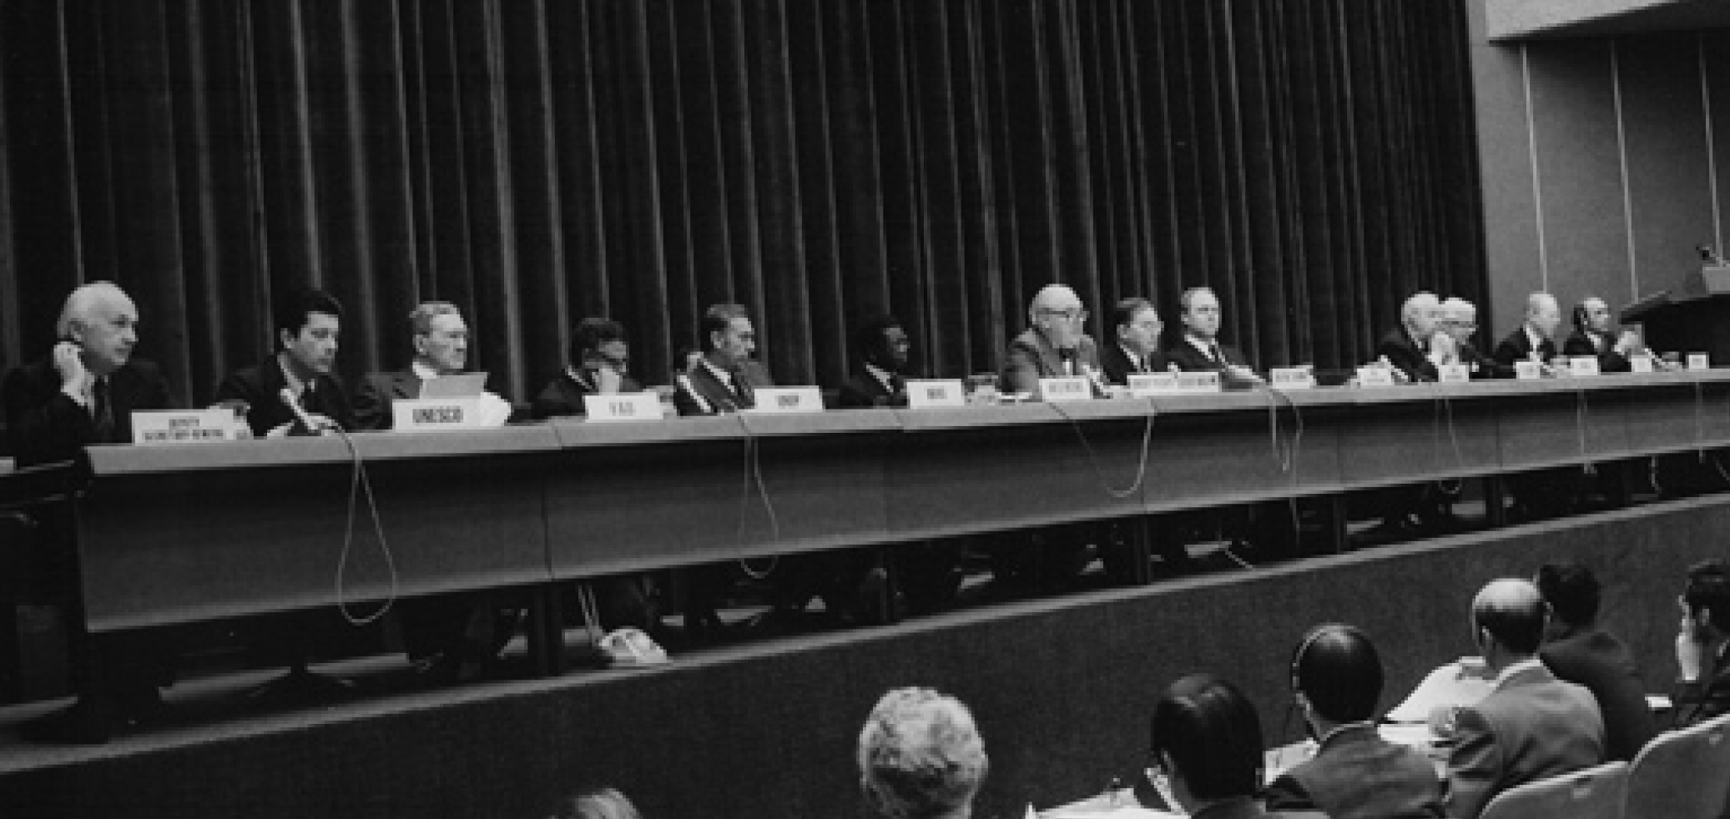
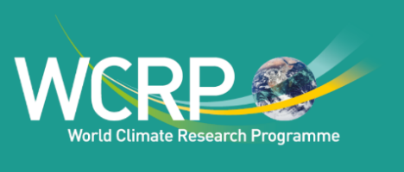
1st World Climate Conference - 1979
GARP Global Weather Experiment -- First GARP Global Experiment - FGGE - 1979a
International Policy Agenda
1972 – Creation of United Nations Environment Programme
1972 - Study of Man’s Impact on Climate
1979 – First World Climate Conference – Geneva
World Climate Program - four major components deal
ing with scientific research, practical applications of climate information,
climate data, and study of the impacts of climate on natural systems and
human society. WMO - applications and data programs; UNEP - impacts; and the research component—the WCRP
World Climate Research Programme - to determine the predictability of climate; and to determine the effect of human activities on climate.
Co-Sponsored by WMO and ICSU

Slide 11
World Climate Research Programme - WCRP
First 2 Decades

Slide 12
World Climate Research Programme – TOGA + WOCE
TOGA – Tropical Ocean Global Atmosphere, Planning began in 1982 - formally started in 1985.
to explore the interannual variability in climate arising from interactions between the tropical oceans and the global atmosphere.
highly visible and successful program within WCRP.
Atmosphere-tropical ocean coupling – El Nino prediction, observing systems
Built on BOMEX and GATE
WOCE – World Ocean Circulation Experiment (1990-2002)
Built on decade plus of thinking and planning for ocean studies – satellites and other observing techniques - CAGE, PATHS, …
JSC/CCCO WOCE Scientific Steering Group, WOCE formally planning began in 1983 - decadal climate prediction goal of the WCRP.
Ocean models for predicting climate change. Focus on observing systems and data. Long-term behavior of the ocean and how to determine long-term changes in ocean circulation.

Slide 13
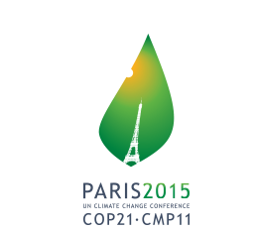
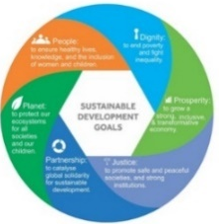
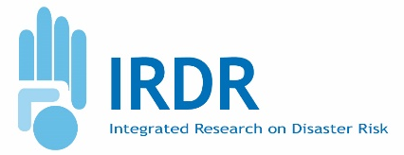
Global Agenda 2030
Actions across the Agenda need to be fully coordinated.
Roles of
Nations and Scientists
Integrated Science to Policy
Global Agenda Global
2030
Global Science Agenda
Sustainable
Development
Goals
+++
Observing systems,
Capacity Enhancement …
SENDAI Disaster
Risk Reduction

Slide 14
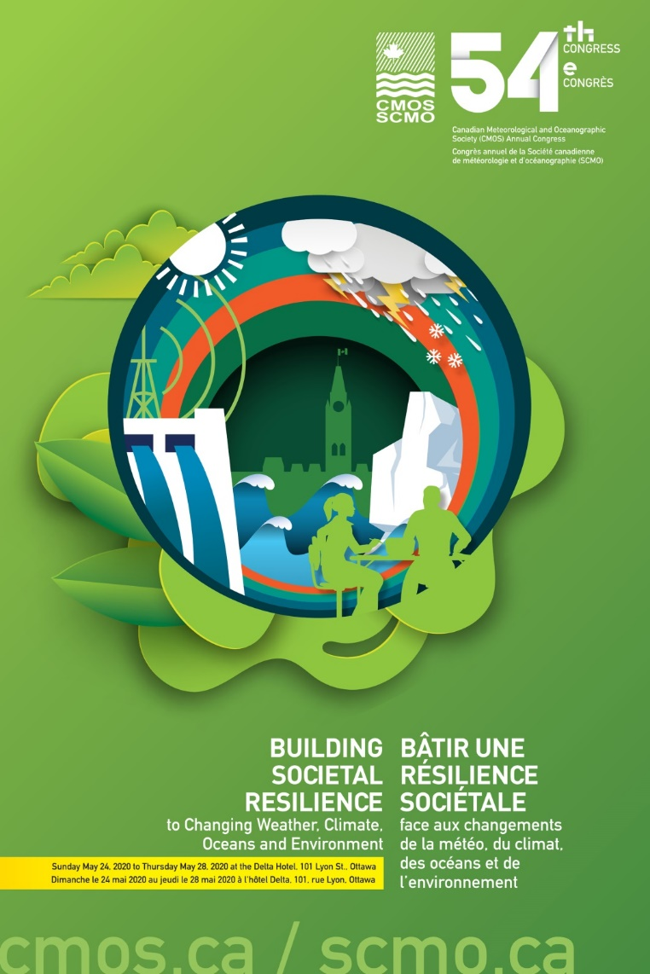
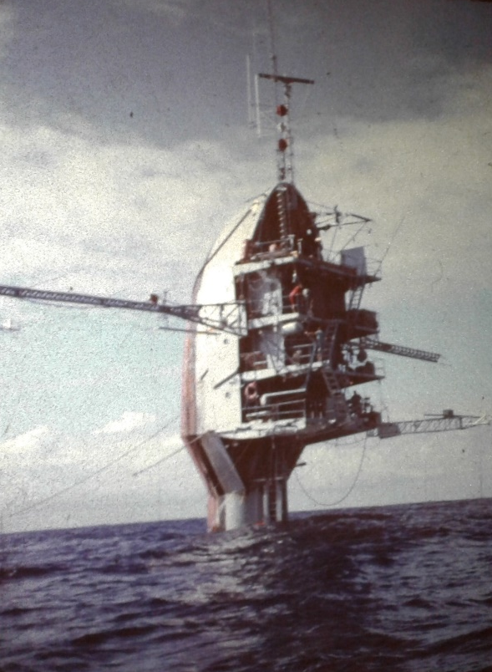
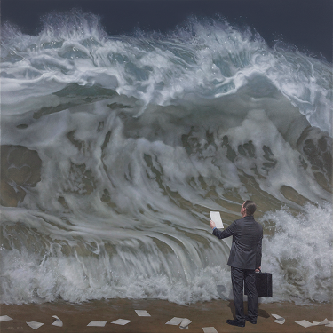
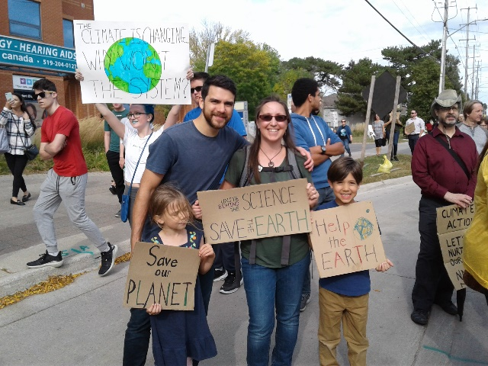
Address Complex Integrated Science Issues
May 24-28, 2020
Ottawa
ACTION
Unite Behind the SCIENCE
SAVE THE EARTH
Comprehensive Actions Needed

