Slide 1
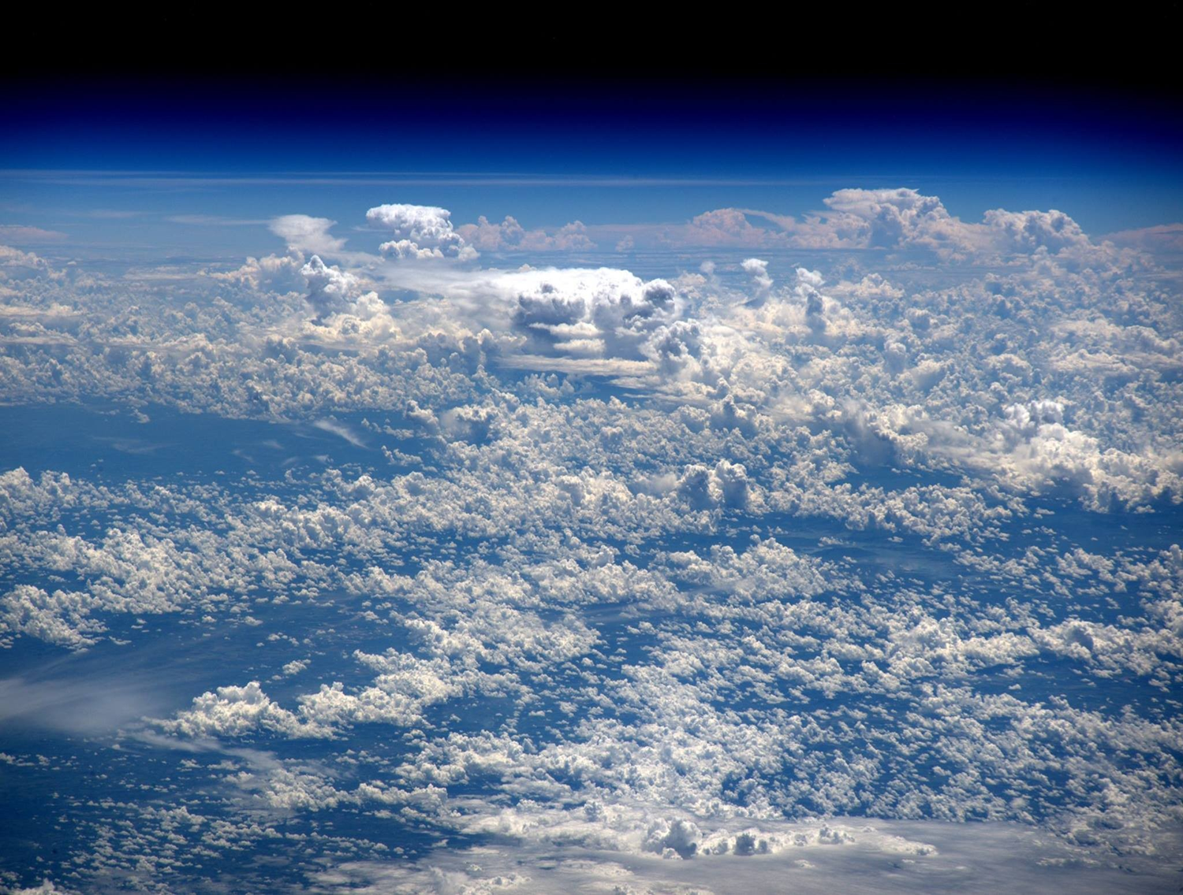
Some Shallow Thoughts about Deep Convection
(plus some very shallow thoughts about shallow convection)
Kerry Emanuel
Lorenz Center
MIT

Slide 2
Objective: Most Basic Theory for Observed Behavior of Tropical Atmosphere
Basic temperature and humidity profiles
Relationship between rainfall and column water vapor
Walker Circulation
Self-Aggregation
Emanuel, K., 2019: Inferences from simple models of slow, convectively coupled processes. J. Atmos. Sci., 76, 195-208, doi:10.1175/jas-d-18-0090.1.

Slide 3
Application of Three Principles:
Quasi-Equilibrium of subcloud layer energy
Quasi-equilibrium of free tropospheric energy
Weak Temperature Gradient approximation

Slide 4
Deep convecting tropical atmospheres are nearly neutral to reversible moist adiabatic ascent from near the top of the subcloud layer
Temperature Profile

Slide 5
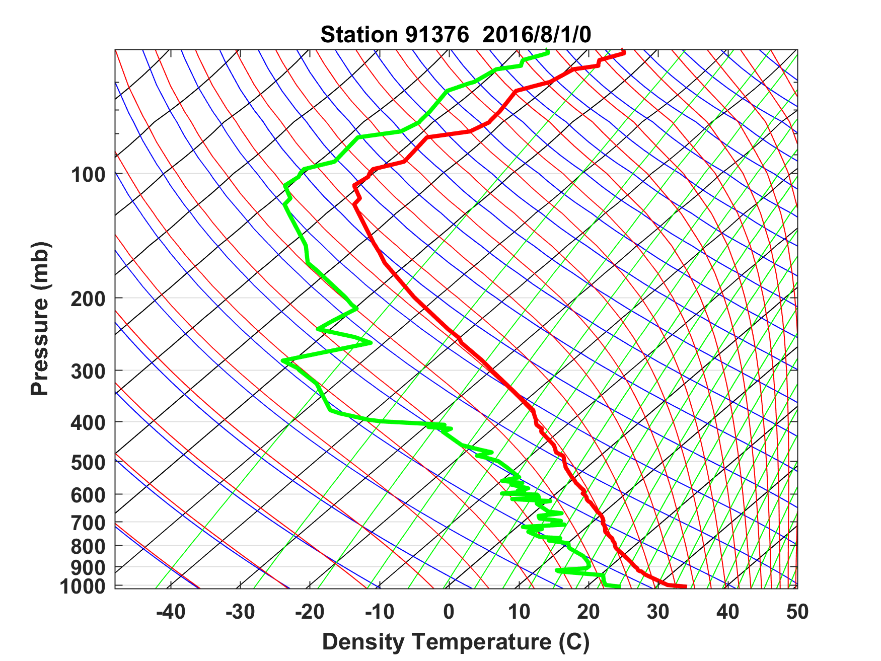
Sounding at Majuro, August 1 2016 0 GMT

Slide 6
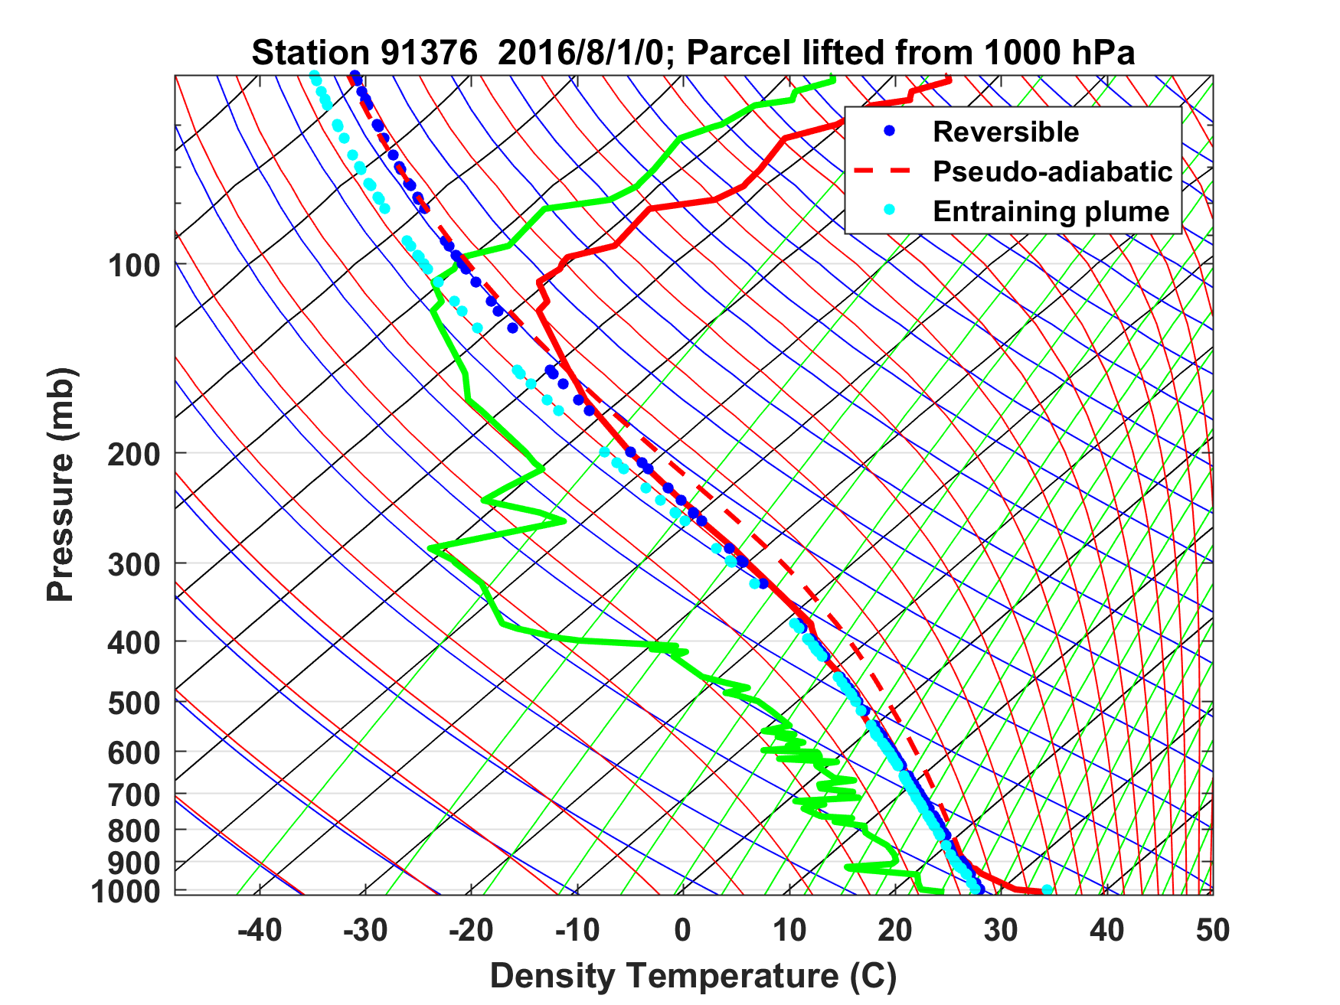
Sounding at Majuro, August 1 2016 0 GMT

Slide 7
Sounding at Majuro, August 1 2016 0 GMT

Slide 8
Introducing the ‘buoyancy potential temperature’, θ_{B}
The temperature an air parcel would have to have at a reference pressure such that when lifted reversibly from saturation, it would have the same density temperature as the air at a given pressure

Slide 9
Time-pressure section of θ_{B} at Majuro

Slide 10
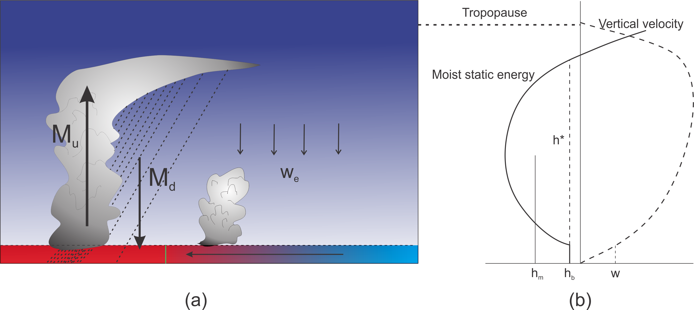
Boundary Layer Quasi-Equilibrium

Slide 11
Boundary Layer Quasi-Equilibrium

Slide 12
Free Troposphere Dry Static Energy

Slide 13
Free Troposphere Moisture:

Slide 14
Eliminate M_{d} and w_{e}:
+

Slide 15
Example 1:Radiative-Convective Equilibrium:

Slide 16
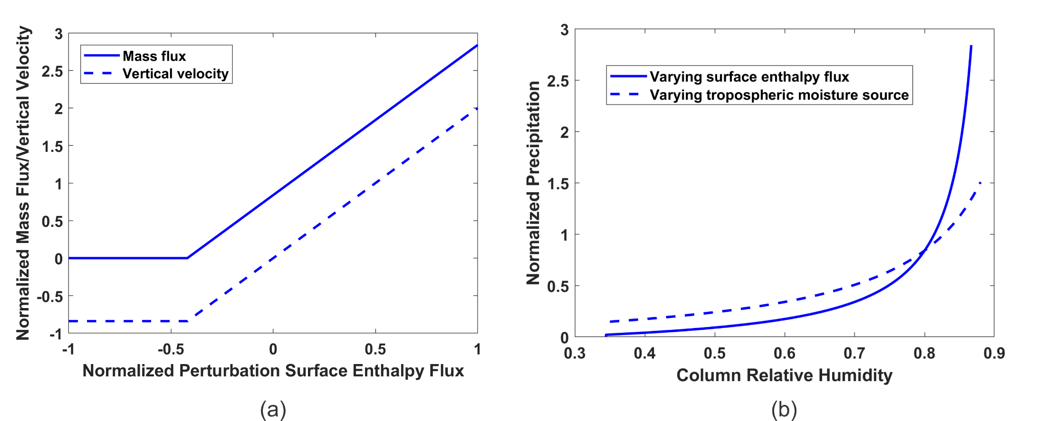
Precipitation vs. Column Water
Find steady solutions varying F_{h} while holding G and Q constant

Slide 17
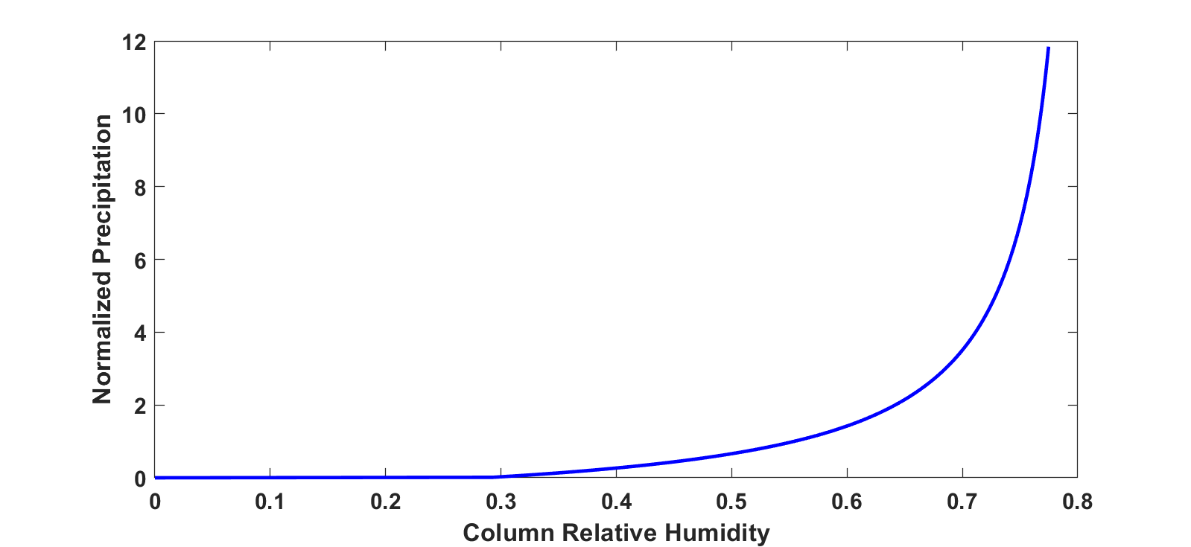
Precipitation vs. Column Water
Find steady solutions varying F_{h} while holding G and Q constant
From Bretherton, Peters, and Back, 2014
Column relative humidity

Slide 18
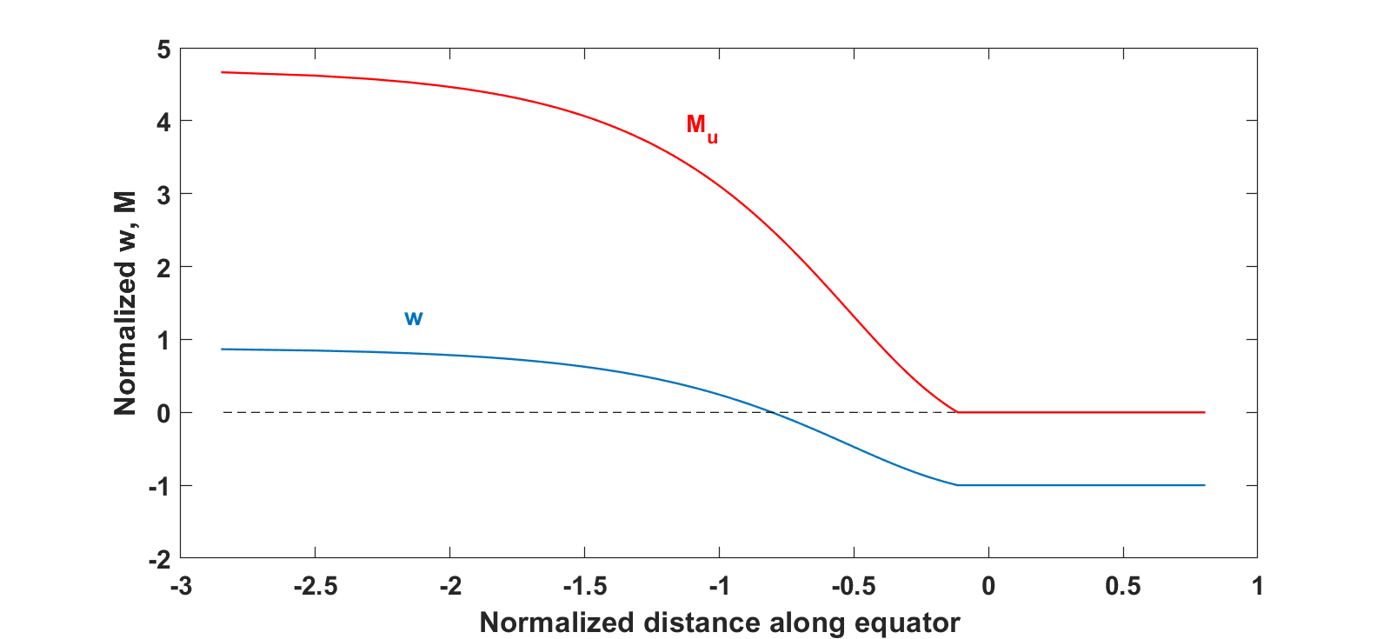
Walker Circulation
Again look for steady solutions

Slide 19
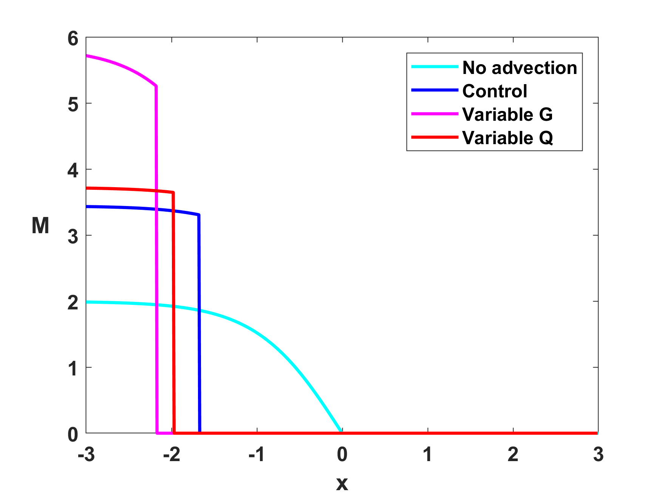
Effects of PBL horizontal advection, interactive radiation, and interactive gross moist stability:

Slide 20
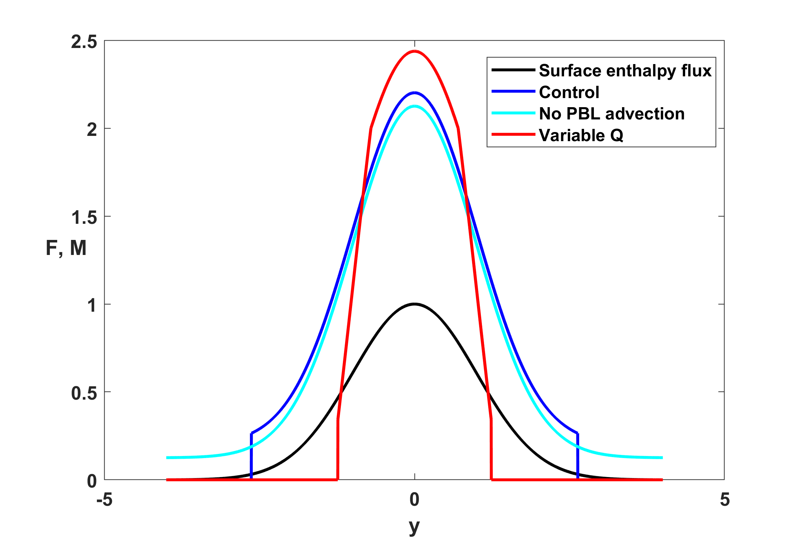
ITCZ Characteristics

Slide 21
Self-Aggregation of Convection
(less cooling in moister columns)
Can solve nonlinear, time-dependent problem starting from small perturbation to RCE state.

Slide 22
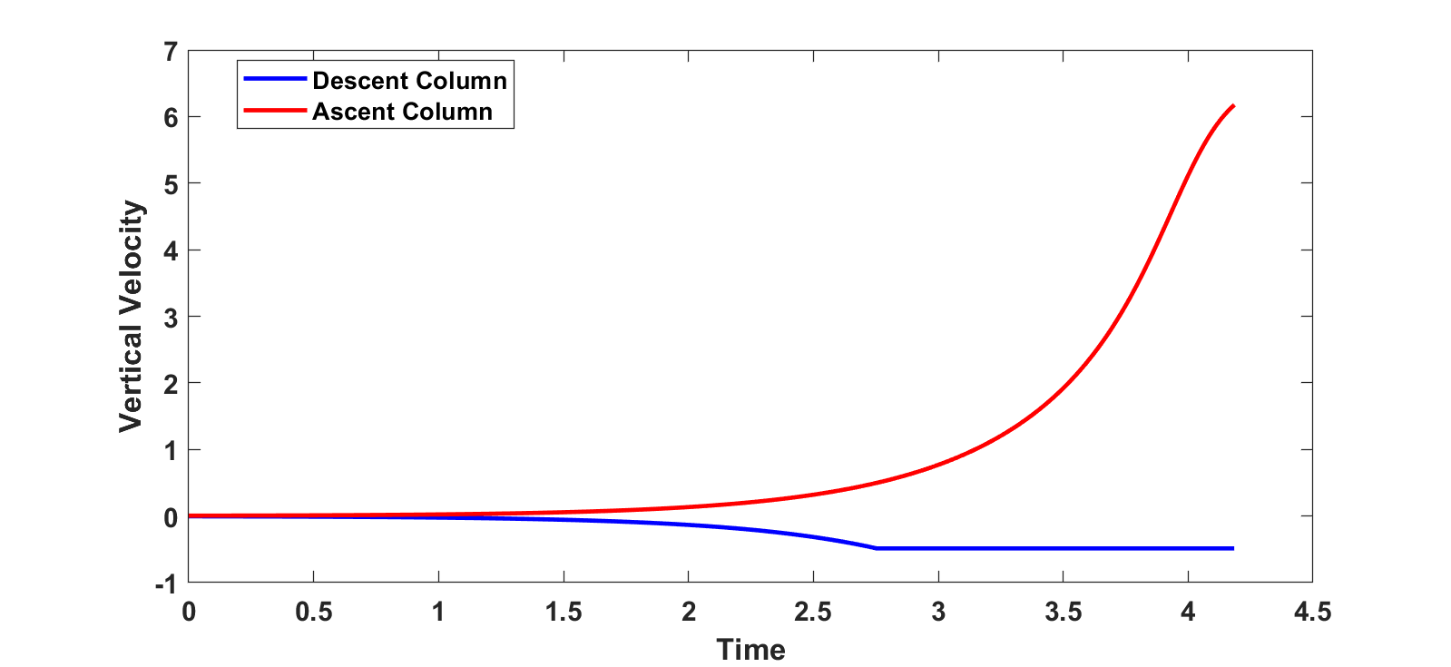
Full Nonlinear Analytic Solution:

Slide 23
Can a similar framework be developed for shallow convecting layers?
What’s similar:
  Cold pool properties suggest that PBL QE may also apply
  Column water vapor dominated by Trade PBL
  Virtual temperature of cloud layer may vary slowly compared to water vapor
What’s different
  Need a closure for PBL depth
  Fluxes of dry and moist static energy through top of convecting layer are probably important
  Precipitation efficiency is a strong function of layer depth
  Horizontal advection of moist static energy in cloud layer may be important:

Slide 24
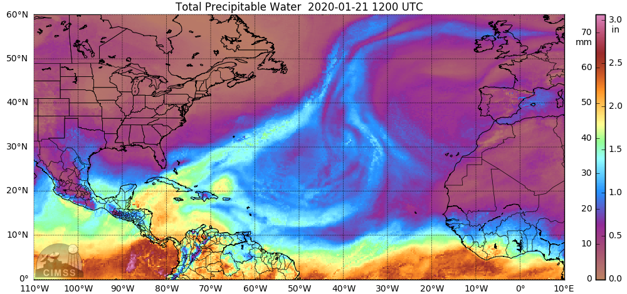

Slide 25
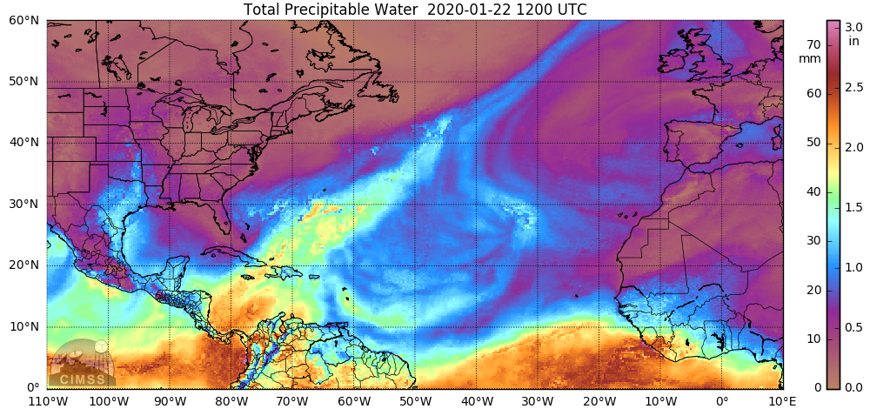

Slide 26
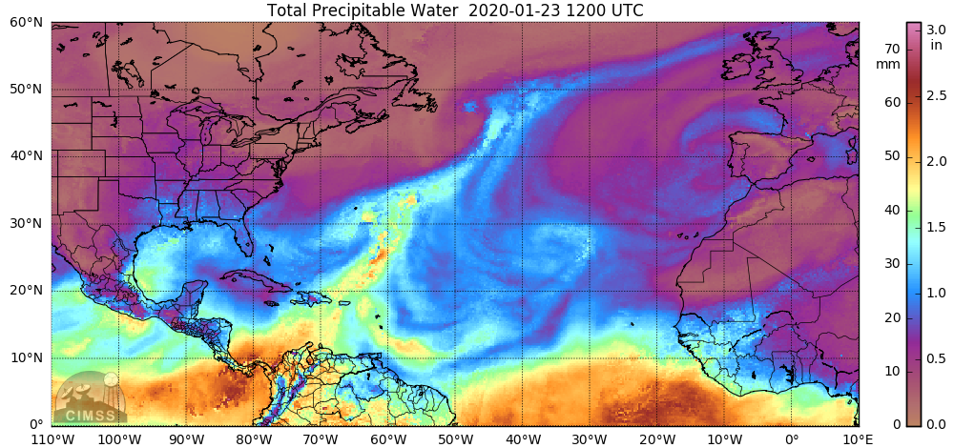

Slide 27
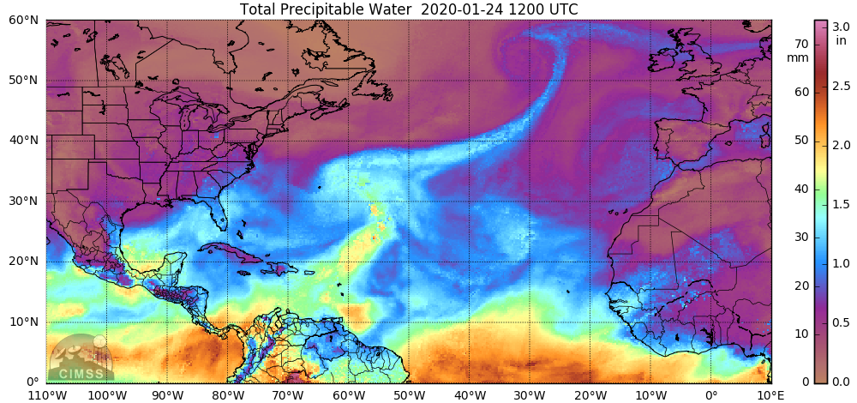

Slide 28
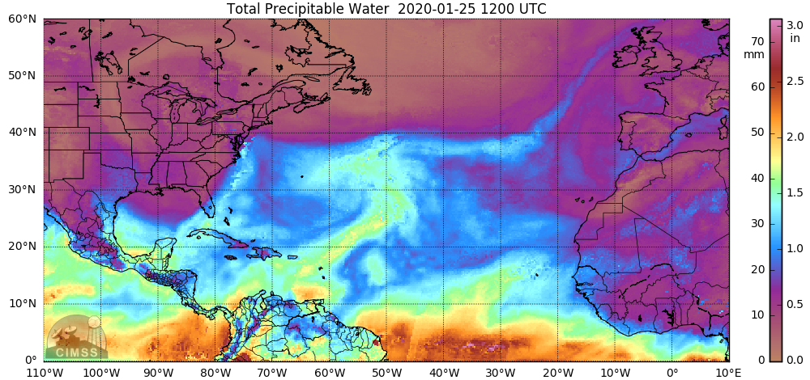

Slide 29
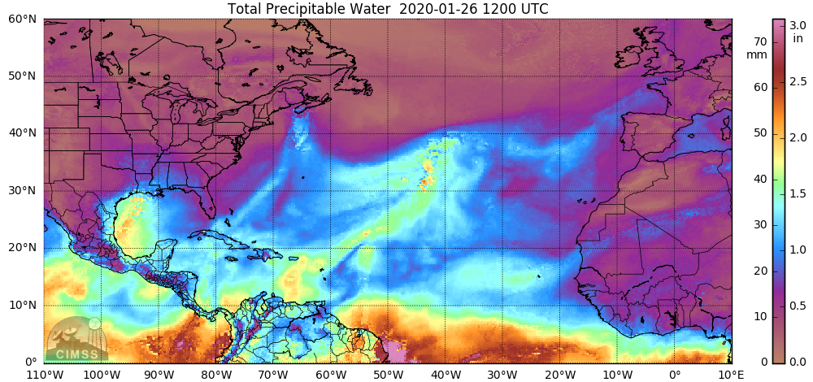

Slide 30
Time-height section of specific humidity at BCO
Column water vapor at BCO

Slide 31
Summary
Quasi-equilibrium of subcloud layer and free tropospheric energy are powerful constraints on tropical convective systems
Time-dependence of “slow” systems like the Walker Circulation and self-aggregation enters through tropospheric moisture (or moist static energy) equation
Basic properties of the tropical atmosphere, such as dependence of equilibrium moisture on cloud physics, relationship between column moisture and rainfall, Walker- type circulations, and self-aggregation, can be understood without resort to exotic formulations of entrainment or cloud physics
With some important modifications, this framework might be extendable to the case of shallow convective layers

Slide 32
