Slide 1

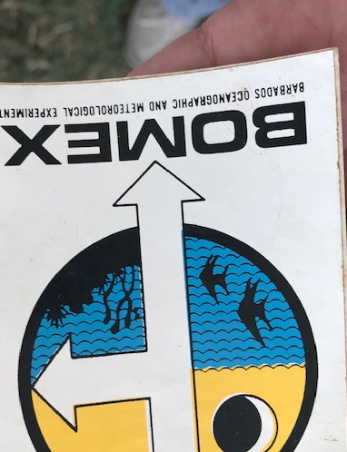
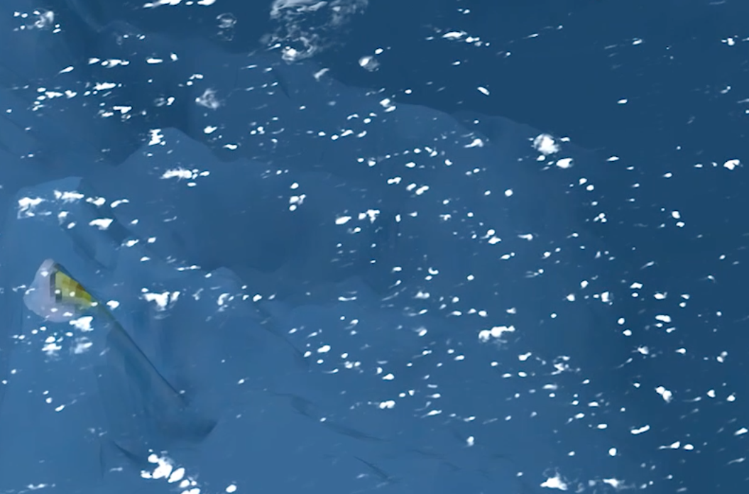
Large Eddy Simulations: from BOMEX to EUREC4A
Pier Siebesma
TU Delft & KNMI
a.p.siebesma@tudelft.nl
1969
2020
1992
2018

Slide 2
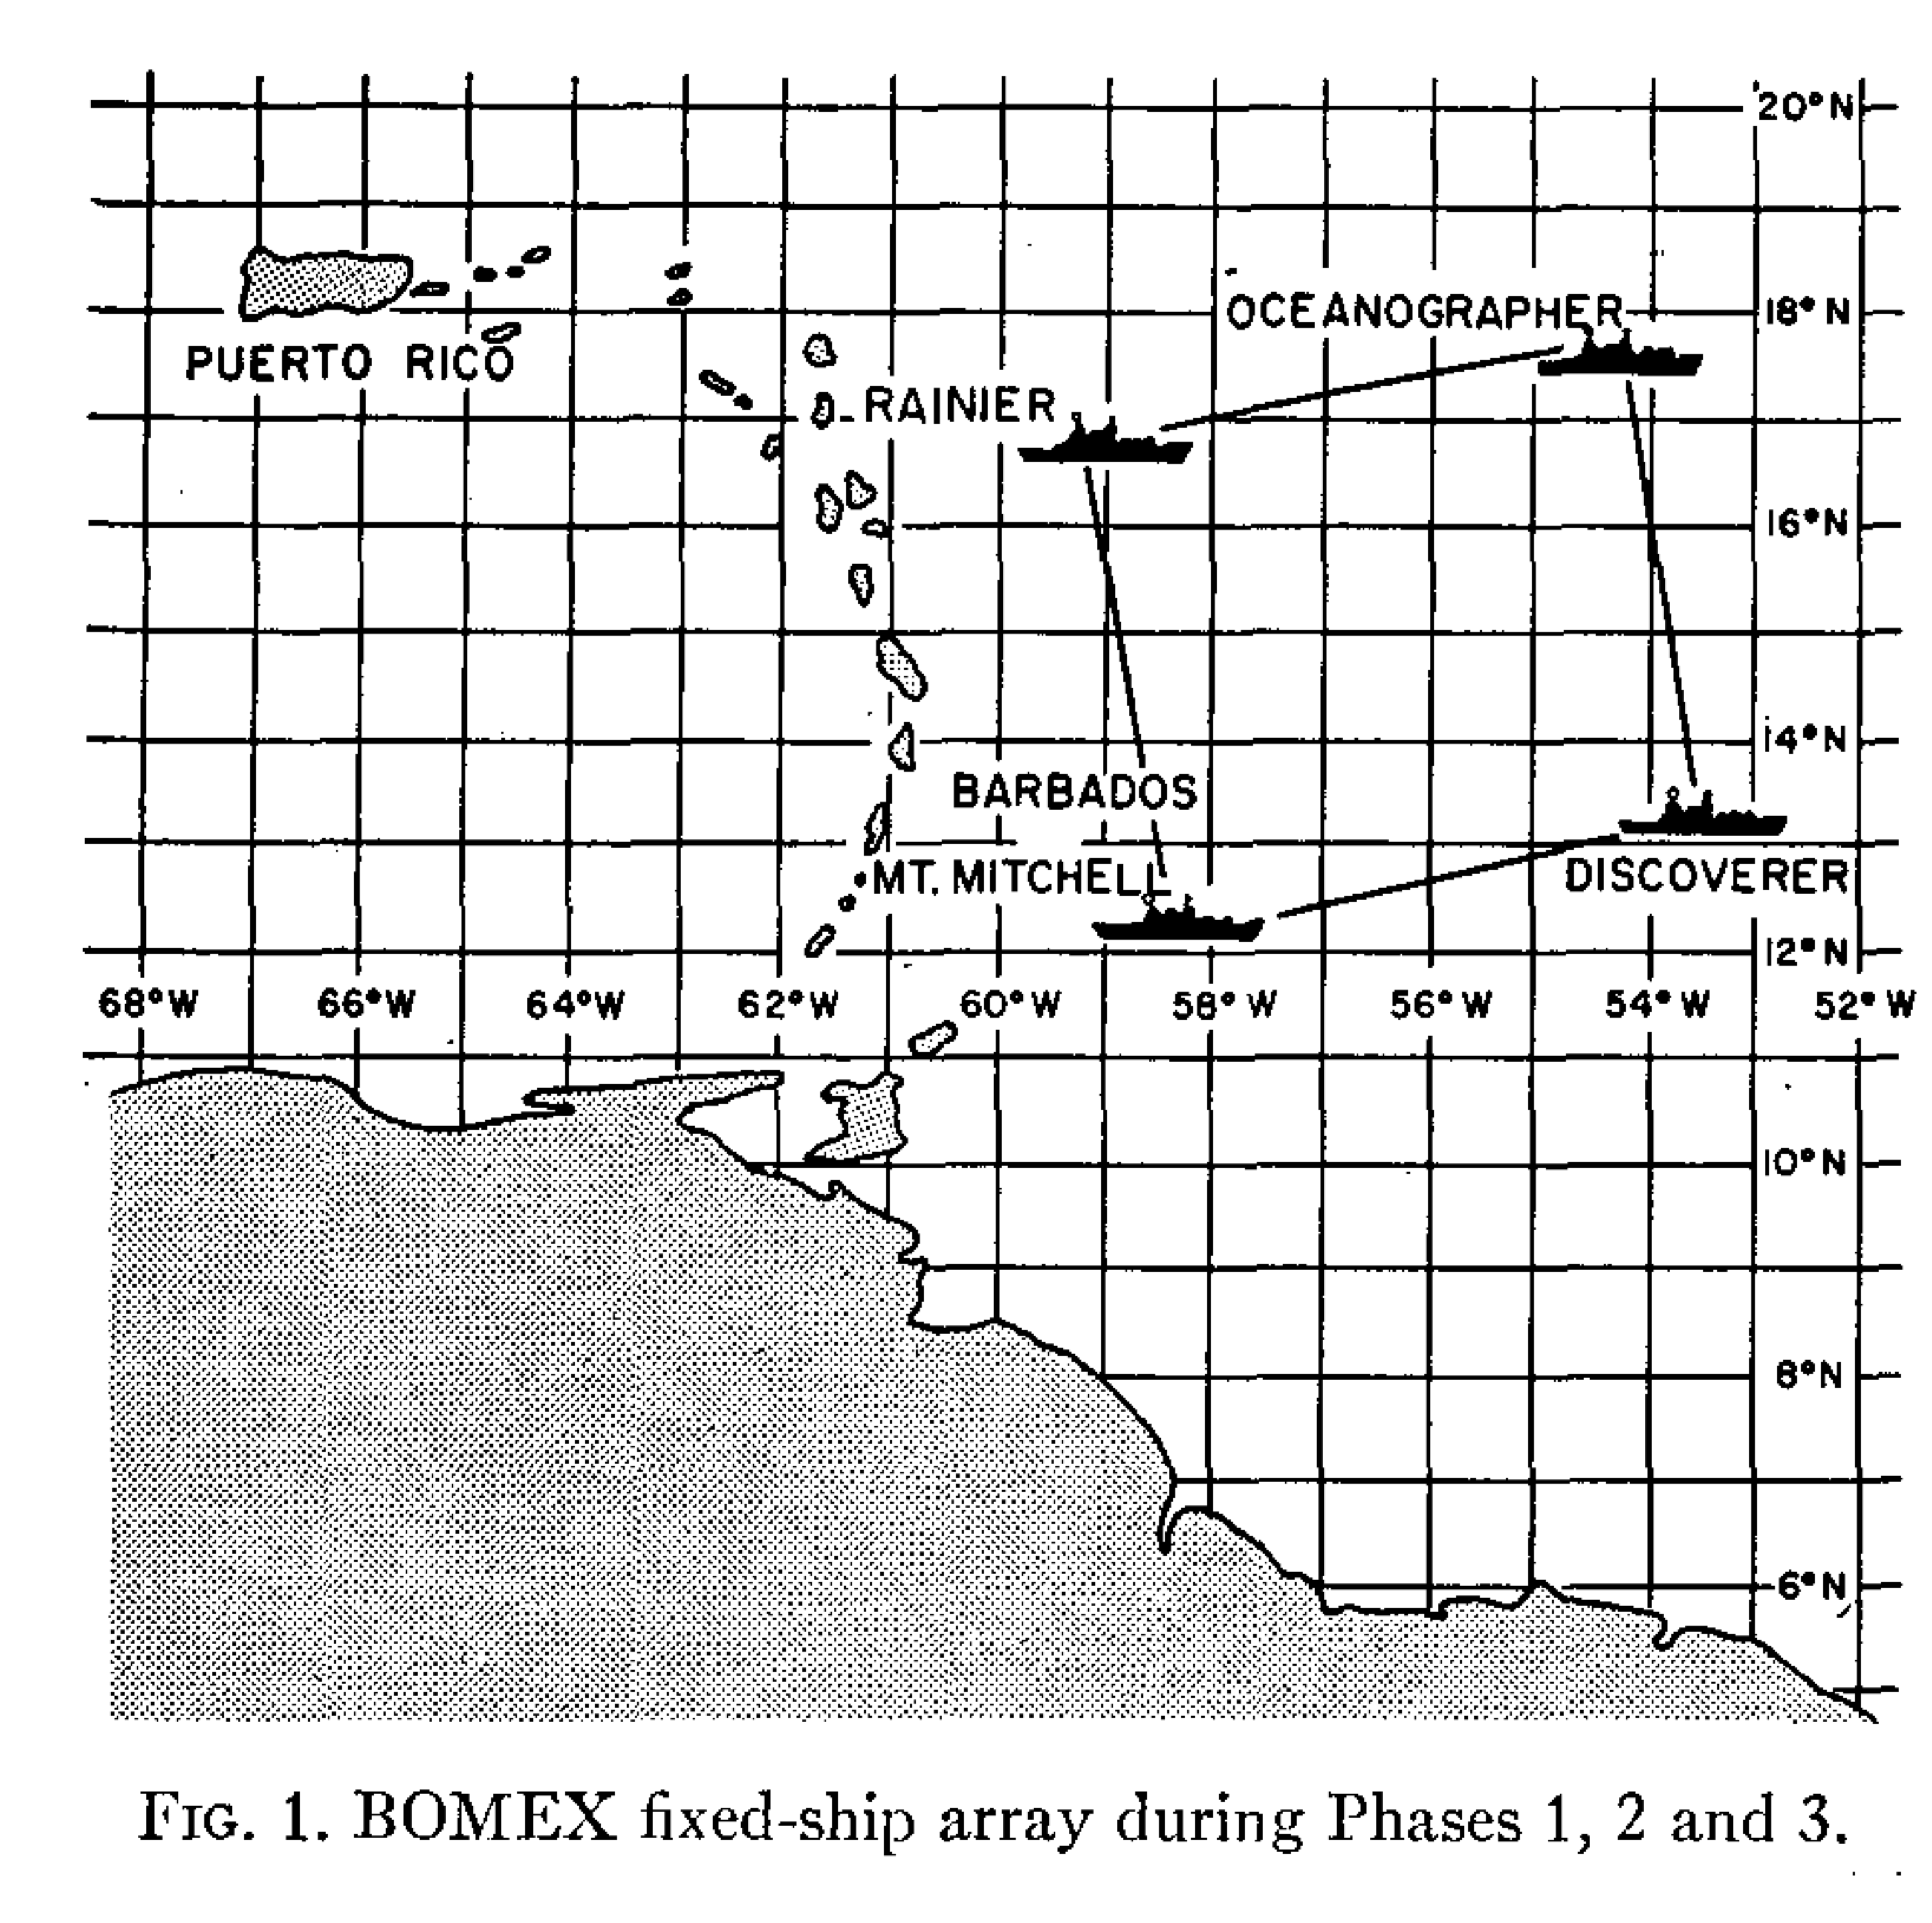

Slide 3
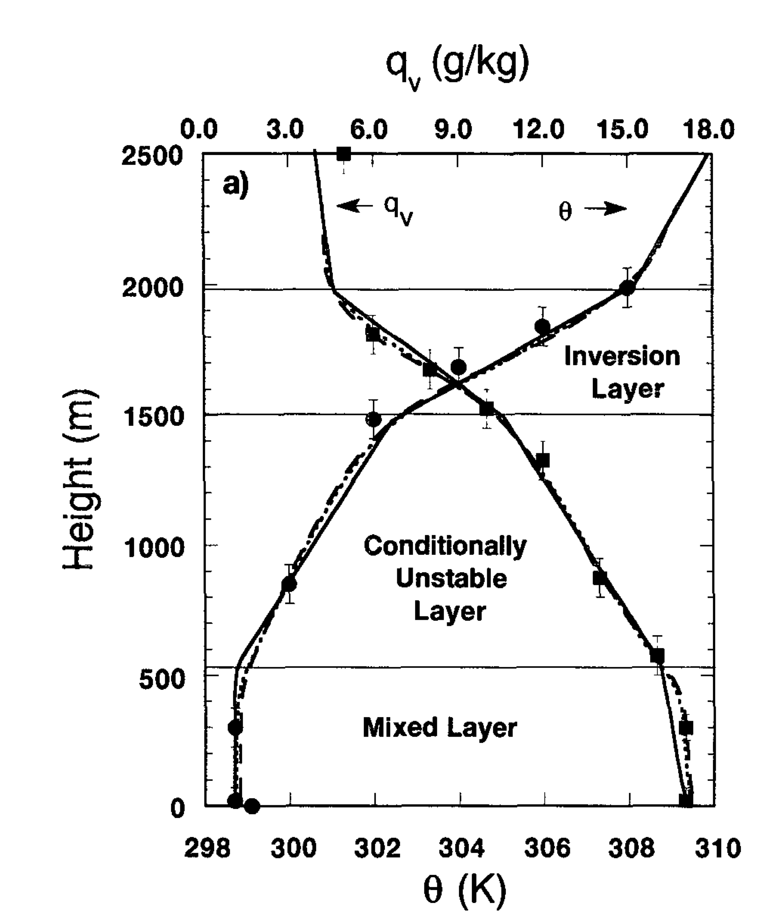
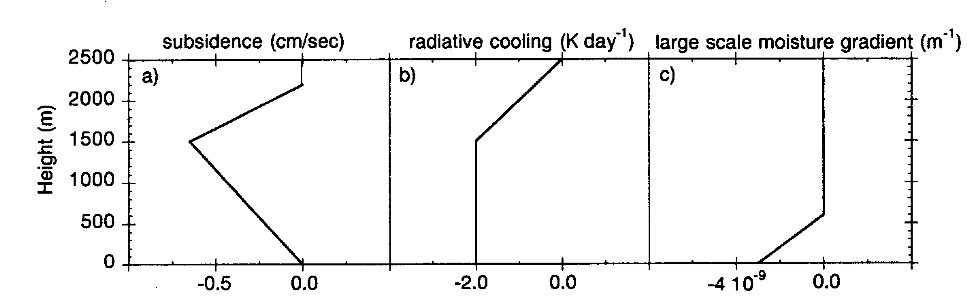
Well observed steady state….
Well observed large scale forcings….
Providing a simple but critical test for Large Eddy Simulations……
siebesma&cuijpers 95

Slide 4
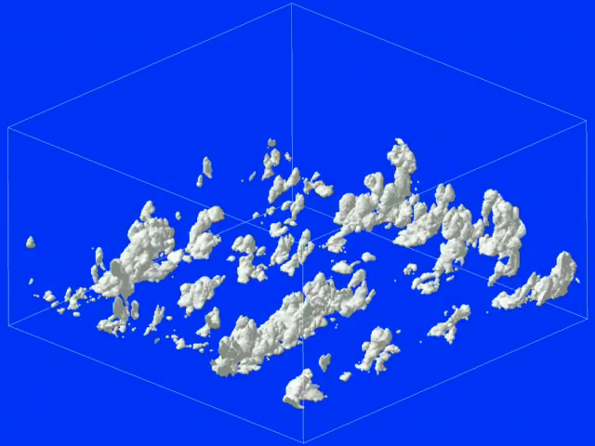
Conceptual Understanding
N independent entraining plumes
Similar Cloud Base
Many clouds: small and shallow…. Lesser clouds: high and deep.
Low Cloud cover ( ~ 15 % )
Transporting moisture and heat out of the boundary layer as to keep it in equilibrium

Slide 5
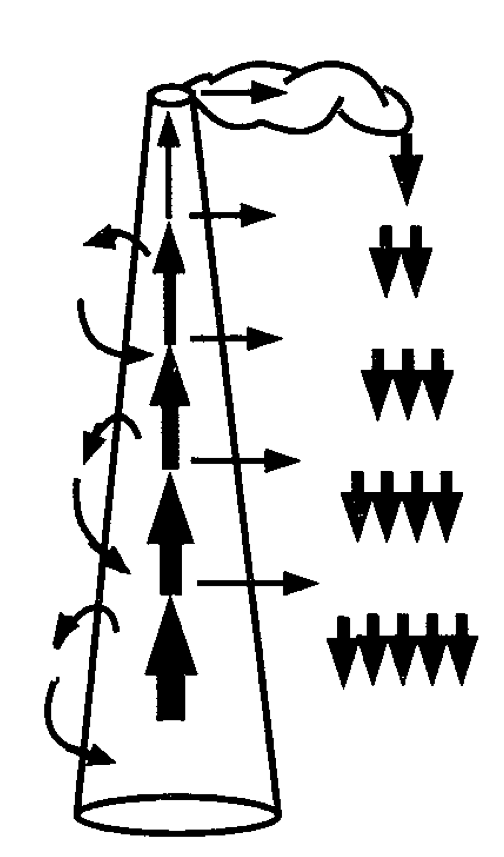
Practical Implications
The ”minimal” model for shallow convection
“Bulk” entraining/detraining plume
Tiedtke (1989)
…… is sufficient
leaking funnel
Provided that……proper diagnosed values of M, ε, δ are used ……

Slide 6
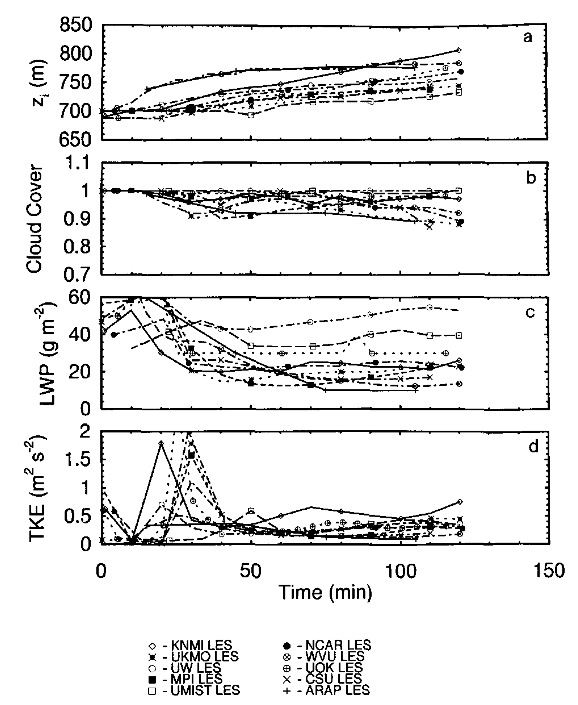
GEWEX Cloud System Intercomparison
Using LES as guideline for cloud and convection parameterizations
Initially focused on stratocumulus
moeng 95

Slide 7
GEWEX Cloud System Intercomparison
Using LES as guideline for cloud and convection parameterizations
Initially focused on stratocumulus
Often a spaghetti festival

Slide 8
GEWEX Cloud System Intercomparison
Using LES as guideline for cloud and convection parameterizations
But not for BOMEX:
Amazing agreement across models!
Even for higher order output parameters!
Problem solved?
mass flux
entrainment and detrainment
siebesma et al 2003

Slide 9

RICO
(November 2004- Jan2005)
Antigua-Barbuda
courtesy bjorn stevens

Slide 10
Relevance of Rain for trade wind cumulus
Observations
undisturbed period with rain
solid : with precipitation
stipled without precipitation
LES - ensemble
Precipitation slows down the growth of the cloud layer
liquid water
cloud fraction
rain
van Zanten et al 2011

Slide 11
Uncertainty in Precipitation for LES
orange : one-moment schemes
purple : two-moment schems
green : bin microphysical schemes
obs ~ 35 Wm²
No convergence with increasing complexity of microphysics scheme

Slide 12
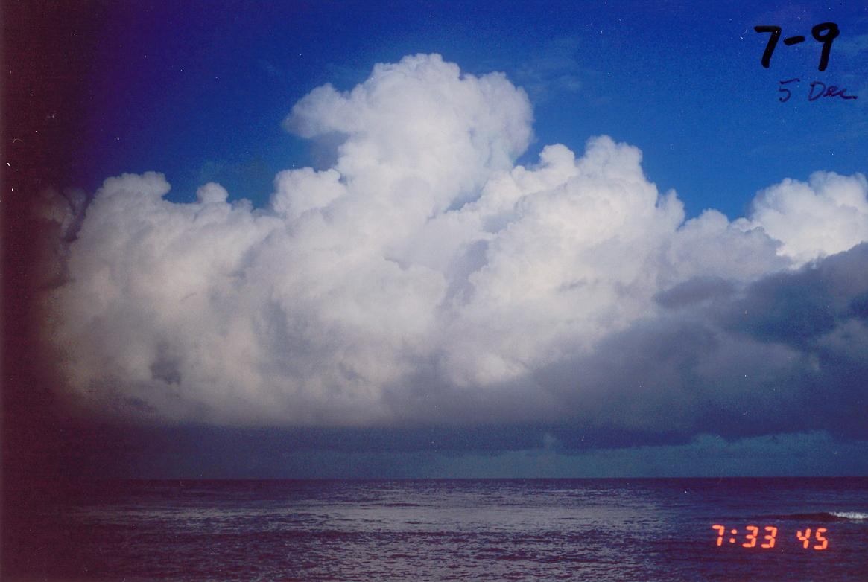

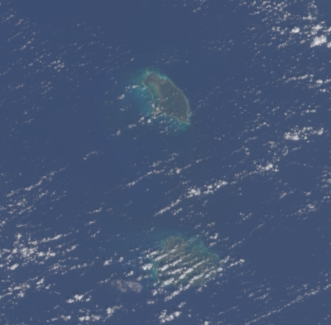
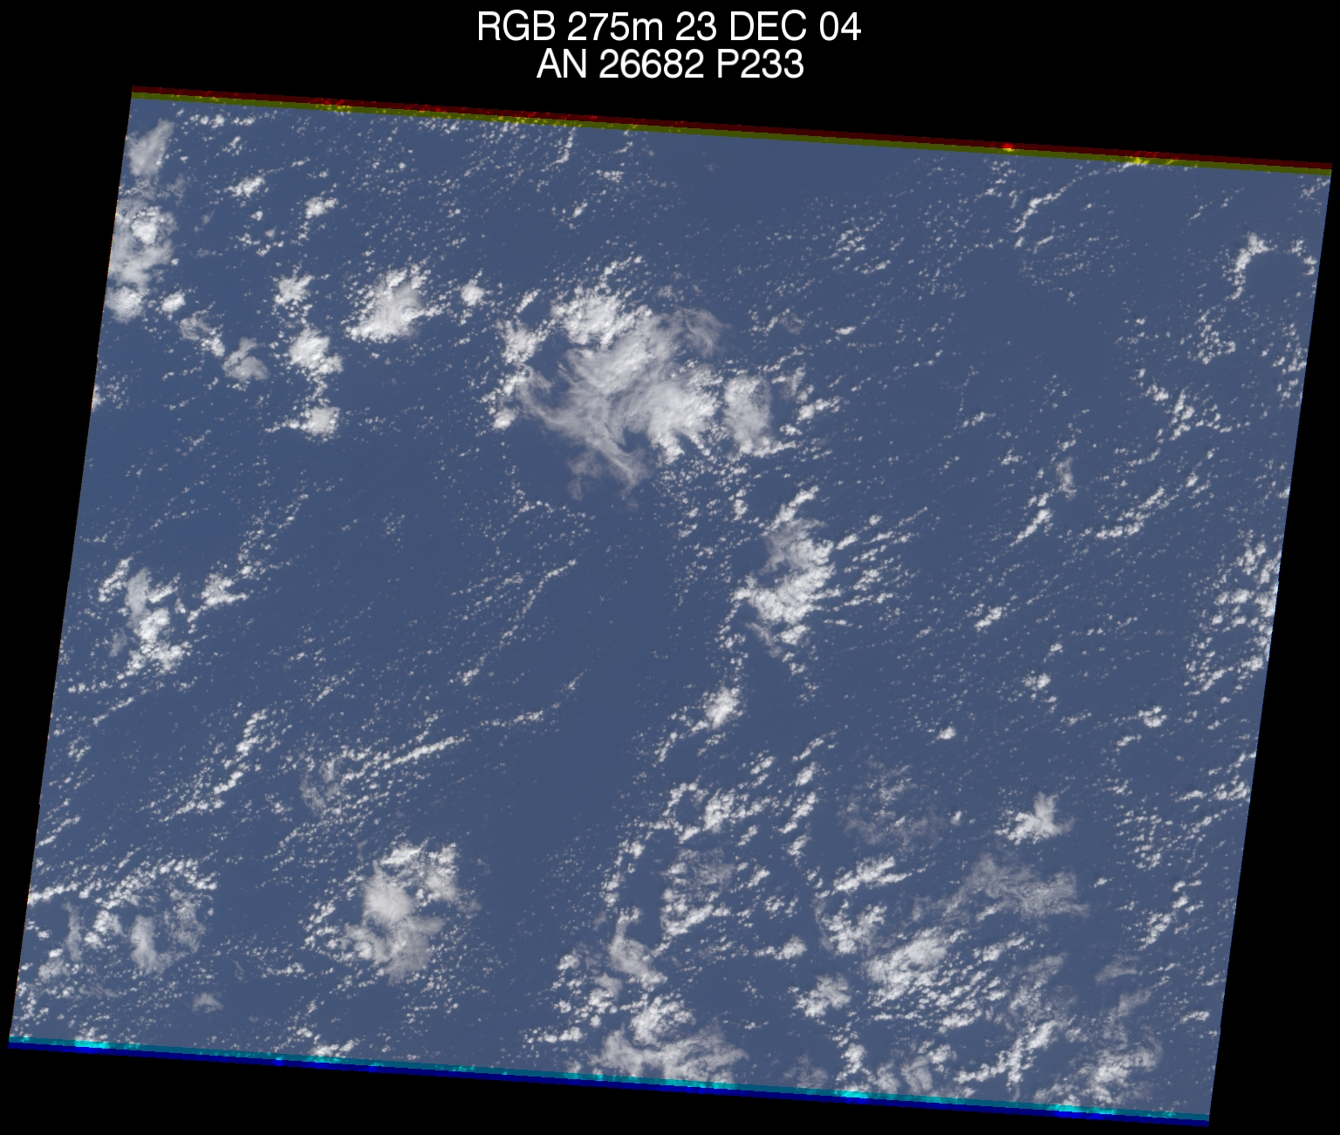
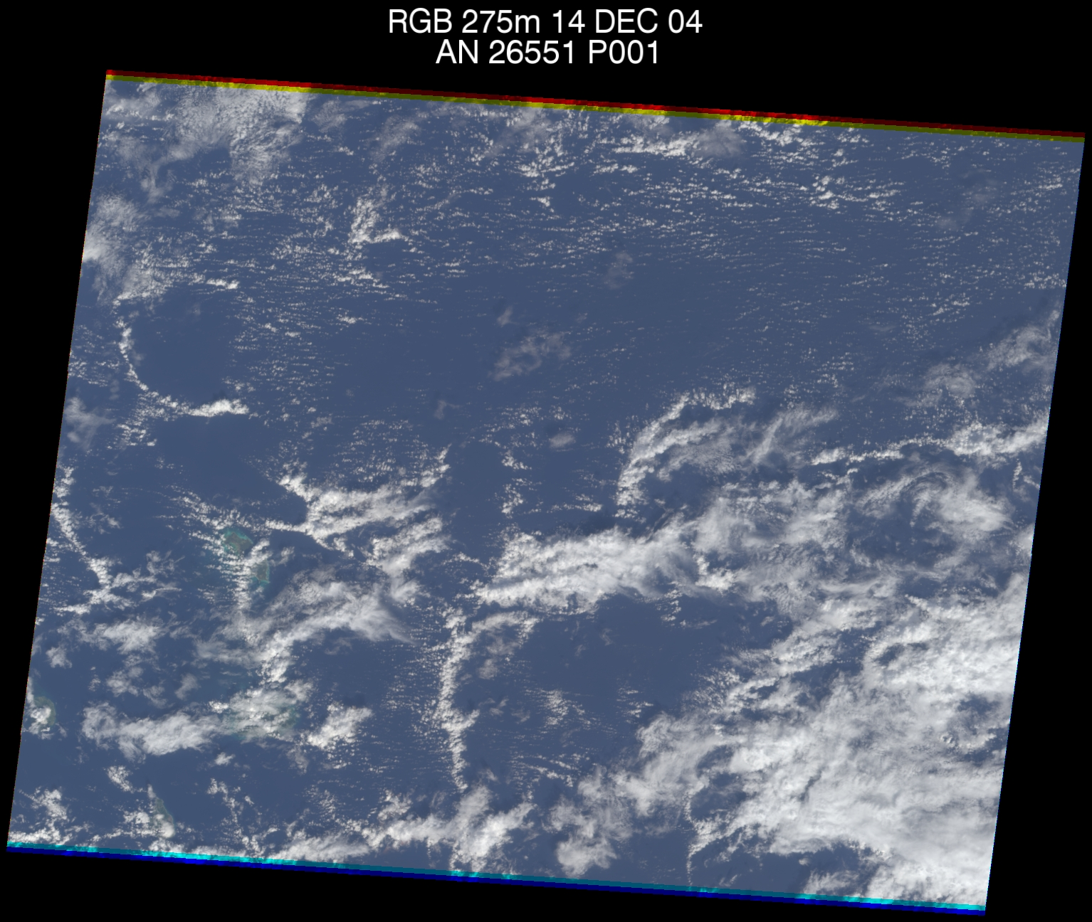
From the observationalists….
Zuidema, Girolamo, Snodgrass ……
Modes of Organization
Wind-parallel bands
Outflow bands
Clusters
Notes:
What are they:
- Shallow moist convection (dominate height, but they do reach to 5000m and are as thin as 100m)
- mainly trapped in the boundary layer (many break through as the convection becomes more organized)
- above freezing – so their development is governed by the warm rain process
Typically the organize into 3 modes of convection
Now that we have an idea of the clouds we are interested in.

Slide 13
Mesoscale organisation needs large domains…….
50 km domain 25m resolution
Seifert & Heus ACP (2013)
and Precipitation…..

Slide 14
Mesoscale organisation needs large domains…….
50 km domain 25m resolution
Seifert & Heus ACP (2013)
and Precipitation…..
or not?
Jonker et al 1999.
de Roode et al. 2004
Bretherton & Blossey 2017

Slide 15

Paradise Lost?
BOMEX induced worldview
Low positive cloud climate sensitivity

Slide 16
sugar
gravel
flowers
fish

Slide 17
EUREC4A simulations will shed new light on
How far off were we with our “BOMEX worldview”?
Can we reproduce the observed mesoscale variability?
Can we understand the observed mesoscale variability?
How variable are cloud fraction and mass flux (at base but also at top) really.
How does this affect climate sensitivity?

Slide 18
