Slide 1
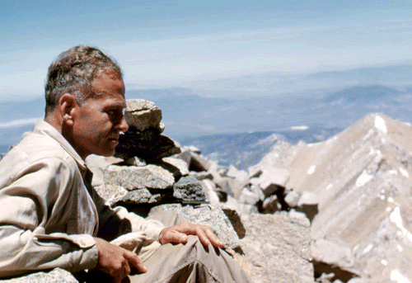
Contributions to tropical meteorology:
Herb Riehl in the Caribbean and beyond
Roger Pulwarty
NOAA
Lewis, Fearon, Klieforth, Garstang and others

Slide 2
Rossby’s requested increased training in tropical meteorology for Army Air Corps Cadets at five Universities (UC, MIT, CalTech, UCLA, NYU)
“They told me that one place was still available at New York University in a course in meteorology, whatever that was” (Riehl, pers comm.)
Riehl ventured into the study of low-latitude weather—the weather of the tropics and subtropics, that region of limited observations and poorly understood dynamical constraints.
His foray into this challenging scientific landscape set the stage for others to follow and he became known as the “father” of tropical meteorology” (Gray 1998)
Spilhaus and Gardner NYU 1940
Palmen and Rossby “Weather briefing” U Chicago. Tor Bergeron seated. 1947

Slide 3
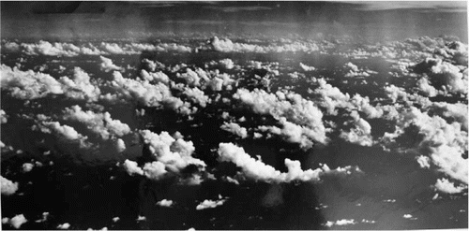
The establishment of the Institute of Tropical Meteorology Rio Piedras Puerto Rico
An Epiphany
On the first evening some of the staff walked along
the beach and admired the beauty of the trade
cumuli in the moonlight. Well schooled in the
ice-crystal theory of formation of rain, they had no
suspicions about these clouds with tops near 8,000
feet where the temperature is higher than +10°C.
Suddenly, however, the landscape ahead of them
began to dim; then it disappeared; a roar approached
as from rain hitting roof tops. When some minutes
later they stood on a porch, drenched and shivering,
they had realized that cloud tops with temperatures
below freezing were not needed for production of
heavy rain from trade-wind cumulus (Riehl 1954).
Trade wind cumuli 1946

Slide 4
T.C. Yeh (1948)
The problem of interest was the process of transferring momentum from the tropics to the midlatitudes. This group (in Rossby’s was the most active group [in the U of C’s Department of Meteorology
T.N. Krishnamurti (1959)
The subtropical jet stream of winter-We watched often the experienced style of Herbert Riehl where he could remove the noise from the important signal”
Robert Simpson (1962)
“as a classroom lecturer he had a reputation for making life quite difficult for students who showed little interest in his lectures”
Director National Hurricane Research Project, the forerunner of the Hurricane Research Division
Bill Gray (1963) On the scale and internal stress characteristic of the hurricane-
……………..any number of stories

Slide 5
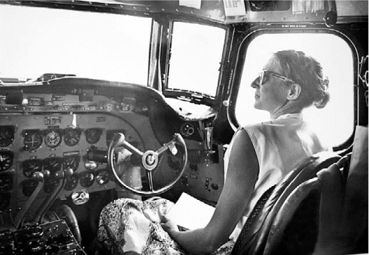
Joanne Malkus Simpson 1949
Entrainment into developing
cumulus—the exchange of mass between the rising
column of cloudy air and its environment
“The hypothesis by Stommel was revolutionary, but also very controversial at first. Once it was recognized that cumulus clouds exchanged air with their surroundings, a whole new area of research was opened. On this foundation, we could pioneer in recognizing the essential role of cumulus convection in tropical circulations”
JS in a DC-3 in preparation for taking observations over the Caribbean
“Research sessions with Riehl were intense and sometimes contentious, but never unproductive” (JS).
Exchanges were sharp 30 years after their collaborative work

Slide 6
“Joanne worked out the mathematical and physical
basis for how these clouds were responsible for
raising the height of the trade wind inversion and
then wetting the cloud layer and making it deeper
as the air flowed from the subtropical high down
to the equatorial trough”
Defining the lower-level structure of the atmosphere along a cross section that follows the average streamlines in the Trades (Riehl 1951)
The Riehl–Simpson collaboration
Formulation of a hypothesis related to the equator-to-pole heat budget - proposed that hemispheric thermal equilibrium could be achieved in the presence of select cumulonimbi that they called “hot towers.”-conjectured to effectively transport latent and sensible heat from the low-level marine
layer to the upper levels of the atmosphere
(1954, 1979)
Elucidating role and structure of the trades including Noel LaSeur and T.C. Yeh
(with very little insight from the models and obs at present)
Focus on genesis and structural maintenance of hurricanes
Riehl’s line drawing of a cumulus cloud breaking
through the trade wind inversion (1951)

Slide 7
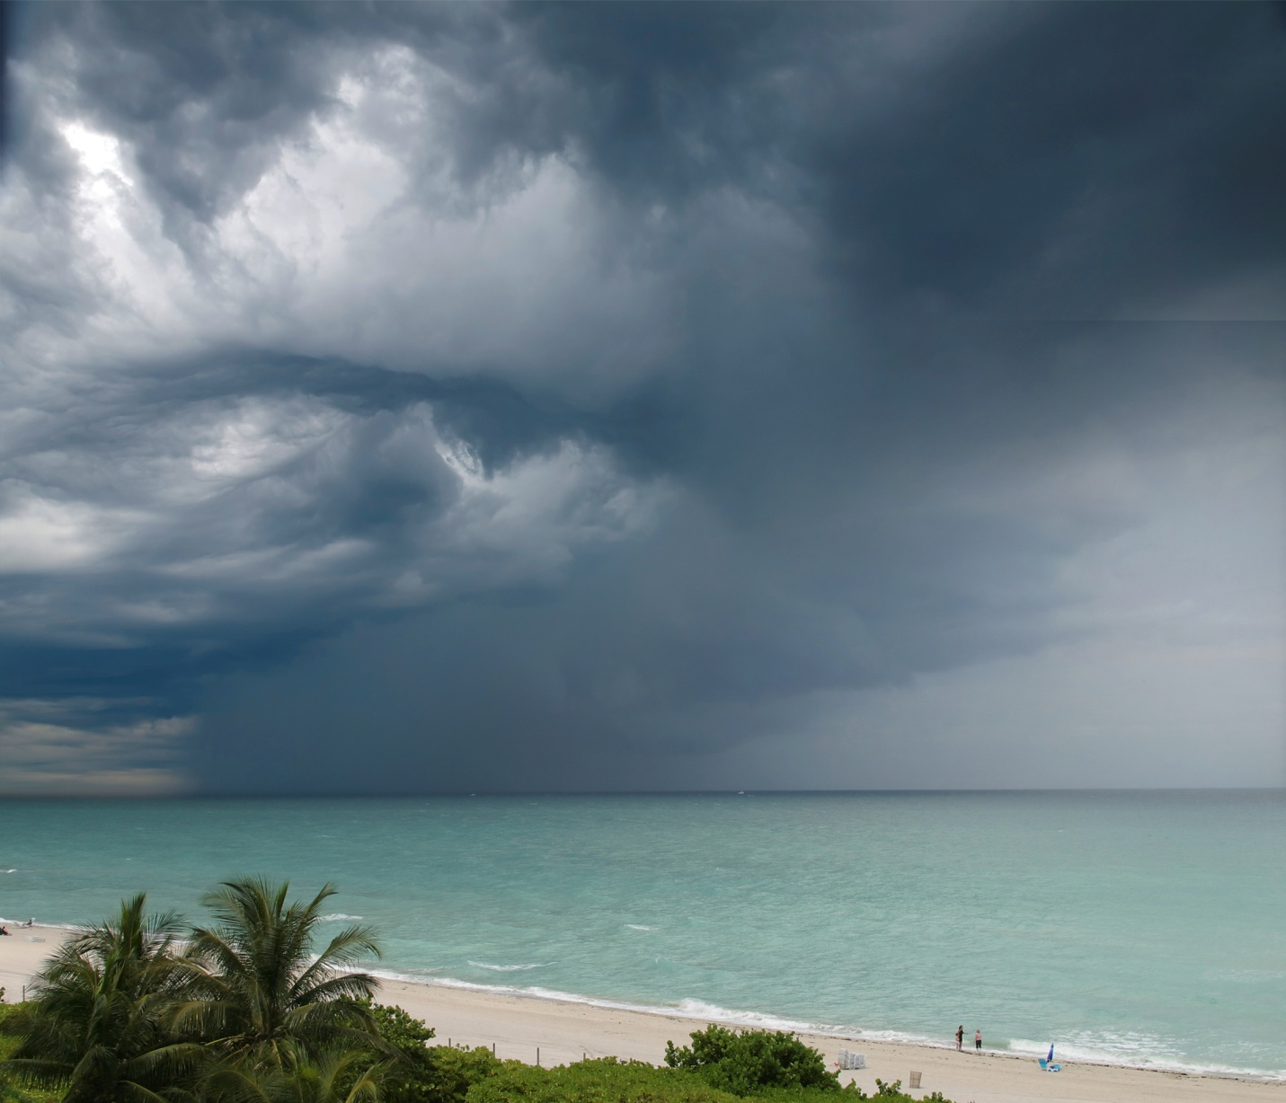
Two objectives of the 1968 experiment influenced subsequent field research and understanding:
the reliability and role of the fluxes of latent and sensible heat between the sea surface and the deeper atmosphere and
the coupling of the boundary layer and the convective cloud layer.
BOMEX (1969)
The water balance (evaporation) is a result of the downward advection of dry air from the subtropical anticyclone and upward transport from the sea surface, consistent with Riehl et al. (1951). Their estimated evaporation, however, may be overestimated by about 20%.
Numerous Riehl proteges- LaSeur, Zipser, Krishnamurti, others
(Garstang et al 2019

Slide 8
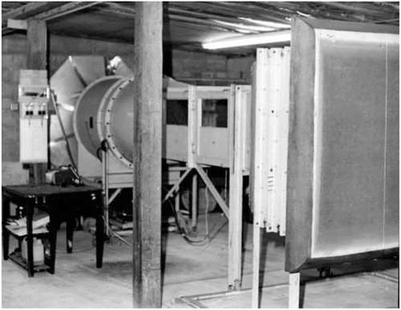
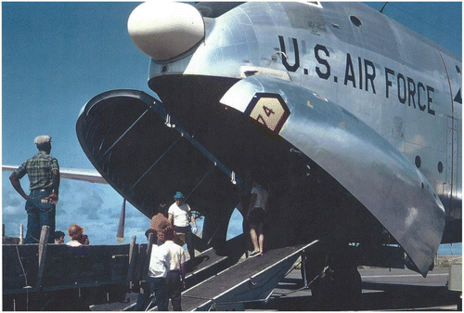
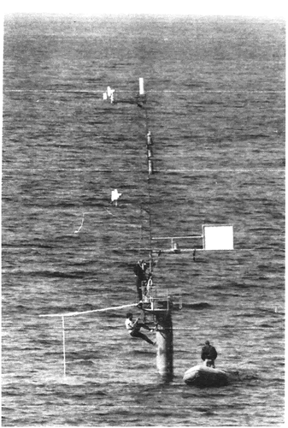
(Garstang et al 2019)
Wind tunnel to calibrate anemometers Caribbean Institute of Meteorology 1968
Georgia Air National Guard C-124 aircraft used to transport personnel and equipment to Barbados 1968
Triton deployment 1968
Vertical profiles of horizontal velocity divergence in units of 10−5 s–1 on the abscissa (solid) and the pressure differential relative to sea level in millibars on the ordinate (cross-dash).
Ship array during 1969 BOMEX; position of Triton buoy approximate

Slide 9
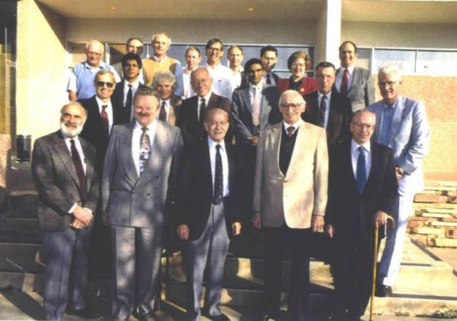
Jose Colon Director Puerto Rico Meteorological Service (First PhD in Meteorology 1960 from the Caribbean)
Florida State University
Colin Depradine CIMH Director
Bert Berridge CMO Director
Others?
Contributions to Tropical Meteorology ”The House That Herb built”
Riehl at 75. Colorado State University 1990
Notes:
Special gathering honoring Herb Riehl’s contribution to meteorology on his 75th birthday (1990)
1st Row (L to R):Â Fred Baer, Elmar Reiter, Herb Riehl, BOB SIMPSON, Ed Zipser.
Â
2nd Row (L to R):Â Russ Elsberry, Roger Pulwarty, Bob Grossman, Bill Marlatt, T.N. Krishnamurti, Pete Sinclair, Bill Gray.
Â
3rd Row (L to R):Â Lew Grant, Roland Madden, Tom Vonder Haar, Dick Johnson, Wayne Schubert, Roger Pielke, Sr., Raul Lopez, Evangelina Lopez, Steve Cox.
Special gathering honoring Hert Riehlâ€™s contribution to meteorology on his 75th birthday (1990)
Â
1st Row (L to R):Â Fred Baer, Elmar Reiter, Herb Riehl, BOB SIMPSON, Ed Zipser.
Â
2nd Row (L to R):Â Russ Elsberry, Roger Pulwarty, Bob Grossman, Bill Marlatt, T.N. Krishnamurti, Pete Sinclair, Bill Gray.
Â
3rd Row (L to R):Â Lew Grant, Roland Madden, Tom Vonder Haar, Dick Johnson, Wayne Schubert, Roger Pielke, Sr., Raul Lopez, Evangelina Lopez, Steve Cox.

Slide 10
“One of my memories of Professor Riehl’s group was that he asked us
to write down our ideas on what should be studied and put these
ideas in a little box. At the beginning of each month he took these ideas out of the box and we discussed them”
“Why do we see the clouds that we do, at this time of day?, along this terrain?”
“… it is not knowledge
or skills that protégés acquire from their masters
so much as a ‘style of thinking.’ It is problem finding
as much as problem solving” (Zuckerman 1977)
Quoted in: Herbert Riehl: Intrepid and Enigmatic Scholar
BAMS 2012

