Slide 1
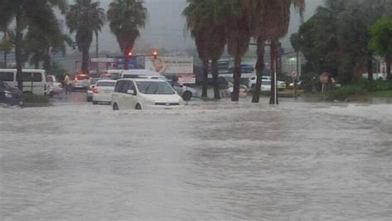
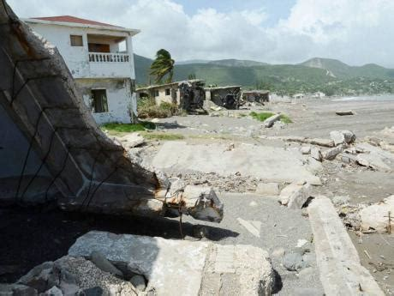
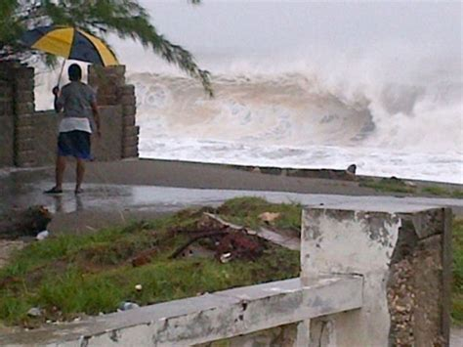
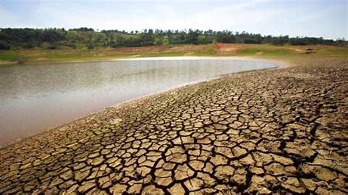
Exploring Caribbean Climatology Contributions from the Climate Studies Group Mona
Tannecia Stephenson
Department of Physics, The University of the West Indies
Mona Campus
February 1, 2020

Slide 2
CONTEXT 1
Climate Studies Group Mona (CSGM)
Established in 1994
To investigate and understand the mechanisms responsible for the mean and extreme Caribbean climate;
To use this understanding to predict climate on a seasonal and annual basis;
To investigate observed and projected Caribbean climate change and promote awareness of global climate change

Slide 3
CONTEXT 1
To investigate and promote the advantageous uses of climate prediction and projections in socio-economic sectors;
To investigate prospects of exploiting renewable energy resources for Jamaica;
Lecturers, students, practitioners across various sectors

Slide 4
CONTEXT 2
Caribbean Climate Modelling Consortium
Established in 2005
Provide Caribbean climate information at the scale of the Caribbean islands for the present and through the end of the century for developmental planning at the national and regional levels.

Slide 5
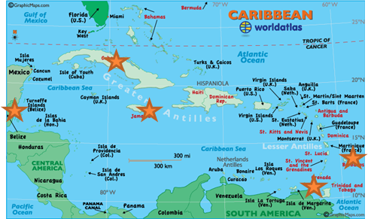
CONTEXT 2
In 2005: Barbados, Belize, Cuba, Jamaica;
In 2019: Barbados, Belize, Cuba, Guyana, Jamaica, St. Lucia, Suriname, Trinidad.
physics, meteorology, computer science
climate dynamics and modelling, meteorology, water, energy, agriculture, tourism, health, economics, policy, engineering, vulnerability and impacts and adaptation and mitigation.

Slide 6
CONTEXT 3

Slide 7
CONTENT: 6+3
6 Science Questions
3 Impacts Questions

Slide 8
CONTENT: 6+4
6 Science Questions

Slide 9
6 Science Questions
1. What are potential oceanic and atmospheric drivers of Caribbean seasonal rainfall variability?
Early season (MJJ) is influenced strongly by anomalies in the sea surface temperatures of the tropical North Atlantic. Warmer TNA -> Positive rainfall anomalies
The strong influence of the tropical North Atlantic wanes in the late season (ASO), with the equatorial Pacific and equatorial Atlantic becoming more significant modulators of interannual variability.
Warm Pacific + Cool Atlantic -> Depressed late season
Science Questions
Impacts Questions
Notes:
9

Slide 10
6 Science Questions
Similar investigations
Whereas traditionally ENSO events have been identified with dry conditions during the later Caribbean rainfall season, a second signal manifests itself as a wet early rainfall season of the year of ENSO decline (the El Nino +1 year).
ENSO has the greatest (concurrent) impact during the late rainfall season (ASO) and the early dry season (NDJ), whereas the tropical Atlantic controls variability in the early rainfall season (MJJ).
Science Questions
Impacts Questions
Notes:
10

Slide 11
6 Science Questions
2. What are characteristic features of the Caribbean low level jet and what are the drivers of its seasonal variability?
There is variability in the strength and zonal extent of the CLLJ which can be related to zonal SST gradients between the eastern equatorial Pacific and the north tropical and/or equatorial Atlantic.
Science Questions
Impacts Questions
Maps from SVD analysis of SSTA data and zonal wind anomalies.
Notes:
11

Slide 12
6 Science Questions
Similar investigations
Similar investigations look at how some regional (e.g. CLLJ) and global atmospheric and oceanic phenomena influence observed seasonal rainfall variability and may likely influence future seasonal rainfall variability.
The Caribbean region is projected to be drier during its traditional rainy season in the face of warmer surface temperatures under global warming.
The Caribbean seemingly enters into a “July” mode, which persists for the duration of the boreal summer. The mode is characterized by higher (lower) geopotentials in the Caribbean (Pacific and Atlantic), a stronger CLLJ, and anomalous descent in the Caribbean in spite of the warmer surface temperatures.
Science Questions
Impacts Questions
Notes:
12

Slide 13
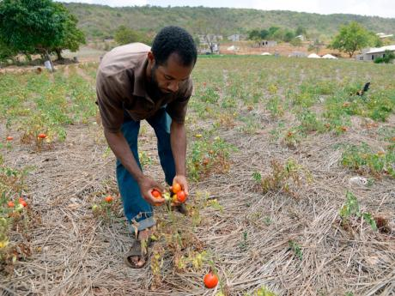
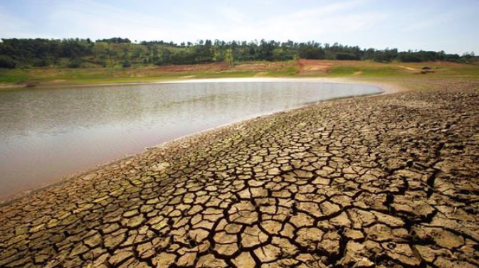
6 Science Questions
3. What are some characteristics of low frequency rainfall variability for Jamaica and what are some large scale features that potentially influence this variability?
Distinct wet and dry decades are observed across Jamaica where island wet periods are evident in 1900s, 1930 and 2000s and island wide drying is observed in the 1920s, 1950s, 1970s and 1980s.
Science Questions
Impacts Questions
C. Douglas, UWI, Mona, MPhil Thesis in prep.
Notes:
13

Slide 14
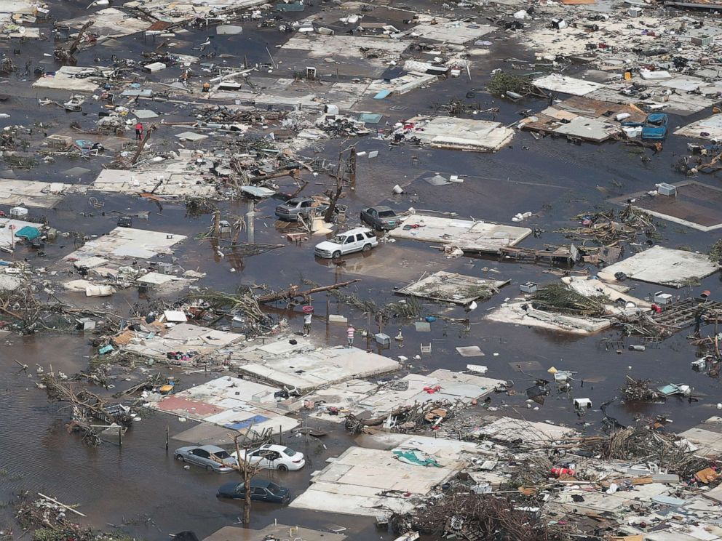
6 Science Questions
4. What are the trends observed in daily weather extremes for the Caribbean and what large-scale features may be associated with these trends?
Examined changes in daily rainfall and temperature extremes
Data: Meteorological station data
Participating countries: Antigua and Barbuda, Bahamas. Barbados, Belize, Cayman Islands, Cuba, Curaçao, Dominica, Dominican Republic, Grenada, Guadeloupe, Guyana, Puerto Rico St. Lucia, St. Kitts and Nevis, St. Vincent and the Grenadines, Suriname, Trinidad, Virgin Islands
Supporting countries: Canada, United States
Published in 2014
Funding: WMO, NOAA, 5C’s
Science Questions
Impacts Questions
Notes:
14

Slide 15
6 Science Questions
Positive trends in heavy rain events.
4. Trends in Climate Extremes
Science Questions
Impacts Questions
1961-2010
1986-2010
Notes:
15

Slide 16
6 Science Questions
Positive trends in heavy rain events.
4. Trends in Climate Extremes
Science Questions
Impacts Questions
Notes:
16

Slide 17
6 Science Questions
5. What do statistical models premised on operational forecast schemes suggest about future North Atlantic tropical cyclone frequency?
The 4 statistical models, created from backward regression, explain 24–48% of the observed variability in 1950–2008 annual TC frequency.
Models utilizing SST and near-surface wind predictors suggest significant increases in mean annual frequency by 2–8 TCs by 2070–2090, compared to a single surface wind predictor model
Wind-only models exhibit declines in TC frequency, while the SST gradient model yields little change relative to the present-day mean.
Science Questions
Impacts Questions
Notes:
17

Slide 18
6 Science Questions
5. What do statistical models premised on operational forecast schemes suggest about future tropical cyclone frequency?
Science Questions
Impacts Questions
Domains of predictor pools
Notes:
18

Slide 19
6 Science Questions
6. How will seasonal rainfall and temperature variability potentially change in response to global warming?
For the period 2071–2100, temperatures are projected to increase across the region by 1–4 °C for all months irrespective of the scenario (A2 and B2).
The rainfall response varies with season with one of the more robust changes being an intensification of a gradient pattern in November–January, in which the northern Caribbean (i.e. north of 22°N) gets wetter and the southern Caribbean gets drier. There is also a robust June–October drying signal.
Science Questions
Impacts Questions
Notes:
19

Slide 20
6 Science Questions
6. Similar Investigations
Future mean and extreme rainfall and temperature are examined using a super-high-resolution atmospheric general circulation model (20 km) and statistical downscaling methods.
A 10-member ensemble from phase 5 of the Coupled Model Intercomparison Project (CMIP5) is used to analyze the Caribbean’s future climate when mean global surface air temperatures are 1.5°, 2.0°, and 2.5°C above preindustrial (1861–1900) values.
Science Questions
Impacts Questions
Notes:
20

Slide 21
CONTENT: 6+3
6 Science Questions
3 Impacts Questions

Slide 22
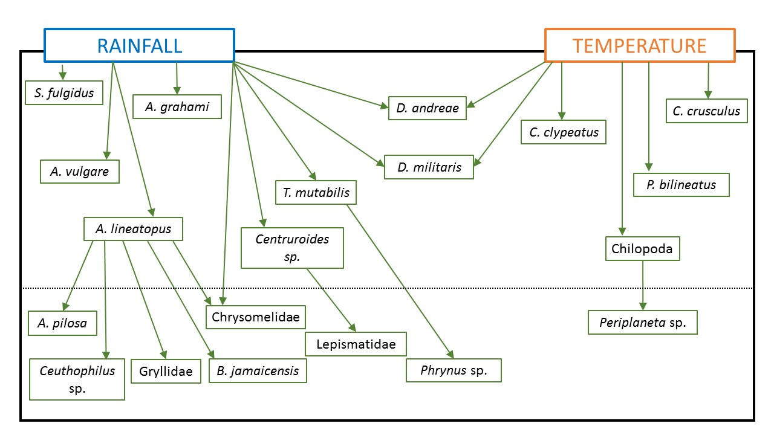
3 Impacts Questions
1. What are likely impacts of climate variability and change on abundance of fauna in the Hellshire Hills, Jamaica?
Statistical models linking climate predictors to fauna were obtained for 22 of 22 taxa under study.
Marginally stronger influence of rainfall was noted. Most of the models retained only one predictor. More rainfall -> Greater abundance
Science Questions
Impacts Questions
K. Stephenson (2017). Modelling the Impact of Climate Change on a Dry Forest Fauna. Ph.D. Thesis.
Notes:
22

Slide 23
Simple model schematic diagram
Arrows indicate connections among model predictors (start of arrow) and predictands (end of arrow). Diagram does not imply order of prediction.
Notes:
Emphasize that it’s often similarities in optimal climatic conditions
Simple, comprehensive, climate based

Slide 24
3 Impacts Questions
2. How do the past and future comparative vulnerabilities of some Caribbean countries change when extreme precipitation events are considered in aggregate vulnerability index analyses?
Results suggest that the inclusion of historical susceptibility to rainfall extremes influences relative vulnerabilities within the Caribbean when compared to the rankings of vulnerability derived using only socioeconomic and demographic inputs. In some cases significant increases in relative rankings are noted.
Projected changes in the intensity of rain events across the Caribbean region in the 2030s and 2050s, do not significantly alter the top and lowest ranked vulnerable locations when demographic and socioeconomic indices are held constant.
Science Questions
Impacts Questions
Notes:
24

Slide 25
3 Impacts Questions
2. How do the past and future comparative vulnerabilities of some Caribbean countries change when extreme precipitation events are considered in aggregate vulnerability index analyses?
Science Questions
Impacts Questions
Vulnerability ranking from socioeconomic and demographic indicators
Vulnerability ranking from socioeconomic, demographic & climate
Historical analyses
Notes:
25

Slide 26
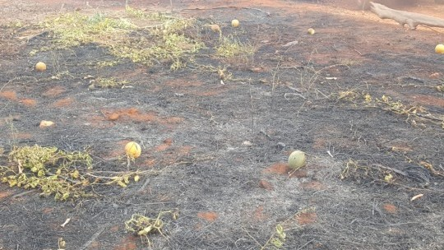
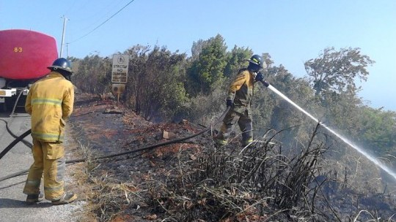
3 Impacts Questions
African Caribbean Pacific-European Union-Caribbean Development Bank Natural Disaster Risk Management (ACP-EU-CDB NDRM)
3. What are primary climate drivers of bush fire variability for Jamaica and what do these drivers suggest about future fire variability for the island?
Aims:
Datasets:
Science Questions
Impacts Questions
To characterize bushfire variability in Jamaica;
To investigate the predictability of bushfire occurrences in Jamaica
Station data: rainfall, mean temperature, relative humidity;
Fire data compiled by the Jamaica Fire Brigade; NASA MODIS C6 Fire Data
Funders: ACP- EU- CDB NDRM
Notes:
26

Slide 27
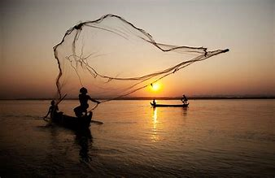
3 Impacts Questions
Similar Investigations
Similar investigations examine the impact of climate variability and change on stream flow, flood risk, animal heat stress, milk production in dairy cattle, sweet potato yields and vulnerabilities in the fisheries sector.
Science Questions
Impacts Questions
Notes:
27

Slide 28
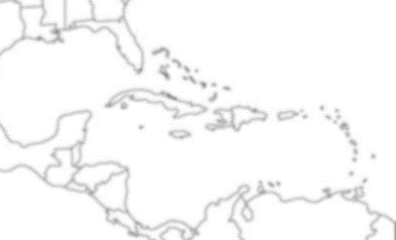
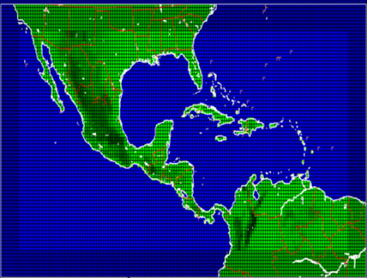
There’s lots more questions to be answered…
Hurricane analysis – the future Caribbean vulnerability
Cost of climate variability & change – sector and regional
Drought and the multi-hazard dilemma
Dynamics of climate variability & change
Sea level rise and the interaction with coastal societies
Caribbean Modellers Consortium
Attribution studies – anthropogenic?
Geo-engineering
Sector modelling – health, tourism, infrastructure, biodiversity?
Regional Climate modelling - SSPs
Loss & damage
the challenge
the response
the contribution
Notes:
28

Slide 29
CONTENT: 6+3
6 Science Questions
3 Impacts Questions
Thank you for listening

