Slide 1
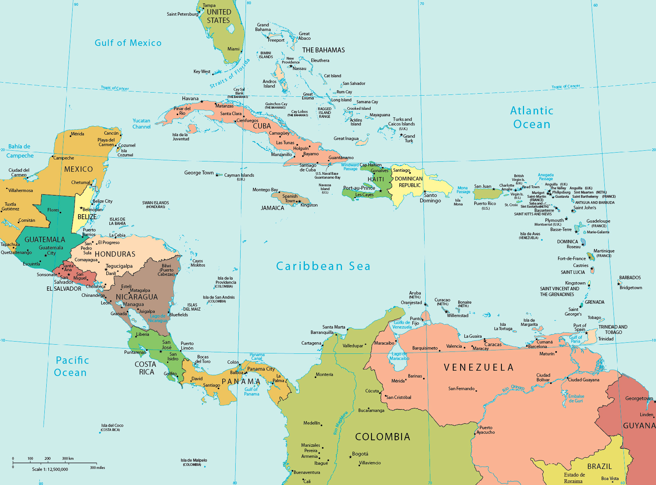
Hurricane Heat Trails
and Their Impact on Caribbean “Heat Waves”
Teddy Allen
tallen@cimh.edu.bb
Caribbean Institute for Meteorology and Hydrology, Barbados
Zack Guido, Univ. of Arizona Tucson
Firoz Abdoel Wahid, Tulane Univ. School of Public Health and Tropical Medicine
Theodore Allen, Caribbean Institute for Meteorology and Hydrology
Hannah Covert, Tulane Univ. School of Public Health and Tropical Medicine
Jazmin Diaz Rivera, Univ. of Puerto Rico-Medical Sciences Campus
Benét Duncan, Western Water Assessment, University of Colorado
Jennifer Henderson, CIRES, University of Colorado
Pablo A Mendez-Lazaro, University of Puerto Rico-Medical Sciences Campus
Maureen Y. Lichtveld, Tulane Univ. School of Public Health and Tropical Medicine
Simon J. Mason, International Research Institute for Climate and Society
Jennifer Spinney, CIRES, University of Colorado, Boulder, CO
Notes:
intro

Slide 2
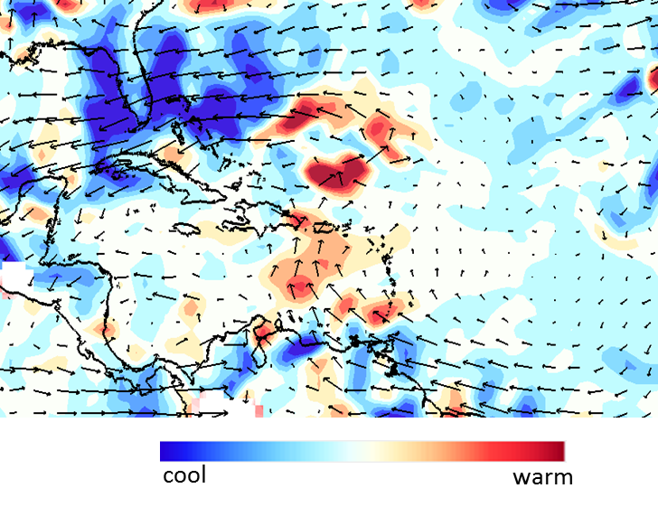
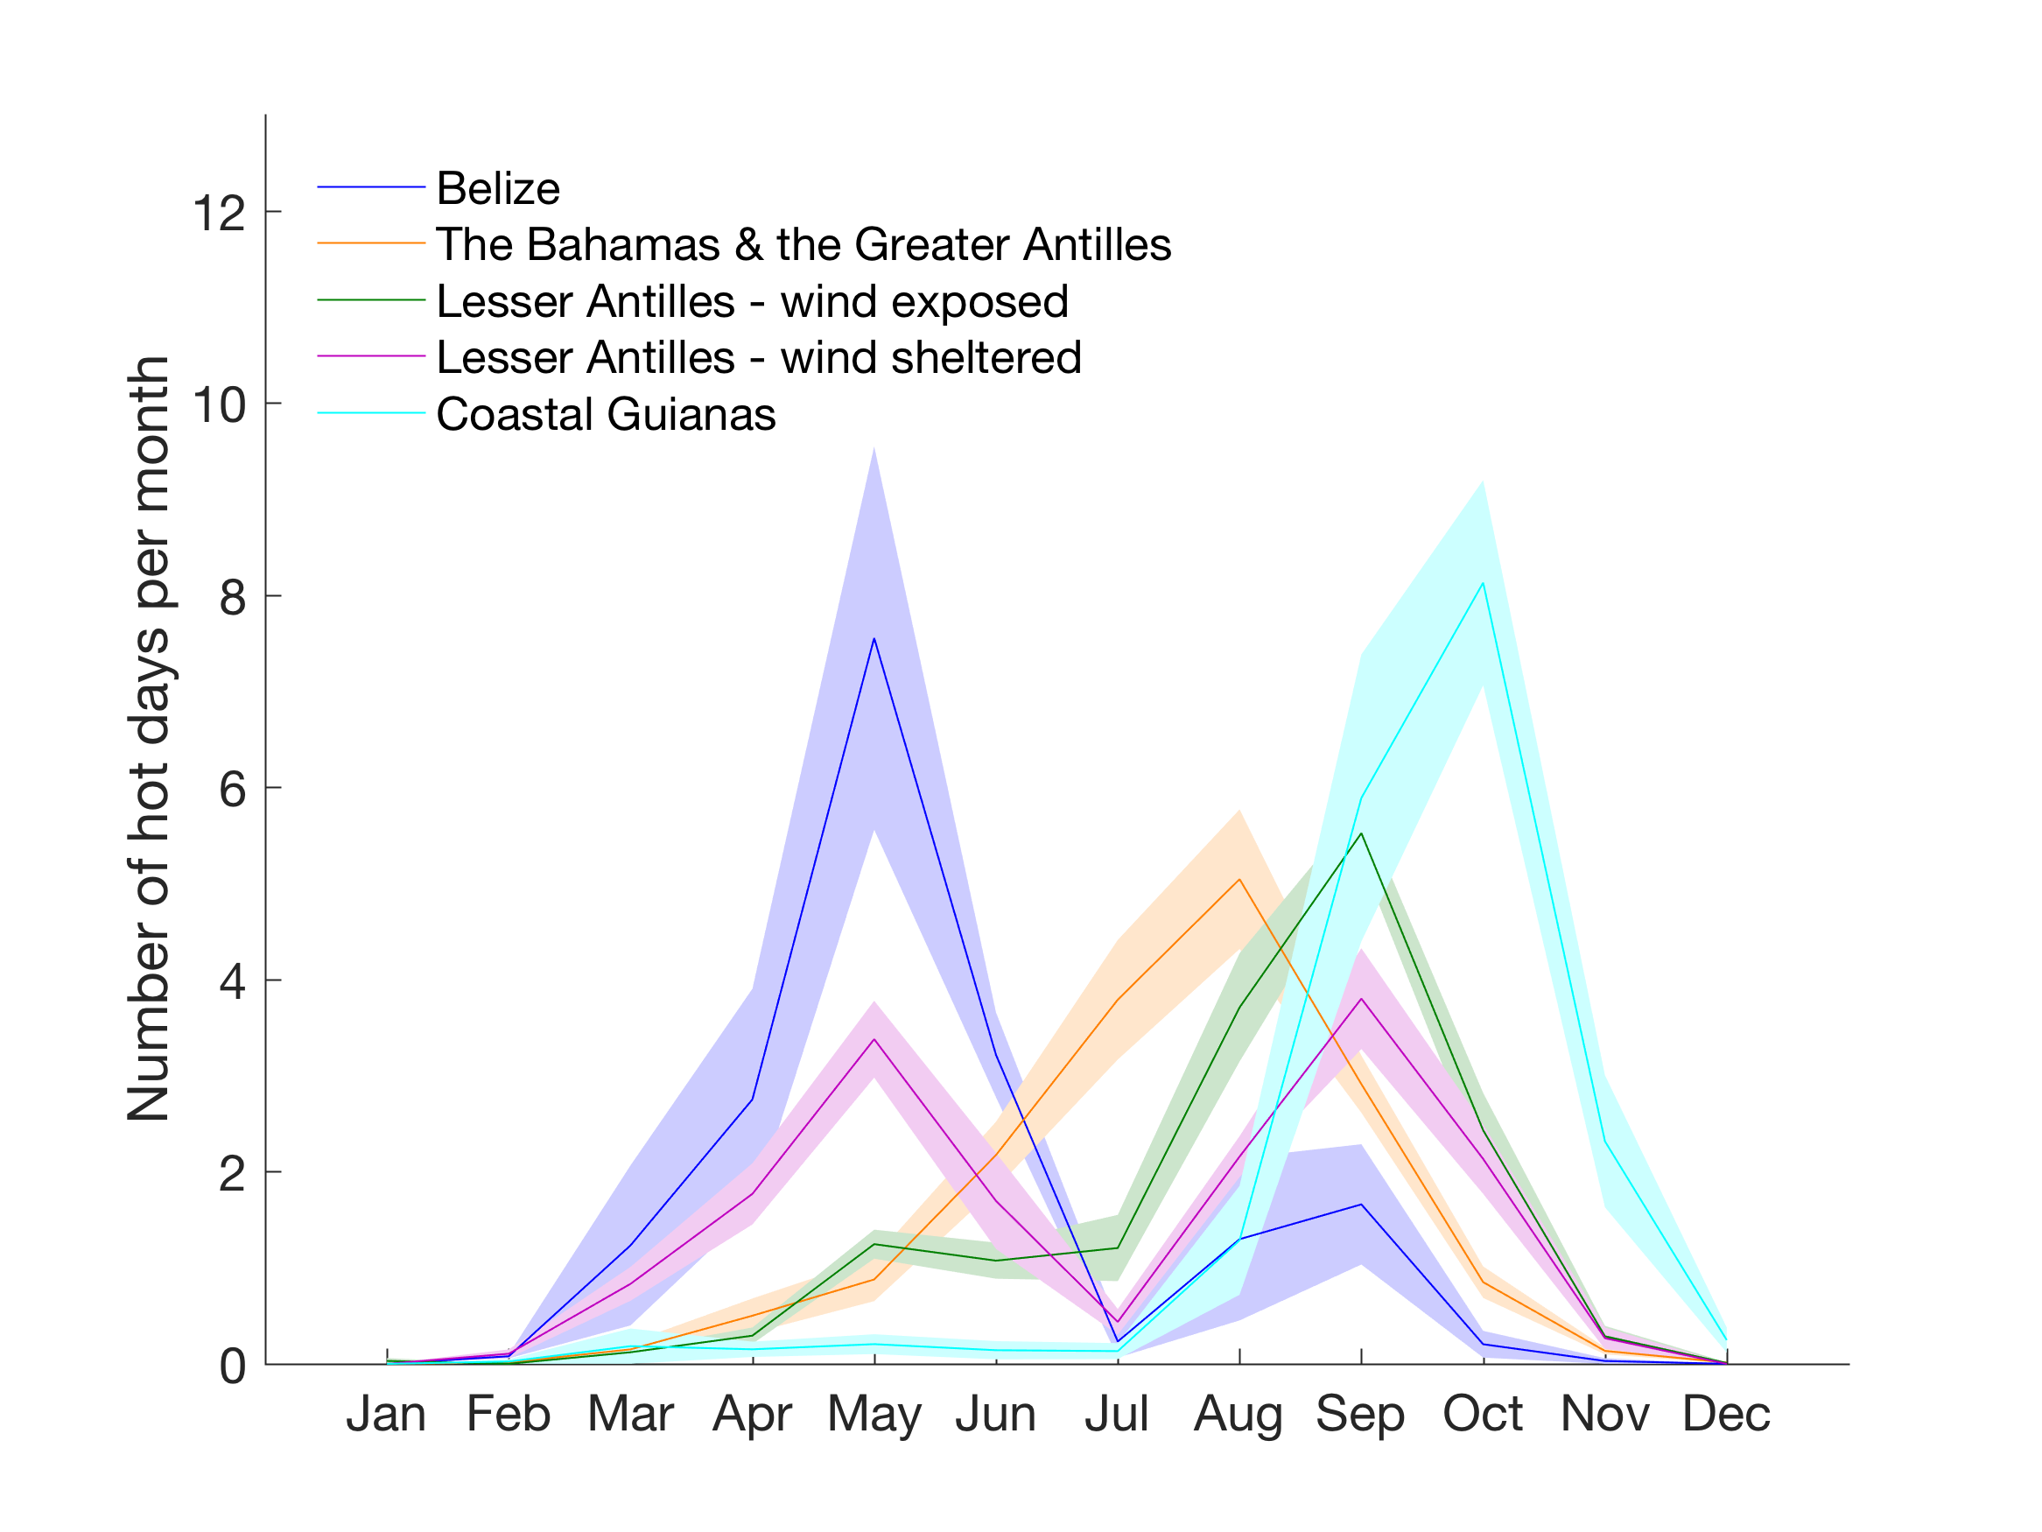
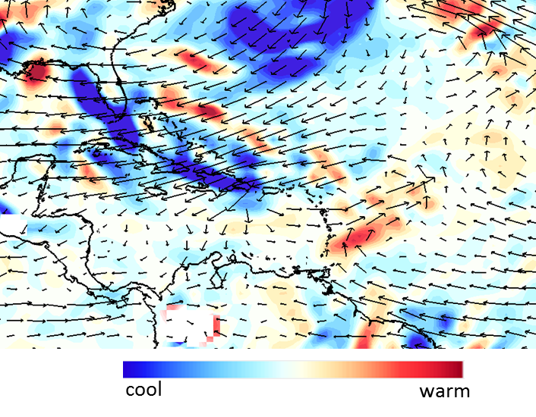
850hPa temperature advection and winds
HEAT IN THE CARIBBEAN - background
OCT 17, 2016
NOV 1, 2016
regional monthly climatology of hot days
Notes:
Heat waves in the Caribbean plot
Heat wave definitions
CIMH products

Slide 3
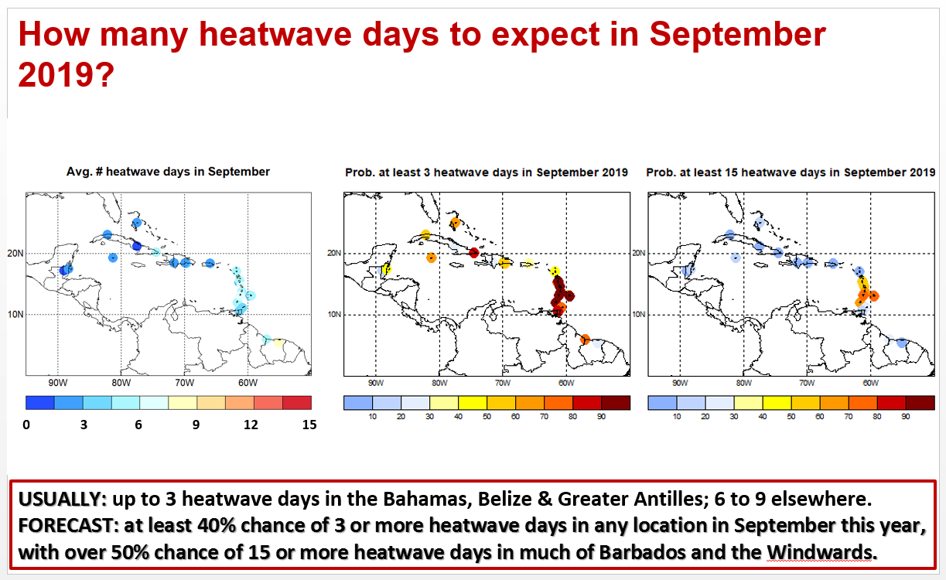
HEAT IN THE CARIBBEAN
monthly heat products from the CIMH
Notes:
Heat waves in the Caribbean plot
Heat wave definitions
CIMH products

Slide 4
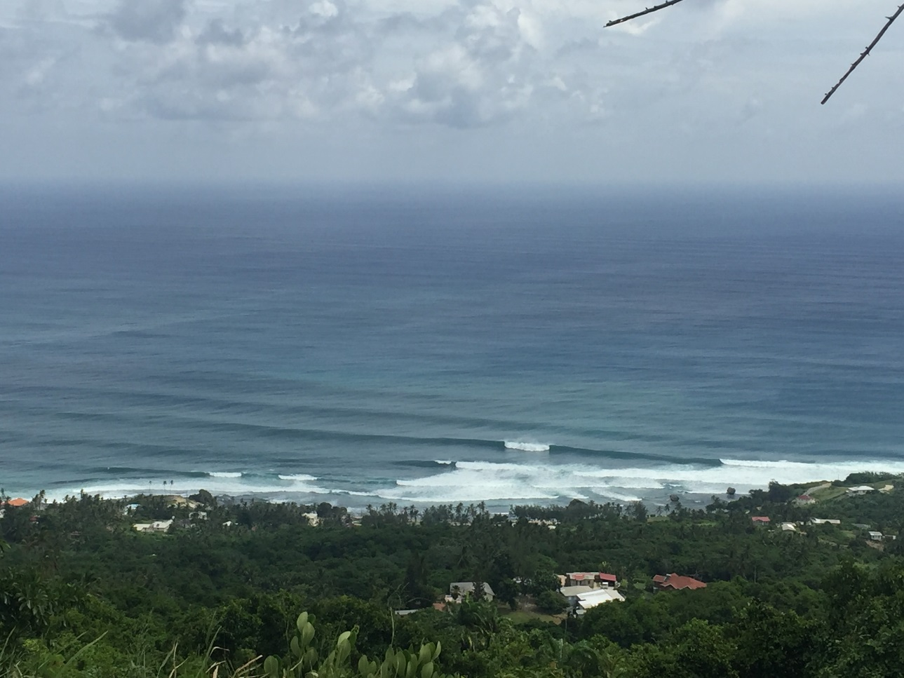
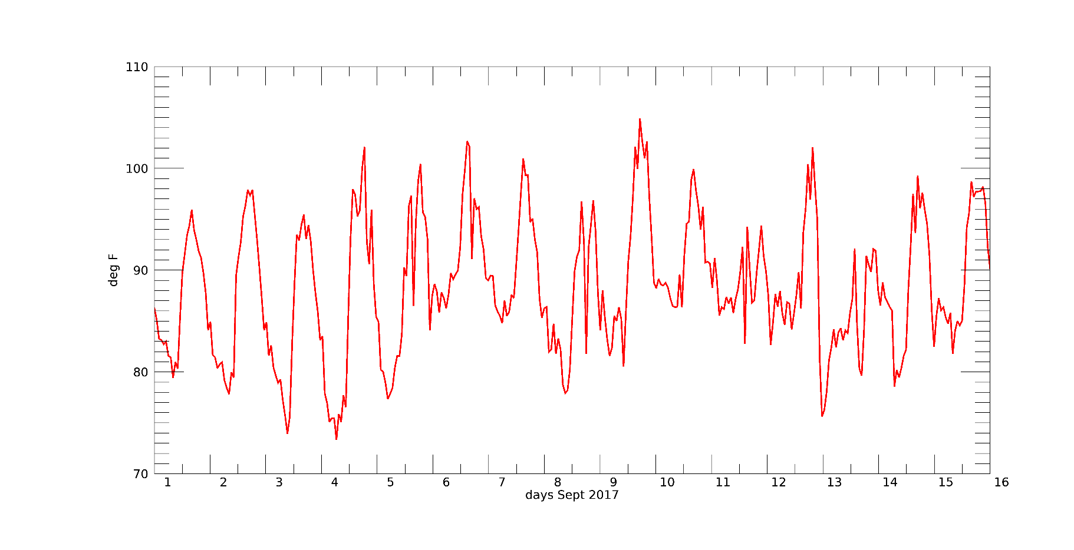
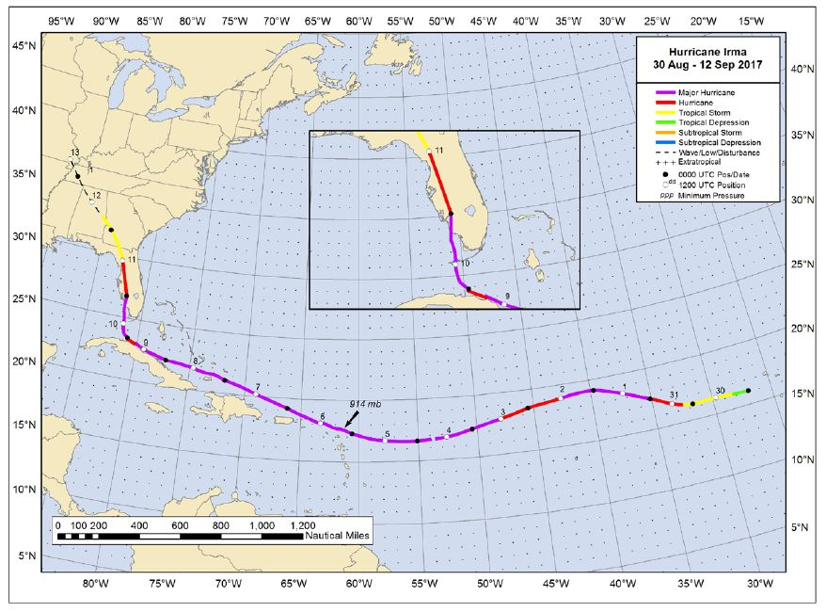
HURRICANE IRMA - 2017
Category 5 – 185mph winds as it approached the eastern Caribbean
hourly heat index – Barbados airport (Sept. 1-16)
Notes:
Problem statement: post hurricane heat
Barbados time series and Antigua
…one result that emerged was the low spatial coherence……are these heat waves?

Slide 5
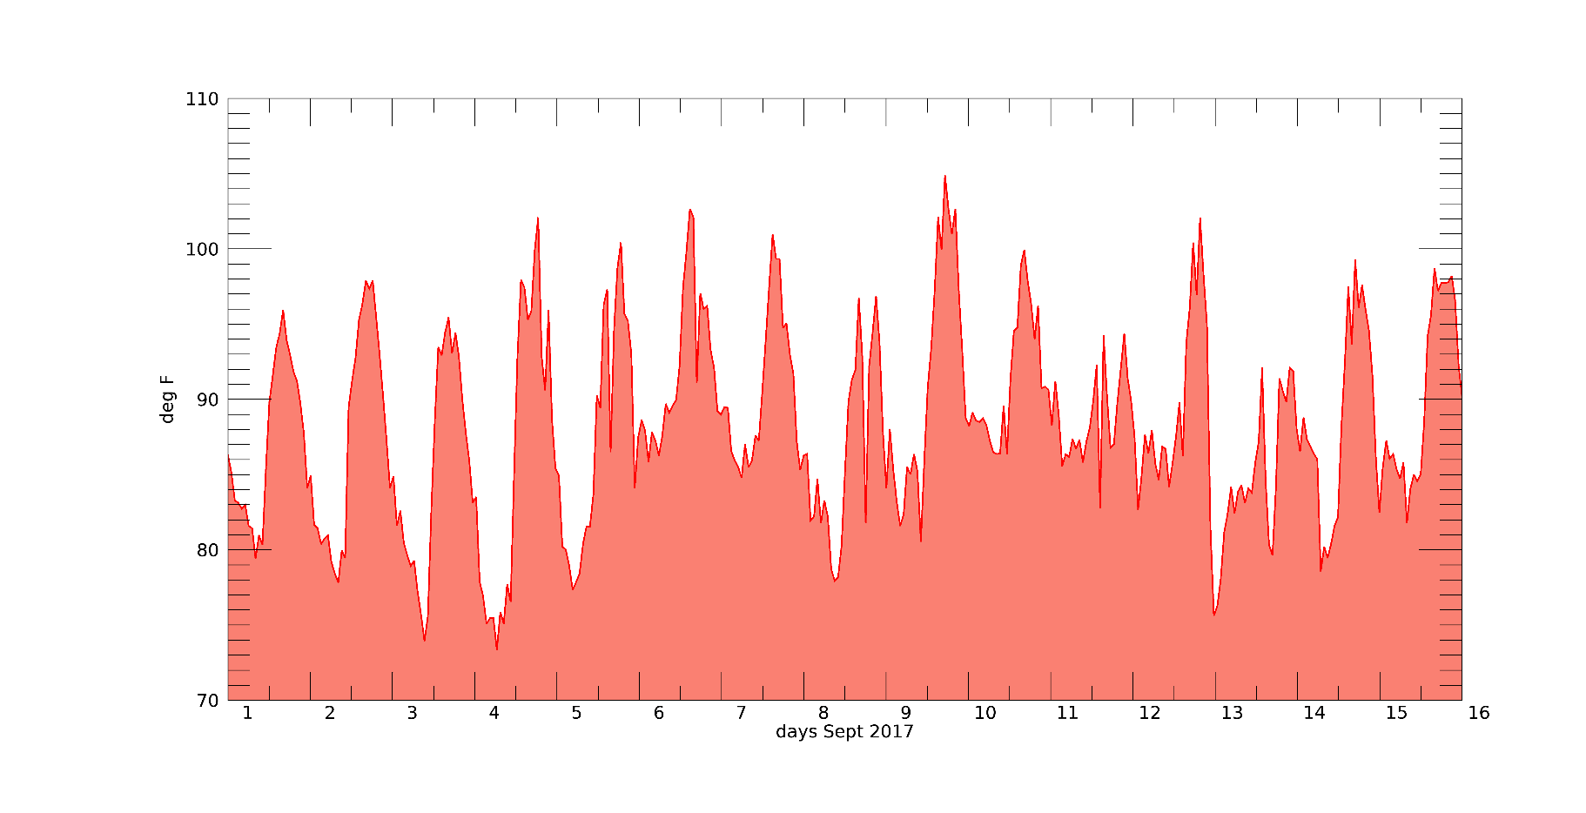
HURRICANE IRMA - 2017
hourly heat index – Barbados airport (Sept. 1-16)
notice the decrease in diurnal range
GAIA - station observations
Notes:
Problem statement: post hurricane heat
Barbados time series and Antigua
…one result that emerged was the low spatial coherence……are these heat waves?

Slide 6
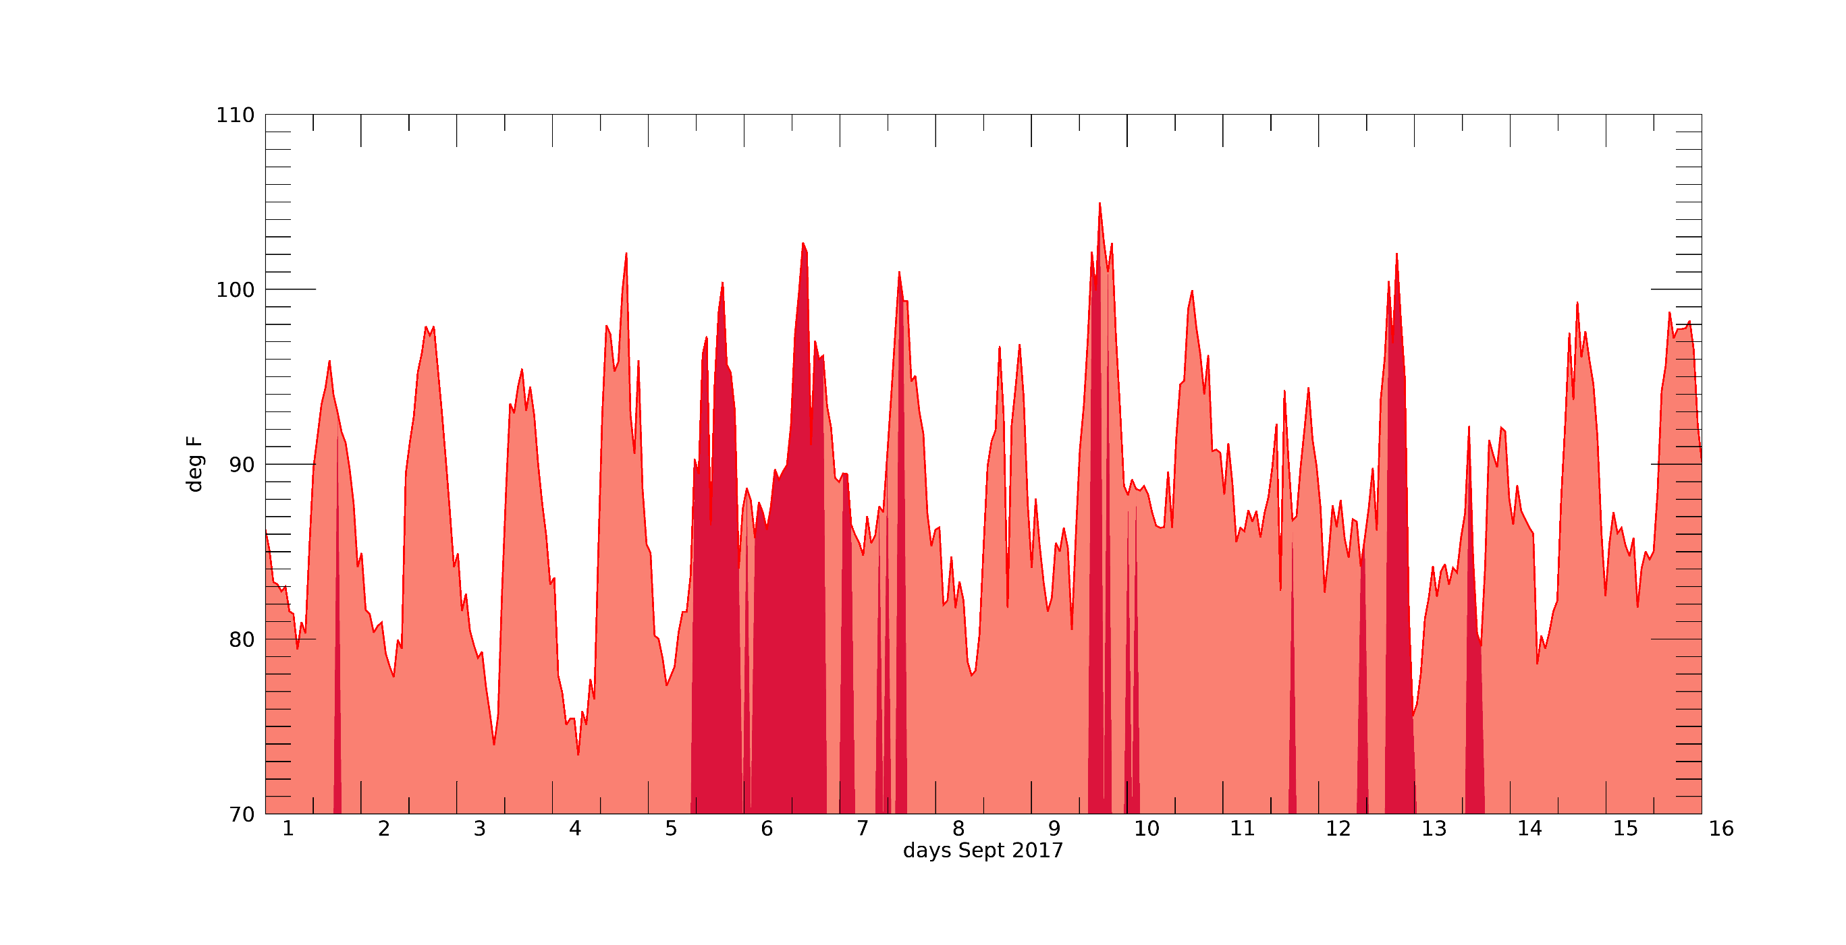
HURRICANE IRMA - 2017
hourly heat index – Barbados airport (Sept. 1-16)
southerly winds > 12knts
IRMA
JOSE
Notes:
Problem statement: post hurricane heat
Barbados time series and Antigua
…one result that emerged was the low spatial coherence……are these heat waves?

Slide 7
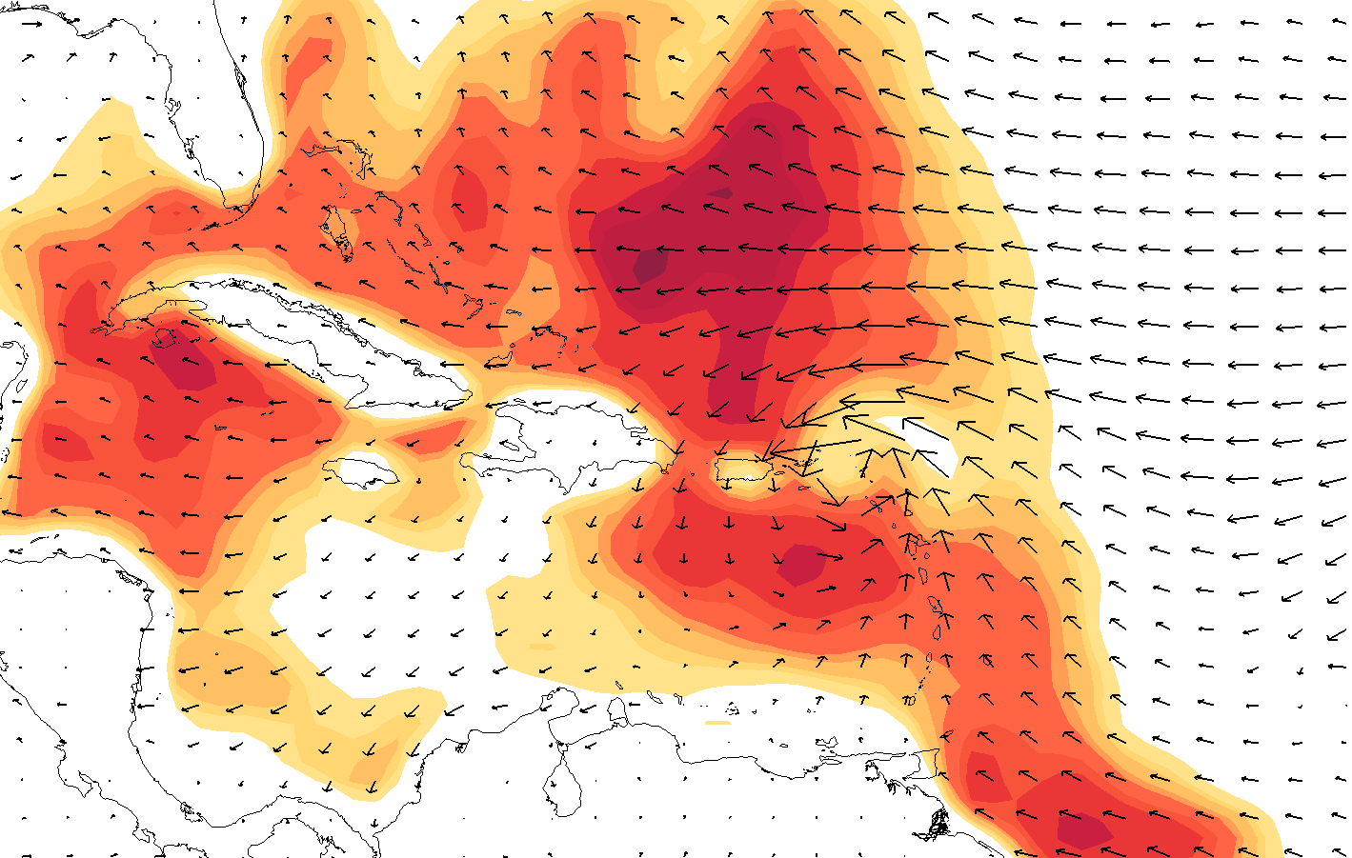
HURRICANE IRMA – Sept. 6. 20Z 2017
2m temperature and 10m winds
ERA-5 Reanalysis
Notes:
Problem statement: post hurricane heat
Barbados time series and Antigua
…one result that emerged was the low spatial coherence……are these heat waves?

Slide 8
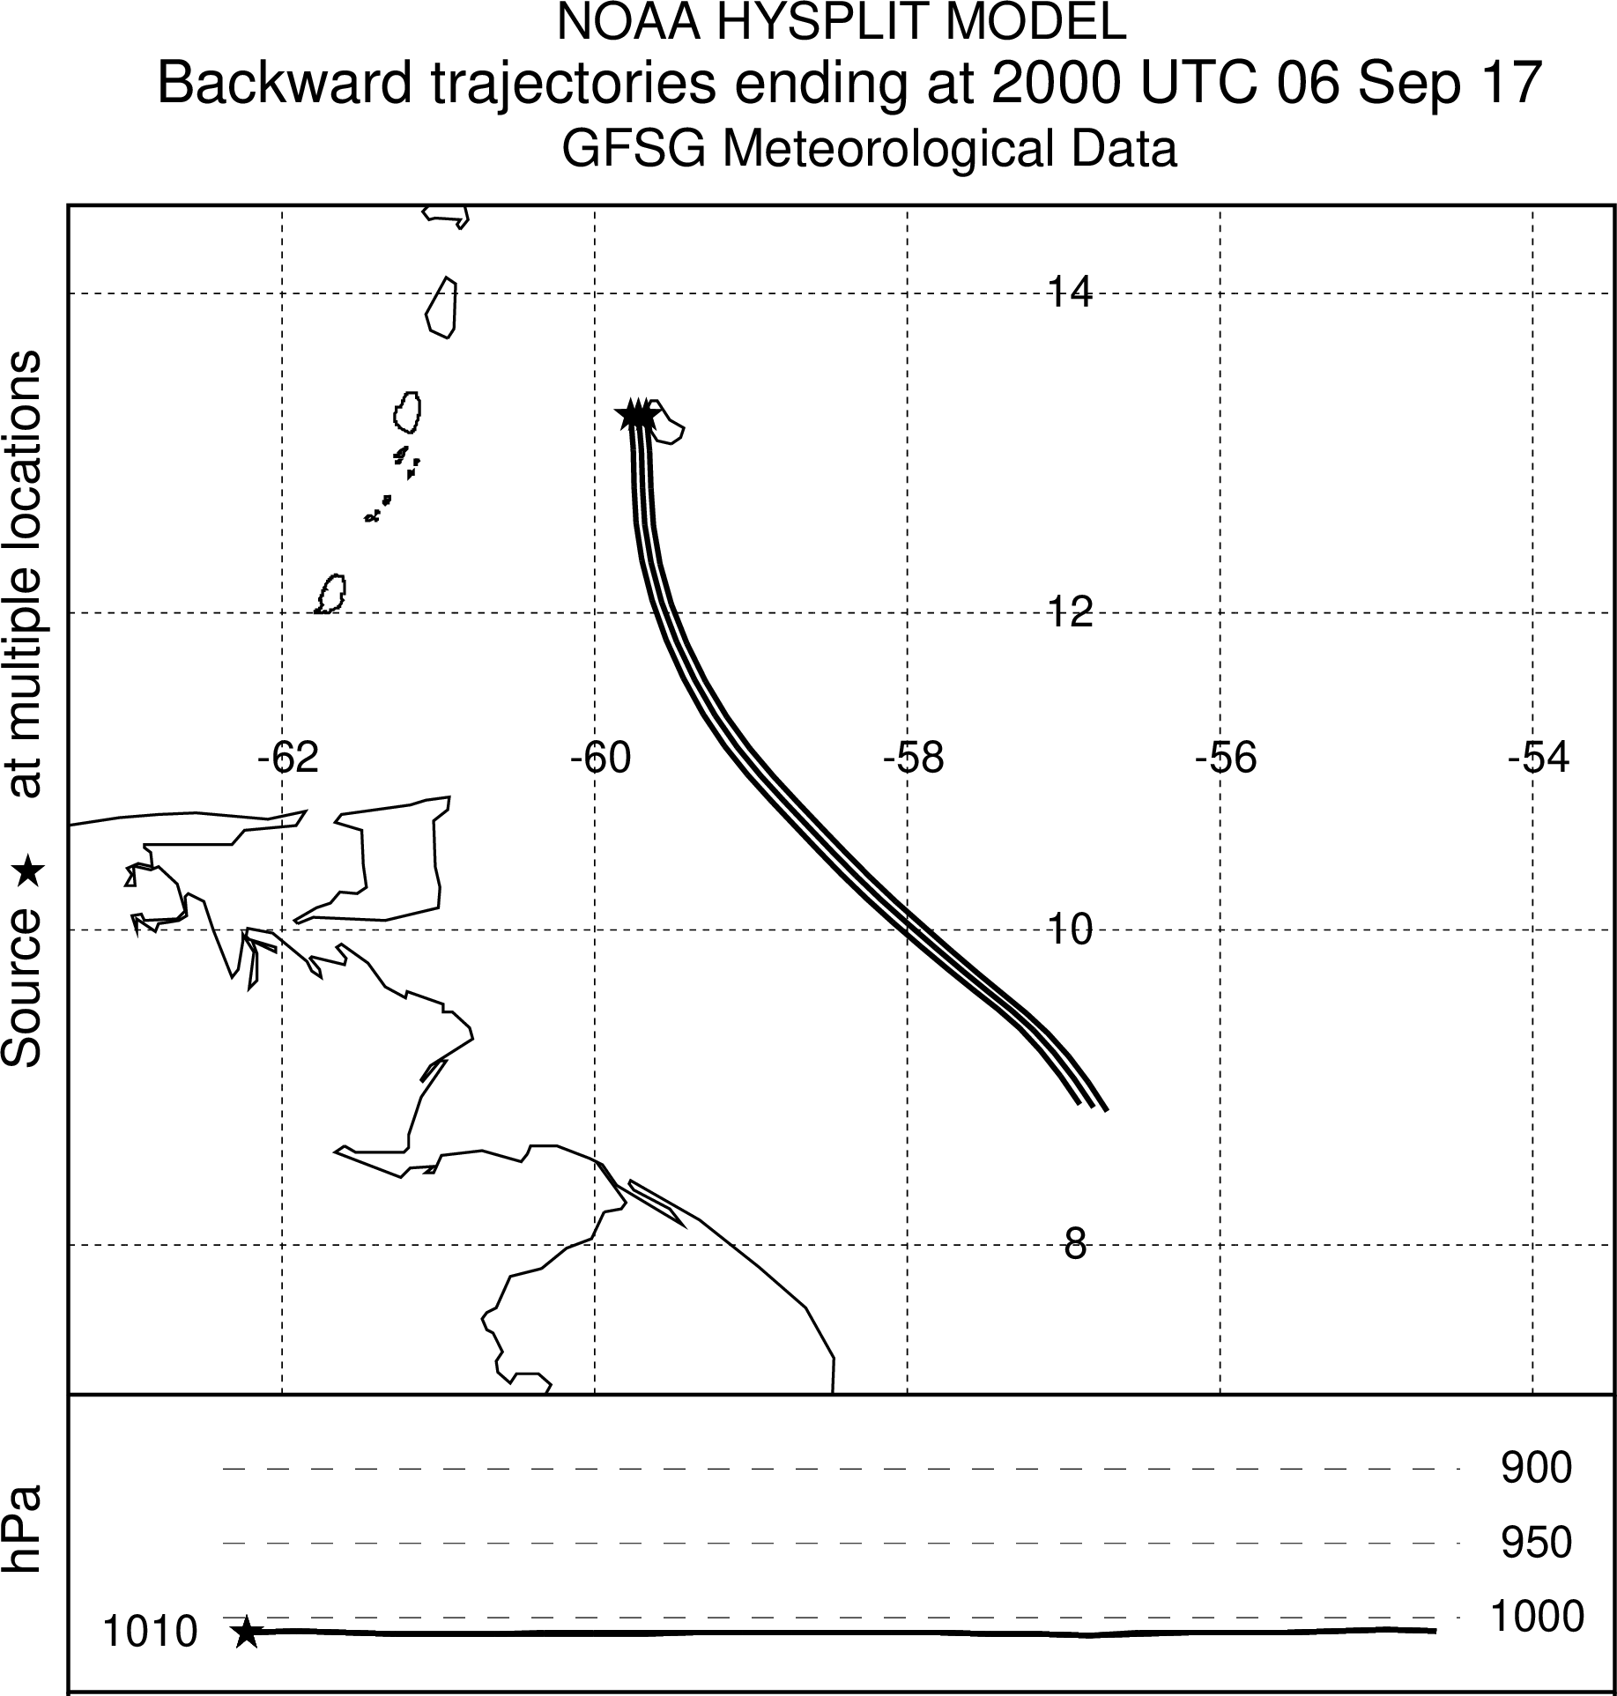
HURRICANE IRMA – Sept. 6. 20Z 2017
HURRICANE HEAT TRAIL
Backward trajectory
Notes:
Problem statement: post hurricane heat
Barbados time series and Antigua
…one result that emerged was the low spatial coherence……are these heat waves?

Slide 9
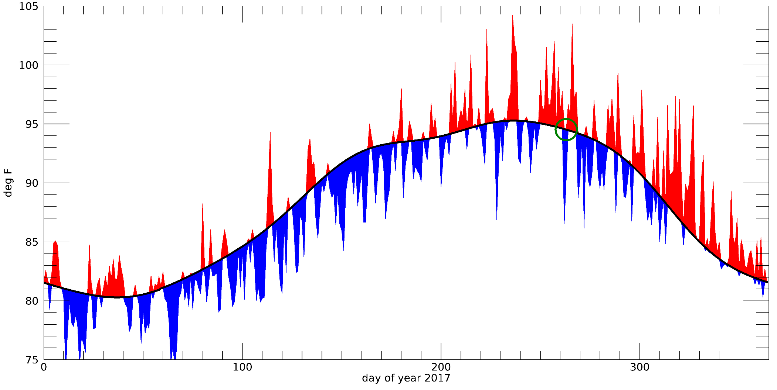
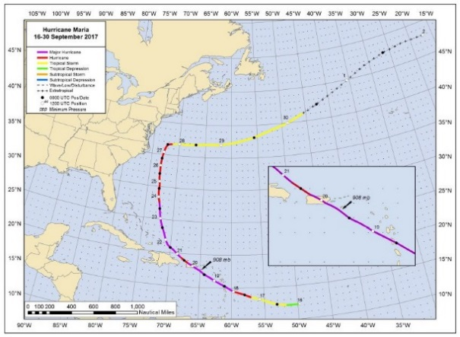
Daily max HEAT INDEX 2017 and climatology (1980-2009) – San Juan
OBSERAVATIONS FROM SJU AIRPORT
Notes:
Work with IRAP2 and Puerto Rico heat health
PR climo plots

Slide 10
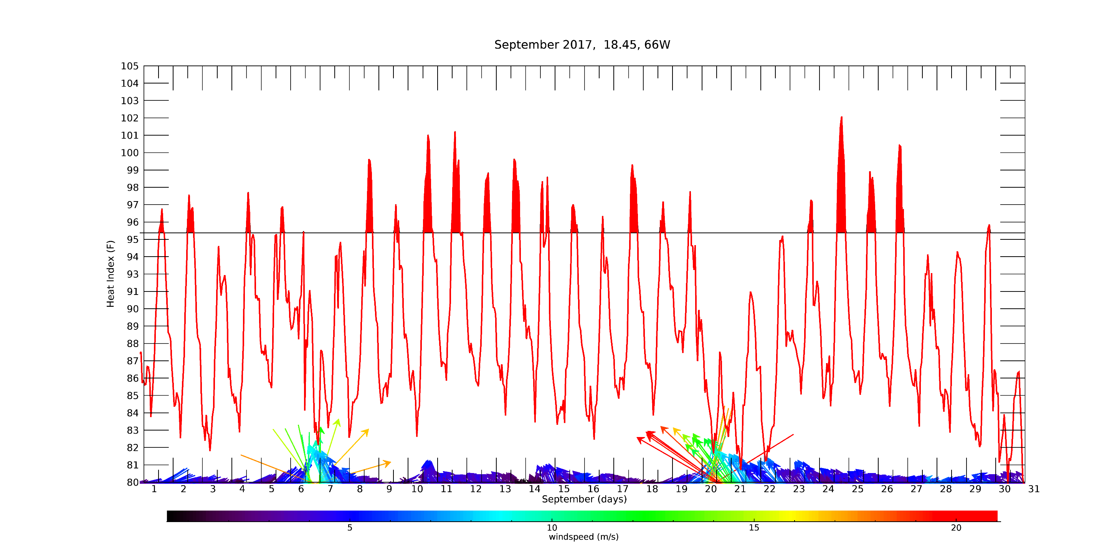
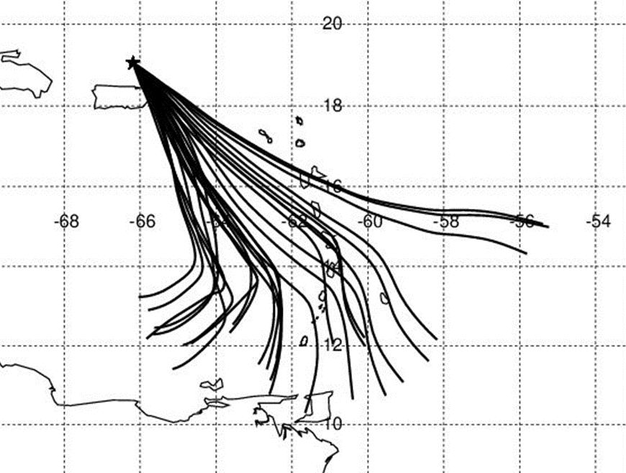
Hourly Heat Index Time Series – San Juan, Puerto Rico
Hurricane Maria
derived 2m heat index
ERA-5 Reanalysis

Slide 11
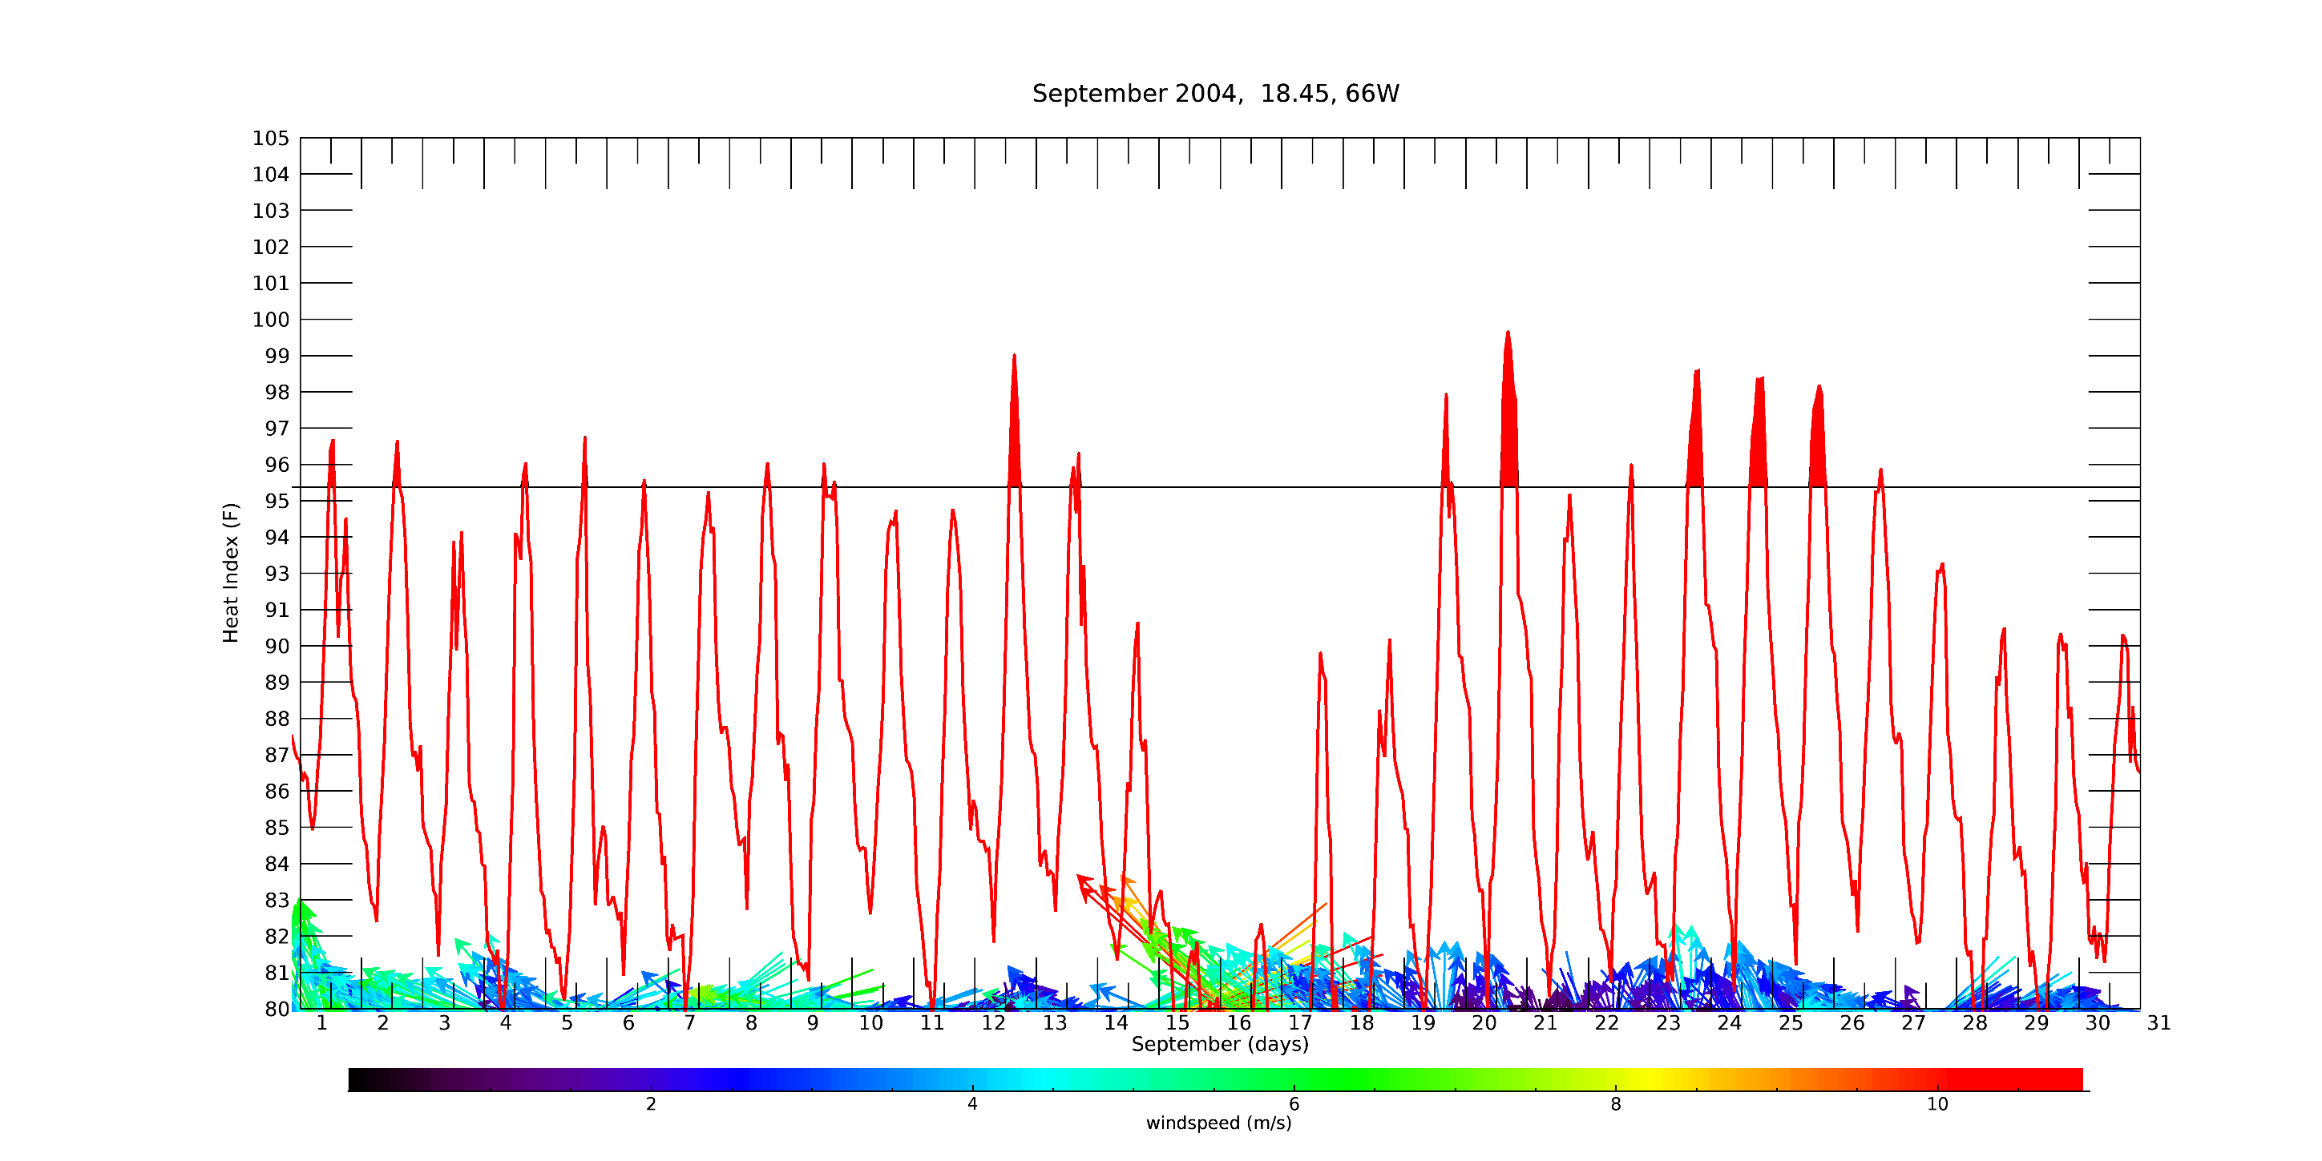
Hourly Heat Index Time Series – San Juan, Puerto Rico
Hurricane Jeanne

Slide 12
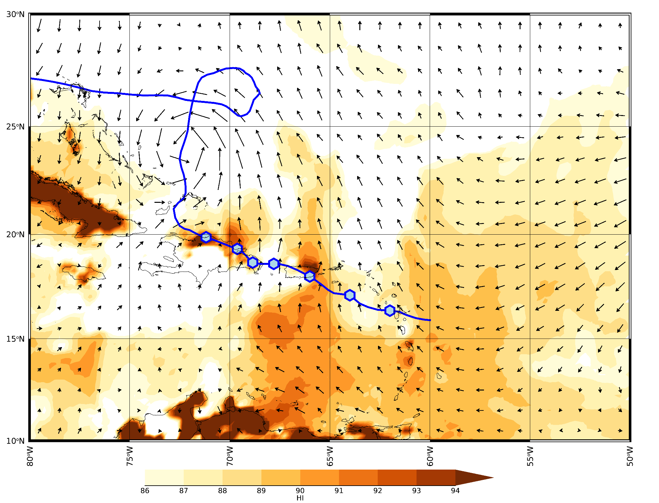
Heat Index
Sept 19, 17Z
Hurricane Jeanne
2004

Slide 13
Heat Index
Sept 19, 17Z
Hurricane Jeanne
2004

Slide 14
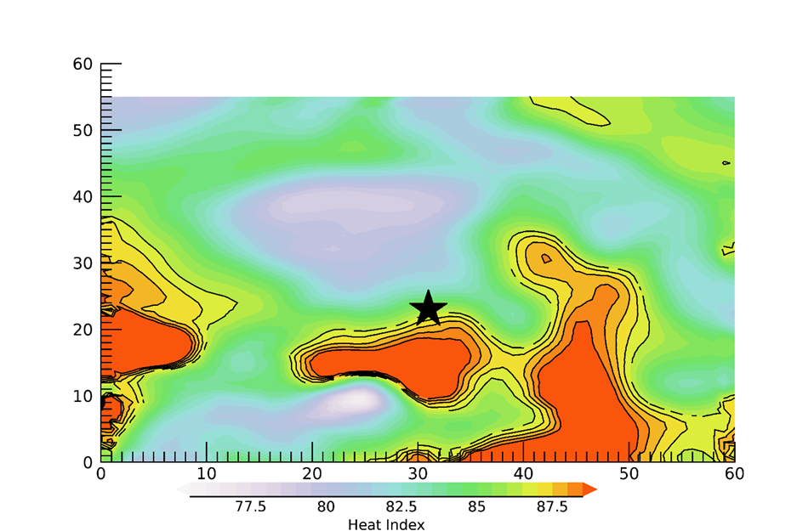
Heat Index
Sept 19, 17Z
15 degrees
Hurricane Jeanne
2004
15 degrees

Slide 15
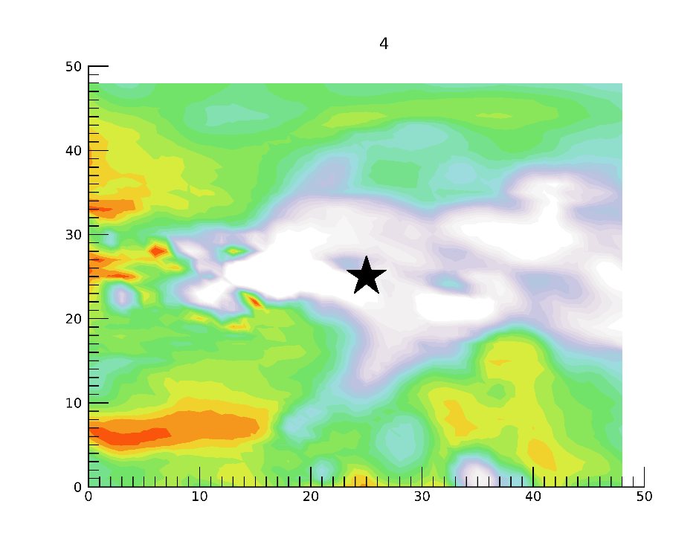
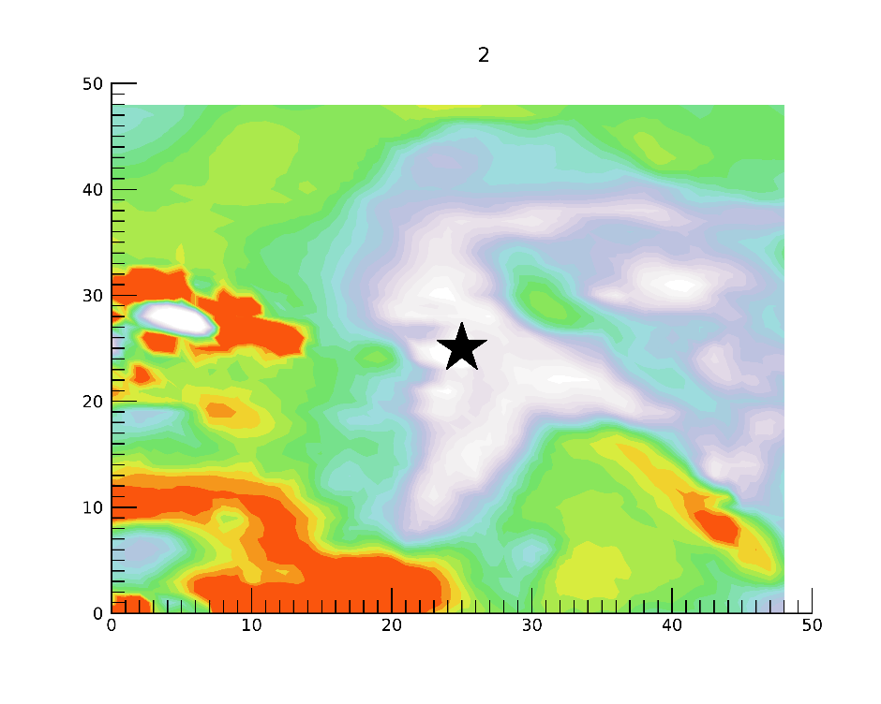
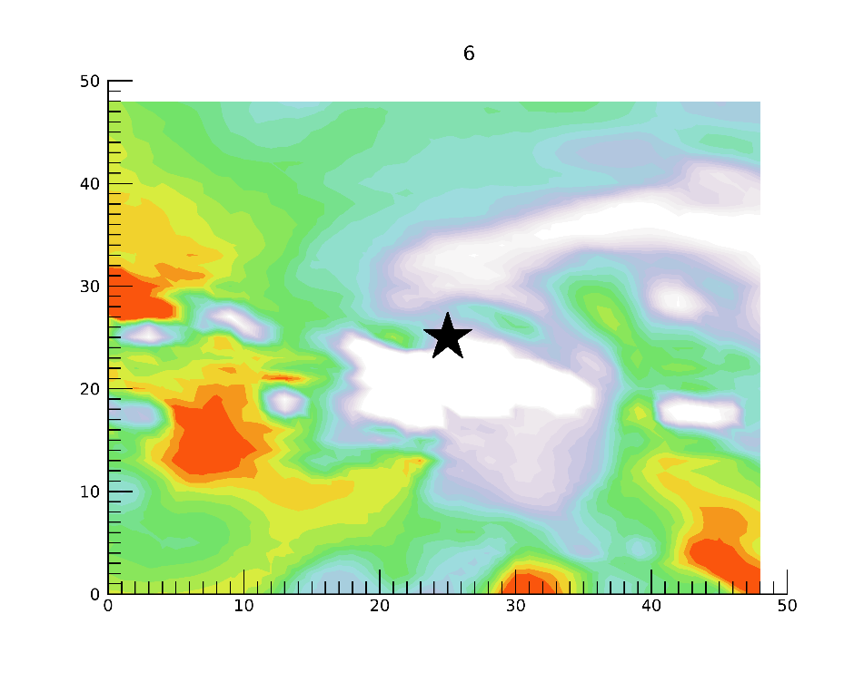

Slide 16
Hurricane
Hurricane Heat Trail
Snapshots

Slide 17
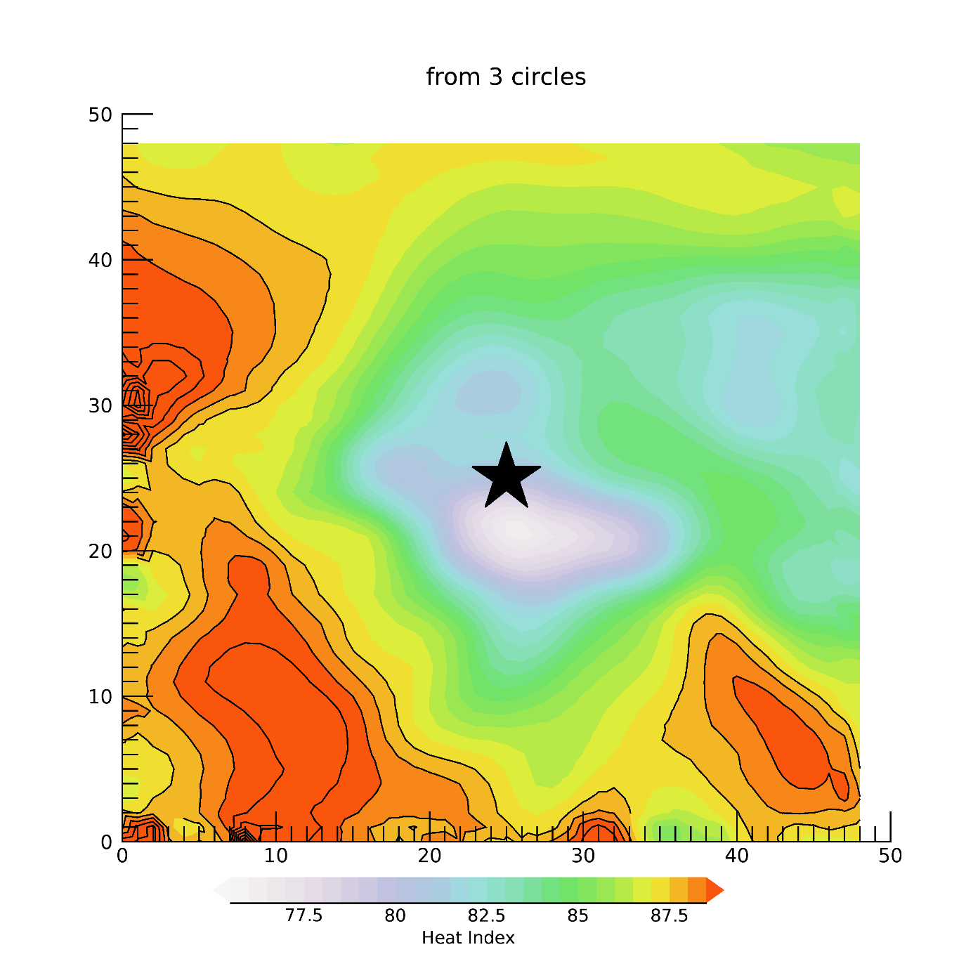
Composite Heat Index Snapshots
12 degree
Composite
winds?, temperature?,
humidity?, wind speed?
12 degree
Hurricane Heat Trail

Slide 18
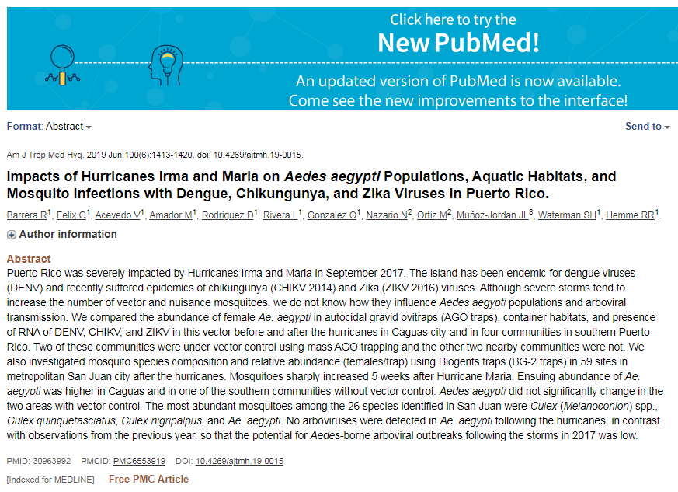
HUMAN HEALTH APPLICATIONS

Slide 19
NEXT
DIAGNOSE each land-falling case– why some had strong or weak signals
INVESTIGATE land falling versus non-land-falling events
within 100nm / 200nm distance from shore
COMPOSITES?
Heat Index THRESHOLD VALUES? Are there better options?
INTEGRATE station data into the analysis
REGIONAL investigation vs island specific
Notes:
Threat related to non-landfalling can be complemented to add to things other than wind-speed / category --- GOOD for NHC
“Derecho” analog from Jen, heat wave post meso-scale storm
Researcher from Ariz detailing nighttime cooling requirements

Slide 21
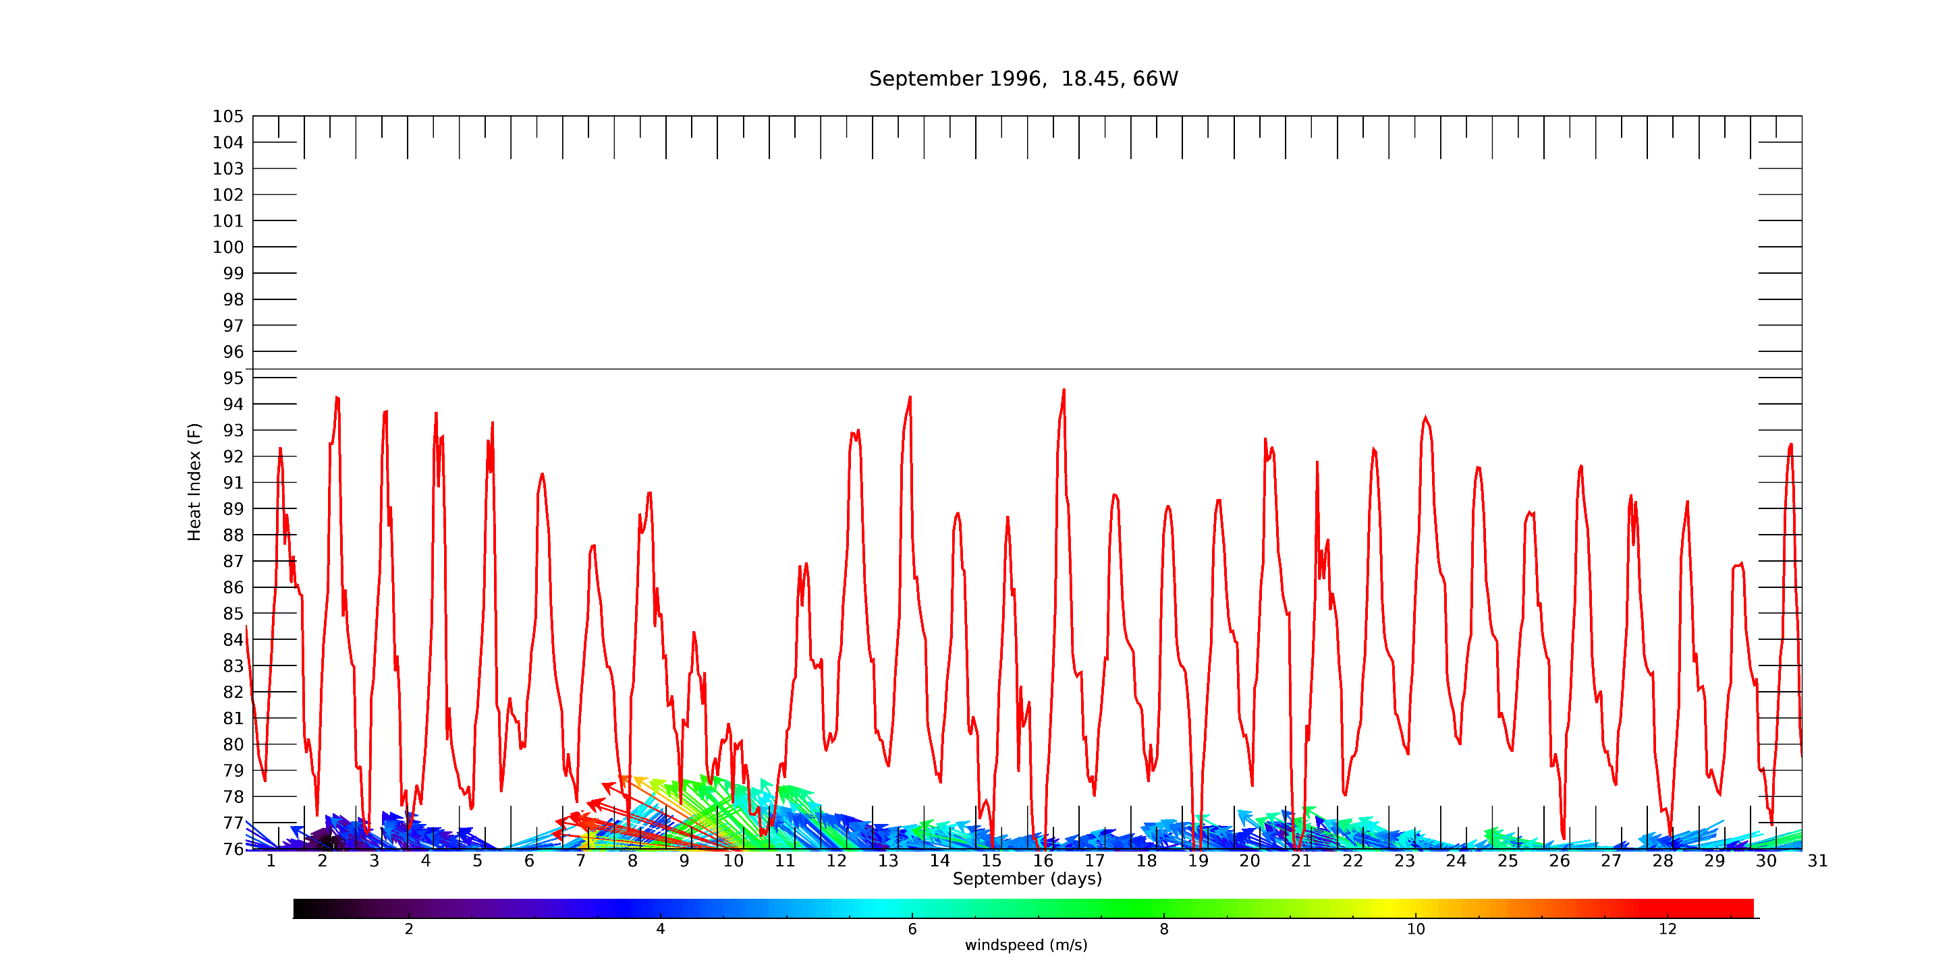
Hourly Heat Index Time Series
Hurricane Hortense

Slide 22
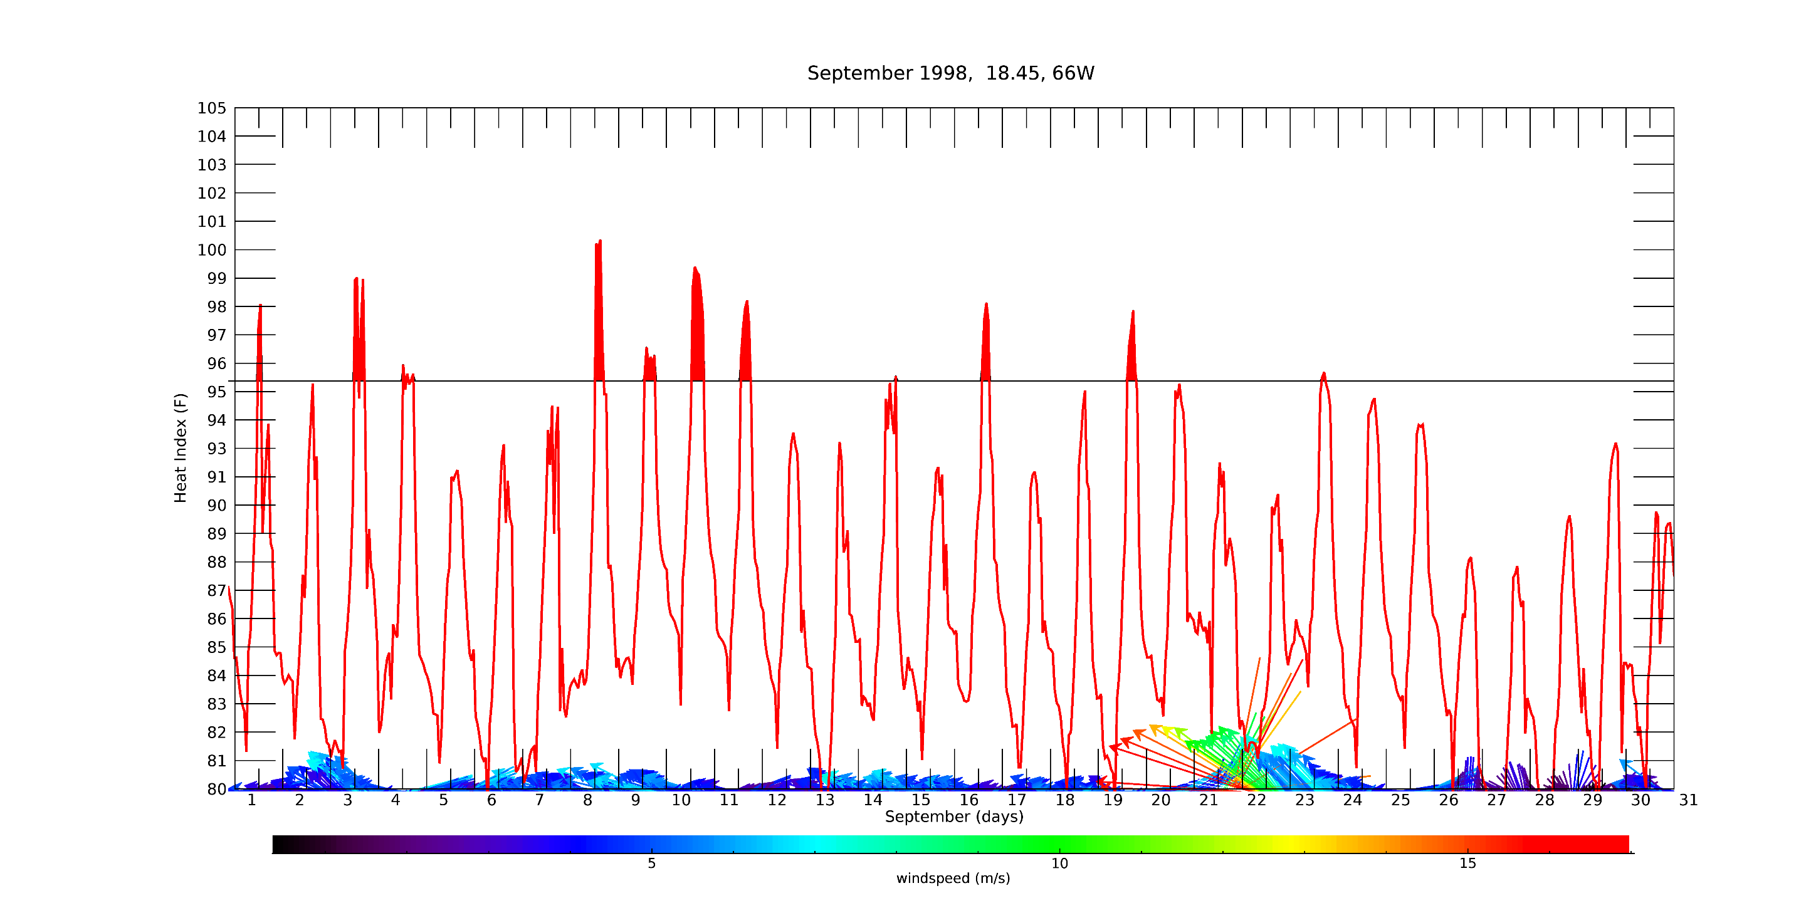
Hurricane Georges

Slide 23
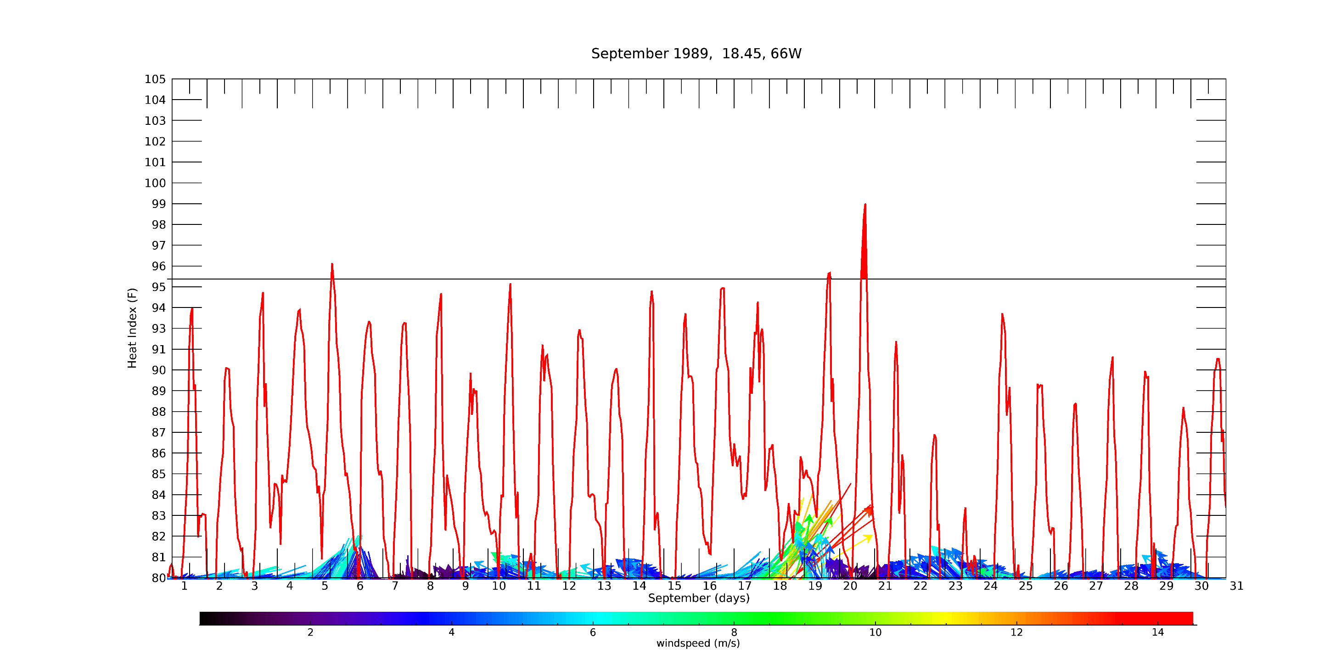
Hurricane Hugo

Slide 24
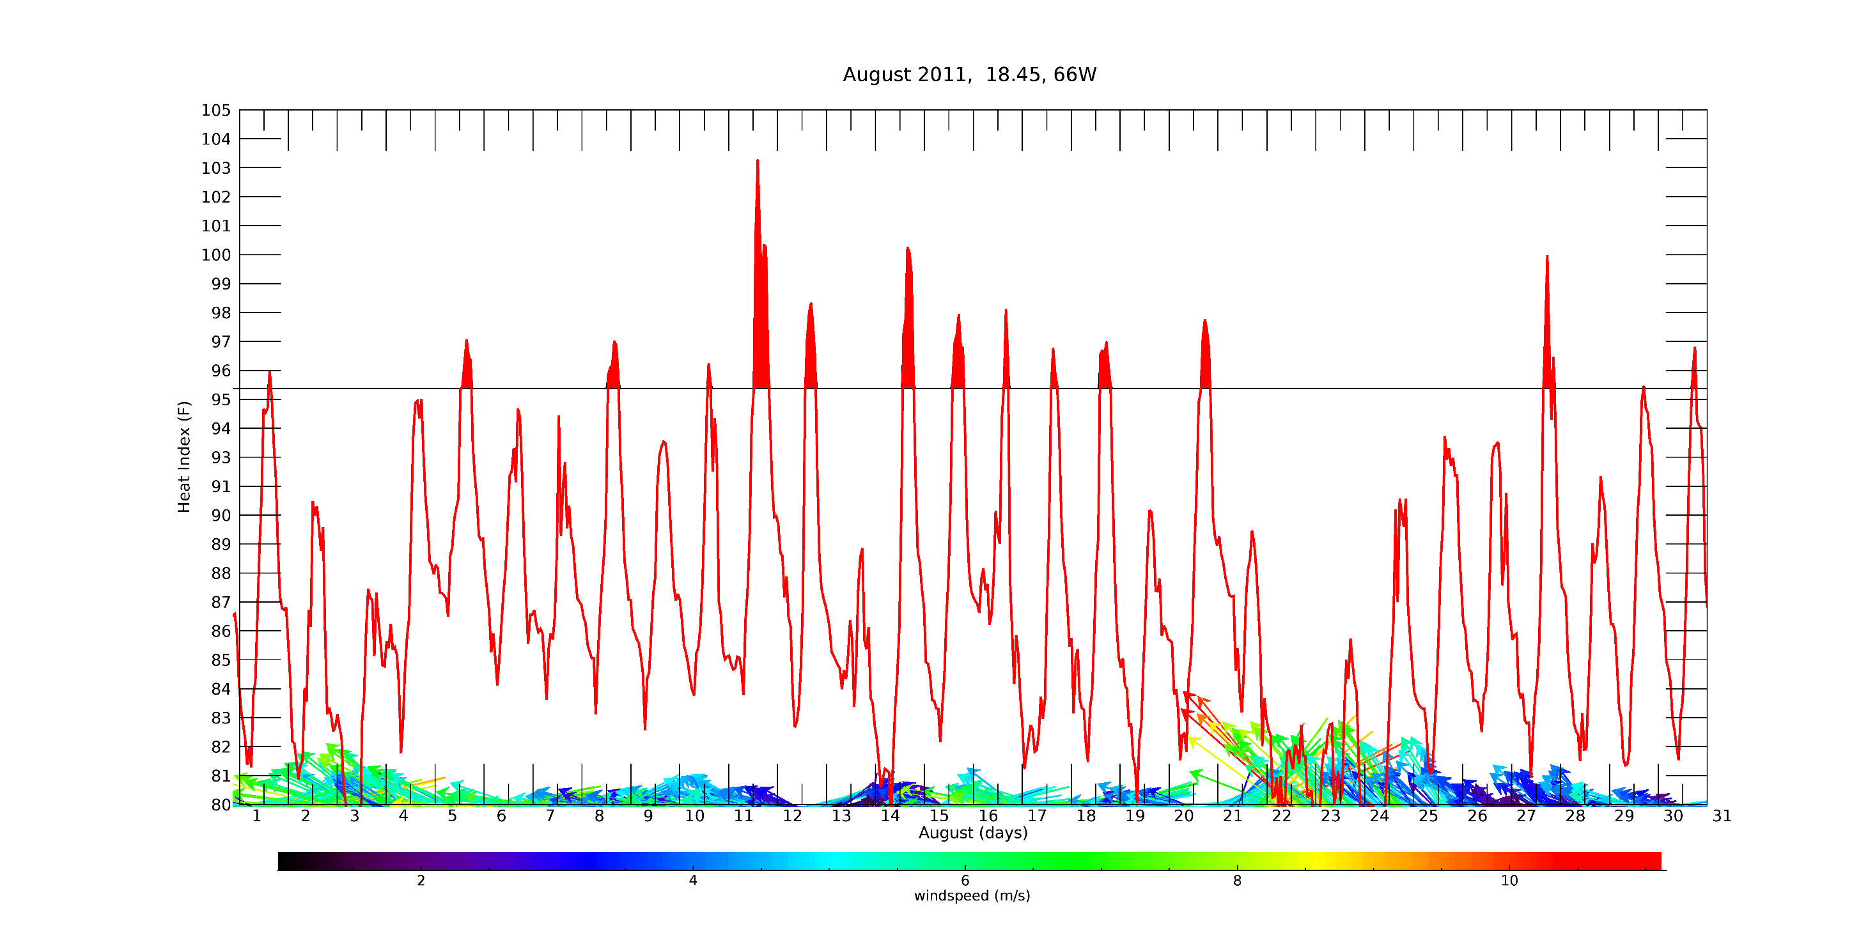
Hurricane Irene

Slide 25
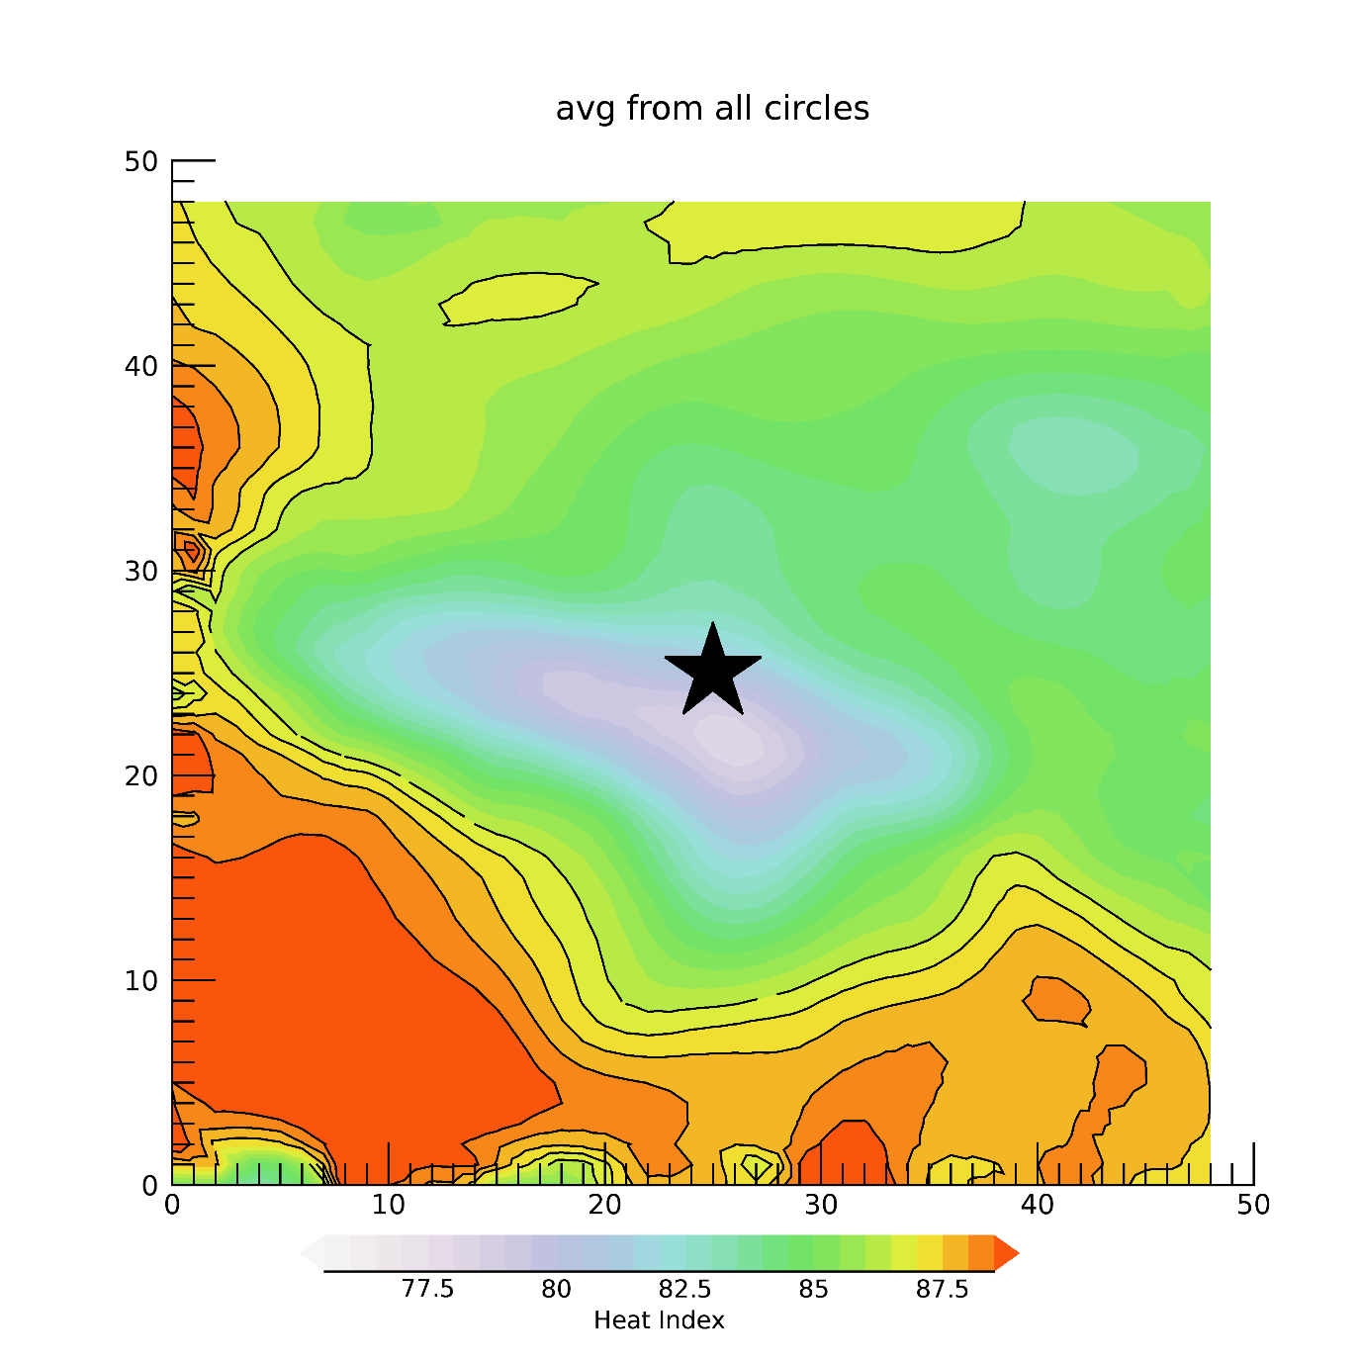

Slide 26
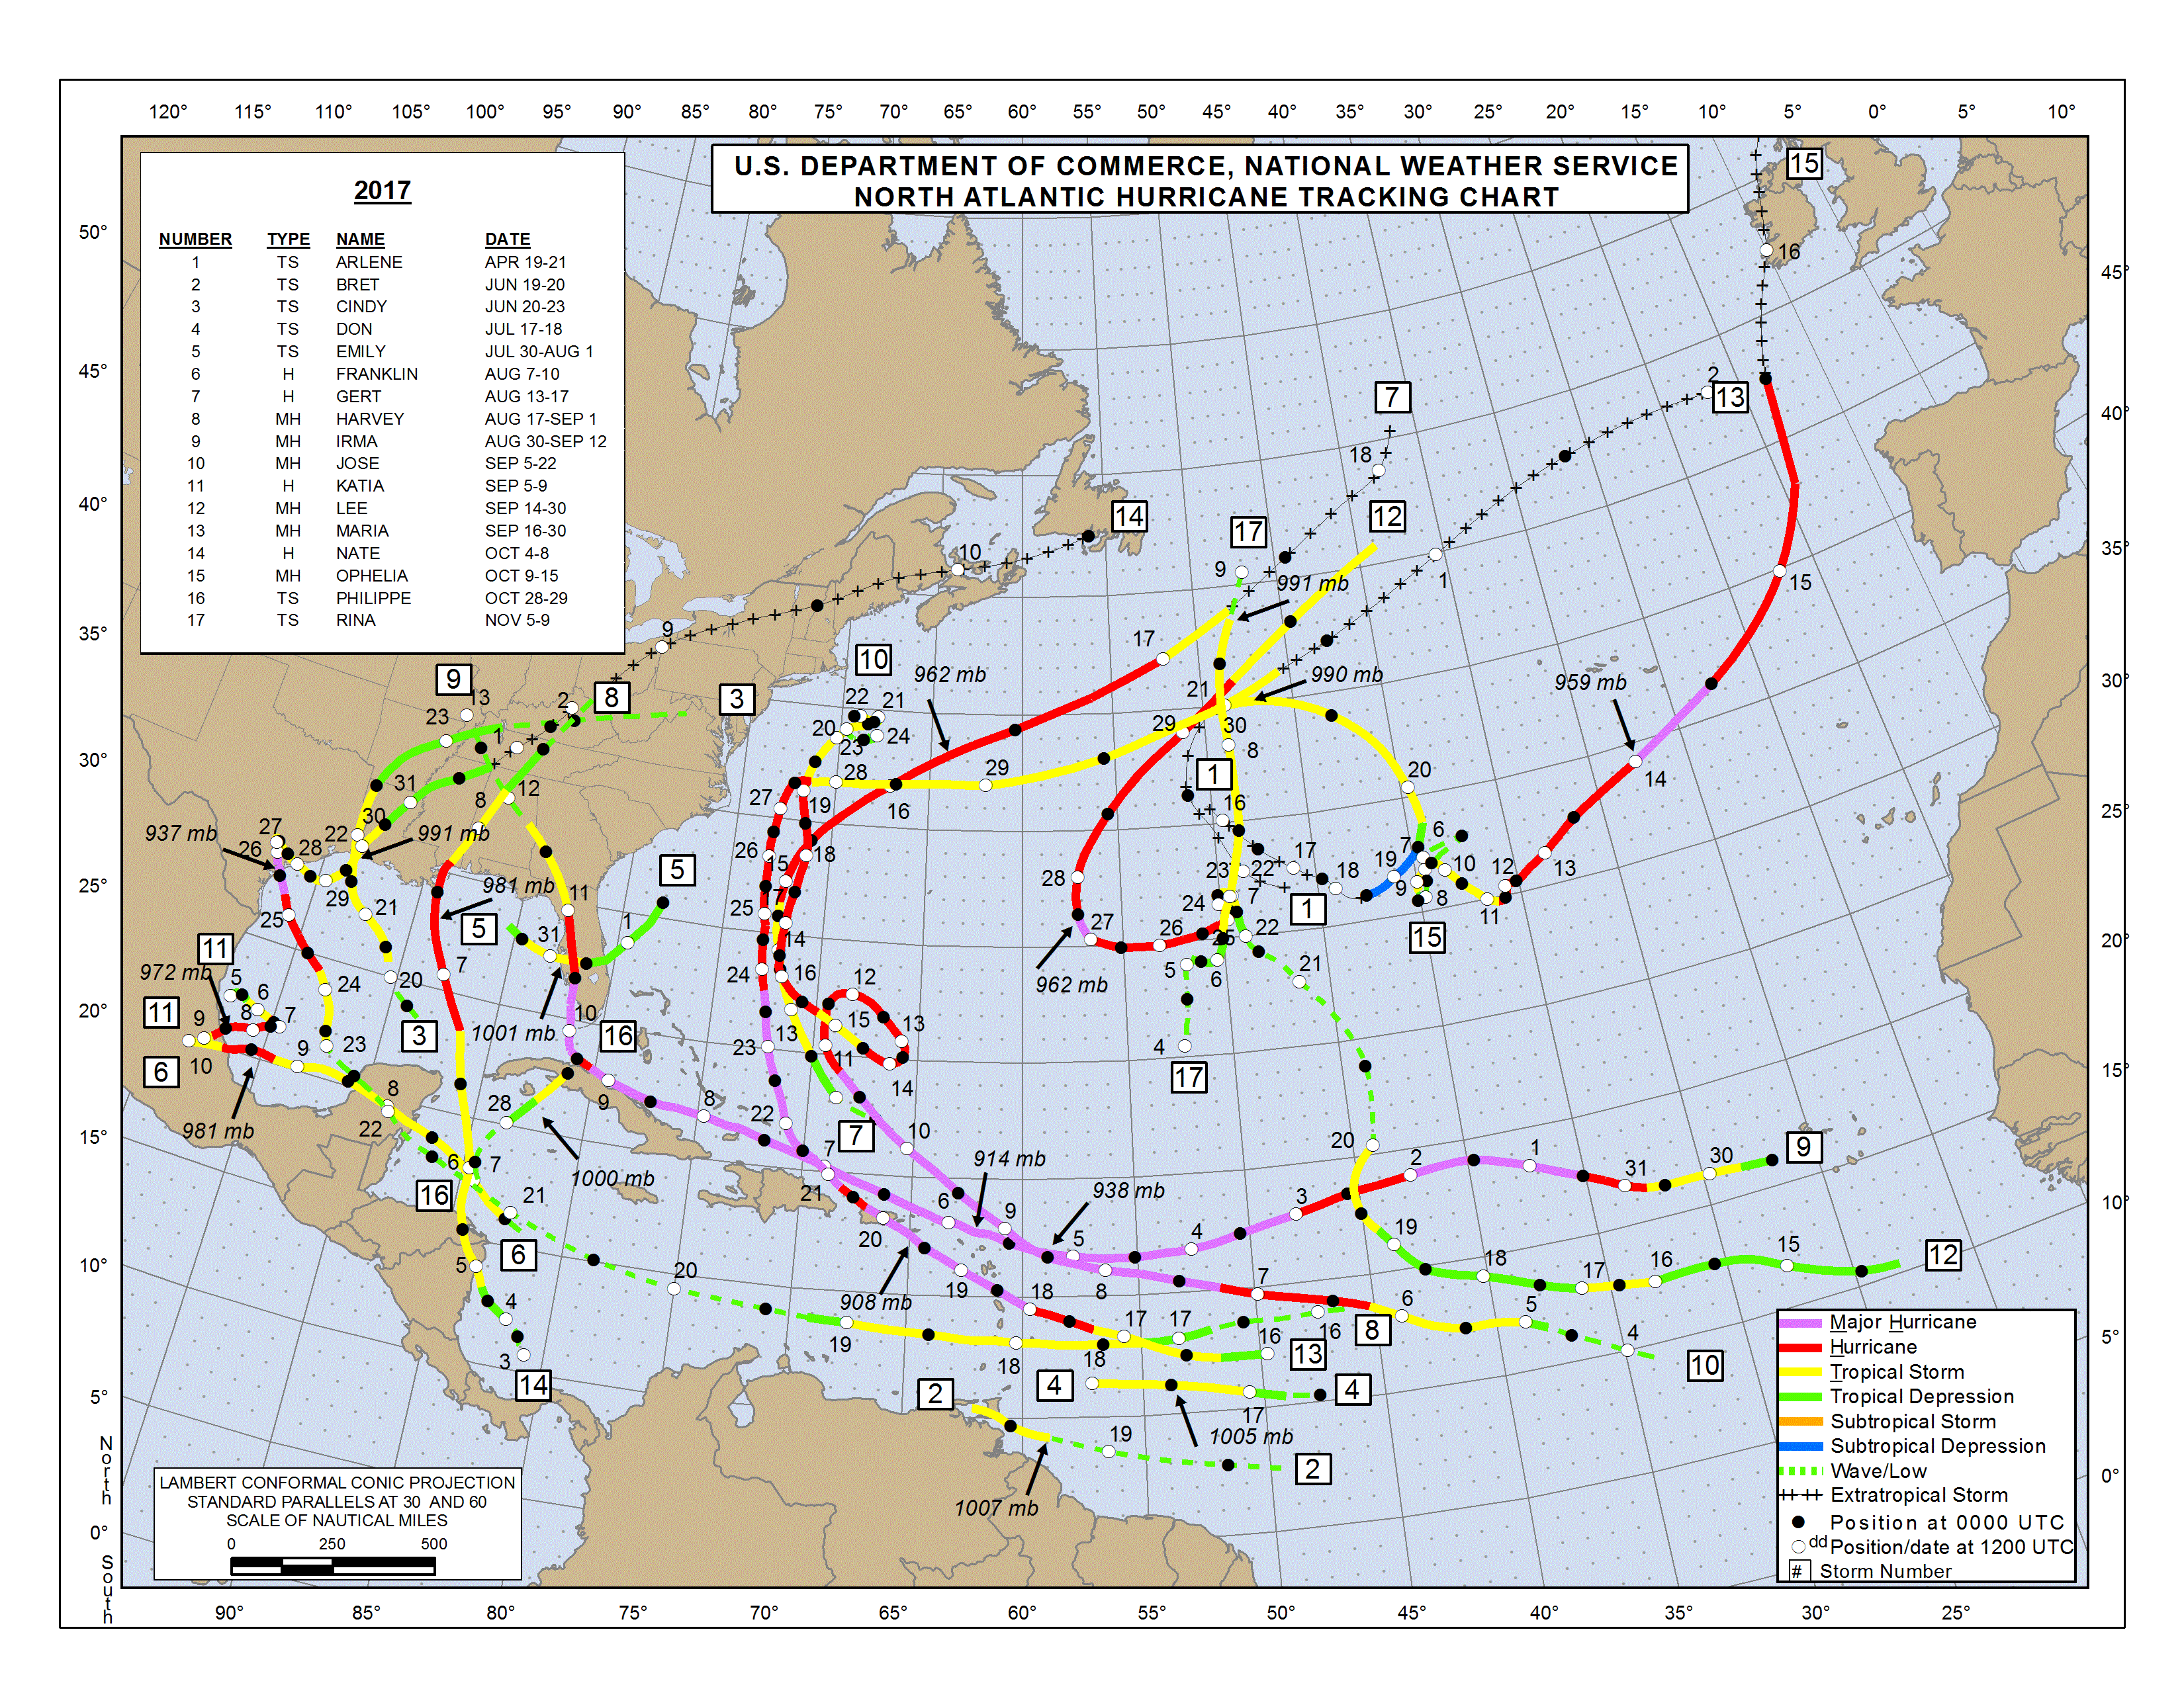

Slide 28
