Slide 1
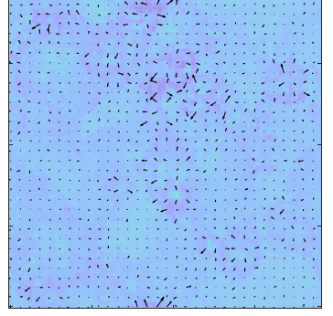
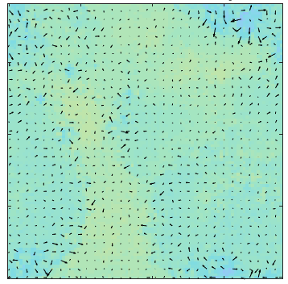
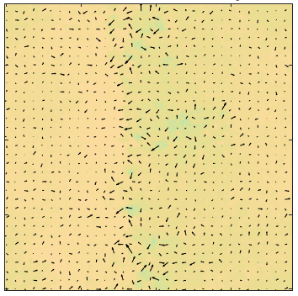
Surface Relative Humidity in Radiative-Convective Equilibrium
Timothy Cronin
MIT, Department of Earth, Atmospheric and Planetary Sciences
From BOMEX to EUREC4A
International Symposium at CIMH
01 February 2020

Slide 2
Why is relative humidity (RH) ~80% over tropical oceans?
Linked questions:
Why does latent heat flux dominate sensible heat flux?
What sets their proportions in radiative-convective equilibrium?
Why is cloud-base at ~500 m and not 50 m or 5000 m?
Same spirit as Romps, 2014 – why is free-tropospheric RH not 1% or 99%?

Slide 3
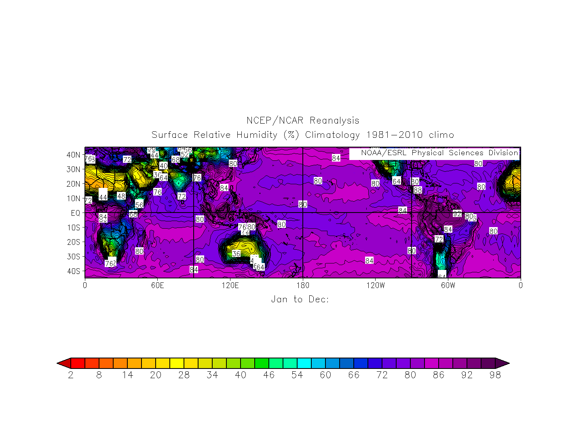
Map of long-term mean RH
(NCEP/NCAR reanalysis)

Slide 4
Need linked theories for:
Surface turbulent flux partitioning in radiative-convective equilibrium
Surface air relative humidity in radiative-convective equilibrium
Implications for:
-Scaling of mean precipitation with surface temperature
-Changes in cloud-base height with surface temperature (possibly relevant for some cloud feedbacks)

Slide 5
Task: try to develop this basic theory
Based on energy balances of troposphere and subcloud layer
Guided by convection-permitting models across a range of surface conditions
Vary surface wetness β and surface temperature T_{S}
Emphasis in this talk on the theory rather than the simulations

Slide 6
Previous work has tackled the question from different angles
Betts & Ridgway, 1989
Naumann et al, 2019
Schneider et al, 2010
Takahashi, 2009
Notes:
Note especially that this work builds off the Takahashi paper!

Slide 7
Radiative-convective equilibrium
Pressure
Stratosphere: radiative equilibrium, essentially no mixing
Troposphere: radiative cooling balanced by convective heating, surface evaporation balanced by precipitation
Temperature
Simplest basic-state notion of tropical atmosphere

Slide 8
Subcloud and free tropospheres
Pressure
Free troposphere – moist adiabatic, stable to dry displacements, q varies with height and laterally
Subcloud layer – dry-adiabatic, well-mixed, θ and q constant
Temperature

Slide 9
Key parameter in solution: fraction of tropospheric mass in subcloud layer, σ
Pressure
p=0
Q
Assume as known: total radiative cooling Q, tropopause pressure p_{t}
Assume tropospheric cooling rate is constant for simplicity/analytic tractability
Larger σ ➔ Lower RH
(a deeper well-mixed layer must be drier)
p_{t}
1-σ
p_{b}
σ
p_{s}
Temperature
Notes:
Note that relative humidity will follow from \sigma because if the subcloud layer top coincides with the lifted condensation level, then knowing the subcloud layer top/LCL amounts to knowing the surface air relative humidity.

Slide 10
Using these ingredients:
Full tropospheric energy balance
Subcloud-layer heat balance
Bulk formulae for surface fluxes
Lifted condensation level of surface air equals depth of subcloud layer
Rain evaporation in subcloud layer depends on σ
Pressure
p=0
Q
p_{t}
1-σ
p_{b}
σ
p_{s}
Temperature

Slide 11
Solve for fractional subcloud layer thickness σ by equating E/Q demand and supply
Pressure
E/Q demand: deeper subcloud layer needs less evaporation to balance cloud-layer radiative cooling
E/Q supply: deeper subcloud layer means drier surface air and thus more evaporation based on surface bulk formulae
p=0
Q
p_{t}
1-σ
p_{b}
σ
p_{s}
Temperature

Slide 12
Root-finding equation for σ: supply = demand
E/Q
E/Q ‘supply’
1
E/Q ‘demand’
0
σ
0
1

Slide 13
Decreasing surface wetness shifts ‘supply’ down, deepens subcloud layer
E/Q
E/Q ‘supply’
1
E/Q ‘demand’
0
σ
0
1

Slide 14
Warming surface shifts ‘supply’ up, shallows subcloud layer
E/Q
E/Q ‘supply’
1
E/Q ‘demand’
0
σ
0
1

Slide 15
Approximate analytic solution σ₀
Based on a linearization near subcloud-layer depth σ=0
β = surface wetness (0=dry, 1=moist)
k = entrainment parameter ~0.2
μ = fraction of atmospheric mass in troposphere ~0.8
M and D: dimensionless ratios of max. possible surface latent and sensible heat fluxes to radiative cooling
Other parameters are thermodynamic constants

Slide 16
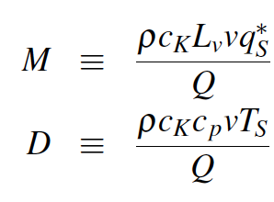
Dimensionless parameters M and D
Ratio of moist-surface latent heat flux to radiative cooling if q_{A}=0
Ratio of sensible heat flux to radiative cooling if T_{A}=0
For an ocean surface at 300 K, v=5 m/s, Q = 120 W/m²
M ≈ 3
D ≈ 15

Slide 17
Subcloud-layer depth for a moist surface
k = entrainment parameter ~0.2
μ = fraction of atmospheric mass in troposphere ~0.8
With M=3, D=15, this gives σ₀ ≈ 0.06 – or a cloud base at around 950 hPa

Slide 18
How does σ map to RH?
The exponent is ~4.2 and μ≈0.8 is the fraction of atmospheric mass in the troposphere
Together with our prior estimate of σ≈0.06, these give RH≈80%

Slide 19
Explains modest RH increases with warming ~+0.006/K
Dominant term: M increases by ~4%/K
Subcloud layer thickness is more sensitive, decreases ~ -3.5%/K
Uncertainty: how does v change with T_{S}?

Slide 20
Test using convection-permitting model simulations
SAM, doubly-periodic square domains, side length ~200 km
Constant tropospheric radiative cooling (1K/d)
1) Scale surface saturation vapor pressure by varying β (0≤β≤1) with SST = 300 K
2) Vary the SST between 290 and 306 K
1 K/day
cooling
~200 km side length
e_{s}* = β e_{sw}*
E = ρL_{v}c_{K}v(βq_{S}* - q_{A})

Slide 21
Theory works well for varied surface wetness

Slide 22
Theory works passably* for varied surface temperature
*Depends on how strict a grader you are

Slide 23
Theory works even worse across wide range of surface temperature
-Change in phase of hydrometeors complicates sedimentation efficiency for cold surfaces (e.g., T_{S}=270-280 K)
-Separation of cloud and subcloud layers ill-defined for very cold surfaces (e.g., T_{s}=250 K)
-Underlying assumptions also fail for boundary layers with strong horizontal variations (e.g., self-aggregated states, cold pools)

Slide 24

Conclusions
Pencil-and-paper theory for near-surface relative humidity
Based on energy balance of subcloud and cloud layers, bulk formulae, and an LCL closure
Explains well the variations in RH with surface moisture (+ requires considering subcloud-layer rain evaporation)
Applies decently to small surface temperature changes, poorly to large temperature changes
Future (past?) steps: include large-scale moisture and dry static energy convergence

Slide 26
Evaporative cooling and subcloud-layer sedimentation efficiency
η = P(p_{s})/P(p_{b})
Ratio of precipitation flux at surface to that at cloud base
Since E=P(p_{s}) in equilibrium, P(p_{b}) = E/η
Subcloud-layer evaporation is then E(η⁻¹ – 1)
P(p_{b})
p_{b}
P(p_{s})
p_{s}

Slide 27
Variation of η with σ is well-fit by raindrop evaporation physics
Squares/circles: output from simulations
Line: fit based on evaporation of population of uniform raindrops

Slide 28
Assume as known:
Surface temperature T_{S}
Bulk formulae for surface fluxes E and H
Pressure
p=0
E = ρ c_{K} L_{V} v (βq_{S}*-q_{A})
H = ρ c_{K} c_{p} v (T_{S}-T_{A})
Q
p_{t}
1-σ
p_{b}
σ
p_{s}
E
H
Temperature

Slide 29
Tropospheric energy balance: Q = E+H
Pressure
p=0
Q = E+H
Q
p_{t}
1-σ
p_{b}
σ
p_{s}
E
H
Temperature

Slide 30
Subcloud-layer thermal balance:
H + entrainment = radiative cooling + evaporative cooling
Pressure
p=0
Q = E+H
(1+k)H =σQ +evaporative cooling
k~0.2: entrainment parameter
Q
p_{t}
1-σ
p_{b}
σ
p_{s}
E
H
Temperature

Slide 31
Subcloud-layer thermal balance:
H + entrainment = radiative cooling + evaporative cooling
Pressure
p=0
Q = E+H
(1+k)H =σQ + (η⁻¹-1)E
η: sedimentation efficiency through subcloud layer (0-1) – may depend strongly on σ
Q
p_{t}
1-σ
p_{b}
σ
p_{s}
E
H
Temperature

Slide 32
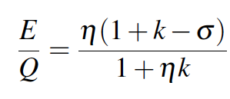
Can rearrange to solve for E/Q demanded by radiation
Cloud-layer demand based on cloud-layer radiative cooling for fractional subcloud layer depth σ
Demand-based E/Q decreases strongly as σ increases
Need a second constraint on E/Q to solve for σ

Slide 33
Supply-based E/Q: more complex but introduces two fun nondimensional #s
Using bulk formulae, constraint that LCL of surface air is at p_{b}, and a similar expression for H/Q, can show that:
Surface evaporative supply-based E/Q increases strongly as subcloud layer deepens

Slide 36
Three interesting features (I)
For dry surfaces (low β), tropopause inversion sharpens with deep “overshooting layer” (e.g., Pauluis and Held, 2002)
Notes:
XX working with Raphael Rousseau-Rizzi and Nick Lutsko to explain this contrast. I was really encouraged in this by Isaac’s statement that he doesn’t understand it, and that it would be really nice to have a theory for it. I agree, because I’d like to know why our moist tropical tropopause region looks utterly unlike the sharp top of a dry-convective troposphere.

Slide 37
Three interesting features (II)
For dry surfaces (low β), tropopause inversion sharpens with deep “overshooting layer” (e.g., Pauluis and Held, 2002)
Peak cloud fraction INCREASES as the surface is dried!
Notes:
XX

Slide 38
Three interesting features (III)
For dry surfaces (low β), tropopause inversion sharpens with deep “overshooting layer” (e.g., Pauluis and Held, 2002)
Peak cloud fraction INCREASES as the surface is dried!
Dry surfaces: “virga-worlds” with very low precipitation efficiency but vigorous internal atmospheric water recycling
Notes:
XX make point that these situations break the typical rule that precipitation equals the radiative cooling of the free troposphere. The radiative cooling of the free troposphere is much larger than the precipitation and evaporation in these cases, with the sensible heat flux contributing to rainfall evaporation in the subcloud layer which is then communicated to the cloud layer by moist convection. Does this picture help to understand constraints on hydrology and hydrological change over real semiarid land surfaces?
Text from earlier:
~~~~~~~~~~~~~~
To finish off, I want to talk about some other interesting aspects of simulations that we did just to prepare the rotating cases on even footing. Each rotating RCE case was initialized from a non-rotating RCE state with the same boundary conditions – surface temperature and moisture availability. And these initialization simulations are themselves interesting.
First, as you can see from temperature profiles on the left, the very dry simulations develop a quite sharp tropopause inversion – up to a jump of 20 K with the parameters we’ve used! They have a deep, nearly dry-adiabatic overshooting layer, which is being cooled by convection and radiatively heated. This is similar to what was found in one of the few previous studies of dry RCE, by Pauluis and Held, and we’re working to understand what controls the depth and strength of the inversion associated with this “overshooting layer”.
Second, in the middle, the cloud fraction in this setup strikingly increases as the surface is dried, and less surprisingly the whole cloud layer contracts in the upper troposphere. This might be explainable in terms of either the weaker asymmetry between up and downward motions for drier convection and thus greater convective mass flux in the upper troposphere for drier surfaces, or in terms of the change in static stability near the upper-tropospheric cloud peak, or maybe something else.
Finally, as the surface wetness \beta is reduced, the dry subcloud layer gets progressively deeper and drier, and as a consequence, even though there is moist convection above, it’s increasingly difficult for rain to survive as it falls through this layer. So what we get are precipitation profiles as a function of height shown on the right, where orange colors correspond to drier surfaces. We get these worlds where there is very little evaporation and rainfall at the surface, but a lot of internal moisture recycling – a lot of rain falling at altitude, getting evaporated and lifted and trying to rain again. This looks a lot in a qualitative sense like parts of the intermountain western US in summer when you can see rain falling from a lot of clouds, but it is so dry that little of it reaches the surface.

