Slide 1
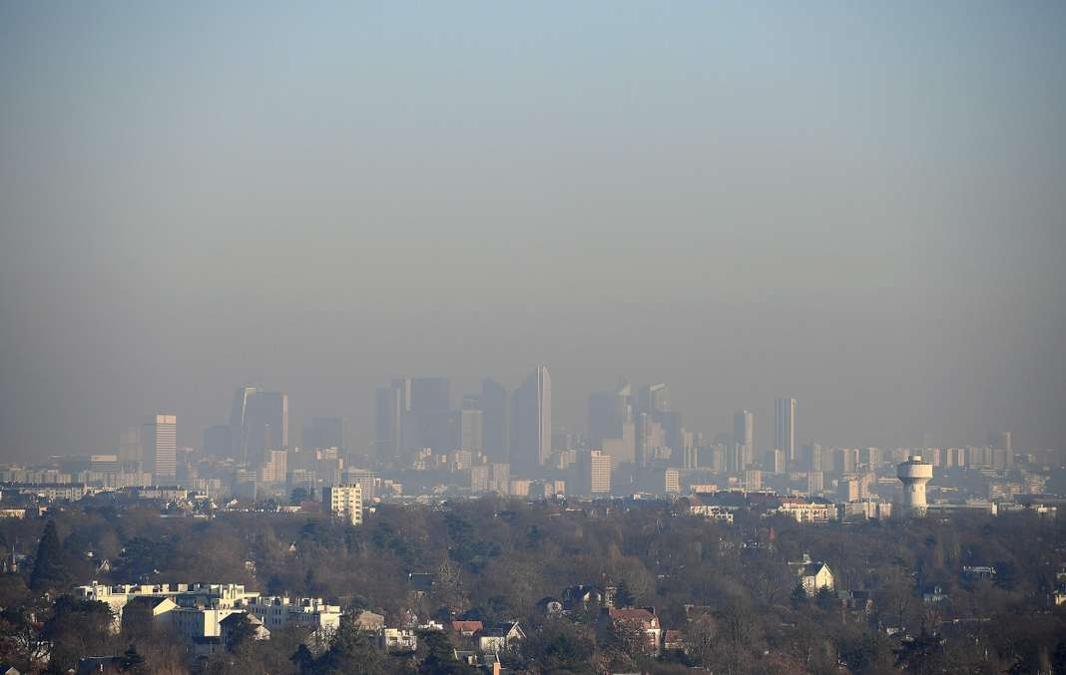
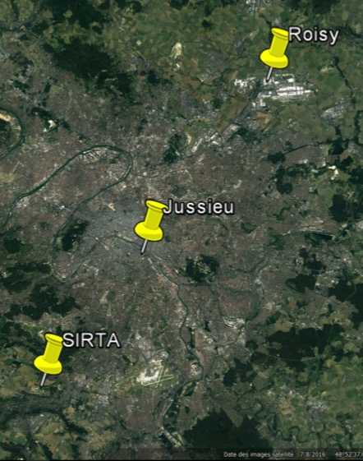
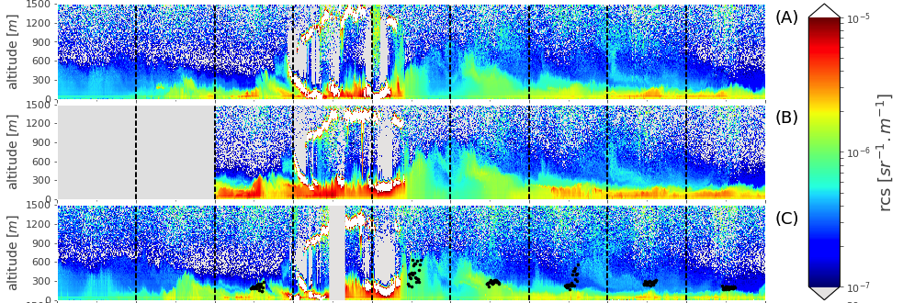
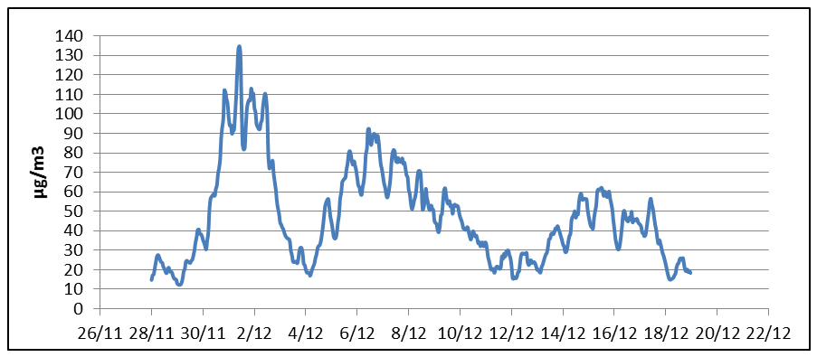
Analysis of 2016 December pollution episode over IDF
Meteorological conditions : anticyclonic conditions driving to stable to very stable situations
PM10, concentrations moyennes horaires des stations AIRPARIF
A strong pollution event in a
context of reduction (decreasing
trends) of PM means and peaks in IDF.
alerte
information
Roissy
29/11
01/12
03/12
05/12
07/12
UPD
SIRTA
Ceilometer transect

Slide 2
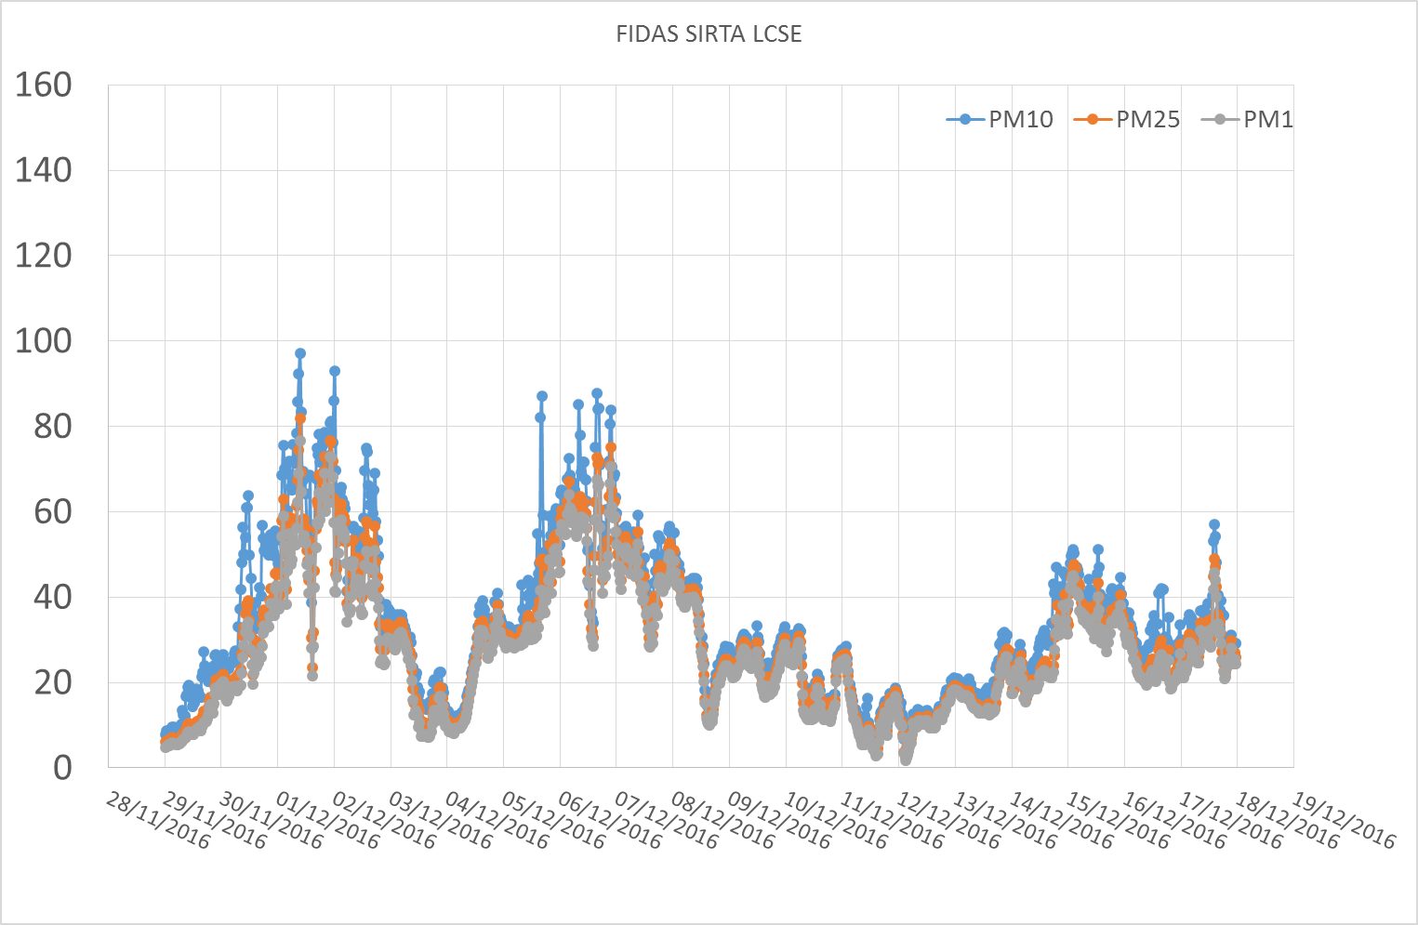
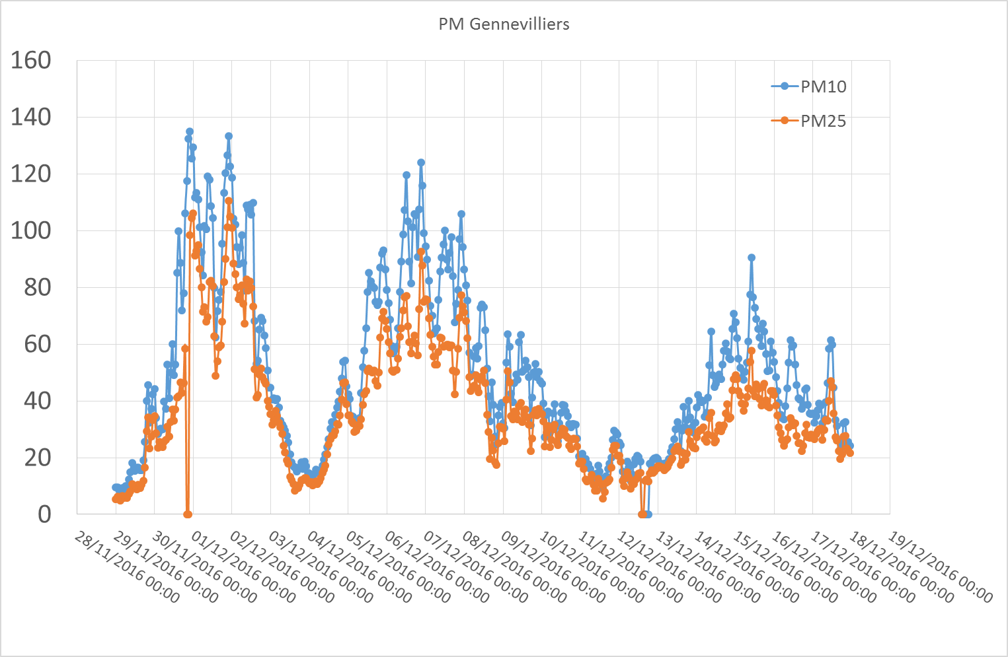
Aerosol Mass / Size Distribution / Number
PM SIRTA (FIDAS)
PM Gennevilliers (TEOM)
µg.m⁻³
µg.m⁻³
Higher mass at urban sites / periurban sites with good temporal correlations between sites
Short differences between PM10/PM25/PM1 mass
Local pollution event (cf also primary fraction)

Slide 3
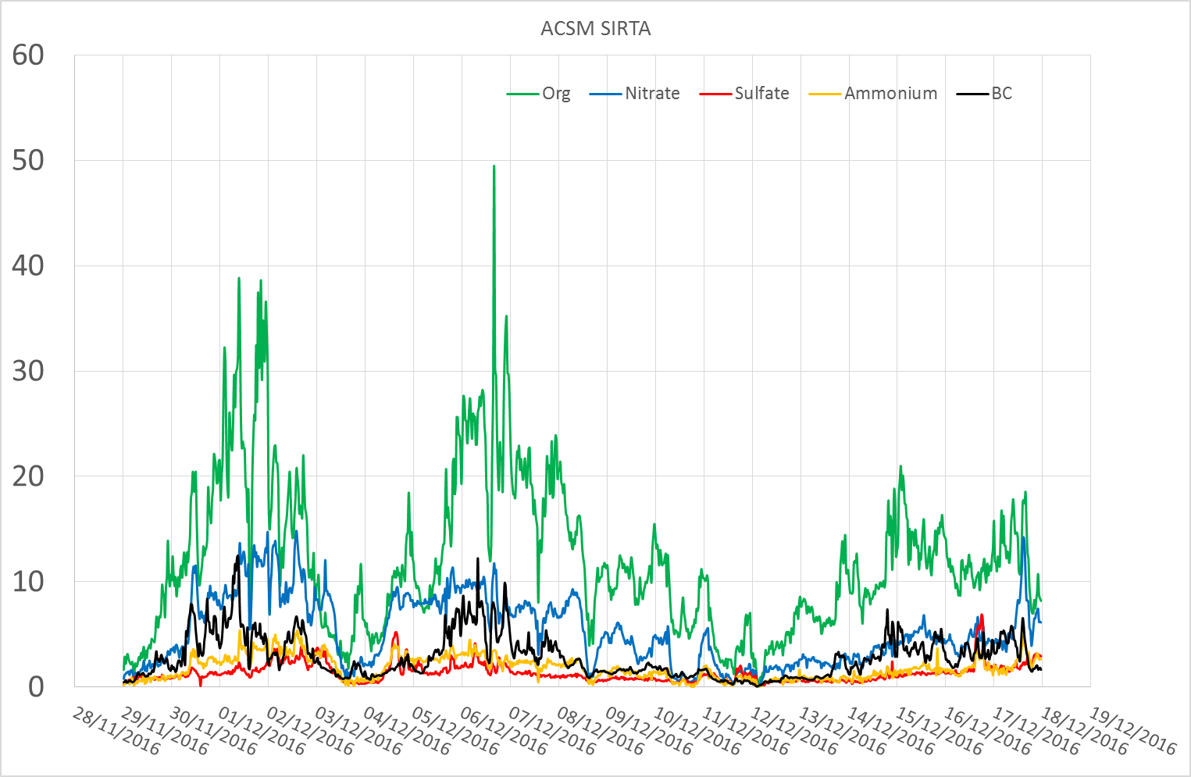
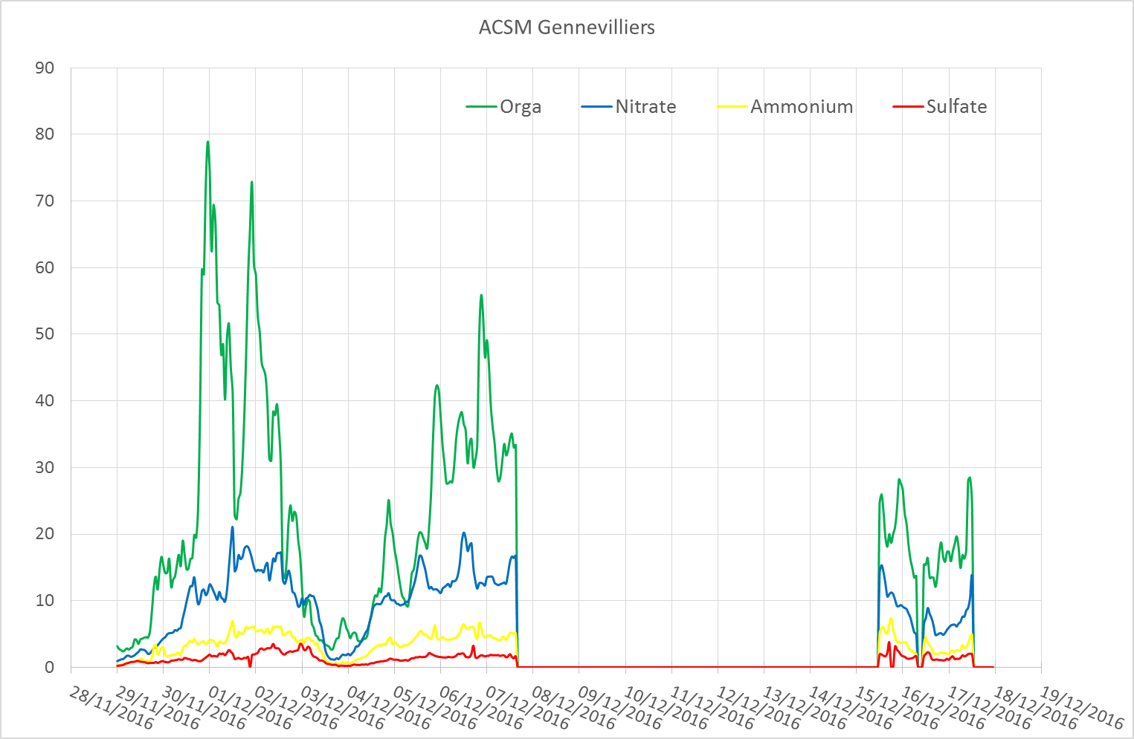
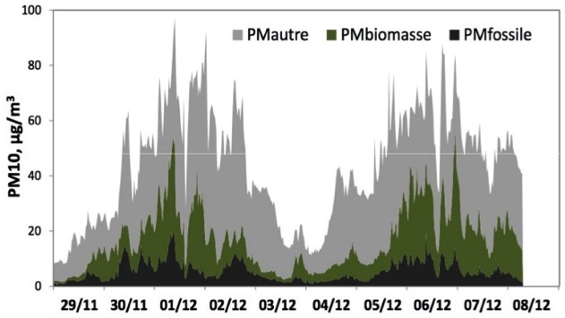
Aerosol composition (ACSM)
PM1 SIRTA (ACSM)
PM1 Gennevilliers (ACSM)
µg.m⁻³
µg.m⁻³
AE33+TEOM (SIRTA)
Organic fraction dominates (large urban/periurban gradient)
– primary fraction dominates
Significant nitrate concentrations ( not that different between urban
and suburban sites)

Slide 4
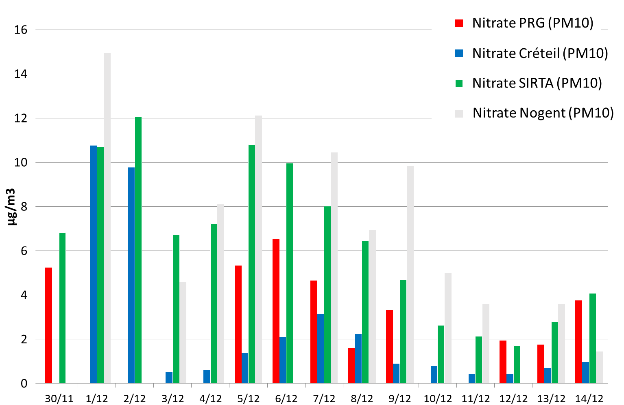
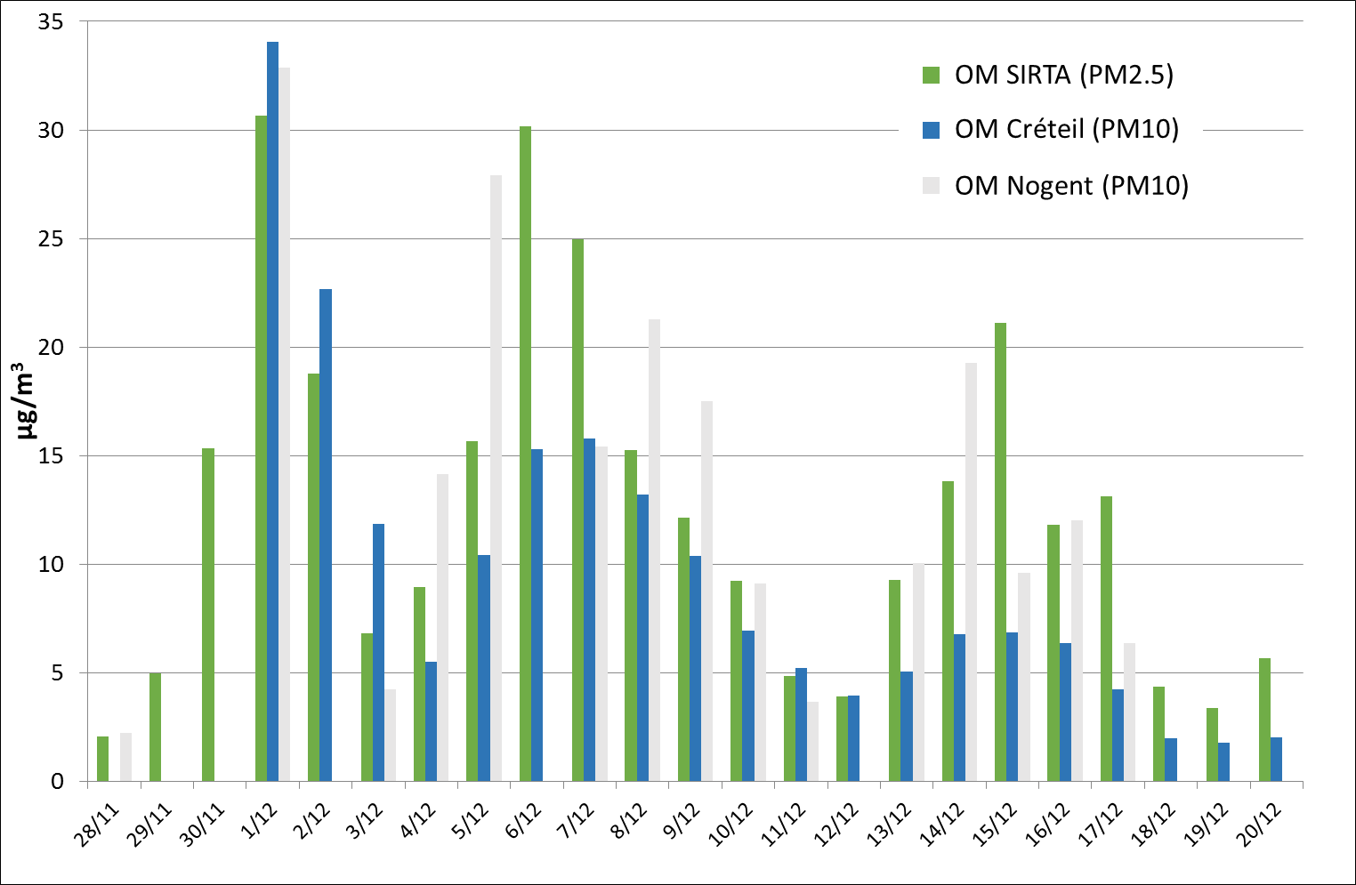
Aerosol composition (Filters)
Filtres
Filtres
Consistent with ACSM measurements
Large spatial gradients for Organic Matter and Nitrate fractions !?

Slide 5
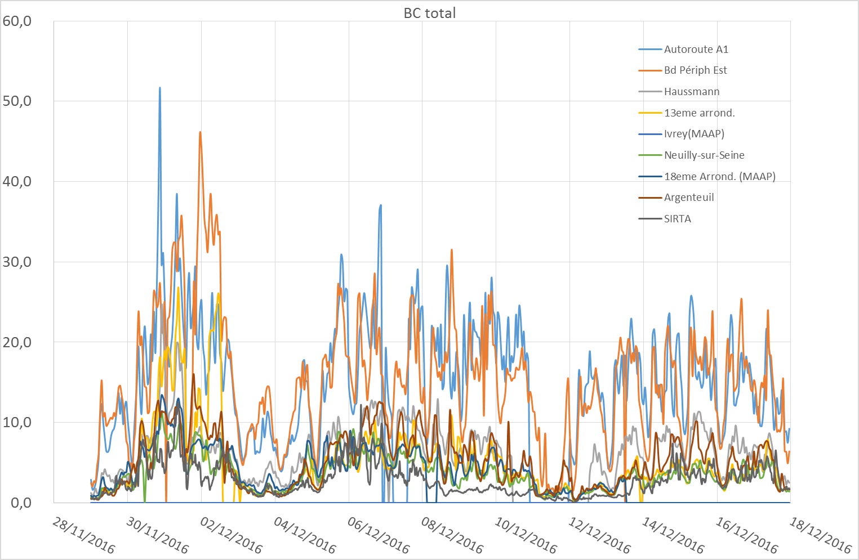
Multi site BC observations : aethalometers + filters (not presented here, 4 to 5 more sites)
µg.m⁻³

Slide 6
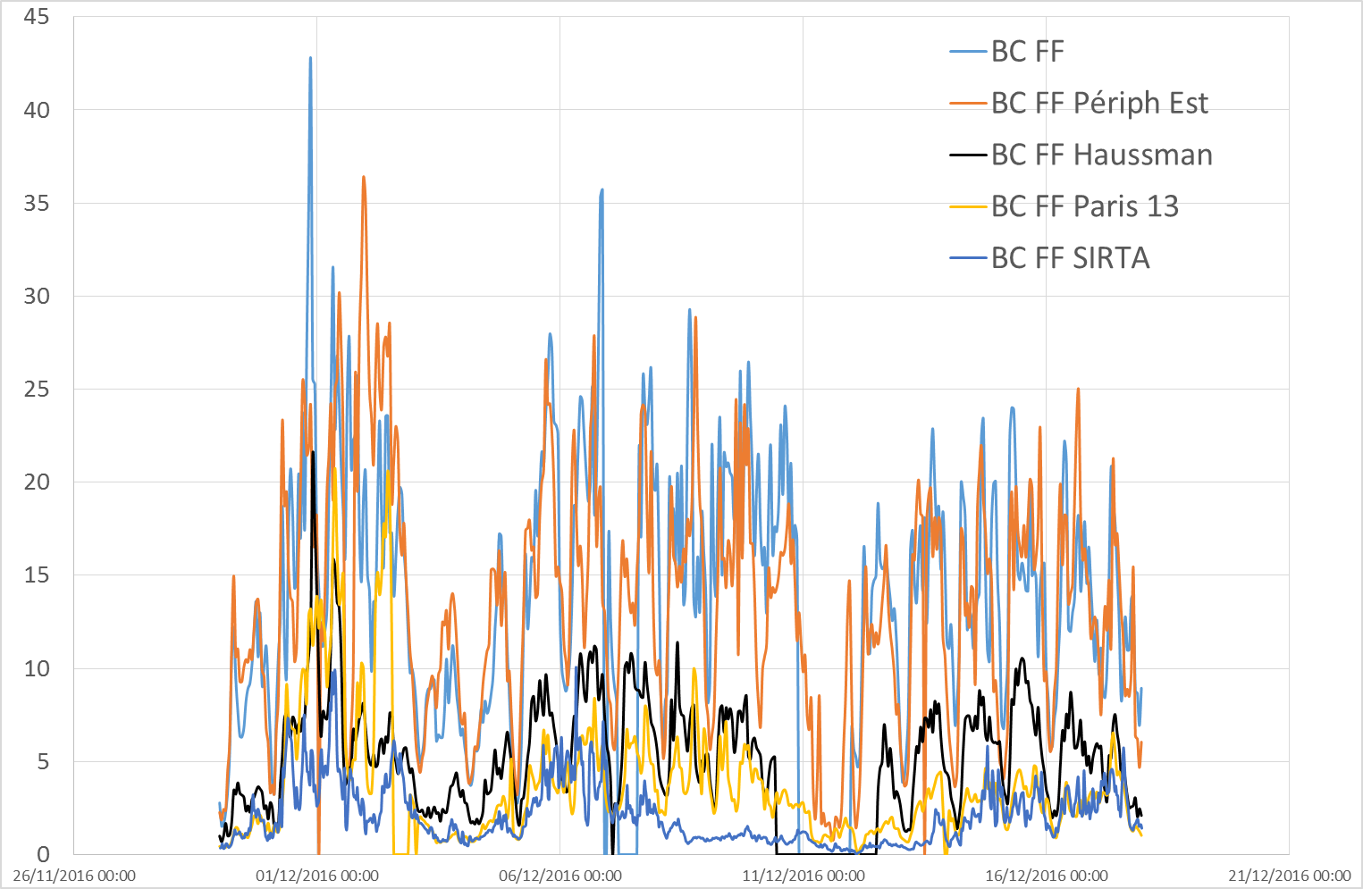
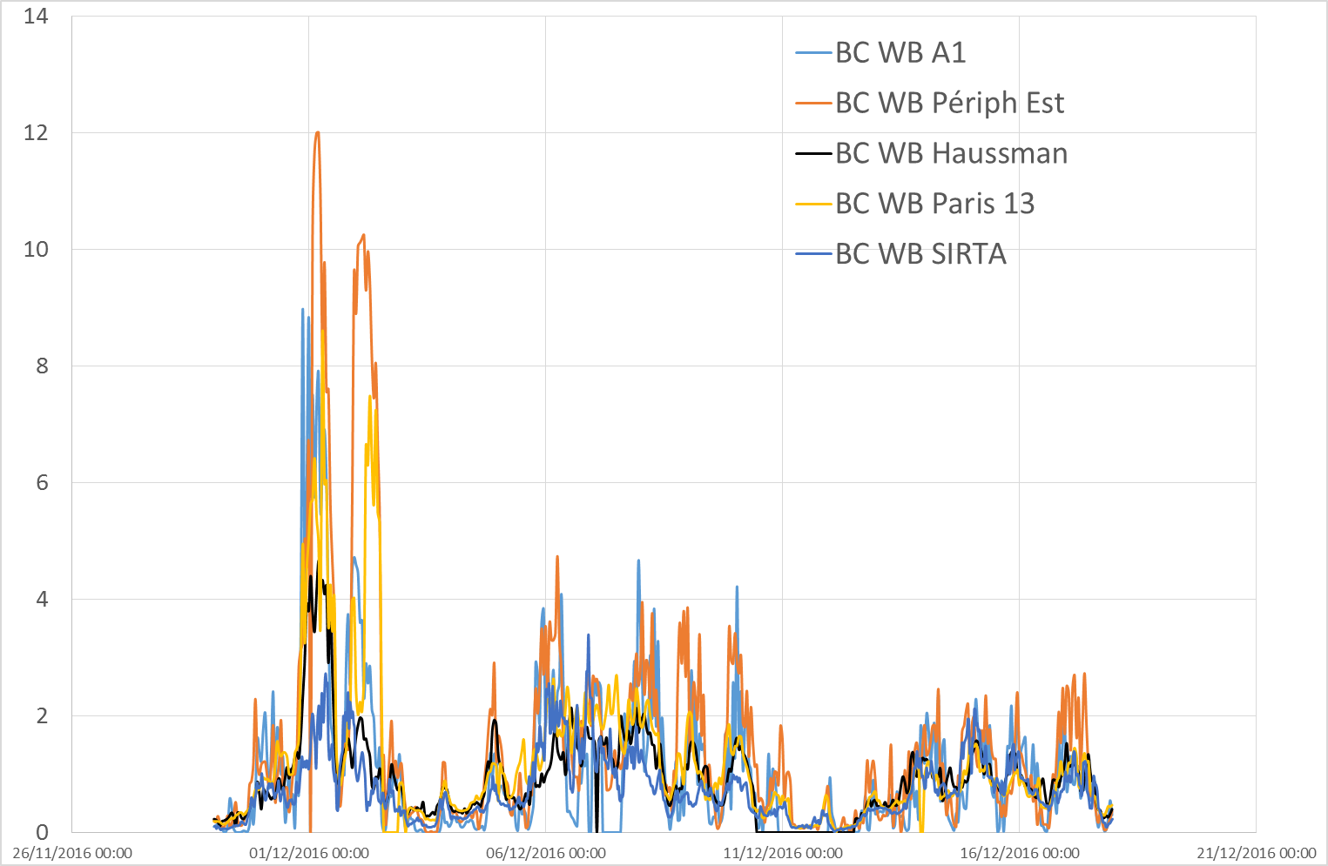
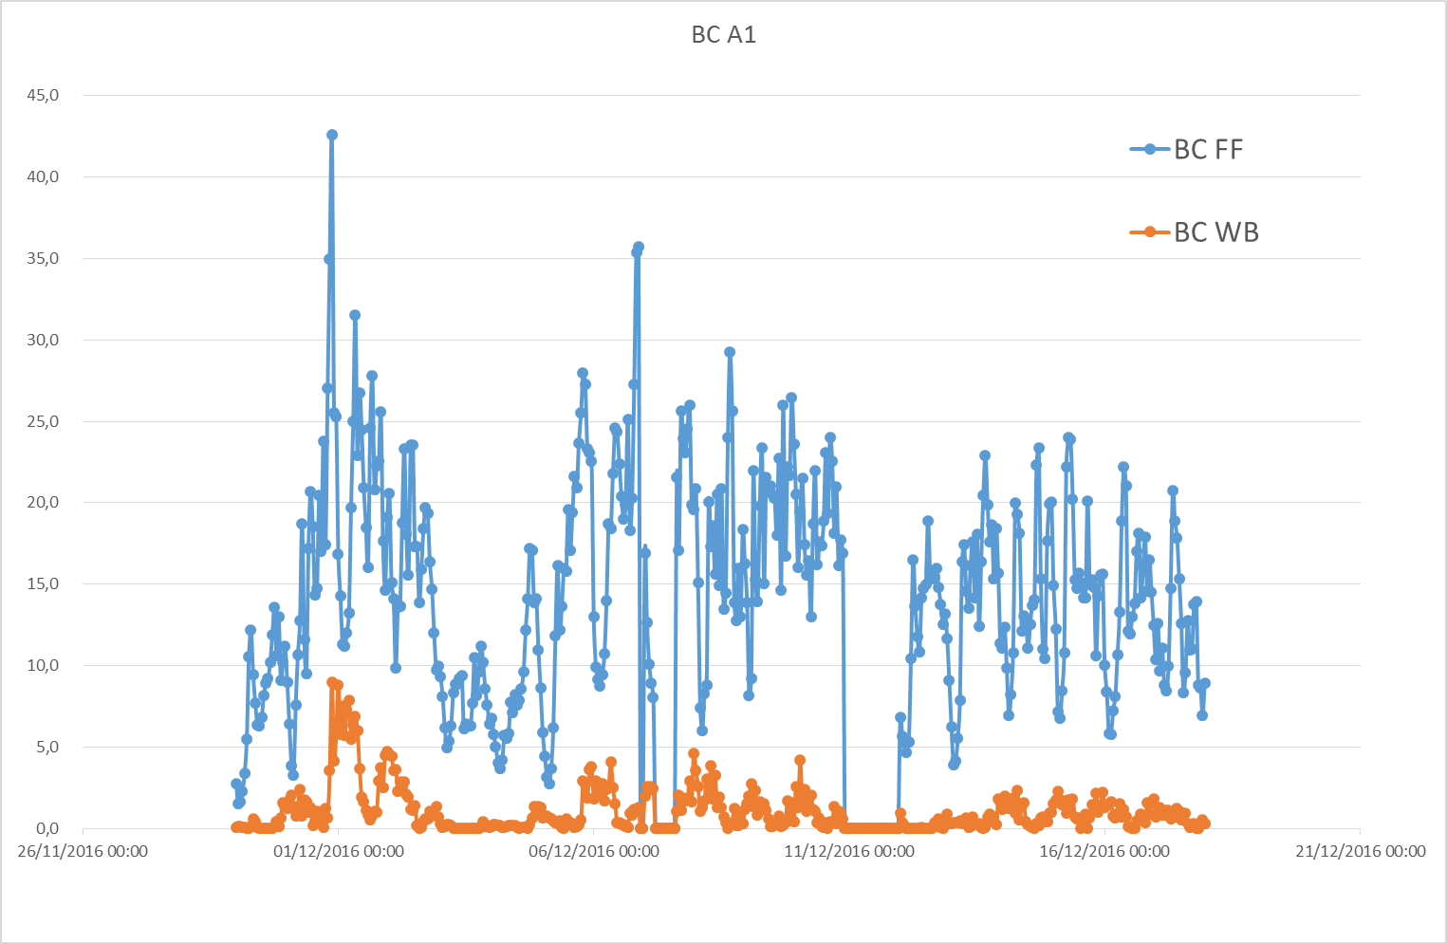
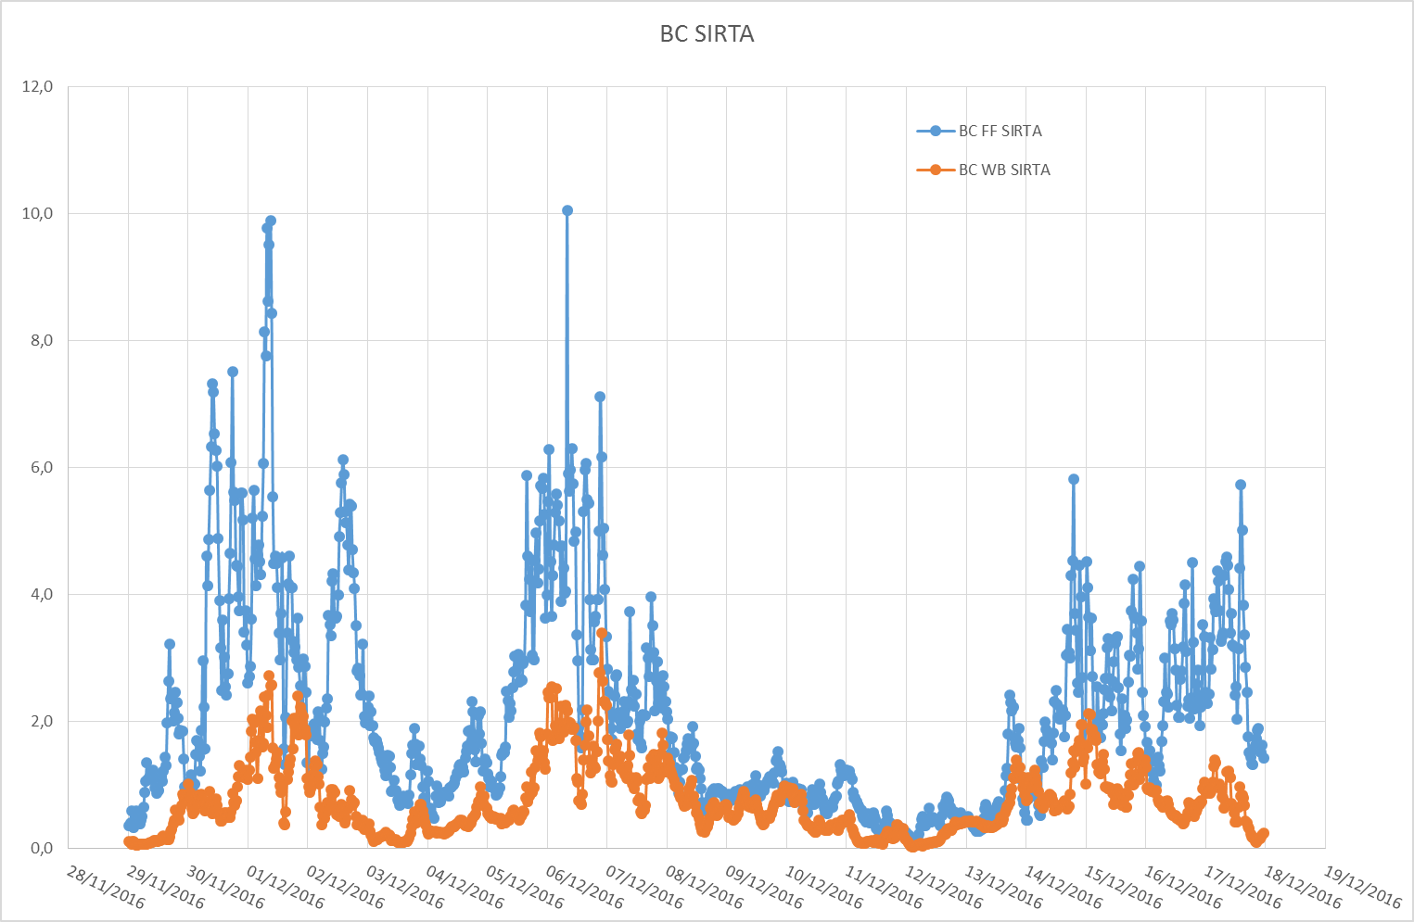
Source attribution using multiwavelenghts aethalometers (AE33) : Fossil fuel / Wood burning
BC Fossil Fuel
BC Wood Burning
FF/WB A1 highway
FF/WB SIRTA

Slide 7
Source attribution using multiwavelenghts aethalometers (AE33) : Fossil fuel / Wood burning
BC Fossil Fuel
BC Wood Burning
Analysis ??
Temporal variability of BC and WB ?
Behavior of FF and WB (and FF/WB ratio) as a function of site type : what do we learn ?
What use ? For models ? Emission calibration ?
FF/WB A1 highway
FF/WB SIRTA

Slide 8
Conclusion / Perspectives
Size distribution (FIDAS, GRIMM, LOAC) / Number (SMPS, …) to be analyzed
Also analysed metals, levoglucosan, HAP, PO → caractérisation of sources (also station representativity) and health impacts
Model evaluation
Analysis of spatial gradients using models and meteorological analysis (back-tarjectories …)
Local / Regional sources quantifications and sensitivity tests to sources

Slide 10
Quelques actions d’OCAPI : EPPI (LEFE-CHAT)
Etude de la Pollution Particulaire en Ile-De-France (cas de Décembre 2016)
PM10, concentrations moyennes horaires des stations AIRPARIF
alerte
information
29/11
30/11
01/12
02/12
03/12
04/12
05/12
06/12
07/12
Les conditions météorologiques synoptiques contrôlent les concentrations via l’intensité du vent et la hauteur de couche
limite

Slide 11
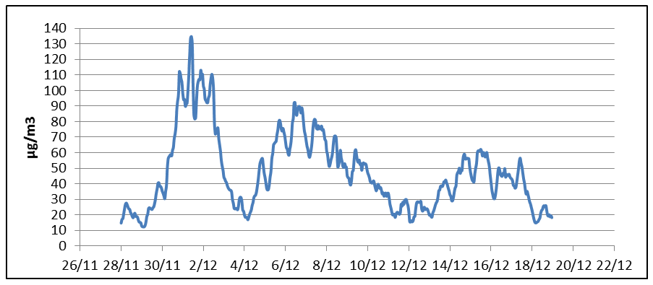
Quelques actions d’OCAPI : EPPI (LEFE-CHAT)
Etude de la Pollution Particulaire en Ile-De-France (cas de Décembre 2016)
PM10, concentrations moyennes horaires des stations AIRPARIF
alerte
information
Roissy
29/11
01/12
03/12
05/12
07/12
UPD
SIRTA
Les conditions météorologiques synoptiques contrôlent les concentrations via l’intensité du vent et la hauteur de couche limite
Transect télémètres

Slide 12
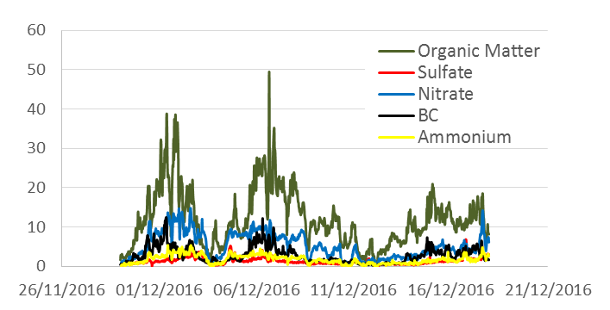
Quelques actions d’OCAPI : EPPI (LEFE-CHAT)
Analyse de la composition chimique des particules
PM1 ACSM (SIRTA)
AE33+TEOM (SIRTA)
µg.m⁻³
ineris
Filtres
Filtres
Episode dominé par la matière organique; une importante fraction de particules primaires
Des gradients importants au sein de l’agglomération.

