Slide 1
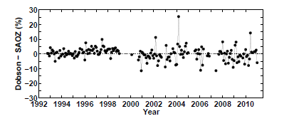
OHP total ozone time series
Difference Dobson with respect to SAOZ at OHP:
within ± 2% in 1992 – 1999
± 5% in 2000 – 2010
Average bias: 0.33% ± 0.17%
Drift: -0.12 ±0.12 %/yr

Slide 2
Multiple regression trend results
Data: 5 month running mean
Model using QBO, solar flux,NAO, heat flux, aerosols, PWLT or EESC
Similar results using both models
Influence of proxies:
  Low ozone values mainly due to QBO west. phase, low heat flux and Pinatubo aerosols in the 1990s
  (e.g. 1990, 1995, 1997, 2002)
  Large anomalies: QBO east. phase, large heat flux, negative NAO index (e.g. 1986, 1987, 2009, 2010)
Long term ozone evolution:
PWLT: Piecewise linear trend
EESC: ODS evolution

Slide 3
OHP total ozone trends
Annual average
PWLT (DU/yr)
Pre-1997: -1.26 ± 0.24
Post 1997: 0.23 ± 0.22
EESC (DU/yr)
Pre-turnaround: -1.18 ± 0.22
Post-turnaround: 0.43 ± 0.1
Turnaround: 1997

Slide 4
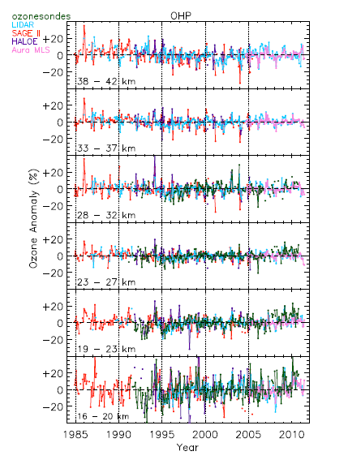
Ozone vertical distribution
Data records at/around OHP
Lidar: 1985 – present
Sondes: 1991 – present
SAGE II: 1984 – 2005
HALOE: 1991 – 2005
Aura MLS: 2004 – present
Similar regression model as for the total ozone time series

Slide 5
Data quality
Drift wrt lidars computed on difference times series (coincident measurements)
Drift generally within ± 0.5%.y⁻¹ in 20 – 40 km range except Aura MLS but only 7 years of data
Most drifts non significant
No drifts with sondes when available
Nair et al., amt 2012
Notes:
5

Slide 6
Regression results
Trend model applied on average anomaly time series
R² as a function of altitude and month

Slide 7
Ozone vertical distribution trends
Post
turnaround trends
Similar trends with EESC and PWLT for pre-turnaround period
Post-turnaround: PWLT significant around 22 km and 38-40 km
EESC: significant in the whole range
Pre-
turnaround
trends
Nair et al., 2013

